Slide 1
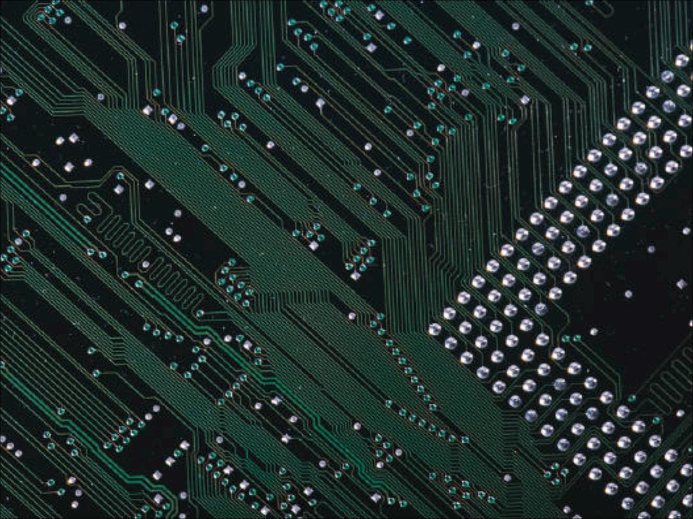

Chapter 9:
Professional Ethics and Responsibilities

Slide 2

What is Professional Ethics?
Ethical Guidelines for Computer Professionals
Scenarios
403

Slide 3

Professional ethics includes relationships with and responsibilities toward customers, clients, coworkers, employees, employers, others who use one’s products and services, and others whom they affect
A professional has a responsibility to act ethically. Many professions have a code of ethics that professionals are expected to abide by
  Medical doctors
  Lawyers and judges
  Accountants
404-405

Slide 4
There are special aspects to making ethical decisions in a professional context
Honesty is one of the most fundamental ethical values; however, many ethical problems are more subtle than the choice of being honest or dishonest
Some ethical issues are controversial
404-405

Slide 5

Special Aspects of Professional Ethics
A professional is an expert in a field
  Customers rely on the knowledge, expertise, and honesty of the professional
The work of many professionals profoundly affect large numbers of people, some indirectly
Professionals must maintain up to date skills and knowledge
405-406
Notes:
Most people affected by the devices, systems, and services of professionals do not understand how they work and cannot easily judge their quality and safety. A professional advertises his or her expertise and thus has an obligation to provide it.
A professional has special responsibilities not just to customers, but to those indirectly affected. These responsibilities include thinking about potential risks to privacy and security of data, safety, reliability, and ease of use.
Because of the complexity of computer software, professionals have an ethical responsibility not simply to avoid intentional evil, but to exercise a high degree of care and follow good professional practices to reduce the likelihood of problems. They must maintain an expected level of competence and be up to date on current knowledge, technology, and standards of the profession.

Slide 6
Professional Codes of Ethics
Provide a general statement of ethical values
Remind people in the profession that ethical behavior is an essential part of their job
Provide guidance for new or young members
406-407
Notes:
There are several organizations for the range of professions included in the general term “computer professional.” The main ones are the ACM (Association for Computing Machinery) and the IEEE (Institute for Electrical and Electronics Engineers, pronounced “Eye-triple-E”) Computer Society. They developed the Software Engineering Code of Ethics and Professional Practice (adopted jointly by the ACM and IEEE CS) and the ACM Code of Ethics and Professional Conduct.
The codes emphasize the basic ethical values of honesty and fairness. They cover many aspects of professional behavior, including the responsibility to respect confidentiality, maintain professional competence, be aware of relevant laws, and honor contracts and agreements. They stress the responsibility to respect and protect privacy, to avoid harm to others, and to respect property rights.

Slide 7
Guidelines and Professional Responsibilities
Understand what success means
Include users (such as medical staff, technicians, pilots, office workers) in the design and testing stages to provide safe and useful systems
Do a thorough, careful job when planning and scheduling a project and when writing bids or contracts
Design for real users
407-410

Slide 8
Guidelines and Professional Responsibilities (cont.)
Don’t assume existing software is safe or correct; review and test it
Be open and honest about capabilities, safety, and limitations of software
Require a convincing case for safety
Pay attention to defaults
Develop communication skills
407-410

Slide 9

Introduction and Methodology
Brainstorming phase
  List all the people and organizations affected (the stakeholders)
  List risks, issues, problems, and consequences
  List benefits. Identify who gets each benefit
  In cases where there is no simple yes or no decision, but rather one has to choose some action, list possible actions
411

Slide 10
Introduction and Methodology
Analysis phase
  Identify responsibilities of the decision maker
  Identify rights of stakeholders
  Consider the impact of the options on the stakeholders (consequences, risks, benefits, harms, costs)
  Categorize each potential action as ethically obligatory, prohibited, or acceptable
  When there are multiple options, select one, considering the ethical merits of each, courtesy to others, practicality, self-interest, personal preferences, etc.
411-412

Slide 11
Scenario 1: Protecting Personal Data
Your customer is a community clinic that works with families with problems of family violence. It has three sites in the same city, including a shelter for battered women and children. The director wants a computerized record and appointment system, networked for the three sites. She wants a few laptop computers on which staffers can carry records when they visit clients at home and stay in touch with clients by email. She asked about an app for staffers’ smartphones by which they could access records at social service agencies. At the shelter, staffers use only first names for clients, but the records contain last names and forwarding addresses of women who have recently left.
412-414
Notes:
Have the class analyze the scenario using the brainstorming and analysis methodology.
The clinic director is likely to be aware of the sensitivity of the information in the records and to know that inappropriate release of information can result in embarrassment for families using the clinic and physical harm to women who use the shelter. But she might not be aware of the risks of the technologies in the system she wants. You, as the computer professional, have specialized knowledge in this area.
The most difficult decision may be deciding what is adequate. There is not always a sharp, clear line between sufficient and insufficient protection.

Slide 12
Scenario 2: Email System With Targeted Ads
Your company is developing a free email service that will include targeted advertising based on the content of the email messages (similar to Google’s Gmail). You are part of the team designing the system. What are your ethical responsibilities?
414-415
Notes:
Have the class analyze the scenario using the brainstorming and analysis methodology.
What data will the system store?
Telling customers that they will see ads based on the content of their email is not sufficient if the system stores data that can link a list of ads with a particular user. You must explain this to potential users in a privacy policy or user agreement.
Should the system let users turn off ads completely? This service is free; the advertising will pay for it. Anyone who objects to ads can find another free email service. There is no strong argument that an opt-out option is ethically obligatory. Offering it is admirable, however, and it could be a good business decision, creating good will and attracting people who might then use other company services.

Slide 13
Scenario 3: Webcams in School Laptops
As part of your responsibilities, you oversee the installation of software packages for large orders. A recent order of laptops for a local school district requires webcam software to be loaded. You know that this software allows for remote activation of the webcam.
415-416
Notes:
Have the class analyze the scenario using the brainstorming and analysis methodology.
Is it your duty to know how your customers will use a product that you supply? Should you inform them, caution them, even require them to take measures to protect the people who will use the product? Consider that the school district might not even be familiar with the workings of the software package they ordered.
Perhaps the most challenging questions for anyone doing business is to whom am I responsible? The most obvious answer is the paying customer – in this case, the school district. But as the ACM Code points out, our responsibilities go beyond customers, to employers, users and the public.

Slide 14
Scenario 4: Publishing Security Vulnerabilities
Three MIT students planned to present a paper at a security conference describing security vulnerabilities in Boston’s transit fare system. At the request of the transit authority, a judge ordered the students to cancel the presentation and not to distribute their research. The students are debating whether they should circulate their paper on the Web. Imagine that you are one of the students.
416-417
Notes:
Have the class analyze the scenario using the brainstorming and analysis methodology. (Note: The first part of the scenario is from an actual incident. The part about the students considering violating the order, however, is made up.)
What are some reasons why you might want to circulate the paper? You might think the judge’s order violates your freedom of speech; posting the paper would be a protest. You might want to circulate the paper for the same reasons you planned to present it at a conference: to make other security experts aware of the problems, perhaps to generate work on a security patch, perhaps to spur the transit authority to fix the problems.
Publishing the vulnerabilities has several risks. The transit system could lose a substantial amount of money if people exploit the information. You and your co-authors could face legal action for violating the order. The university could face negative consequences because the work was part of a school project.

Slide 15
Scenario 5: Specifications
You are a relatively junior programmer working on modules that collect data from loan application forms and convert them to formats required by the parts of the program that evaluate the applications. You find that some demographic data are missing from some forms, particularly race and age. What should your program do? What should you do?
417-418
Notes:
Have the class analyze the scenario using the brainstorming and analysis methodology.
Consult the specifications for the program. Any project should have specification documents approved by the client or managers of the company developing the project (or both). Your company has an ethical and business obligation to ensure that the specifications are complete and to produce a program that meets them. Ethical reasons for this include, but go beyond, doing what the company has agreed to do and has been paid to do.
Suppose you do not find anything in the specs that covers your problem. The next step is to bring the problem to the attention of your manager.
Any changes to specifications must be made in consultation with the client. Decisions about how a program handles unusual situations might have serious consequences.
All changes to specifications must be documented.

Slide 16
Scenario 6: Schedule Pressures – Safety-critical
Your team is working on a computer-controlled device for treating cancerous tumors. The computer controls direction, intensity, and timing of a beam that destroys the tumor. Various delays have put the project behind schedule, and the deadline is approaching. There will not be time to complete all the planned testing. The system has been functioning properly in the routine treatment scenarios tested so far. You are the project manager, and you are considering whether to deliver the system on time, while continuing testing and making patches if the team finds bugs.
418-420
Notes:
Have the class analyze the scenario using the brainstorming and analysis methodology.
The central issue here is safety. Your company is building a machine designed to save lives, but if it malfunctions, it can kill or injure patients.
Who does your decision affect? First, the patients. A malfunction would cause injury or death. On the other hand, delay might cause some patients to die whose cancer might have been cured by the treatment. Should the interests of those who might benefit bear equal weight with those of the patients whom a malfunction might harm? Not necessarily.
The issue is not simply profits versus safety.
It is human nature to put more weight on short-term and/or highly likely effects.
What about your responsibility to your company? You do have a responsibility to help your company be successful, but your responsibility to the financial success of the company is secondary to ethical constraints. Avoiding unreasonable risk of harm to patients is an ethical constraint.

Slide 17
Scenario 7: Schedule Pressures – Product to market
You are a programmer working for a very small start-up company. The company has a modest product line and is now developing a truly innovative new product. Everyone is working 60-hour weeks and the target release date is nine months away. The bulk of the programming and testing is done. You are about to begin the beta testing. (See Section 8.3.1 for an explanation of beta testing.) The owner of the company (who is not a programmer) has learned about an annual industry show that would be ideal for introducing the new product. The show is in two months. The owner talks with the project manager. They decide to skip the beta testing and start making plans for an early release.
420-421
Notes:
Have the class analyze the scenario using the brainstorming and analysis methodology.
Should you protest? Should you say nothing, speak up, or quit?
You might be the only one who recognizes the problem or understands a particular situation. Your responsibilities to your company include applying your knowledge and skill to help avoid a bad decision.

Slide 18
Scenario 8: Software License Violation
Your company has 25 licenses for a computer program, but you discover that it has been copied onto 80 computers.
421-422
Notes:
Have the class analyze the scenario using the brainstorming and analysis methodology.
The first step here is to inform your supervisor that the copies violate the license agreement. Suppose the supervisor is not willing to take any action? What next? What if you bring the problem to the attention of higher-level people in the company and no one cares? There are several possible actions: Give up; you did your best to correct the problem. Call the software vendor and report the offense. Quit your job.
Suppose you signed the license agreements. You could be exposed to legal risk, or unethical managers in your company could make you a scapegoat.

Slide 19
Scenario 9: Going Public
Suppose you are a member of a team working on a computer-controlled crash avoidance system for automobiles. You think the system has a flaw that could endanger people. The project manager does not seem concerned and expects to announce completion of the project soon. Do you have an ethical obligation to do something?
422-423
Notes:
Have the class analyze the scenario using the brainstorming and analysis methodology.
Given the potential consequences, you do have an ethical obligation to do something. First, at a minimum, discuss your concerns with the project manager. Voicing your concerns is admirable and obligatory. It is also good for your company. Internal “whistleblowing” can help protect the company, as well as the public, from all the negative consequences of releasing a dangerous product. If the manager decides to proceed as planned with no examination of the problem, your next option is to go to someone higher up in the company.
If no one with authority in the company is willing to investigate your concerns, you have a more difficult dilemma. You now have the option of going outside the company to the customer, to the news media, or to a government agency. You must consider whether you are confident that you have the expertise to assess the risk. Mistaken public whistleblowing can itself cause serious harm. It might help to discuss the problem with other professionals.
It is important, for practical and ethical reasons, to keep a complete and accurate record of your attempts to bring attention to the problem and the responses from the people you approach.

Slide 20
Scenario 10: Release of Personal Information
You work for the IRS, the Social Security Administration, a movie-rental company, or an Internet service provider. Someone asks you to get a copy of records about a particular person. He will pay you $500.
You know another employee sells records with people’s personal information.
423-424
Notes:
Have the class analyze the scenario using the brainstorming and analysis methodology.
With the first scenario, you have many alternative actions open to you: Sell the records. Refuse and say nothing about the incident. Refuse and report the incident to your supervisor. Refuse and report to the police. Contact the person whose information the briber wants and tell him or her of the incident. Agree to sell the information, but actually work with the police to collect evidence to convict the person trying to buy it. The first option is clearly wrong. Depending upon company policies (and laws related to certain government agencies), you might be obligated to report any attempt to gain access to the records. It is difficult to decide how much you must do to prevent a wrong thing from happening if you are not participating in the wrong act.
With the second scenario, your options include doing nothing, talking to the other employee and trying to get him or her to stop selling files (by ethical arguments or threats of exposure), reporting to your supervisor, or reporting to an appropriate law enforcement agency. This scenario differs from the previous one in two ways. First, you have no direct involvement; no one has approached you. This difference might seem to argue for no obligation. Second, in the previous scenario, if you refused to sell the file, the buyer might give up, and the victim’s information would remain protected. In the current scenario, you know that a sale of confidential, sensitive information occurred. This makes the argument in favor of an obligation to take action stronger. You should report what you know.

Slide 21
Scenario 11: Conflict of Interest
You have a small consulting business. The CyberStuff company plans to buy software to run a cloud data-storage business. CyberStuff wants to hire you to evaluate bids from vendors. Your spouse works for NetWorkx and did most of the work in writing the bid that NetWorkx plans to submit. You read the bid while your spouse was working on it and you think it is excellent. Do you tell CyberStuff about your spouse’s connection with NetWorkx?
424-425
Notes:
Have the class analyze the scenario using the brainstorming and analysis methodology.
Is this a simple choice between saying nothing and getting the consulting job or disclosing your connection and losing the job?
The affected parties are the CyberStuff company, yourself, your spouse, your spouse’s company, other companies whose bids you will be reviewing, and future customers of CyberStuff’s cloud storage services. We do not know whether CyberStuff will later discover your connection to one of the bidders. If CyberStuff discovers the conflict of interest later, your reputation for honesty will suffer. The reputation of your spouse’s company could also suffer. The appearance of bias can be as damaging (to you and to Networkx) as actual bias.
Suppose you take the job and find that one of the other bids is much better than the bid from NetWorkx. Are you prepared to handle that situation ethically?
What are the consequences of disclosing the conflict of interest to the client now? You will probably lose this particular job, but CyberStuff might value your honesty more highly, and you might get more business in the future.
When someone hires you as a consultant, they expect you to offer unbiased, honest, impartial, professional advice. In spite of your belief in your impartiality, you could be unintentionally biased. It’s not up to you to make the decision about whether you can be fair. The client should make that decision.

Slide 22
Scenario 12: Kickbacks and Disclosure
You are an administrator at a major university. Your department selects a few brands of security software to recommend to students for their desktop computers, laptops, tablets, and other devices. One of the companies whose software you will evaluate takes you out to dinner, gives you free software (in addition to the security software), offers to pay your expenses to attend a professional conference on computer security, and offers to give the university a percentage of the price for every student who buys its security package.
426-417
Notes:
Have the class analyze the scenario using the brainstorming and analysis methodology.
Does your employer have a policy about accepting gifts from vendors?
People want to know when a recommendation represents an honest opinion and when someone is paying for it.
Disclosure is a key point.

Slide 23
Scenario 13: A Test Plan
A team of programmers is developing a communications system for firefighters to use when fighting a fire. Firefighters will be able to communicate with each other, with supervisors near the scene, and with other emergency personnel. The programmers will test the system in a field near the company office.
427
Notes:
Have the class analyze the scenario using the brainstorming and analysis methodology.
Testing should involve real firefighters in the field. Testing must address issues such as: Will the devices withstand heat, water, and soot? Can someone manipulate the controls wearing heavy gloves? Are the controls clear and easy to use in poor light conditions? Will a building’s structure interfere with the signal?

Slide 24
Scenario 14: Artificial Intelligence and Sentencing
You are part of a team developing a sophisticated program using artificial intelligence techniques to help judges make sentencing decisions for convicted criminals.
427-429
Notes:
Have the class analyze the scenario using the brainstorming and analysis methodology.
Some argue that software might be more fair than a judge influenced by personal impressions and biases.
The system will analyze the characteristics of the crime and the criminal to find other cases that are similar. Based on its analysis of cases, should it then make a recommendation for the sentence in the current case, or should it simply display similar cases, more or less as a search engine would, so that the judge can review them? Or should it provide both a recommended sentence and the relevant cases?
The expertise and experience of judges and lawyers are essential for choosing criteria the program will use. Should the system order the cases by date or by the length of the sentence? If the latter, should the shortest or longest sentences come first? Perhaps you should order the cases according to an evaluation of their similarity or relevance to the current case.
Should the system recommend a sentence? A specific recommendation from the system that differs from the judge’s initial plan might lead a judge to give a case more thought. Or, it might influence a judge more than it should.

Slide 25
Scenario 14: Artificial Intelligence and Sentencing (cont.)
Suppose judges in your state use a sentencing decision system that displays similar cases for the judge to view. You are a programmer working for your state government. Your state has just made it a criminal offense to use a cellphone while taking a college exam. Your boss, a justice department administrator, tells you to modify the program to add this new category of crime and assign the same relevancy weights to cases as the program currently does for using a cellphone while driving a car (already illegal in your state).
427-429
Notes:
Have the class analyze the scenario using the brainstorming and analysis methodology.
The first question, one for your boss, is whether the contract under which the system operates allows the state to make changes.
Modifications and upgrades should undergo as thorough planning and testing as did initial design, and be done in consultation with experts and end users.

Slide 26
Scenario 15: A Gracious Host
You are the computer system administrator for a mid-sized company. You can monitor the company network from home, and you frequently work from home. Your niece, a college student, is visiting for a week. She asks to use your computer to check her email. Sure, you say.
430
Notes:
Have the class analyze the scenario using the brainstorming and analysis methodology.
You’re being a gracious host. What is the ethical problem? Maybe there is none. Maybe you have an excellent firewall and excellent antivirus software. Maybe you remember that you are logged in to your company system and you log out before letting your niece use the computer. Maybe your files are password protected and you create a separate account on your computer for your niece.
But maybe you did not think about security when your niece asked to use the computer. Your niece might not intentionally snoop or do harm. In an actual incident, someone in the family of a mortgage company employee signed up for a peer-to-peer file sharing service and did not properly set the options indicating which files to share. Mortgage application information for a few thousand customers leaked and spread on the Web.
You must always be alert to potential risks. Mixing family and work applications poses risks.

