Slide 1
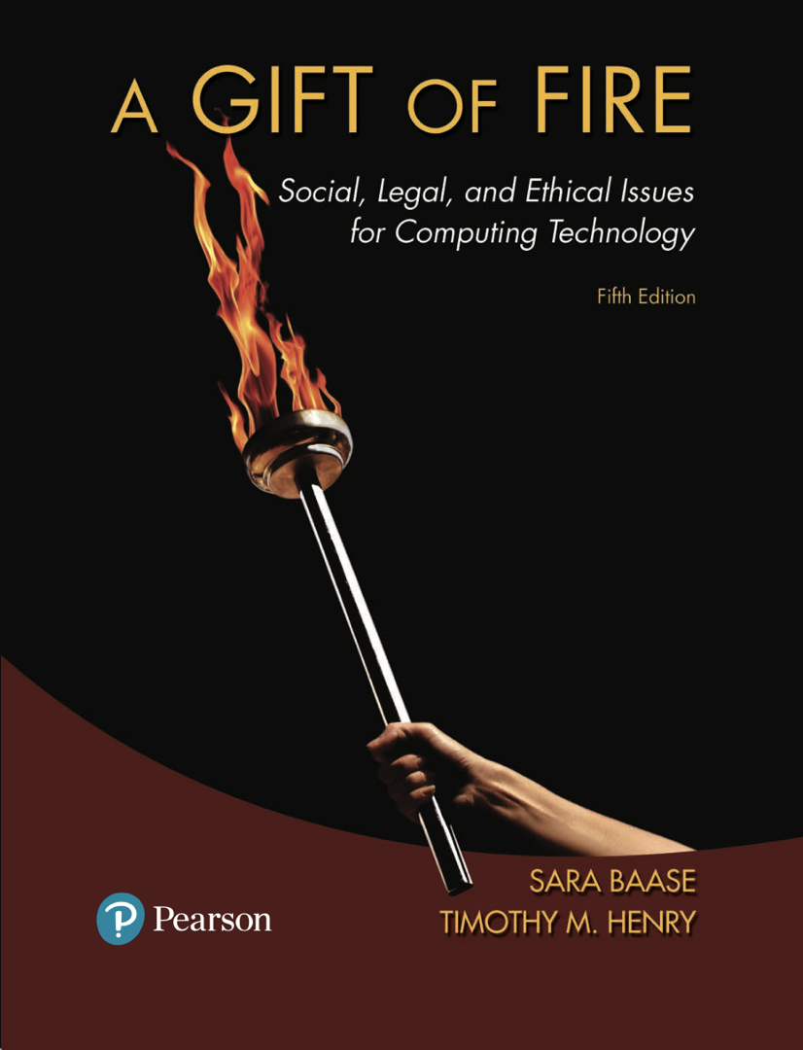
Chapter 4: Intellectual Property
Based on slides prepared by Cyndi Chie, Sarah Frye and Sharon Gray.
Fifth edition updated by Timothy Henry

Slide 2

Principles, Laws, and Cases
Reponses to Copyright Infringement
Search Engines and Online Libraries
Free Software
Patents for Inventions in Software

Slide 3

What is Intellectual Property?
The intangible creative work, not its particular physical form
Value of intelligence and artistic work comes from creativity, ideas, research, skills, labor, non-material efforts and attributes the creator provides
Protected by copyright and patent law

Slide 4
U.S copyright Law (Title 17 of U.S. Code) gives copyright holder following exclusive rights:
To make copies
To produce derivative works, such as translations into other languages or movies based on books
To distribute copies
To perform the work in public (e.g. music, plays)
To display the work in public (e.g. artwork, movies, computer games, video on a Web site)

Slide 5
Challenges of New Technology
Digital technology and the Internet make copyright infringement easier and cheaper.
New compression technologies make copying large files (e.g. graphics, video and audio files) feasible.
Search engines make finding material easier.
Peer-to-peer technology makes transferring and sharing files easier.
Notes:
The content industries claim that about one-quarter of Internet traffic worldwide consists of copyright-infringing material.

Slide 6
Challenges of New Technology
Broadband connections make transferring files easier and enable streaming video.
Miniaturization of cameras and other equipment enable audience members to record and transmit events.
Scanners allow us to change the media of a copyrighted work, converting printed text, photos, and artwork to electronic form.
New tools allow us to modify graphics, video and audio files to make derivative works.

Slide 7
What does it mean to solve the problems of technology’s impact on intellectual property rights?
We should recognize that “the problem” looks different from different perspectives.
Notes:
To consumers, who get movies and music online, the problem is to get them cheaply and conveniently.
To writers, singers, artists, actors – and to the people who work in production, marketing, and management – the problem is to ensure that they are paid for the time and effort they put in to create the intangible intellectual-property products we enjoy.
To the entertainment industry, to publishers and software companies, the problem is to protect their investment and expected, or hoped-for, revenues.
To the millions who post amateur works using the works of others, the problem is to continue to create without unreasonably burdensome requirements and threats of lawsuits.
To scholars and various advocates, the problem is how to protect intellectual property, but also to protect fair use, reasonable public access, and the opportunity to use new technologies to the fullest to provide new services and creative work.

Slide 8
A bit of history
1790 first copyright law passed
1909 Copyright Act of 1909 defined an unauthorized copy as a form that could be seen and read visually
1976 and 1980 copyright law revised to include software and databases that exhibit "authorship" (original expression of ideas), included the "Fair Use Doctrine"
1982 high-volume copying became a felony
1992 making multiple copies for commercial advantage and private gain became a felony

Slide 9
A bit of History
1997 No Electronic Theft Act made it a felony to willfully infringe copyright by reproducing or distributing one or more copies of copyrighted work with a total value of more than $1,000 within a six-month period
1998 Digital Millennium Copyright Act (DMCA) prohibits making, distributing or using tools to circumvent technological copyright protection systems and included protection from some copyright lawsuits for Web sites where users post material
2005 Congress made it a felony to record a movie in a movie theater

Slide 10
Fair Use Doctrine
Four factors considered
Purpose and nature of use – commercial (less likely) or nonprofit purposes
Nature of the copyrighted work
Amount and significance of portion used
Effect of use on potential market or value of the copyright work (will it reduce sales of work?)
No single factor alone determines
Not all factors given equal weight, varies by circumstance

Slide 11
Ethical arguments about copying
Copying or distributing a song or computer program does not decrease the use and enjoyment any other person gets from his or her copy.
Copying can decrease the amount of money that the copyright owner earns.
Notes:
Value of intellectual property is not just the direct use and enjoyment one gets from a copy.

Slide 12
Ethical arguments about copying
Copying enables users to try out products, benefiting the copyright owner by encouraging sales.
Businesses and organizations should make their own decisions about marketing products, not consumers who want free samples.
Fair use guidelines are useful ethical guidelines.
There are many arguments for and against unauthorized copying.
Notes:
Arguments people make supporting personal copying or posting on the Web without authorization are listed, along with some counterpoints to consider, on page 189.

Slide 13
Discussion Questions
How is intellectual property like physical property?
How is intellectual property different than physical property?
Do you agree with the idea that someone can "own" intellectual property?

Slide 14
Significant Cases
Sony v. Universal City Studios (1984)
Supreme Court decided that the makers of a device with legitimate uses should not be penalized because some people may use it to infringe on copyright
Supreme Court decided copying movies for later viewing was fair use
Arguments against fair use
People copied the entire work
Movies are creative, not factual

Slide 15
Significant Cases
Sony v. Universal City Studios (1984)
Arguments for fair use
The copy was for private, noncommercial use and generally was not kept after viewing
The movie studios could not demonstrate that they suffered any harm
The studios had received a substantial fee for broadcasting movies on TV, and the fee depends on having a large audience who view for free

Slide 16
Significant Cases
Reverse engineering: game machines
Sega Enterprises Ltd. v. Accolade Inc. (1992)
Atari Games v. Nintendo (1992)
Sony Computer Entertainment, Inc. v. Connectix Corporation (2000)
Courts ruled that reverse engineering does not violate copyright if the intention is to make new creative works (video games), not copy the original work (the game systems)

Slide 17
Significant Cases
Sharing music: the Napster case
Napster's arguments for fair use
The Sony decision allowed for entertainment use to be considered fair use
Did not hurt industry sales because users sampled the music on Napster and bought the CD if they liked it

Slide 18
Significant Cases
Sharing music: the Napster case
RIAA's (Recording Industry Association of America) arguments against fair use
"Personal" meant very limited use, not trading with thousands of strangers
Songs and music are creative works and users were copying whole songs
Claimed Napster severely hurt sales
Court ruled sharing music via copied MP3 files violated copyright

Slide 19
Significant Cases
Sharing music: the Napster case
Was Napster responsible for the actions of its users?
Napster's arguments
It was the same as a search engine, which is protected under the DMCA
They did not store any of the MP3 files
Their technology had substantial legitimate uses

Slide 20
Significant Cases
Sharing music: the Napster case
RIAA's arguments
Companies are required to make an effort to prevent copyright violations and Napster did not take sufficient steps
Napster was not a device or new technology and the RIAA was not seeking to ban the technology
Court ruled Napster liable because they had the right and ability to supervise the system, including copyright infringing activities

Slide 21
Significant Cases
File sharing: MGM v. Grokster
Grokster, Gnutella, Morpheus, Kazaa, and others provided peer-to-peer (P2P) file sharing services
The companies did not provide a central service or lists of songs
P2P file transfer programs have legitimate uses
Lower Courts ruled that P2P does have legitimate uses
Supreme Court ruled that intellectual property owners could sue the companies for encouraging copyright infringement

Slide 22
Discussion Question
What do you think the impact would be on creative industries, such as music, movies and fiction novels, if copyright laws did not protect intellectual property?

Slide 23
Significant Cases
“Look and feel”
Refers to features such as pull-down menus, windows, icons, and finger movements and specific ways they are used to select or initiate actions.
Reflects major creative effort by programmers.
Notes:
Does copyright apply to user interfaces? The internal structure and programing could be entirely different.
In the 1980s and 1990s, some companies won copyright infringement suits against others whose software had similar look and feel. An appeals court, reversing one such case, ruled that menu commands are “a method of operation,” explicitly excluded from copyright protection. They are, the court said, like the controls of a car. The trend of court decisions has been against copyright protection for “look and feel.”
The main argument in favor of protecting a user interface is that it is a major creative effort. On the other hand, standard user interfaces increase productivity of users and programmers.

Slide 24

Responses from the Content Industries
Ideas from the software industries
Expiration dates within the software
Dongles (a device that must be plugged into a computer port)
Copy protection that prevents copying
Activation or registration codes
Court orders to shut down Internet bulletin boards and Web sites

Slide 25
International Piracy
Some countries do not recognize or protect intellectual property
Countries that have high piracy rates often do not have a significant software industry
Many countries that have a high amount of piracy are exporting the pirated copies to countries with strict copyright laws
Economic sanctions often penalize legitimate businesses, not those they seek to target

Slide 26
Responses from the Content Industries
Banning, suing and taxing
Ban or delay technology via lawsuits
CD-recording devices
DVD players
Portable MP3 players
Require that new technology include copyright protections
Tax digital media to compensate the industry for expected losses

Slide 27
Digital Rights Management
Collection of techniques that control uses of intellectual property in digital formats
Includes hardware and software schemes using encryption
The producer of a file has flexibility to specify what a user may do with it
Apple, Microsoft and Sony all use different schemes of DRM

Slide 28
The Digital Millennium Copyright Act (DMCA) 1998
Anticircumvention
Prohibit circumventing technological access controls and copy-prevention systems
Safe harbor
Protect Web sites from lawsuits for copyright infringement by users of site

Slide 29
The DMCA vs. Fair Use, Freedom of Speech, and Innovation
Lawsuits have been filed to ban new technologies
U.S. courts have banned technologies such as DeCSS even though it has legitimate uses, while courts in other countries have not.
Protesters published the code as part of creative works (in haiku, songs, short movies, a computer game and art)
U.S. courts eventually allowed publishing of DeCSS, but prohibited manufacturers of DVD players from including it in their products
Notes:
Smartphones, tablets, game machines, and other devices have mechanisms to prevent installation of software or use of services that the maker of the device does not support or approve. Cracking such mechanisms is sometimes called jailbreaking, unlocking, or rooting.

Slide 30
Safe Harbor
Industry issues "take down" notices per the DMCA
As long as sites like YouTube and MySpace comply with take down notices they are not in violation
Take down notices may violate fair use, some have been issued against small portions of video being used for educational purposes

Slide 31
Evolving Business Models
Organizations set up to collect and distribute royalty fees (e.g. the Copyright Clearance Center), users don't have to search out individual copyright holders
Sites such as iTunes and the new Napster provide legal means for obtaining inexpensive music and generate revenue for the industry and artists
Revenue sharing allows content-sharing sites to enable the posting of content and share their ad revenues with content owners in compensation

Slide 32
Evolving Business Models
Cloud storage raises copyright issues.
Is copying legally purchased files to and from the cloud a fair use?
Will the companies operating the cloud services have any responsibility for unauthorized content their customers store and share?
Since copyright holders do not see what is stored, they do not have the option of sending takedown notices.

Slide 33
Evolving Business Models
What does not work
Zediva, a small startup in 2011, bought DVDs and rented the content (not the physical DVD) to customers legally. Court ordered Zediva to shut down.
Pirate Bay
Megaupload
Notes:
Zediva argued that if it could rent the physical DVD without authorization from the studios, as do services such as Netflix under the first sale doctrine, then it should be legal to rent it digitally over the Internet, streaming a movie from one DVD to only one renter at a time. The movie studios argued that streaming a movie is a public performance, which requires authorization. A court agreed with the movie studios and Zediva shut down. Does this interpretation of the law make sense?

Slide 34

Search Engines
Caching and displaying small excerpts is fair use
Creating and displaying thumbnail images is fair use
Google negotiated licensing agreements with news services to copy and display headlines, excerpts, and photos.
Trademarked search terms
Notes:
A group of Belgian newspapers claimed they lose revenue from subscription fees when Google displays headlines, photos, and excerpts from their news archives. They won a lawsuit against Google (in a Belgian course) in 2007. In response to similar lawsuits and disputes with other news services, Google negotiated licensing agreements to copy and display headlines, excerpts, and photos.
A company that makes software for learning foreign languages sued a competitor and Google over the issue of selling and purchasing trademarked search terms. The case (Rosetta Stone Ltd v. Google Inc.), filed in 2009, is still in the courts.

Slide 35
Books Online
Project Guttenberg digitizes books in the public domain
Microsoft scanned millions of public domain books in University of California's library
Google has scanned millions of books that are in the public domain and that are not; they display only excerpts from those still copyrighted
Some court rulings favor search engines and information access; some favor content producers

Slide 36
Tools for authorized sharing
Creative Commons: Enables an author to specify permissions

Slide 37

What is free software?
Free software is an idea advocated and supported by a large, loose-knit group of computer programmers who allow people to copy, use, and modify their software
Free means freedom of use, not necessarily lack of cost
Open source - software distributed or made public in source code (readable and modifiable)
Notes:
Commercial software, often called proprietary software, is normally sold in object code, the code run by the computer, but not intelligible to people. It is not modifiable by the end user. The source code is kept secret.
Critics (and some supporters) of free software point out some of its weaknesses. Much free software is not easy for ordinary consumers to use. Often, there is no technical support number to call for help. Because anyone can modify free software, there are many versions and few standards, creating a difficult and confusing environment for nontechnical consumers and businesses.

Slide 38
GNU project
Began with a UNIX-like operating system, a sophisticated text editor, and many compilers and utilities
Now has hundreds of programs freely available and thousands of software packages available as free software (with modifiable source code)
Developed the concept of copyleft
Notes:
Free software has many advantages. With freely distributed software, more people can use and benefit from a program. With source code available, any of thousands of programmers can find and fix bugs quickly. Users and programmers can adapt and improve programs.
Under copyleft, the developer copyrights the program and releases it under an agreement that allows people to use, modify, and distribute it, or any program developed from it, but only if they apply the same agreement to the new work. No one may develop a new program from a copylefted program and add restrictions that limit is use and free distribution. Courts have said a person can sue for an injunction against someone who uses copylefted software without following the open source licensing agreement.

Slide 39
Should all software be free?
Would there be sufficient incentives to produce the huge quantity of consumer software available now?
Would the current funding methods for free software be sufficient to support all software development?
Should software be covered under copyright law?
Concepts such as copyleft and the GNU Public License provide alternatives to proprietary software within today's current legal framework
Notes:
Free software is undoubtedly valuable, but does it provide sufficient incentives to produce the huge quantity of consumer software available now? How are free software developers paid? Programmers donate their work because they believe in the sharing ethic. Most programmers work for a salary, even if they write free software on their own time. Would the extra services for which a business could charge bring in enough revenue to support all software development?
Richard Stallman believes that proprietary software – particularly, the aspect that prohibits people from making copies and changes in programs without the software publisher’s approval – is ethically wrong. He argues that copying a program does not deprive the programmer, or anyone else, of use of the program.

Slide 40
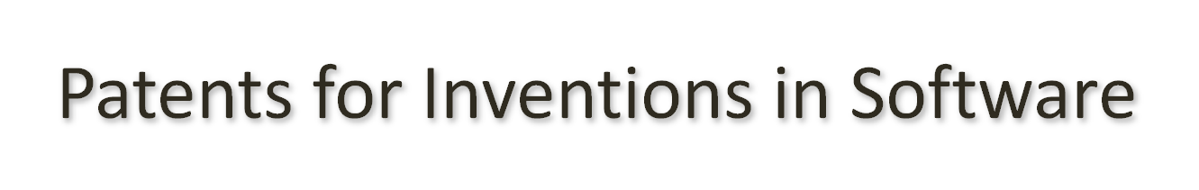
Patent decisions, confusion, and consequences
Patents protect inventions by giving the inventor a monopoly for a specified time period.
Laws of nature and mathematical formulas cannot be patented.
Obvious inventions or methods cannot be patented.
Notes:
Using a patented invention or process requires permission from the patent holder, even if another inventor independently came up with the same idea or invention.
Businesses routinely pay license fees to use patented inventions in their products.

Slide 41
A few cases
Paul Allen, co-founder of Microsoft, and e-commerce and Web-viewing
Apple, Android, and tap-touch screens
IBM , Amazon, and electronic catalogues
Notes:
Paul Allen (co-founder of Microsoft) sued several companies (Google, Facebook, Apple, eBay, Netflix, AOL, and others) for violating four early patents related to now widely used e-commerce and Web-viewing features. A judge dismissed the suit in 2011 while the Patent Office reconsiders the patents.
Apple won a patent case against a maker of Android phones. It covers technology that allows a user to tap a touch screen to perform various tasks.
IBM sued Amazon for violating a patent on electronic catalogues that covers targeting advertising and recommending specific products to a customer. Eventually, Amazon agreed to pay IBM a licensing fee.

Slide 42
Patent trolls
Some companies accumulate thousands of technology patents but do not make any products.
They license the patents to others and collect fees.
Notes:
Some patent-licensing firms make all or a significant part of their income by suing other companies for patent infringement (for hardware as well as software patents.)
Some see the existence of patent-licensing firms as an indication of a serious flaw in the patent system. On the other hand, some inventors have neither the skills nor the desire to market their inventions and negotiate contracts. In a highly specialized economy, the existence of firms that buy and license patents is not in itself a negative thing.

Slide 43
To patent or not?
In favor of software patents
Reward inventors for their creative work
Encourage inventors to disclose their inventions so others can build upon them
Encourage innovation

Slide 44
To patent or not?
Against software patents
Patents can stifle innovation, rather than encourage it.
Cost of lawyers to research patents and risk of being sued discourage small companies from attempting to develop and market new innovations.
It is difficult to determine what is truly original and distinguish a patentable innovation from one that is not.
Notes:
Many computer scientists see all algorithms as mathematical formulas.

