Slide 1
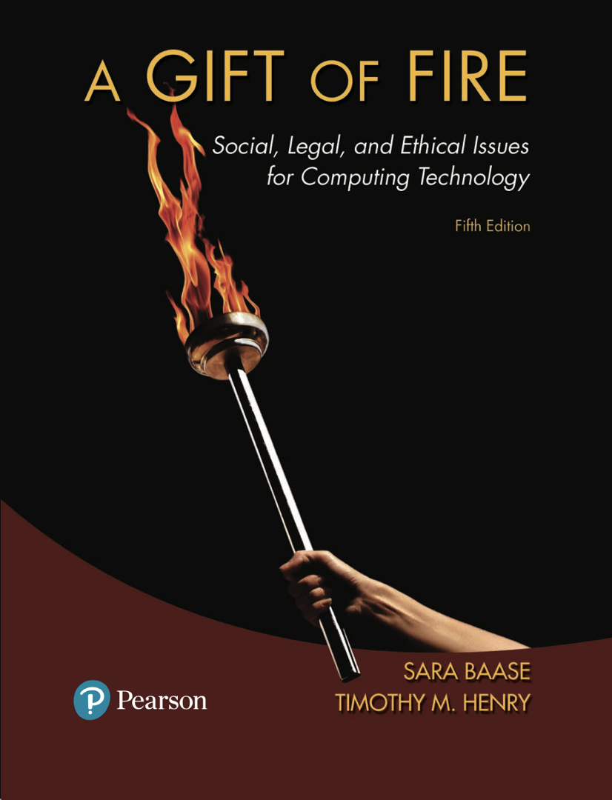
Chapter 5: Crime and Security
Based on slides prepared by Cyndi Chie, Sarah Frye and Sharon Gray.
Fifth edition updated by Timothy Henry

Slide 2

Hacking
Identity Theft and Credit Card Fraud
Whose Laws Rule the Web

Slide 3

Intentional, unauthorized access to computer systems
The term has changed over time
Phase 1: The joy of programming
Early 1960s to 1970s
It was a positive term
A "hacker" was a creative programmer who wrote elegant or clever code
A "hack" was an especially clever piece of code

Slide 4
Phase 2: 1970s to mid 1990s
Hacking took on negative connotations
Breaking into computers for which the hacker does not have authorized access
Still primarily individuals
Includes the spreading of computer worms and viruses and ‘phone phreaking’
Companies began using hackers to analyze and improve security

Slide 5
Phase 3: The growth of the Web and mobile devices
Beginning in mid 1990s
The growth of the Web changed hacking; viruses and worms could be spread rapidly
Political hacking (Hacktivism) surfaced
Denial-of-service (DoS) attacks used to shut down Web sites
Large scale theft of personal and financial information

Slide 6
Is “harmless hacking” harmless?
Responding to nonmalicious or prank hacking uses resources.
Hackers could accidentally do significant damage.
Almost all hacking is a form of trespass.

Slide 7
Hacktivism, or Political Hacking
Use of hacking to promote a political cause
Disagreement about whether it is a form of civil disobedience and how (whether) it should be punished
Some use the appearance of hacktivism to hide other criminal activities
How do you determine whether something is hacktivism or simple vandalism?
Notes:
A factor to consider when evaluating hactivism is the political system under which the hacktivists live. From both an ethical and social perspective, in free countries where almost anyone can tweet or post their words and video on the Web for free, it is hard to justify hacking someone else’s site to promote a political cause. On the other hand, countries with oppressive governments control the means of communications and prohibit open political discussion, have secret police who kill dissenters, ban some religions, and jail people who express opposition views. In such countries, where openly communicating one’s views is impossible or dangerous, there might be good arguments to justify political hacking to get one’s message out to the public and, in some cases, to sabotage government activities.

Slide 8
Hackers as Security Researchers
“White hat hackers” use their skills to demonstrate system vulnerabilities and improve security
Notes:
Ethical dilemmas:
Is it ethical to break into a system without permission, even with good intentions?
How can people responsibly inform potential victims of security vulnerabilities without informing malicious hackers who would exploit them?
Many security researcher hackers are scornful of big software companies because of the large number of security flaws in their products and because they are slow to plug leaks even when they know of them.

Slide 9
Hacking as Foreign Policy
Hacking by governments has increased
Pentagon has announced it would consider and treat some cyber attacks as acts of war, and the U.S. might respond with military force.
How can we make critical systems safer from attacks?
Notes:
Many cyber attacks come from China. The nature and sophistication of the attacks, as well as the type of targets, lead security researchers to believe that they are the work of government agencies, not civilian hackers.
A 2011 attack on the Gmail accounts of White House staffers, China policy experts, military officials, human rights activists, and others originated in a Chinese city where a major Chinese national security division is located. The attack used email carefully written in government jargon about State Department reports to fool the recipients into thinking the email was authentic. High-level government officials (and other people targeted) disclosed their passwords, allowing hackers to read their email for months.

Slide 10
Stuxnet
An extremely sophisticated worm
Targets a particular type of control system
Beginning in 2008, damaged equipment in a uranium enrichment plant in Iran
Notes:
The focus on Iran’s nuclear program and the sophistication of Stuxnet led to speculation that the Israeli and/or U.S. government created it. In 2012, journalist David Sanger published extensive research indicating that the two governments did indeed produce Stuxnet.
Is cyber sabotage against Iran justified? (Is it better than a military attack by Israel on Iran’s nuclear facilities?)
Will China, Russia, or other governments cite Stuxnet as an excuse for their own cyber intrusions into the U.S. and other countries?

Slide 11
Security
Hacking is a problem, but so is poor security.
Variety of factors contribute to security weaknesses:
History of the Internet and the Web
Inherent complexity of computer systems
Speed at which new applications develop
Economic and business factors
Human nature

Slide 12
Security
Internet started with open access as a means of sharing information for research.
Attitudes about security were slow to catch up with the risks.
Firewalls are used to monitor and filter out communication from untrusted sites or that fit a profile of suspicious activity.
Security is often playing catch-up to hackers as new vulnerabilities are discovered and exploited.

Slide 13
Responsibility for Security
Developers have a responsibility to develop with security as a goal.
Businesses have a responsibility to use security tools and monitor their systems to prevent attacks from succeeding.
Home users have a responsibility to ask questions and educate themselves on the tools to maintain security (personal firewalls, anti-virus and anti-spyware).

Slide 14
Discussion Questions
Is hacking that does no direct damage a victimless crime?
Do you think hiring former hackers to enhance security is a good idea or a bad idea? Why?

Slide 15
The Law: Catching and Punishing Hackers
1984 Congress passed the Computer Fraud and Abuse Act (CFAA)
Covers government computers, financial and medical systems, and activities that involve computers in more than one state, including computers connected to the Internet
Under CFAA, it is illegal to access a computer without authorization
The USA PATRIOT Act expanded the definition of loss to include the cost of responding to an attack, assessing damage and restoring systems

Slide 16
The Law: Catching and Punishing Hackers
Catching hackers
Law enforcement agents read hacker newsletters and participate in chat rooms undercover
They can often track a handle by looking through newsgroup or other archives
Security professionals set up ‘honey pots’ which are Web sites that attract hackers, to record and study
Computer forensics specialists can retrieve evidence from computers, even if the user has deleted files and erased the disks
Investigators trace viruses and hacking attacks by using ISP records and router logs
Notes:
Most people are unaware that word processors and other programs include a lot of “invisible information” in files – in some cases, unique identifying numbers and the author’s name. Security experts use such information to trace viruses. The hidden identifying information in files worries privacy advocates – another reminder of the tension between privacy and crime fighting.
When law enforcement methods receive publicity, hackers learn what mistakes to avoid. Law enforcement and security personnel update their skills and tools as hackers change theirs.

Slide 17
The Law: Catching and Punishing Hackers
Penalties for young hackers
Many young hackers have matured and gone on to productive and responsible careers
Temptation to over or under punish
Sentencing depends on intent and damage done
Most young hackers receive probation, community service, and/or fines
Not until 2000 did a young hacker receive time in juvenile detention
Notes:
In 2000, a 16-year-old was sentenced to six months in a juvenile detention facility. He was the first juvenile incarcerated for hacking. He had broken into NASA and Defense Department computers and was a member of a hacker group that vandalized government Web sites. As more young people caused more disruption, the severity of penalties increased.

Slide 18
The Law: Catching and Punishing Hackers
Criminalize virus writing and hacker tools?
Notes:
A law against distributing virus and hacking code would raise issues similar to those discussed in Chapters 2 and 4 about restricting or banning strong encryption and technologies to circumvent copyright protections.

Slide 19
The Law: Catching and Punishing Hackers
Expansion of the Computer Fraud and Abuse Act
The CFAA predates social networks, smartphones, and sophisticated invisible information gathering.
Some prosecutors use the CFAA to bring charges against people or businesses that do unauthorized data collection.
Is violating terms of agreement a form of hacking?
Notes:
Is violating the terms of use of a Web site a crime under CFAA’s provision about exceeding one’s authorized access for the purpose of committing fraud and obtaining something of value? The first major case involved a woman who pretended to be a 16-year-old boy on MySpace, began an online flirting relationship with a 13-year-old girl in her neighborhood (a former friend of the woman’s daughter), then broke off the relationship and sent cruel messages. The girl killed herself. The woman’s behavior was nasty and unethical. People wanted to see her punished, but it was not clear that she had broken any law. Prosecutors charged her with illegal hacking under the CFAA. A jury convicted the woman, but a judge reversed the conviction. Normally, a breach of contract is not a criminal offense.

Slide 20
Small Business Insecurity
Have you heard of the small business Fazio Mechanical?
Specializes in supermarket refrigeration systems
Small business (less than 200) employees in southwest Pennsylvania
Target Security Breach (Fall 2013)
Data on 40 million credit cards stolen
Over 70 million customer records stolen
Started with phishing email sent to Fazio Mechanical

Slide 21
Small Business Insecurity
Small businesses
can’t afford a security staff
are gateways to larger systems
often go out of business after a breach

Slide 22
Security
Security breaches occur:
Poorly written software
Poorly configured networks and applications
For Security Researchers and Cybersecurity Professionals
Whistleblowing versus Responsible Disclosure

Slide 23
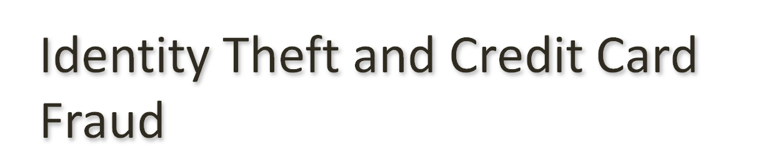
Stealing Identities
Identity Theft –various crimes in which criminals use the identity of an unknowing, innocent person
Use credit/debit card numbers, personal information, and social security numbers
18-29 year-olds are the most common victims because they use the Web most and are unaware of risks
E-commerce has made it easier to steal and use card numbers without having the physical card
Notes:
The Federal Trade Commission receives hundreds of thousands of complaints of identity theft each year. Losses from identity theft amount to billions of dollars per year in the U.S., with several million victims. A single incident can affect thousands of people.
Credit card companies and other businesses bear the direct cost of most credit card fraud, but the losses lead to higher charges to consumers. In addition, individual victims might lose a good credit rating, be prevented from borrowing money or cashing checks, be unable to get a job, or be unable to rent an apartment.

Slide 24
Stealing Identities
Techniques used to steal personal and financial information
Requests for personal and financial information disguised as legitimate business communication
Phishing – e-mail
Smishing – text messaging
Vishing – voice phishing
Pharming – false Web sites that fish for personal and financial information by planting false URLs in Domain Name Servers
Online resumés and job hunting sites may reveal SSNs, work history, birth dates and other information that can be used in identity theft

Slide 25
Responses to Identity Theft
Authentication of email and Web sites
Use of encryption to securely store data, so it is useless if stolen
Authenticating customers to prevent use of stolen numbers, may trade convenience for security
In the event information is stolen, a fraud alert can flag your credit report; some businesses will cover the cost of a credit report if your information has been stolen

Slide 26
Responses to Identity Theft
Authenticating customers and preventing use of stolen numbers
Activation for new credit cards
Retailers do not print the full card number and expiration date on receipts
Software detects unusual spending activities and will prompt retailers to ask for identifying information
Services, like PayPal, act as third party allowing a customer to make a purchase without revealing their credit card information to a stranger

Slide 27
Biometrics
Biological characteristics unique to an individual
No external item (card, keys, etc.) to be stolen
Used in areas where security needs to be high, such as identifying airport personnel
Biometrics can be fooled, but more difficult to do so, especially as more sophisticated systems are developed

Slide 28

When Digital Actions Cross Borders
Laws vary from country to country.
Corporations that do business in multiple countries must comply with the laws of all the countries involved.
Someone whose actions are legal in their own country may face prosecution in another country where their actions are illegal.

Slide 29
Yahoo and French censorship
Display and sale of Nazi memorabilia illegal in France and Germany
Yahoo was sued in French court because French citizens could view Nazi memorabilia offered on Yahoo’s U.S.-based auction sites
Legal issue is whether the French law should apply to Yahoo auction sites on Yahoo’s computers located outside of France.
Notes:
Display and sale of Nazi memorabilia are illegal in France and Germany, with some exceptions for historical purposes. Two antiracism organizations sued Yahoo in a French court in 1999 because French people could view Nazi memorabilia offered for sale on Yahoo’s U.S.-based auction sites. The French government also brought criminal charges against Yahoo and former CEO Tim Koogle for justifying a crime against humanity. (Yahoo’s French sites, based in France, complied with the French law.)
Yahoo argued that it was not technically feasible to block access from France. In addition, French people could access Yahoo’s sites from outside France or using anonymizing services. Geolocation software was fairly new, but a French court ordered Yahoo to make a serious effort to use such tools to block access by French people to material France deemed illegal.
Koogle did not go to France to attend his trial. Yahoo and Koogle were acquitted because the court decided that permitting the auctions was not “justifying” the Nazi crimes. The decision did not resolve the issue of whether one country’s government could or should bring criminal charges against content providers based in another country for content legal in their own country.

Slide 30
Applying U.S. copyright law to foreign companies
Russian company sold a computer program that circumvents controls embedded in electronic books to prevent copyright infringement.
Program was legal in Russia, but illegal in U.S.
Program’s author, Dmitry Sklyarov, arrested when arrived in U.S. to present a talk on the weaknesses in control software used in ebooks.
After protests in U.S. and other countries, he was allowed to return to Russia.
Notes:
The program violated the Digital Millennium Copyright Act (DMCA) which prohibits distribution of software to thwart built-in copyright protection. The Russian company agreed to stop distributing the program in U.S. Thus, the case did not resolve the basic issue of whether a prosecution would be successful against a company for continuing to distribute a product that is legal in its own country.

Slide 31
Arresting executives of online gambling and payment companies
An executive of a British online gambling site was arrested as he transferred planes in Dallas. (Online sports betting is not illegal in Britain.)
Unlawful Internet Gambling Enforcement Act prohibits credit card and online-payment companies from processing transactions between bettors and gambling sites.
Notes:
The executive, facing a possible 20-year jail sentence, pleaded guilty for a lower sentence.
Foreign online gambling companies thrive with U.S. customers if their employees stay out of the U.S., so Congress passed the Unlawful Internet Gambling Enforcement Act. It prohibits credit card and online-payment companies from processing transactions between bettors and gambling sites. Within months of passing the new law, the U.S. government arrested the founders of a British Internet payment company that processed payments for gambling sites.

Slide 32
Libel, Speech and Commercial Law
Even if something is illegal in both countries, the exact law and associated penalties may vary.
In cases of libel, the burden of proof differs in different countries.
Notes:
The burden of proof differs in different countries. In the U.S., the person who is suing has the burden of proving the case. Public figures must prove the published information is false and that the publisher knew it was false or acted recklessly. Libel law in some other countries requires that the publisher of the statement in question prove it is true or that the publisher reasonably believed it was true.
In 2006, the New York Times reprogrammed its geolocation tools, normally used for targeting advertisements, to block people in England from reading a news article describing an investigation of suspects in an alleged plot to carry liquid explosives onto airplanes and blow them up. It is illegal in England to publish information damaging to defendants before trial.
What might happen to individuals who email the article to a friend in England or quote it in a blog that has readers in England? Those individuals don’t have legal staff and access to geolocation tools. They might not even know the article is illegal in another country.

Slide 33
Libel, Speech and Commercial Law
Libel tourism
Traveling to places with strict libel laws in order to sue
SPEECH Act of 2010 makes foreign libel judgments unenforceable in the U.S. if they would violate the First Amendment.
Foreign governments can still seize assets
Where a trial is held is important not just for differences in the law, but also the costs associated with travel between the countries; cases can take some time to come to trial and may require numerous trips.
Freedom of speech suffers if businesses follow laws of the most restrictive countries.
Notes:
Saudi Arabia bans “anything damaging to the dignity of heads of state.” In Russia, it is a crime to slander government officials. Government officials in Singapore have long used libel laws to bankrupt political opponents who criticize them.

Slide 34
Libel, Speech and Commercial Law
Some countries have strict regulations on commercial speech and advertising.
Notes:
The European Union restricts advertising of medical drugs and devices directed to consumers.
Some countries prohibit or restrict direct price comparisons, product give-aways, and advertising unconditional-return policies or that a business gives a contribution to charity for each sale. The justification for these laws is that such practices and advertisements confuse or trick consumers. Germany repealed some of these laws, in force for 90 years, in part because of the influence of the Internet.

Slide 35
Discussion Questions
What suggestions do you have for resolving the issues created by differences in laws between different countries?
What do you think would work, and what do you think would not?

Slide 36

Respecting cultural differences is not the same as respecting laws
Where a large majority of people in a country support prohibitions on certain content, is it ethically proper to abandon the basic human rights of free expression and freedom of religion for minorities?
Notes:
If publishers comply with laws of almost 200 countries, some fear the Internet might come to reflect a combination of Muslim restrictions on discussion of religion, U.S. opposition to online gambling, and Chinese censorship of political discussion. Others argue that companies would adapt and acquire software to handle appropriate screening.
Governments often claim to be protecting national culture and values when they impose controls on their citizens to maintain their own power or to benefit special interests within their country. Laws can have ignoble sources.
The U.S. defends its ban on offshore gambling sites with the argument that is has the right to ban morally objectionable activities. But the federal and state governments allow and tax many forms of legal gambling and profit from monopolies on their state lotteries. It seems likely that anticompetitiveness – not morality – motivates the governments, casinos, and racetracks that oppose offshore online poker playing.

Slide 37

International agreements
Countries of the World Trade Organization (WTO) agree not to prevent their citizens from buying certain services from other countries if those services are legal in their own.
The WTO agreement does not help when a product, service, or information is legal in one country and not another.

Slide 38
Alternative principles
Responsibility-to-prevent-access
Publishers must prevent material or services from being accessed in countries where they are illegal.
Authority-to-prevent entry
Government of Country A can act within Country A to try to block the entrance of material that is illegal there, but may not apply its laws to the people who create and publish the material, or provide a service, in Country B if it is legal there.

