Slide 1
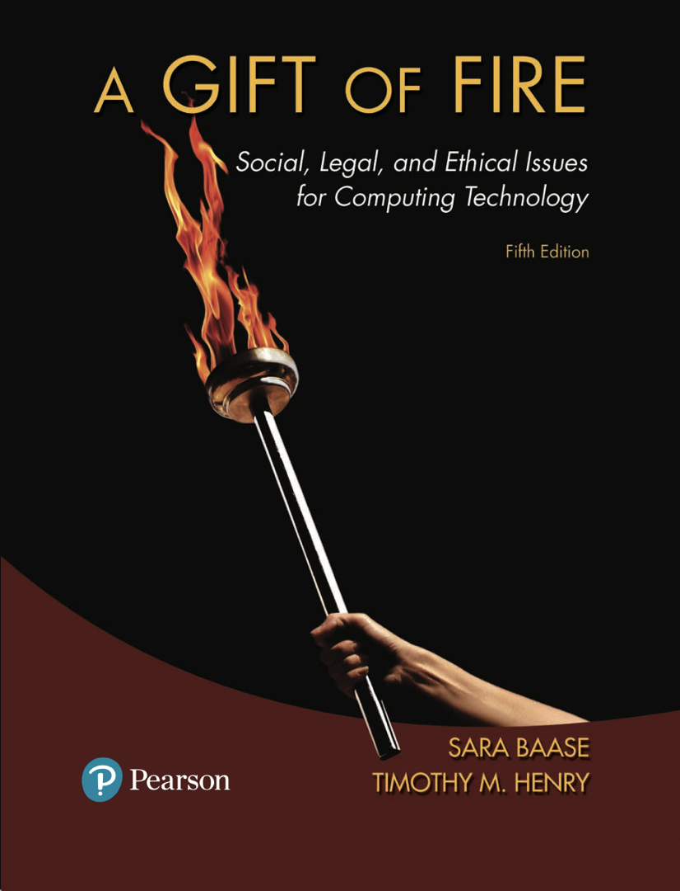
Chapter 7: Evaluating and Controlling Technology
Based on slides prepared by Cyndi Chie, Sarah Frye and Sharon Gray.
Fifth edition updated by Timothy Henry

Slide 2

Evaluating Information
The “Digital Divide”
Neo-Luddite Views of Computers, Technology, and Quality of Life
Making Decisions About Technology

Slide 3

The Need for Responsible Judgment
Expert information or ‘wisdom of the crowd’?
Daunting amount of information on the web, much of this information is not correct
Search engines are replacing librarians, but Web sites are ranked by popularity, not by expert evaluation
Wisdom of the crowd - ratings by public of Web site
If millions participate, the results will be useful

Slide 4
The Need for Responsible Judgment
Wikipedia
Written by volunteers, some posts are biased and not accurate
Although anyone can write, most people do not
Those that do typically are educated and experts

Slide 5
The Need for Responsible Judgment
Wisdom of the crowd
Problems of unreliable information are not new
The Web magnifies the problems
Rating systems are easy to manipulate
Vulnerable viewers
Less educated individuals
Children

Slide 6
The Need for Responsible Judgment
Narrowing the information stream
Notes:
Some critics see the web as significantly encouraging narrowness and political extremes by making it easy for people to avoid seeing alternative opinions.
Searching online “puts researchers in touch with prevailing opinions, but this may accelerate consensus and narrow the range of findings and ideas built upon.”⁸

Slide 7
The Need for Responsible Judgment
Abdicating responsibility
People willing to let computers do their thinking
Reliance on computer systems over human judgment may become institutionalized
Fear of having to defend your own judgment if something goes wrong

Slide 8
Computer Models
Evaluating Models
How well do the modelers understand the underlying science or theory?
Models necessarily involve assumptions and simplifications of reality.
How closely do the results or predictions correspond with the results from physical experiments or real experience?
Notes:
Car crash analysis programs use a technique called the finite-element method. They superimpose a grid on the frame of a car, dividing the car into a finite number of small pieces, or elements. The grid is entered into the program, along with data describing the specifications of the materials making up each element (e.g., density, strength, and elasticity). A real crash test can cost several thousand dollars. It includes building and testing a unique prototype for each new car design. The crash analysis programs allow engineers to consider alternatives and discover the effect without building another prototype for each alternative. But how good are the programs?
How well is the physics of car crashes understood? How accurate and complete are the data? Force and acceleration are basic principles. Engineers know the relevant properties of the materials. However, although they understand the materials when force is applied gradually, they know less about the behavior of some materials under abrupt acceleration.
What simplifications do the programs make? Obviously, the grid pattern.
How do the computed results compare to actual crash tests on real cars? Crash analysis programs do an extremely good job.

Slide 9
Computer Models
Why models may not be accurate
We might not have complete knowledge of the system we are modeling.
The data describing current conditions or characteristics may be incomplete or inaccurate.
Computing power may be inadequate for the complexity of the model.
It is difficult, if not impossible, to numerically quantify variables that represent human values and choices.
Notes:
Climate change is an example of something that is very difficult to model because of its complexity.

Slide 10

Trends in Computer Access
New technologies only available to the wealthy
The time it takes for new technology to make its way into common use is decreasing
Cost is not the only factor; ease of use plays a role
Entrepreneurs provide low cost options for people who cannot otherwise afford something
Government funds technology in schools
As technology becomes more prevalent, the issues shift from the haves and have-nots to level of service

Slide 11

The Global Divide and the Next Billion Users
Approximately two billion people worldwide have access to the Web, a fivefold increase over roughly a decade. Approximately five billion do not use the Internet.
Non-profit organizations and huge computer companies are spreading computer access to people in developing countries.
Bringing new technology to poor countries is not just a matter of money to buy equipment; PCs and laptops must work in extreme environments.
Some people actively working to shrink the digital divide emphasize the need to provide access in ways appropriate to the local culture.
Notes:
Some companies use the catchphrase “the next billion users” to describe the people their programs address. For the companies, these programs create good will and – if successful in improving the standard of living and economies of the target countries – a large future customer base.
One Laptop per Child is a nonprofit organization that supplies an inexpensive laptop computer specially designed for elementary school children in developing countries. The laptop works in extreme heat or cold, extremes of humidity, and dusty or rainy environments. The power requirements are very low. The success of the program, however, depends upon the presence of supporting social and technical infrastructures, such as electricity and tech support.

Slide 12

Criticisms of Computing Technologies
Computers cause massive unemployment and de-skilling of jobs.
Computers “manufacture needs”; we use them because they are there, not because they satisfy real needs.
Computers cause social inequity
Computers cause social disintegration; they are dehumanizing. They weaken communities and lead to isolation of people from each other.

Slide 13
Criticisms of Computing Technologies
Computers separate humans from nature and destroy the environment.
Computers benefit big business and big government the most.
Use of computers in schools thwarts development of social skills, human values, and intellectual skills in children.
Computers do little or nothing to solve real problems.

Slide 14
Views of Economics, Nature, and Human Needs
Difference in perspective between Luddites and non-Luddites
What is the purpose of technology?
To Luddites, it is to eliminate jobs to reduce cost of production
To non-Luddites, it is to reduce effort needed to produce goods and services.
While both statements say nearly the same thing, the first suggests massive unemployment, profits for capitalists, and a poorer life for most workers. The second suggests improvements in wealth and standard of living.

Slide 15
Does the technology create a need for itself?
Notes:
A common criticism of capitalism is that it survives by convincing us to buy products we do not need. Luddites argue, similarly, that technology causes production of things we do not need. Luddites believe that advertising, work pressure, or other external forces manipulate buyers. Those who emphasize the value of individual action and choices argue that needs are relative to goals.
Environmental and anti-technology groups use computers and the Web. The editor of Wild Earth, who considers himself a neo-Luddite, said he “inclines toward the view that technology is inherently evil,” but he “disseminates this view via email, computer, and laser printer.”⁵⁶
According to Kirkpatrick Sale, another neo-Luddite, the use of computers insidiously embeds into the user the values and thought processes of the society that makes the technology. ⁵⁷

Slide 16
Nature and human life styles
Luddites argue that technology has made no important improvements in life.
Many debates set up a humans-versus-nature dichotomy.
Whether a computing device is “good,” by a human-centered standard, depends on whether it meets our needs, how well it does so, at what cost, and how well it compares to alternatives.
Notes:
Kirkpatrick Sale’s list of “benefits” include speed, ease, and mass access – all of which he disdains. He says that although individuals might feel their lives are better because of computers, the perceived benefits are “industrial virtues that may not be virtues in another morality.” He defines moral judgment as “the capacity to decide that a thing is right when it enhances the integrity, stability, and beauty of nature and is wrong when it does otherwise.”⁵⁸
Jerry Mander, another neo-Luddite, points out that thousands of generations of humans got along without computers, suggesting that we could do just fine without them too.
Critics of modern technologies point out their weaknesses but often ignore the weaknesses of alternatives.

Slide 17
Accomplishments of technology
Increased life expectancy
Elimination or reduction of many diseases
Increased standard of living
Assistive technologies for those with disabilities
Notes:
Technology and the Industrial Revolution have had a dramatic impact on life expectancy. A study in 1662 estimated that only 25% of people in London lived to age 26. Records from 18th-century French villages showed that the median age of death was lower than the median age of marriage. In the U.S., life expectancy at birth increased from 47.3 years in 1900 to 77.9 in 2007. Worldwide average life expectancy increased from approximately 30 in 1900 to approximately 64 in 2006.
Science and technology (along with other factors such as education) reduced or almost eliminated typhoid, smallpox, dysentery, plagues, and malaria in most of the world.
In the early 2000s, Americans spent less than 10% of family income on food, compared to 47% in 1901. When new forms of wheat and crop management were introduced in India, yields rose from 12.3 million tons in 1965 to 73.5 million tons in 1999. In about the same timeframe, U.S. production of its 17 most important crops increased from 252 million tons to 596 million tons, but used 25 million fewer acres.

Slide 18
Discussion Questions
To what extent are Neo-Luddite criticisms (on slides 12 and 13) valid?
Can a society choose to have certain specific desirable modern inventions while prohibiting undesirable ones?

Slide 19

The Difficulty of Prediction
Each new technology finds new and unexpected uses
The history of technology is full of wildly wrong predictions
Weizenbaum argued against developing speech recognition technology
Mistaken expectations of costs and benefits
Should we decline a technology because of potential abuse and ignore the benefits?
New technologies are often expensive, but costs drop as the technology advances and the demand increases
Notes:
Computer scientist Peter Denning says technology “shapes the space of possibilities.”

Slide 20
Intelligent Machines and Superintelligent Humans - Or the End of the Human Race?
Technological Singularity - point at which artificial intelligence or some combined human-machine intelligence advances so far that we cannot comprehend what lies on the other side
We cannot prepare for aftermath, but prepare for more gradual developments
Select a decision making process most likely to produce what people want

Slide 21
A Few Observations
Limit the scope of decisions about development of new technology
Decentralize the decision-making process and make it noncoercive, to reduce the impact of mistakes, avoid manipulation by entrenched companies who fear competition, and prevent violations of liberty

Slide 22
Discussion Questions
How well can we predict the consequences of a new technology or application?
Who would make the decisions?

