Slide 1
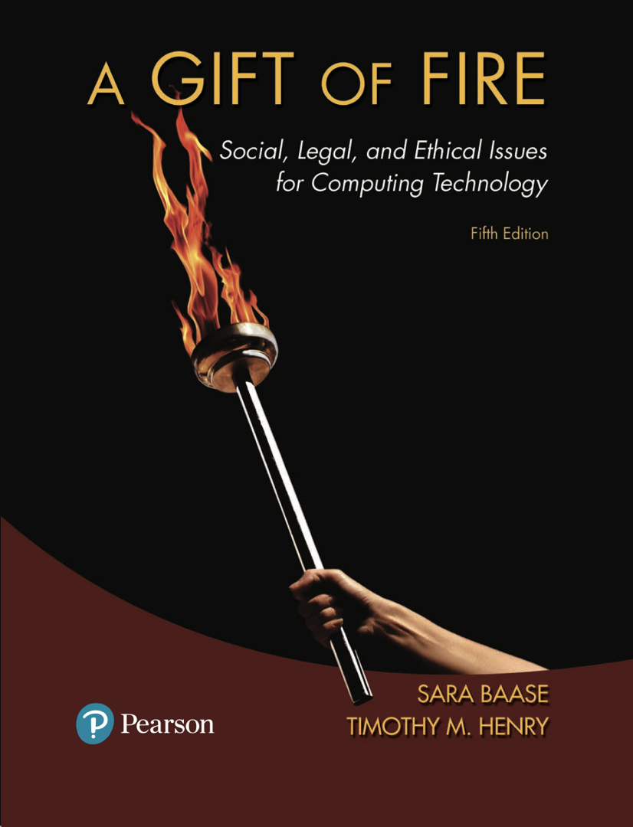
Chapter 8: Errors, Failures and Risks
Based on slides prepared by Cyndi Chie, Sarah Frye and Sharon Gray.
Fifth edition updated by Timothy Henry

Slide 2

Failures and Errors in Computer Systems
Case Study: The Therac-25
Increasing Reliability and Safety
Dependence, Risk, and Progress

Slide 3
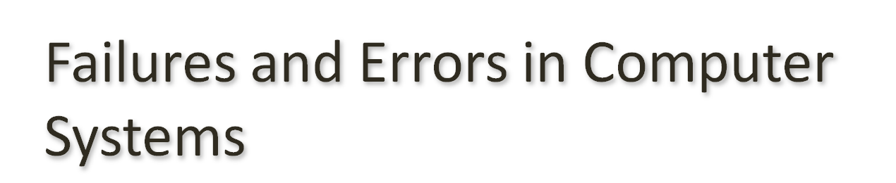
Most computer applications are so complex it is virtually impossible to produce programs with no errors
The cause of failure is often more than one factor
Computer professionals must study failures to learn how to avoid them
Computer professionals must study failures to understand the impacts of poor work

Slide 4
Problems for Individuals
Billing errors
Inaccurate and misinterpreted data in databases
Large population where people may share names
Automated processing may not be able to recognize special cases
Overconfidence in the accuracy of data
Errors in data entry
Lack of accountability for errors
Notes:
A woman received a $6.3 million bill for electricity. The correct amount was $63. The cause was an input error made by someone using a new computer system.
When the IRS modified its programs to avoid billing victims of a Midwest flood, the computer generated erroneous bills for almost 5000 people. One Illinois couple received a bill for a few thousand dollars in taxes – and $68 billion in penalties.
The auto insurance rate of a 101-year-old man suddenly tripled. Rates depend on age, but the program handled ages only up to 100. It mistakenly classified the man as a teenager.
Hundreds of Chicago cat owners received bills from the city for failure to register dachshunds, which they did not own. The city used two databases to try to find unlicensed pets. One database used DHC as the code for domestic house cat, and the other used the same code for dachshund.
A water-utility company sent a customer an incorrect bill for $22,000. A spokesman for the company pointed out that one incorrect bill out of 275,000 monthly bills is pretty good. It is better than a 99.999% accuracy rate. Is that reasonable?

Slide 5
System Failures
Galaxy IV
Amtrak
Notes:
When a Galaxy IV satellite computer failed, many systems we take for granted stopped working. Pager service stopped for an estimated 85% of users in the U.S., including hospitals and police departments. Airlines that got their weather information from the satellite had to delay flights. The gas stations of a major chain could not verify credit cards. Some services were quickly switched to other satellites or backup systems. It took days to restore others.
A failure of Amtrak’s reservation and ticketing system during Thanksgiving weekend caused delays because agents had no printed schedules or fare lists.

Slide 6
System Failures
Voting systems
Technical failures
Programmers or hackers rigging software to produce inaccurate results.
Vulnerability to viruses
Notes:
Machines in North Carolina failed to count more than 400 votes because of a technical problem.
One county lost more than 4000 votes because the machine’s memory was full.
A programming error generated 100,000 extra votes in one Texas county.
A programming error caused some candidates to receive votes actually cast for other candidates.
Security researchers strongly criticized electronic voting machines. They found that programmers omitted basic procedures such as input validation and boundary checks.

Slide 7
System Failures
Denver Airport
Baggage system failed due to real world problems, problems in other systems and software errors
Main causes:
Time allowed for development was insufficient
Denver made significant changes in specifications after the project began
Notes:
During tests of the baggage handling system for the $3.2 billion Denver International Airport, carts crashed into each other at track intersections. The system misrouted, dumped, and flung luggage.
Real-world problems: some scanners got dirty or knocked out of alignment. Faulty latches on carts caused luggage to fall onto the tracks between stops.
Problems in other systems: The airport’s electrical system could not handle the power surges associated with the baggage system.
Software errors: A software error caused the routing of carts to waiting pens when they were actually needed.

Slide 8
System Failures
Airports in Hong Kong and Kuala Lumpur
Comprehensive systems failed because designers did not adequately consider potential for user input error.
Notes:
The systems were designed to manage everything, from moving 20,000 pieces of luggage per hour, to coordinating and scheduling crews, to assigning gates for flights. They failed spectacularly.
At Hong Kong’s Check Lap Kok airport, cleaning crews and fuel trucks, baggage, passengers, and cargo went to the wrong gates, sometimes far from where their airplanes were. Airplanes scheduled to take off were empty.
At Kuala Lumpur, airport employees had to write boarding passes by hand and carry luggage. Flights were delayed; food cargo rotted in the tropical heat.
At both airports, the failures were blamed on people typing in incorrect information. A spokesman for the Malaysian airport said, “There’s nothing wrong with the system.” A spokesman at Hong Kong made a similar statement. They were both deeply mistaken. Any system that has a large number of users and a lot of user input must be designed and tested to handle input mistakes. The “system” includes more than software and hardware. It includes the people who operate it.

Slide 9
System Failures
Abandoned systems
Some flaws in systems are so extreme that the systems are discarded after wasting millions, or even billions, of dollars.
Notes:
A large British food retailer spent more than $500 million on an automated supply management system before abandoning it because it did not work.
The Ford Motor Company abandoned a $400 million purchasing system.
The California and Washington state motor vehicle departments each spent more than $40 million on computer systems before abandoning them because they never worked properly.
A consortium of hotels and rental car businesses spent $125 million on a comprehensive travel-industry reservation system, then canceled the project because it did not work.
The state of California spent more than $100 million to develop one of the largest and most expensive state computer systems in the country; a system for tracking parents who owe child support payments. After five years, the state abandoned the system.
After spending $4 billion, the IRS abandoned a tax-system modernization plan.
The FBI spent $170 million to develop a database called the Virtual Case File system to manage evidence in investigations, then scrapped it because of many problems.
Software expert Robert Charette estimates that from 5% to 15% of information technology projects are abandoned before or soon after delivery as “hopelessly inadequate”.

Slide 10
System Failures
Lack of clear, well-thought-out goals and specifications
Poor management and poor communication among customers, designers, programmers, etc.
Institutional and political pressures that encourage unrealistically low bids, low budget requests, and underestimates of time requirements
Use of very new technology, with unknown reliability and problems
Refusal to recognize or admit a project is in trouble

Slide 11
System Failures
Legacy systems
Reliable but inflexible
Expensive to replace
Little or no documentation
Notes:
Legacy systems are out-of-date systems (hardware, software, or peripheral equipment) still in use, often with special interfaces, conversion software, and other adaptations to make them interact with more modern systems.
Major users of computers in the early days included banks, airlines, government agencies, and providers of infrastructure services such as power companies. The systems grew gradually. A complete redesign would be expensive and would possibly involve downtime. Thus legacy systems persist.
Limited computer memory led to obscure and terse programming practices. A variable a programmer might now call “flight-number” might have been simply “f.”

Slide 12
What Goes Wrong?
The job they are doing is inherently difficult.
Sometimes the job is done poorly.
Notes:
Computer systems interact with the real world (including both machinery and unpredictable humans), include complex communications networks, have numerous features and interconnected subsystems, and are extremely large.
Computer software is “nonlinear” in the sense that, whereas a small error in a mechanical system might cause a small degradation in performance, a single typo in a computer program can cause a dramatic difference in behavior.
The job can be done poorly at any of many stages, from system design and implementation to system management and use.

Slide 13
What Goes Wrong?
Design and development problems
Inadequate attention to potential safety risks
Interaction with physical devices that do not work as expected
Incompatibility of software and hardware, or of application software and the operating system
Not planning and designing for unexpected inputs or circumstances
Confusing user interfaces
Insufficient testing
Reuse of software from another system without adequate checking
Overconfidence in software
Carelessness

Slide 14
What Goes Wrong?
Management and use problems
Data-entry errors
Inadequate training of users
Errors in interpreting results or output
Failure to keep information in databases up to date
Overconfidence in software by users

Slide 15
What Goes Wrong?
Misrepresentation, hiding problems and inadequate response to reported problems
Insufficient market or legal incentives to do a better job

Slide 16
What Goes Wrong?
Reuse of software: the Ariane 5 rocket and “No Fly” lists
It is essential to reexamine the specifications and design of the software, consider implications and risks for the new environment, and retest the software for the new use.
Notes:
Less than 40 seconds after the first launch of France’s Ariane 5 rocket, the rocket veered off course and was destroyed as a safety precaution. The rocket used software that had worked correctly in an earlier rocket model. But, the newer rocket was faster than the older rocket. Its speed threw off velocity calculations, resulting in an “overflow” and causing the system to halt. The rocket and the satellites it was carrying cost approximately $500 million.
To compare passenger names with those on the Transportation Security Agency’s “No Fly” list, some airlines used old software and strategies designed to help ticket agents quickly locate a passenger’s reservation. The software searches quickly and “casts a wide net.” That is, it finds any possible match, which a sales agent can then verify. In the intended applications for the software, there is no inconvenience to anyone if the program presents the agent with a few potential matches of similar names. In the context of tagging people as possible terrorists, a person mistakenly “matched” will likely undergo questioning and extra luggage and body searches by security agents.

Slide 17

Therac-25 Radiation Overdoses
Massive overdoses of radiation were given; the machine said no dose had been administered at all
Caused severe and painful injuries and the death of three patients
Important to study to avoid repeating errors
Manufacturer, computer programmer, and hospitals/clinics all have some responsibility

Slide 18
Software and Design problems
Re-used software from older systems, unaware of bugs in previous software
Weaknesses in design of operator interface
Inadequate test plan
Bugs in software
Allowed beam to deploy when table not in proper position
Ignored changes and corrections operators made at console

Slide 19
Why So Many Incidents?
Hospitals had never seen such massive overdoses before, were unsure of the cause
Manufacturer said the machine could not have caused the overdoses and no other incidents had been reported (which was untrue)
The manufacturer made changes to the turntable and claimed they had improved safety after the second accident. The changes did not correct any of the causes identified later.

Slide 20
Why So Many Incidents? (cont.)
Recommendations were made for further changes to enhance safety; the manufacturer did not implement them.
The FDA declared the machine defective after the fifth accident.
The sixth accident occurred while the FDA was negotiating with the manufacturer on what changes were needed.

Slide 21
Observations and Perspective
Minor design and implementation errors usually occur in complex systems; they are to be expected
The problems in the Therac-25 case were not minor and suggest irresponsibility
Accidents occurred on other radiation treatment equipment without computer controls when the technicians:
Left a patient after treatment started to attend a party
Did not properly measure the radioactive drugs
Confused micro-curies and milli-curies

Slide 22
Discussion Question
If you were a judge who had to assign responsibility in this case, how much responsibility would you assign to the programmer, the manufacturer, and the hospital or clinic using the machine?

Slide 23

Professional techniques
Importance of good software engineering and professional responsibility
User interfaces and human factors
Redundancy and self-checking
Testing
Include real world testing with real users

Slide 24
Professional techniques
Management and communication
High reliability organization principles
preoccupation with failure
loose structure
Notes:
Management experts use the term high reliability organization (HRO) for an organization (business or government) that operates in difficult environments, often with complex technology, where failures can have extreme consequences (for example, air traffic control, nuclear power plants.)
Preoccupation with failure
Always assuming something unexpected can go wrong – not just planning, designing, and programming for all problems the team can foresee, but always being aware that they might miss something.
Being alert to cues that might indicate an error, including fully analyzing near failures.
Looking for systemic reasons for an error or failure rather than narrowly focusing on the detail that was wrong.
Loose structure
It should be easy for a designer or programmer to speak to people in other departments or higher up without going through rigid channels that discourage communication.

Slide 25
Safety-critical applications
Identify risks and protect against them
Convincing case for safety
Avoid complacency
Notes:
Software expert Nancy Leveson emphasizes that with good technical practices and good management, you can develop large systems right: “One lesson is that most accidents are not the result of unknown scientific principles but rather of a failure to apply well-known, standard engineering practices.”³²
The two space shuttle disasters illustrate important principles in safety-critical applications. Aware that cold weather posed a severe threat, Challenger engineers were expected to prove that it was not safe to launch. For the ethical decision maker, the policy should be to suspend or delay use of the system in the absence of a convincing case for safety, rather than to proceed in the absence of a convincing case for disaster.
In the case of the Columbia disaster, NASA knew that a large piece of insulating foam had dislodged and struck the wing of the space shuttle. But, pieces of foam had struck the shuttle on other flights without causing a major problem. Thus NASA managers declined to pursue available options to observe and repair the damage. Columbia broke up when reentering the earth’s atmosphere at the end of its mission. An organization focused on safety must explore ambiguous risks and avoid complacency.

Slide 26
Specifications
Learn the needs of the client
Understand how the client will use the system
Notes:
Good software developers help clients better understand their own goals and requirements, which the clients might not be good at articulating.
One company that developed a successful financial system that processes one trillion dollars in transactions per day spent several years developing specifications for the system, then only six months programming, followed by carefully designed, extensive testing.

Slide 27
User interfaces and human factors
User interfaces should:
provide clear instructions and error messages
be consistent
include appropriate checking of input to reduce major system failures caused by typos or other errors a person will likely make

Slide 28
User interfaces and human factors
The user needs feedback to understand what the system is doing at any time.
The system should behave as an experienced user expects.
A workload that is too low can be dangerous.

Slide 29
Redundancy and self-checking
Multiple computers capable of same task; if one fails, another can do the job.
Voting redundancy
Notes:
Software modules can check their own results – either against a standard or by computing the same thing in two different ways and then comparing to see if the two results match.
Voting redundancy, used in flight control systems in aircraft, aims to protect against consistently faulty assumptions or methods of one programming team. Three independent teams write modules for the same purpose, in three different programming languages. The modules run on three separate computers. A fourth unit examines the outputs of the three modules and chooses the result obtained by at least two out of three.

Slide 30
Testing
Even small changes need thorough testing
Independent verification and validation (IV&V)
Beta testing
Notes:
Adequate, well-designed testing is extremely important. Unfortunately, many cost-conscious managers, programmers, and software developers see testing as a dispensable luxury, a step you can skimp on to meet a deadline or to save money.
Independent verification and validation means that an independent company or independent team (that is, not the programmers nor the customer) tests and validates the software. They act as “adversaries” and try to find flaws. IV&V is helpful for two reasons:
The people who designed and/or developed a system think the system works. They think they thought about potential problems and solved them. With the best of intentions, they tend to test for the problems they have already considered.
Consciously or subconsciously, the people who created the system may be reluctant to find flaws in it.
Beta testing is a near-final stage of testing. A selected set of customers use a complete, presumably well-tested system in their “real-world” environment. It can detect device limitations and bugs that designers, programmers, and testers missed. It can also uncover confusing aspects of user interfaces and problems that occur when interfacing with other systems.

Slide 31

Traffic Collision Avoidance System (TCAS)
Computers in some airplanes prevent certain pilot actions
Notes:
A German and Russian plane collided after one of the pilots followed an air traffic controller’s instructions rather than TCAS instructions. A few months later, a pilot of a Lufthansa 747 ignored instructions from an air traffic controller and instead followed instructions from the computer system, avoiding a midair collision. U.S. and European pilots are now trained to follow TCAS instructions even if they conflict with instructions from an air traffic controller.

Slide 32

Criminal and civil penalties
Provide incentives to produce good systems, but shouldn't inhibit innovation
Regulation for safety-critical applications
Professional licensing
Arguments for and against
Taking responsibility

Slide 33
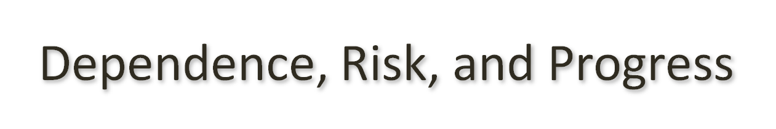
Are We Too Dependent on Computers?
Computers are tools
They are not the only dependence
Electricity
Risk and Progress
Many new technologies were not very safe when they were first developed
We develop and improve new technologies in response to accidents and disasters
We should compare the risks of using computers with the risks of other methods and the benefits to be gained

Slide 34
Discussion Questions
Do you believe we are too dependent on computers? Why or why not?
In what ways are we safer due to new technologies?

