Slide 1
Algorithms for Structured Matrices
By
Vamsi Kondari & Suresh Paleti

Slide 2
Outline:
Structured Matrices
Features of Structured Matrices
Types of Structured Matrices
Toeplitz matrix
Hankel matrix
Vandermonde matrix
Cauchy matrix
Algorithms for structured matrices
Fast Fourier Transform based algorithms.
Solving least squares problem.
Polynomial interpolation using Vandermonde system
Structured iterative inversion via matrix-by-vector multiplication.

Slide 3
Structured Matrices:
Problems in Engineering and Mathematics require the solution of n x n linear system of equations.
n can be large and in such cases the complexity O(n³) will become prohibitively large.
Matrices with structure are required to reduce computational burden.
Toeplitz, Hankel, Vandermonde and Cauchy are important.

Slide 4
Features of Structured Matrices:
Can be represented with smaller number of parameters
Can be multiplied by vectors very fast
Have close algorithmic correlation to computations with polynomials and rational functions.
Naturally associated with linear displacement operators L and can be recovered easily from the operators L.

Slide 5
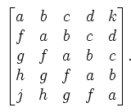
Toeplitz Matrix
A Toeplitz Matrix is a matrix in which each descending diagonal from left to right is constant.
The following matrix is Toeplitz Matrix.

Slide 6
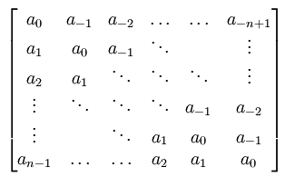
Toeplitz Matrix cont’d
Any nxn matrix will be of the form

Slide 7
Toeplitz Matrix cont’d
What is the necessity of these matrices?
It can be shown that the addition of two Toeplitz matrices can be done in O(n) time, a Toeplitz matrix can be multiplied by a vector in O(n log n) time, and the matrix multiplication of two Toeplitz matrices can be done in O(n²) time.
If a Toeplitz matrix has the additional property that a_{i} = a_{i+n} then it is a circulant matrix.
Toeplitz matrices are closely connected with Fourier series.

Slide 8
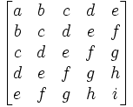
Hankel Matrix
Hankel Matrix is a square matrix composed by elements which are constant along skew diagonals.
Hankel matrix closely related to Toeplitz matrix ( a Hankel matrix is an upside-down Toeplitz matrix.

Slide 9
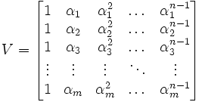
Vandermonde Matrix
Vandermonde matrix is a matrix with a geometric progression in each row.

Slide 10

Cauchy Matrix
A matrix whose elements are in the form

Slide 11
Algorithms
Fast Fourier Transform based algorithms.
Polynomial version of FFT algorithm.
Binary split FFT algorithm.
Polynomial multiplication.
Algorithm for solving the Toeplitz-like Least Squares Problem.
Algorithm for solving the Toeplitz-plus-Hankel-like Least Squares Problem.

Slide 12
Algorithms cont’d
Polynomial interpolation using Vandermonde systems.
Algorithm for Matrix inversion
Algorithm for solving dual confluent Vandermonde-like system.
Algorithm for solving primal confluent Vandermonde-like system.
Structured iterative inversion via matrix-by-vector multiplication.

Slide 13
Thank you

