Slide 1
Σ’s Enigmas or Some Sums
Andrew A. Anda, Ph.D.
Algorithms and Architectures for Fixed Precision Floating Point Summation.

Slide 2
Here Be Dragons
Many assumed algebraic laws fail for floating point arithmetic:
a + b = a, |a| » |b|, b ≠ 0
a + ( b + c ) != ( a + b ) + c
a x ( b x c ) != ( a x b ) x c
a x b = a x c !→ b = c, a != 0
a x ( b + c ) != ( a x b ) + (a x c )
a x ( b / a ) != b
We’ll be concerned with the first two.

Slide 3
Fixed precision floating point
A floating point system, is a subset of the rational number system.
x ∈ F ⊂ Q ⊂ R
Logically, Heath presents a nice description of the floating point system.

Slide 4
Fixed precision floating point
Physically, a floating point number is represented in computer memory as a contiguous set of bytes having a predefined internal formatting for the partitioning into three fields: sign, significand (mantissa), and exponent.
In registers, a floating point format is extended by using some combination of guard bits (guard, round, and sticky), and extension (usually 64 → 80)

Slide 5
IEEE754 Rounding
IEEE754 specifies that all operations are to be performed as if first calculated to infinite precision, then rounded.
Of the four rounding modes, we will assume round to even.
Double rounding is possible and permitted when using an extended format: round first to extended (e.g. 10 byte) then to destination (8 byte).
Fused multiply add (a x b + c) units perform a single round resulting sometimes in a more accurate result and a violation of the standard.
x ≥ y → fl(x) ≥ fl(y)

Slide 6

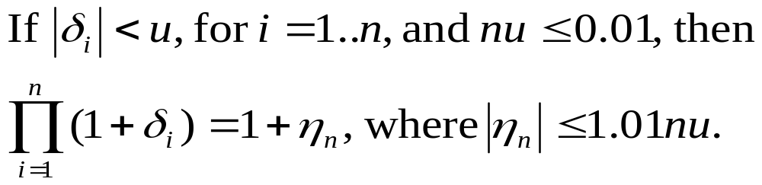
Error Analysis Basics
fundamental units:
  u = ½β^{1-p} = ε_{M} = the unit roundoff.
  [bounds the relative error]
  = smallest number ε such that fl(1 + ε) > 1.
  ulp(x) = gap between x and next larger number when x > 0.
fl(x) = x ( 1 + δ ) = x / ( 1 + δ ) , |δ|< u.

Slide 7
Signed Zero
IEEE numbers include ± Inf, NaN, & ±0.
+0 = -0
x – x = +0,
but – (+0) = -0,
so (–x) != (0 – x)

Slide 8
Cancellation
If subtraction is performed with a guard digit, and y/2 ≤ x ≤ 2y, then x – y is computed exactly.
But, there is loss of information.
The most significant bits cancel.
Move cancellation to original data, e.g.
  Replace a² – b² with (a – b) (a + b)

Slide 9
On/Off-Line Algorithms
Definitions:
An on-line algorithm can begin processing data before it has received all the data.
  e.g. Insertion sort
An off-line algorithm must wait to receive all data before processing can commence.
  e.g. Selection sort

Slide 10
Sorting Limitations
If comparisons of elements are made, the theoretical best worst-case for an n element sorting algorithm is O( n log n )
If no comparisons are made, then some sorts exhibit O( n )-ish performance,
e.g. counting sort, radix sort, bucket sort

Slide 11
General n-1 Operation Sum
Let S = { x₁, …, x_{n}}.
while S contains more than one element
{
  Remove x & y from S
  Add x + y to S
}
___________________________________
Describes recursive, pairwise, & insertion sum algorithms.

Slide 12
Recursive Summation
s = 0
for i = 1..n
  s += x_{i}
____________________
Options:
Increasing order: |x₁| ≤ |x₂| ≤ … ≤ |x_{n}|
Decreasing order: |x₁| ≥ |x₂| ≥ … ≥ |x_{n}|

Slide 13
Pairwise Summation
[also cascade or fan-in summation]
while n > 1 // repeats log2(n) times
{
  for n = 1 .. n/2
    y_{i} = x_{i} + x_{i+1}
  x = y
  n/=2
}

Slide 14
Insertion Summation
Let S = { x₁, …, x_{n}}.
Sort S by increasing magnitude
  (or maintain a heap-based priority queue)
while S contains more than one element
{
  Remove x₁ & x₂ from S
  Insert x₁ + x₂ into S (maintaining sorting)
}

Slide 15
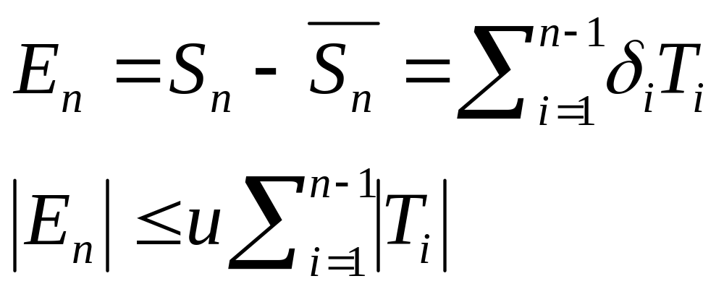
Error Analysis for Summation
Partial Sum T_{i} = (x_{i} + y_{i}) / ( 1 + δ ) , |δ|< u.

Slide 16
Summation Error Analysis Observation
In designing or selecting a summation method to achieve high accuracy, the objective should be to minimize the absolute values of the intermediate sums T_{i}

Slide 17
Summation Error Analysis Implications
For positive terms, increasing recursive summation will exhibit a smaller (better) sequence of partial sums than decreasing.
Add near-cancelling terms in decreasing order. e.g. x = [1, M, 2M, -3M], fl(1+M)=M
Pairwise summation should have significantly fewer large partial sums.

Slide 18
Summation Error Analysis Implication Hybrid Algorithm I
Combining the previous three observations:
Perform insertion summation using decreasing order magnitude summation on cancelling terms only until the negative or positive terms run out.
Perform increasing order insertion summation on remaining (single-sign) terms.
[For single-sign terms, all of close magnitude, this sum will resemble pairwise]

Slide 19
Hybrid [Wolfe’s] Algorithm II
The primary liability of Hybrid Algorithm I is the
O(n log n) sorting penalty.
If we use a O(n) sort to segregate terms into bins of the same sign and comparable magnitude, the initial set of partial sums will be small.
Reinsertion can be efficient if the bins are stack based, and partial sum will be reinserted in its own bin or one higher in the case of same-sign operands.

Slide 20
Hybrid Algorithm III
The limit of Hybrid Algorithm II is for the bins to be indexed by exponent value. There are a couple of benefits to this:
Same-sign operations:
  Reinsertion is trivial : place partial sum in next higher bin.
  Maximum error per partial sum will be < ½ulp.
Opposite–sign operations:
  Reinsertion is O(1): place partial sum by index.

Slide 21
Hybrid Algorithm III Refinement
There is no need now to:
presort the terms
store more than one term per bin (exponent)
Now our summation algorithm is no longer constrained to performing off-line.
We can now operate on-line. Each term will be placed either in an empty bin, or added to the sole resident of the bin, emptying the bin while placing or adding the sum in the next higher bin. The cascades of various lengths will occur. [there will still be only n-1 additions]
[Mixed-sign terms will require bin doubling]

Slide 22
Hybrid Algorithm IV
Let’s consider the case of same-sign summation.
An error occurs only when the least significant bit (l.s.b.) of the partial sum is one, and it is shifted away with an ensuing round.
If we could ensure that the l.s.b. of the partial sum is zero, then the shifted result would be exact.

Slide 23
Hybrid Algorithm IV
We can accomplish this now at the expense of doubling our bins:
partition terms by both exponent & l.s.b.
if new terms enter into a partial sum, it is with another term having the same l.s.b.
place the partial sum in the appropriate one of the two adjacent higher bins based on its l.s.b.
Now, all partial sums will be exact until we exhaust terms to place in bins. Then it remains only to add together the bin contents.

Slide 24
> n-1 Operation Sums:
Compensated Summation
Compensated summation operates on the principle of computing error terms then feeding them back into the sum.

Slide 25
Kahan’s Compensated Summation
a | a1 | a2
+b |  | b1 | b2
=s | a1 | a2+b1
-a |  | b1 | 0
-b |  |  | -b2 | 0 | = -e

Slide 26
Kahan’s Compensated Summation
Algorithm:
s = 0; e = 0;
for i = 1..n
  temp = s;
  y = x_{i} + e;
  e = (temp – s) + y;
s = s + e;

Slide 27
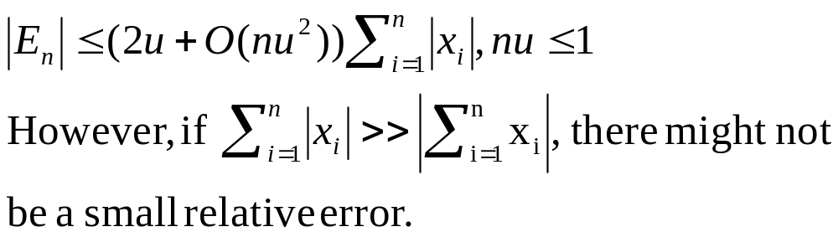
Kahan’s Compensated Summation
Error analysis:

Slide 28
Priest’s “Doubly” Compensated Summation
Algorithm:
Sort the x_{i}, so that |x₁| ≥ |x₂| ≥ … ≥ |x_{n}|
s₁ = x₁; c₁ = 0;
for k = 2..n
  y_{k} = c_{k-1} + x_{k}
  u_{k} = x_{k} – (y_{k} – c_{k-1})
  t_{k} =y_{k}+s_{k-1}
  v_{k} = y_{k} - (t_{k}-s_{k-1})
  z_{k} = u_{k} + v_{k}
  s_{k} = t_{k}+z_{k}
  c_{k} = z_{k} - (s_{k} – t_{k})

Slide 29
Priest’s “Doubly” Compensated Summation
Error analysis:
|Sn – fl(Sn)| ≤ 2u|Sn| if n ≤ β^{p-3}
i.e., the computed sum is accurate to almost full precision.

