Slide 1
Use 36 Font
Use 29 Font

Slide 2
ECEN720: High-Speed Links Circuits and Systems Spring 2021
Lecture 6: RX Circuits

Slide 3
A Good Single-Line Title
For a single-line title
Use Font = Tahoma, Size=41
If the title is too long, then decrease the font to 32
If is still 2 lines with Size=32, then use 2 lines and stick with Size=32
Title should be left-justified
Single-line Title text box position should be Hor = 0.5, Vert = 0.2
To change the position
Right-click on the box and select “Size and Position”
Select “Shape Options”
Click on the right-most black box with the arrows
Select “Position
Type in the Horizontal position and Vertical position

Slide 4
This Title Spans 2 Lines and This is How It Should Look
For a single-line title
Use Font = Tahoma, Size=41
If the title is too long, then decrease the font to 32
If is still 2 lines with Size=32, then use 2 lines and stick with Size=32
Title should be left-justified
Single-line Title text box position should be Hor = 0.5, Vert = 0.4
You can adjust the first and second line length to be roughly the same length and/or have a logical separation

Slide 5
Main Text Box
The text box position should be Hor=0.4, Vert=1.4
Use Font=Tahoma, Ideally Size = 32 but you may need to make smaller depending on how much is on the slide
Make sure you have the nice Maroon circle bullets for the main and sub-bullets
Make sure the sub-bullet has the nice Maroon circle

Slide 6
Text in the Main Text Box
It looks best to have the text in a text-only slide to fill the page
Thus, you can put empty lines between the text lines
These lines can either be same size as the main text font you are using, OR use a smaller Font = 8 for the separating lines
This slide is a example of using the smaller Font=8 lines for the empty separating lines

Slide 7
Text in the Main Text Box
It looks best to have the text in a text-only slide to fill the page
These lines can either be same size as the main text font you are using, OR use a smaller Font = 8 for the separating lines
This slide is a example of using the same size lines for the empty separating lines

Slide 8
Outline
Receiver parameters
T-coils at RX examples
Analog front-end
Clocked comparators
Sensitivity & offset correction
Demultiplexing
PAM4 RX example

Slide 9
Slide with Top Figure
[Pisati ISSCC 2019]
The figure should be on the top for the VAST MAJORITY of the cases
I don’t like to see the figures on the bottom!
The text box position should be Hor = 0.4, Vert = Depends on the figure size

Slide 10
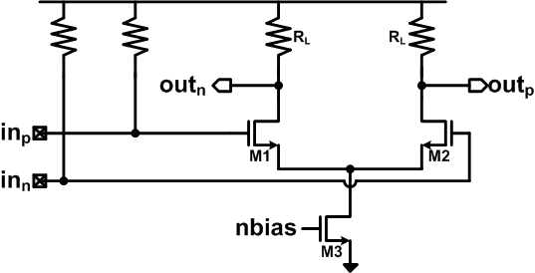
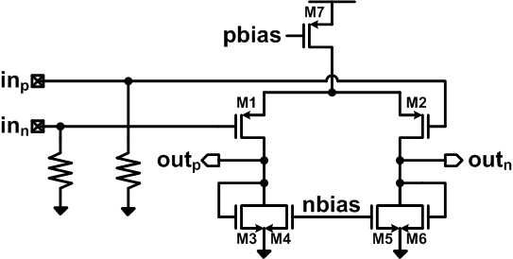
Slide with Right Figure
The slide should be on the right for the VAST MAJORITY of the cases
I don’t like to see the figures on the left!
The text box position should be Hor = 0.4, Vert = 1.4

Slide 11
Conclusion
AFE provides equalization and gain stages to optimize the signal for symbol detection (mixed-signal RX) or quantization (ADC-based RX)
Gm-TIA and inverter-based front-ends allow for higher gain with shrinking supply voltages
Achieving good RX sensitivity requires careful front-end noise analysis and sampler offset correction
Higher input stage demultiplexing relaxes clock frequencies at the cost of front-end loading and clock phase generation
PAM4 receivers require extra threshold adaptation

