Slide 1
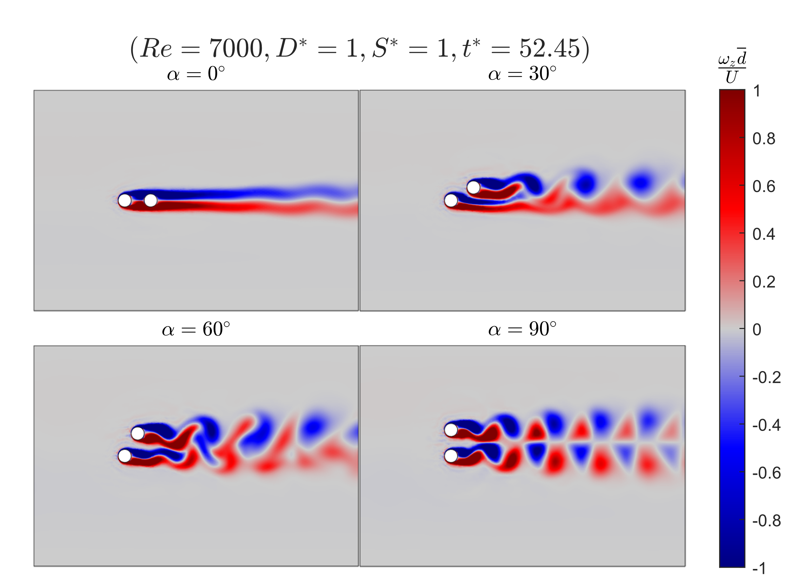

Slide 2
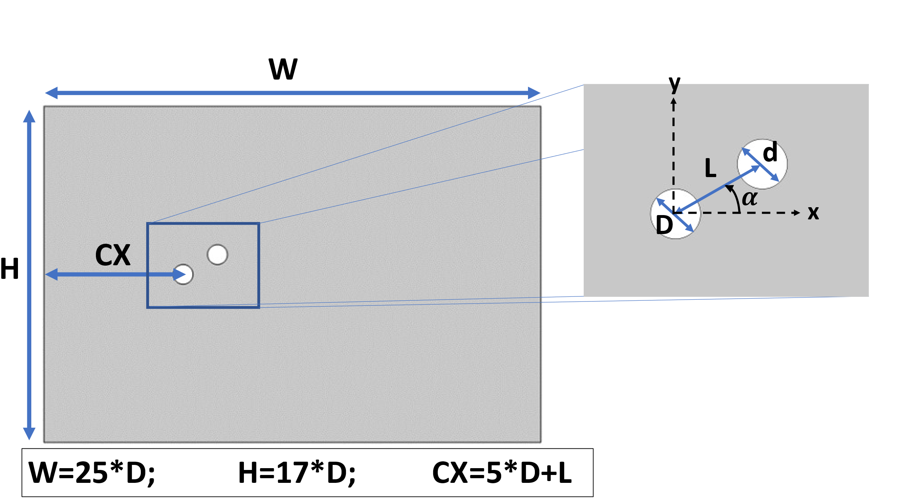

4.2 Model setup and geometry of the problem
Resolve the viscous sublayer $δ=\frac{d}{\sqrt{Re} }$
Notes:
The computational domain selected for the two cylinder simulations has a width of 25 diameters. An Inlet height of 17 diameters. And the mooring line cylinder is placed 5 diameters away plus the length between the two cylinders.
The larger mooring line cylinder diameter is shown with a capital D and the smaller hydrophone cylinder is shown as a lower case d. The angel between the axis created between the centers of each cylinder and the free stream velocity is denoted as alpha. The length between the centers of the cylinders is denoted as L.

