Slide 1
Rare Species Posting and Reviewing
Andrey Andreev
№ 62173

Slide 2
Description
(RSPR) is a system where people can post, rate and comment different posts for rare species.

Slide 3
Technologies
Frontend
  Thymeleaf
  Bootstrap 4.0
Backend
  SpringMVC
  MySQL

Slide 4
REST API
Users
  Tokens
  Personal Information
Posts
Comments

Slide 5
Frontend Views
Guest
  Home, Login, Register, Activate, About
User
  User Information/View User/Post(View/Edit/New)/Comment
Admin
  Manage Users

Slide 6
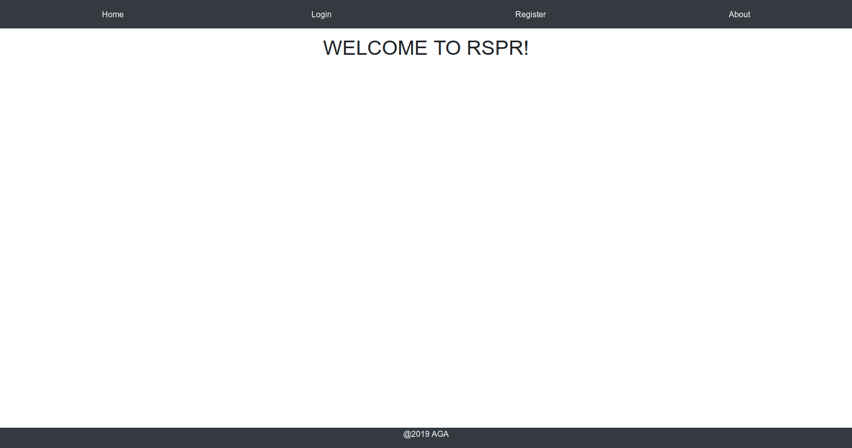
Home

Slide 7
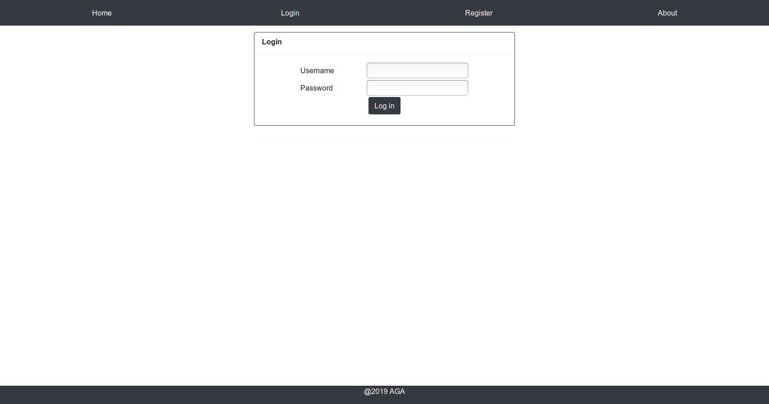
Login

Slide 8
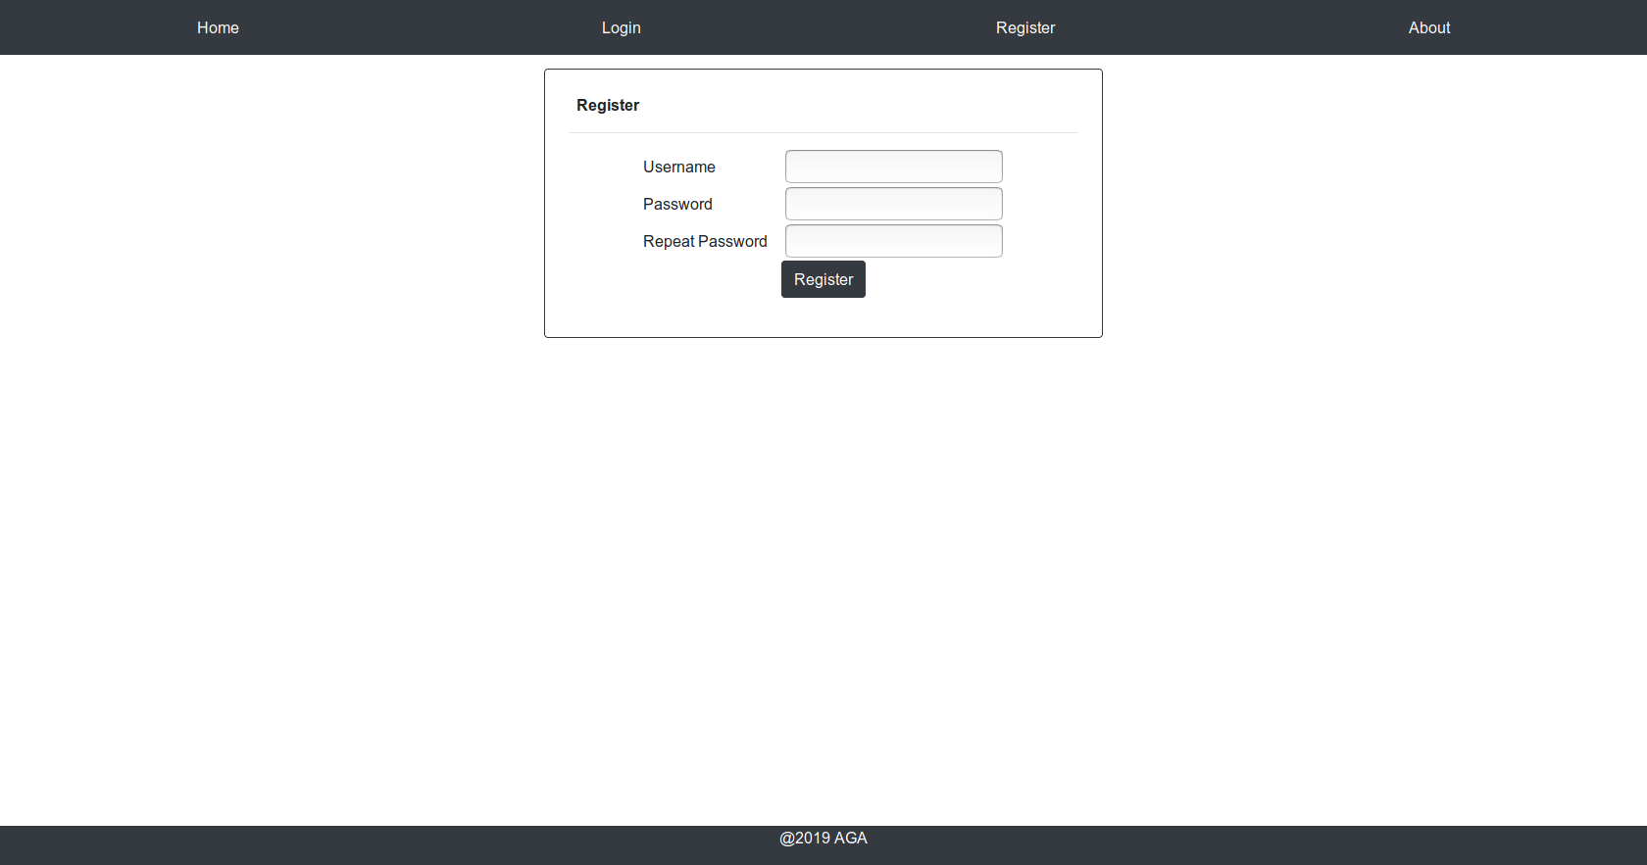
Register

Slide 9
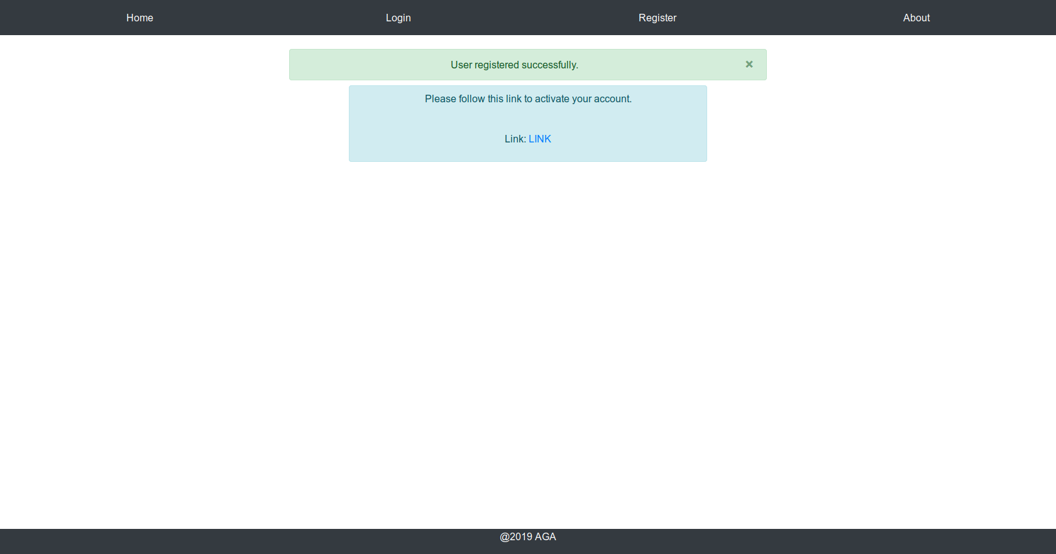
Activate User

Slide 10
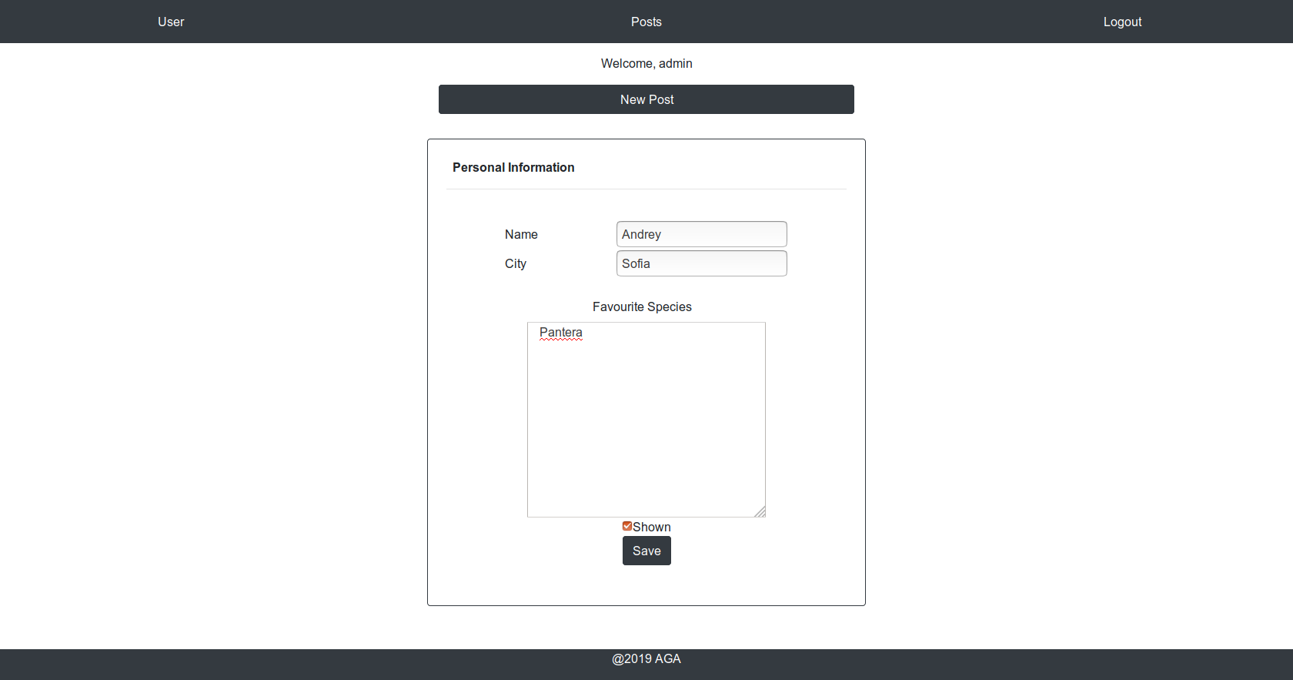
User Information

Slide 11
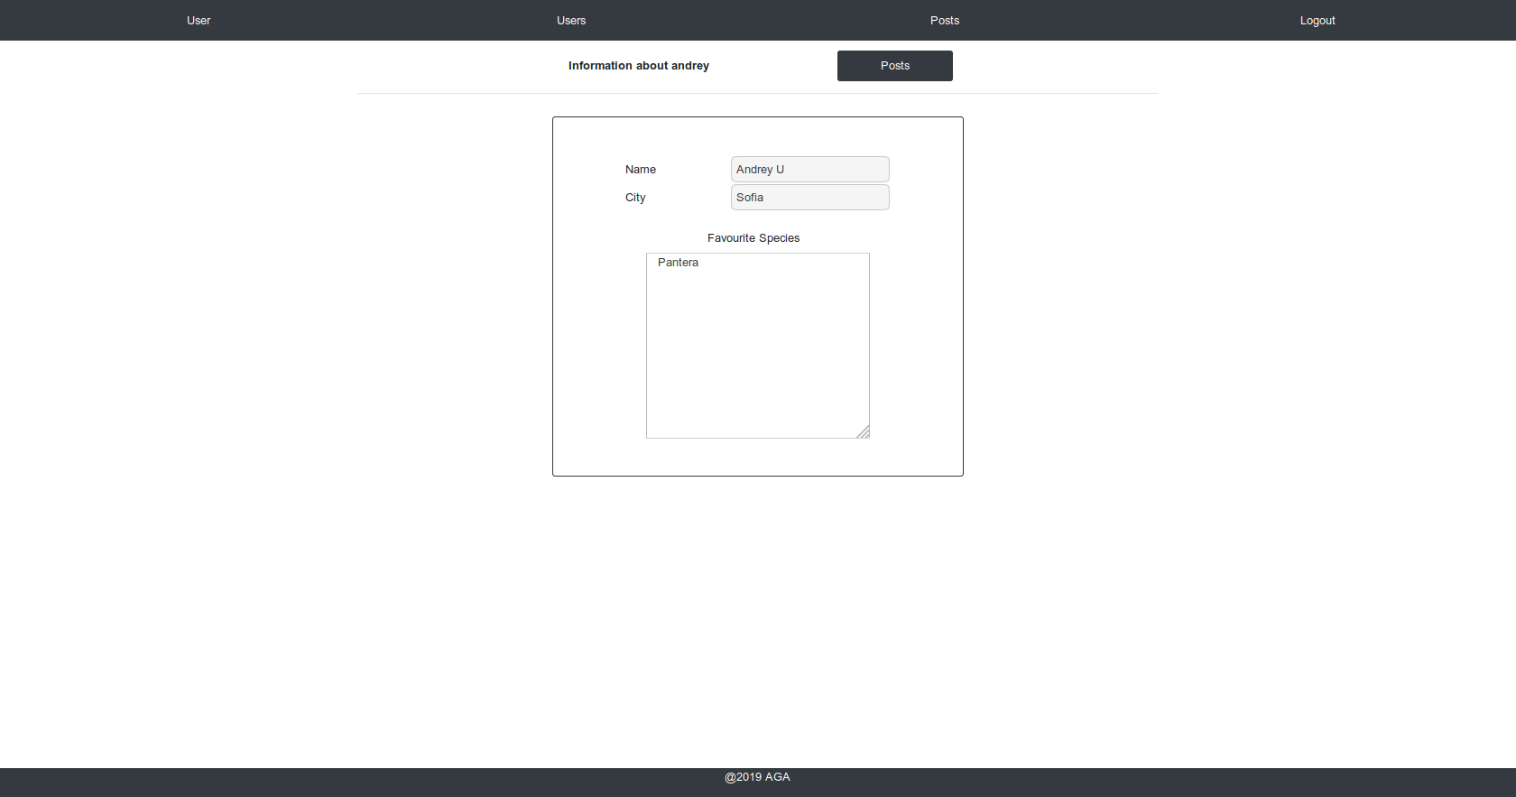
User view

Slide 12
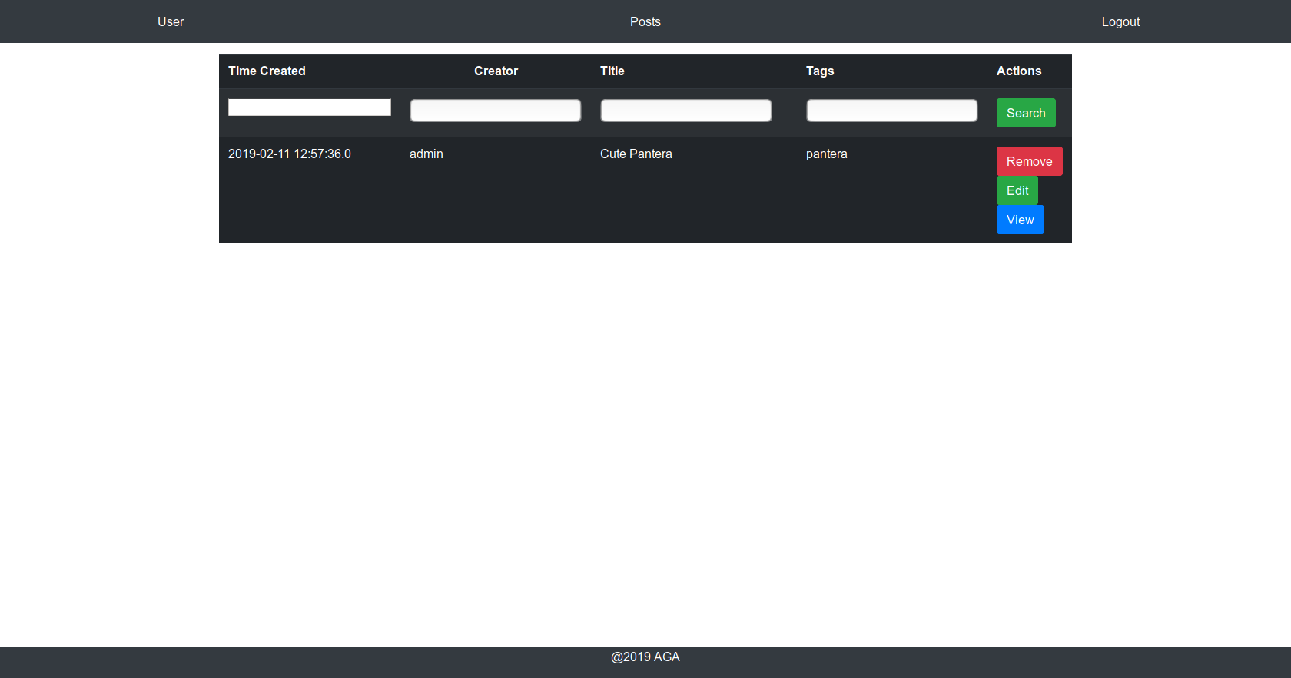
Posts View

Slide 13
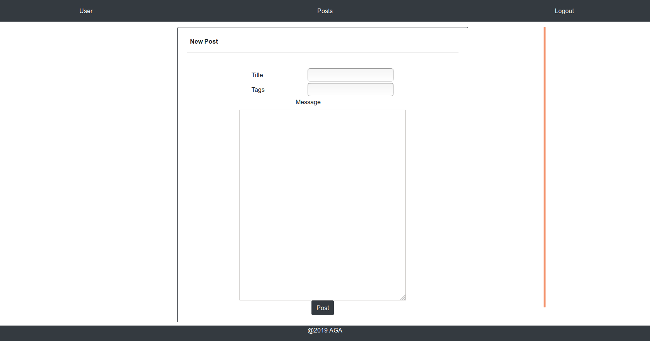
Post Creation

Slide 14
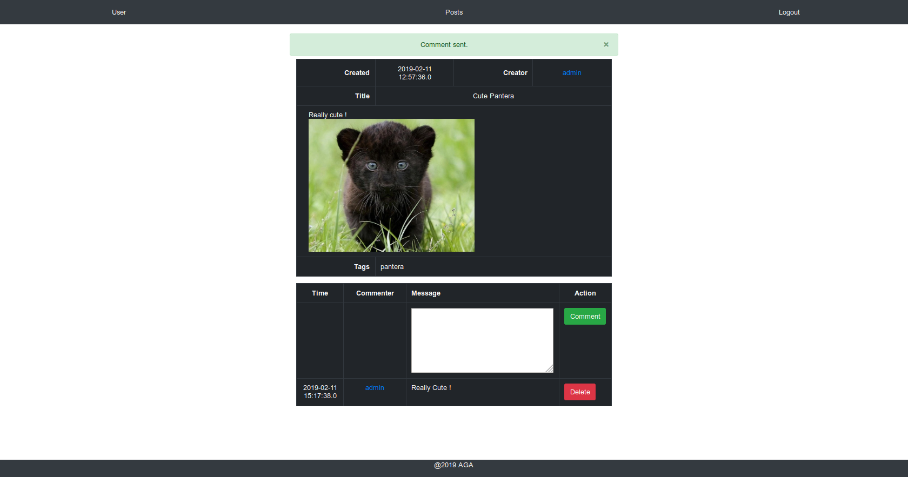
Post/Comment View

Slide 15
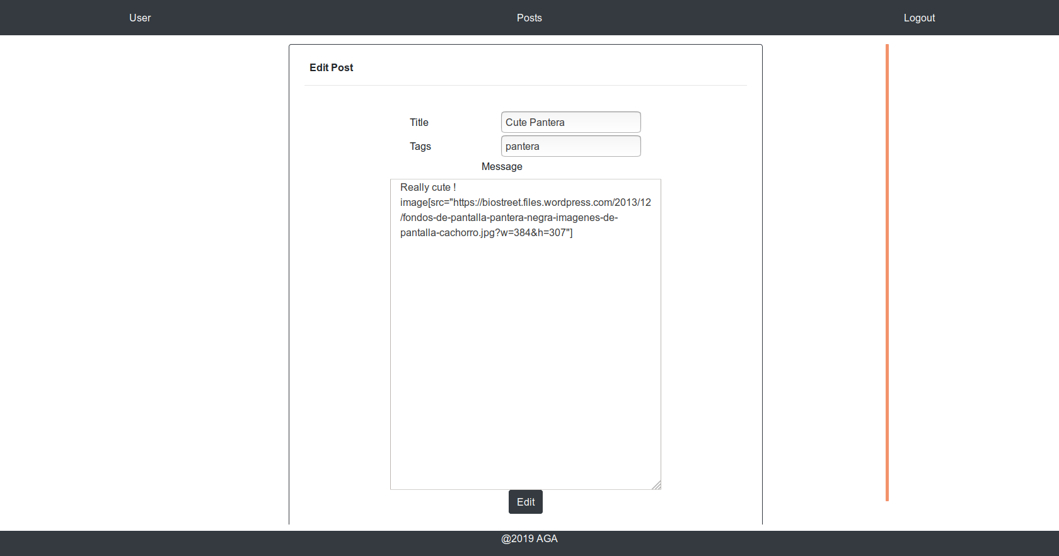
Edit Post

Slide 16
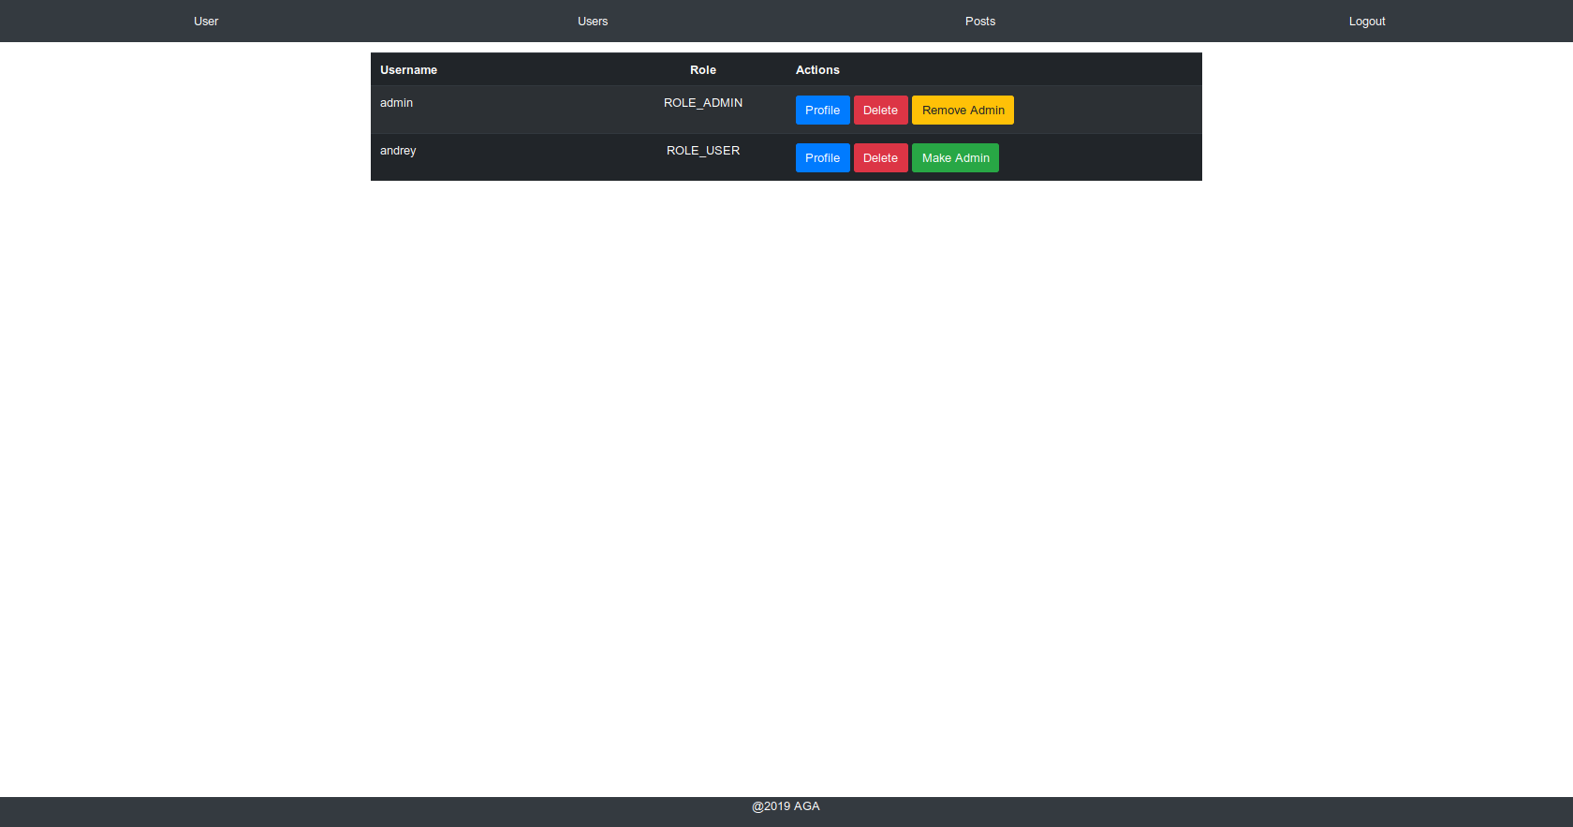
Admin Users management

Slide 17
Questions ?

