Slide 1
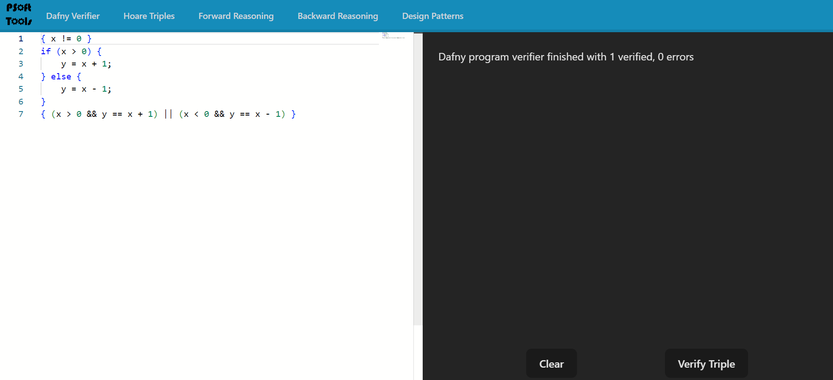
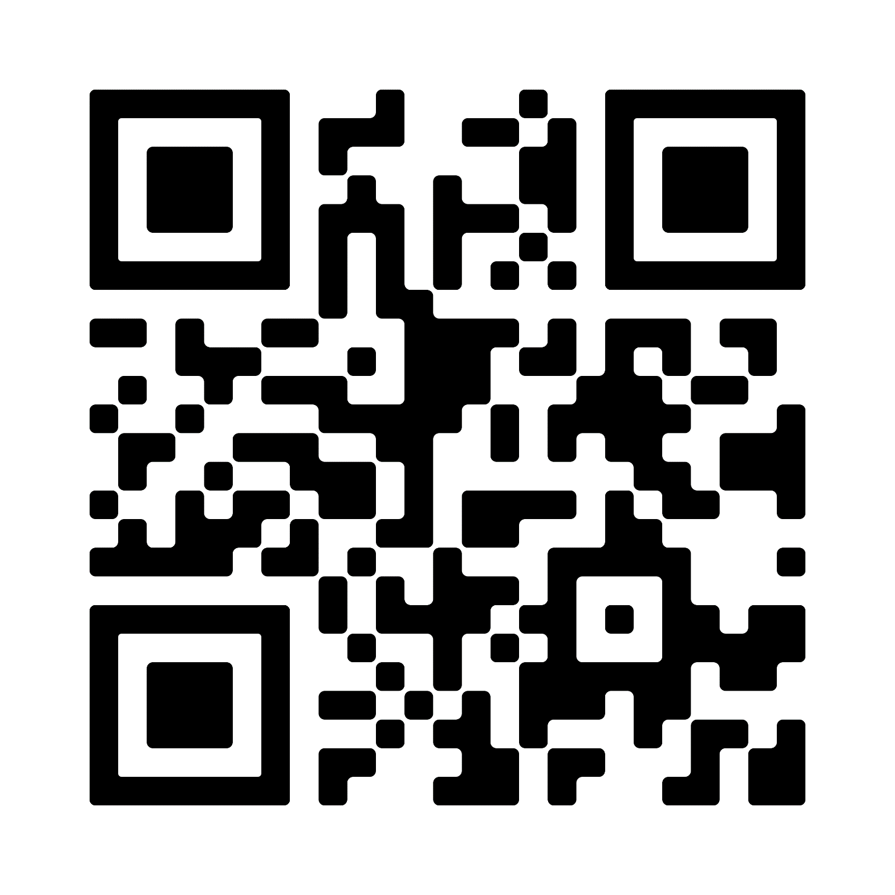
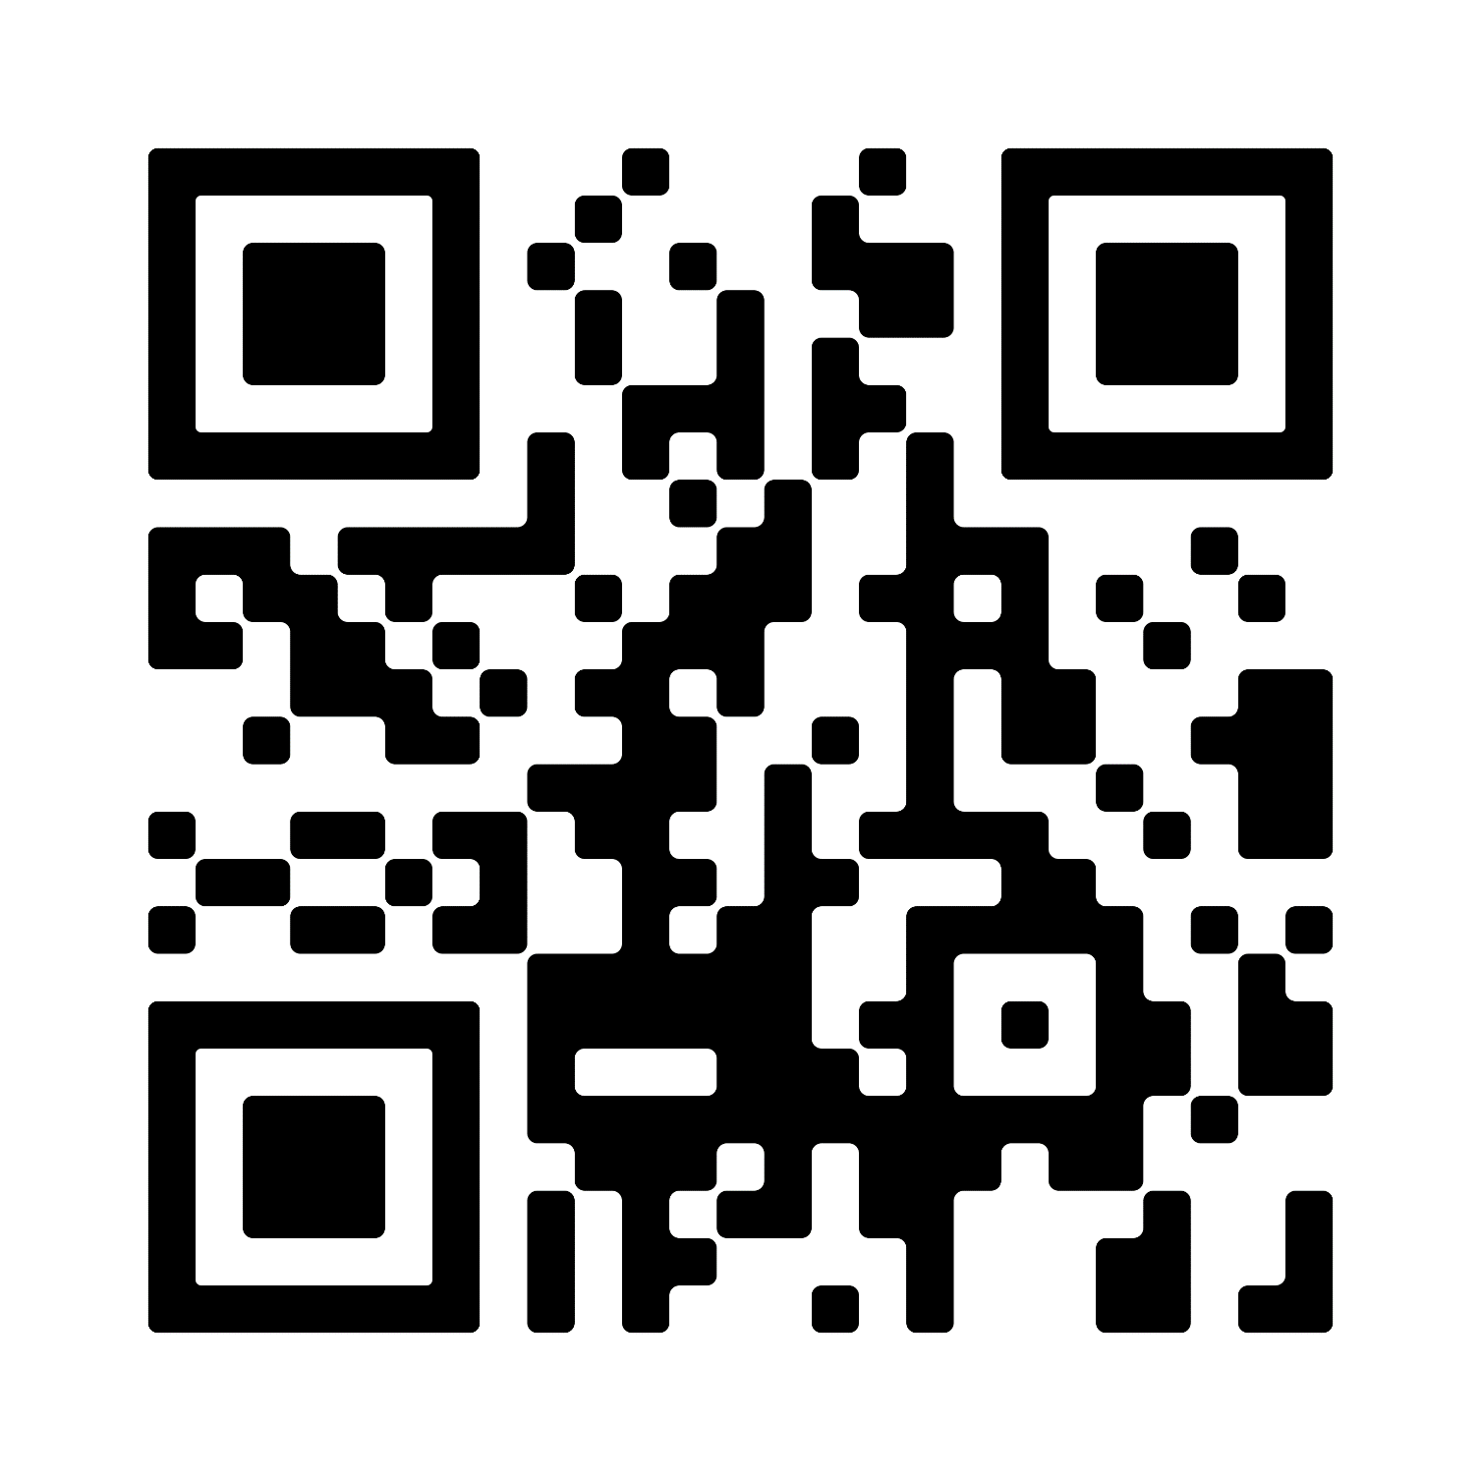
PSOFT TOOLS
Ryan Carroll, Luke Kissling, Thalia Jackson
RCOS Summer 2024
FRONT END
PSOFT TOOLS
BACK END
CHALLENGES
Our accomplishments this semester
Changed the overall theme of the website to look closer to the PSoft website
Added pages for design patterns
Changed the formatting of Hoare Triple output
Began working on new logo
Interactive Web Tools for Students Taking Principles of Software
Tech Stack
Front end: React, Vite, Tailwind
Back end: Express.js
Goals
Provide a useful tool for students taking Psoft
Implement tools for Hoare triples, forward and backwards reasoning, and CFGs
Host the website on a server so it can be accessed by students
Improve the appearance of the website
Our accomplishments this semester
Completed Hoare Triple verification
Started forward and backwards reasoning
None of the people working on the project this semester had any web dev experience
Forward and backwards reasoning is difficult to implement, especially when the code contains if statements
Simplifying in forward and backwards reasoning is difficult
FUTURE PLANS
Front end
Continue to improve the overall appearance of website
Finish the pages for design patterns
Back end
Finish forward and backwards reasoning
Implement CFG generator
Front end
Back end

