Slide 1

made with VoiceMint

Slide 2

made with VoiceMint

Slide 3
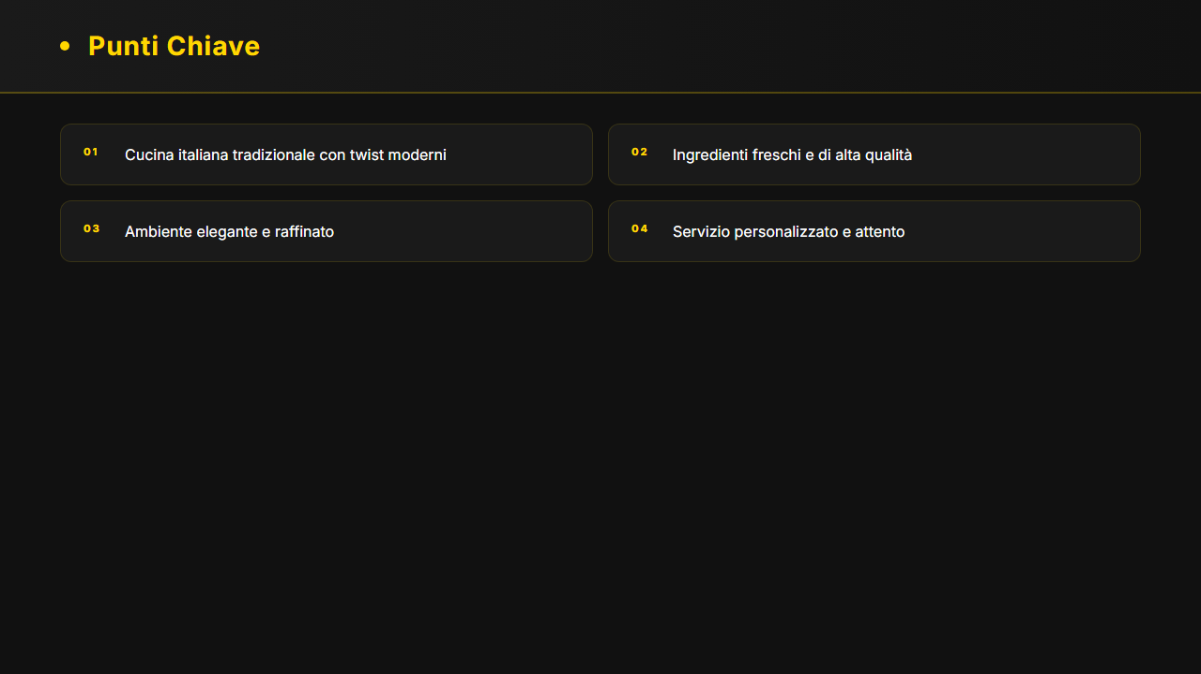
made with VoiceMint

Slide 4
made with VoiceMint

Slide 5
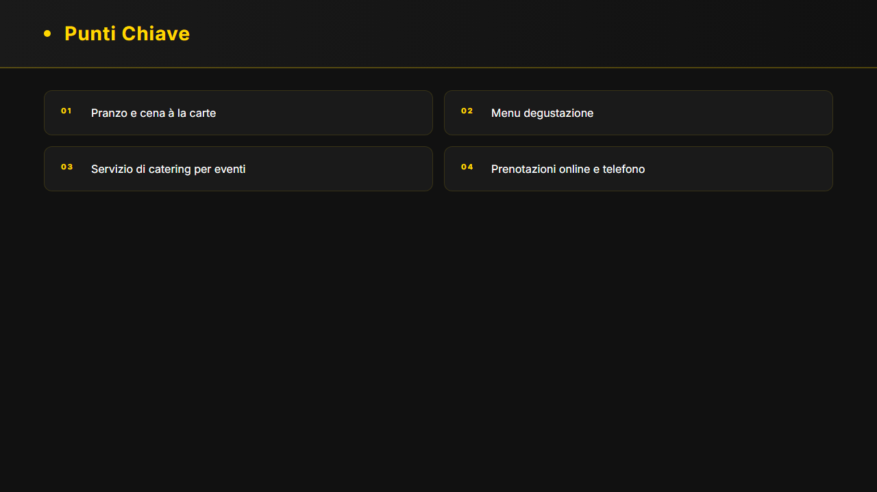
made with VoiceMint

Slide 6
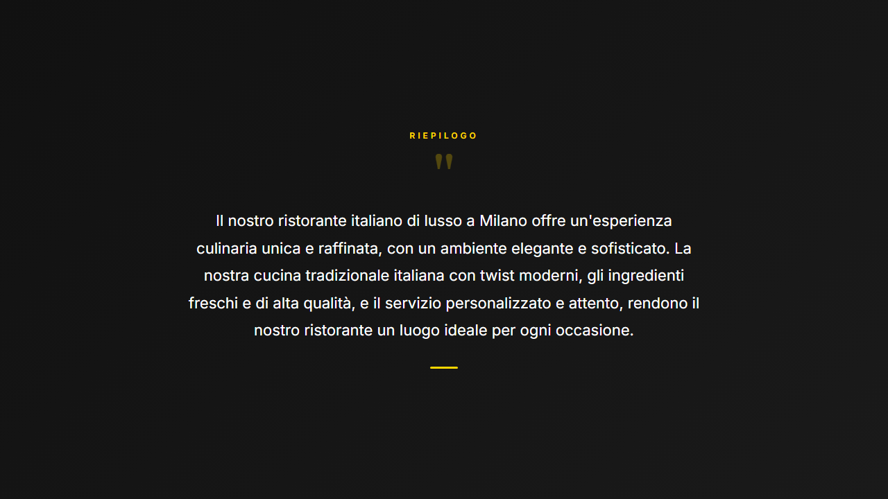
made with VoiceMint

