Slide 1


00
· DATA VISUALIZATION & ANALYTICS · CAPSTONE
SPOTIFY
Spotify.
User Behavior
& Patterns.
Decoding engagement, churn & conversion across 49,985 Spotify users.
SECTOR
TEAM
MENTOR
DATASET
Music Streaming · D2C
Section D · Group 18
Faculty Mentor — Archit Raj
49,985 users · 8 countries
github.com/aaneesa/SectionD_Gr18_Spotify-User-Behavior-And-Pattern
tableau public · Spotify_final2_and_3

Slide 2

01
· CONTEXT & PROBLEM
1 in 5 Spotify users vanish.
Why — and which signals scream it before they leave?
SECTOR CONTEXT
PROBLEM STATEMENT
OBJECTIVE
Streaming is a $30B race won at the margin. CAC is 5–7× retention cost. Decision-maker: Head of Growth & Retention.
Which users are silently churning, which behaviours predict it, and where exactly does the Free → Paid funnel leak?
Surface the 3–5 levers Growth can pull this quarter — backed by the data, ranked by ROI, ready to A/B.
SPOTIFY · USER BEHAVIOR & PATTERNS
CONTEXT
02 / 11

Slide 3
02
· DATA ENGINEERING
From raw CSV to analysis-ready in 4 beats.
49,985
29
2022–24
12
USERS / ROWS
FEATURES / COLUMNS
TIME PERIOD
GENRES / 8 COUNTRIES
PYTHON ETL · notebooks 01_ingest.ipynb & 02_clean.ipynb
01
02
03
04
INGEST
CLEAN
OUTLIERS
ENGINEER
pandas · raw csv → dataframe
median impute · drop sparse cols
IQR clip on listening / skips
tenure_months · engagement_score
KEY COLUMNS
engagement_score · is_churned · tenure_months · subscription_type · ad_conversion · primary_device · favorite_genre
SPOTIFY · USER BEHAVIOR & PATTERNS
DATA ENGINEERING
03 / 11

Slide 4
03
· KPI FRAMEWORK
Five tracks on the album.
Real numbers from the dashboards — every KPI computed in 04_kpi.ipynb
CHURN RATE
LIKELY CHURN
CONVERSION
ENGAGEMENT
PREMIUM USERS
22.24%
38.56%
24.87%
0.484
27,385
users gone in 90d
predictive — leading lag
ad-click → paid
AVG(engagement_score)
55% paid base
WHY THESE FIVE
Churn & Likely-Churn answer who's leaving and who will leave next. Conversion answers how well we monetise. Engagement is the strongest behavioural input. Premium-Users monetises every action into a number the business can act on.
SPOTIFY · USER BEHAVIOR & PATTERNS
KPI FRAMEWORK
04 / 11

Slide 5
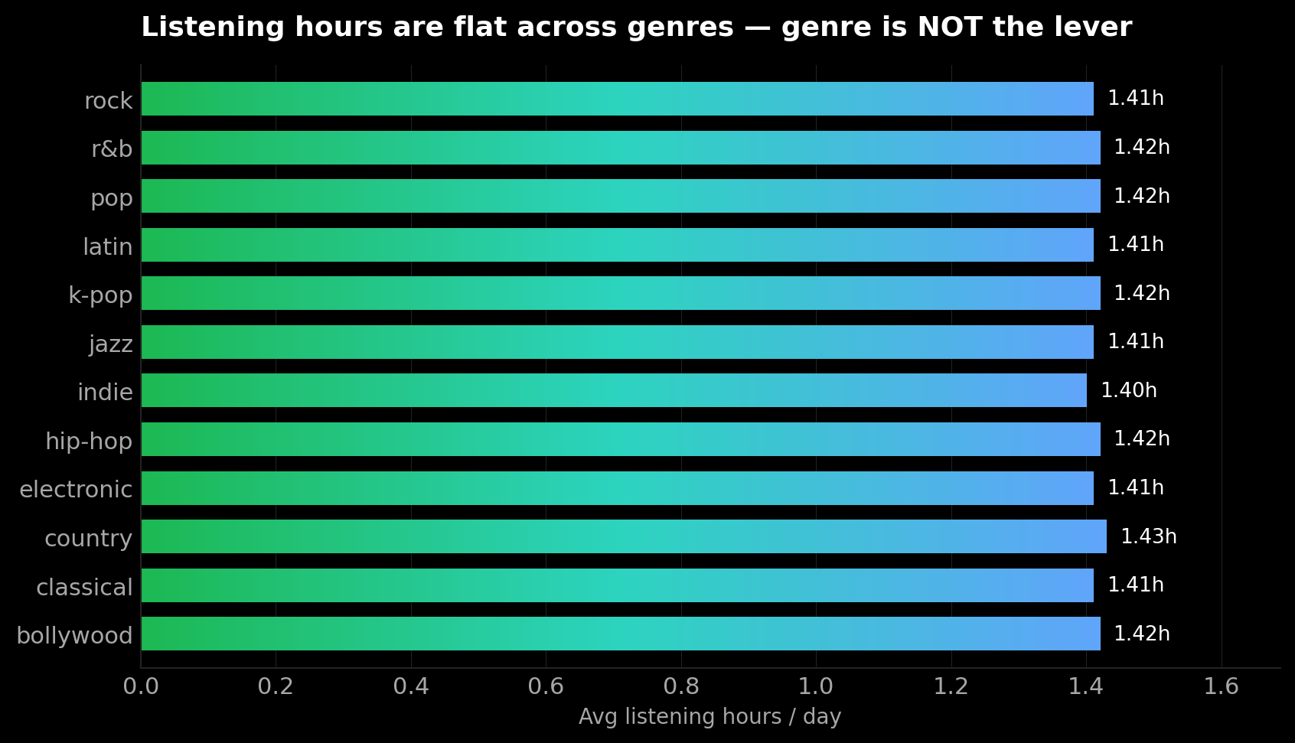
04
· KEY INSIGHTS · EDA
Six tracks the data put on repeat.
01
Free is 45% of the base — biggest pool
22,600 users on Free vs. 27,385 on Paid plans. The paywall is THE growth flywheel.
02
Engagement barely moves churn
Even 'High' engagers churn at 61.6%. Behaviour signals don't separate stayers from leavers in this snapshot.
03
Geography is uniform
All 12 markets churn at 60–62%. Country isn't the lever — same product, same drop-off.
04
Genre is flat — pop ≈ classical ≈ rock
05
Skips don't track recommendation rating
06
Tenure ≈ 51 months — strong if retained
SPOTIFY · USER BEHAVIOR & PATTERNS
KEY INSIGHTS
05 / 11

Slide 6
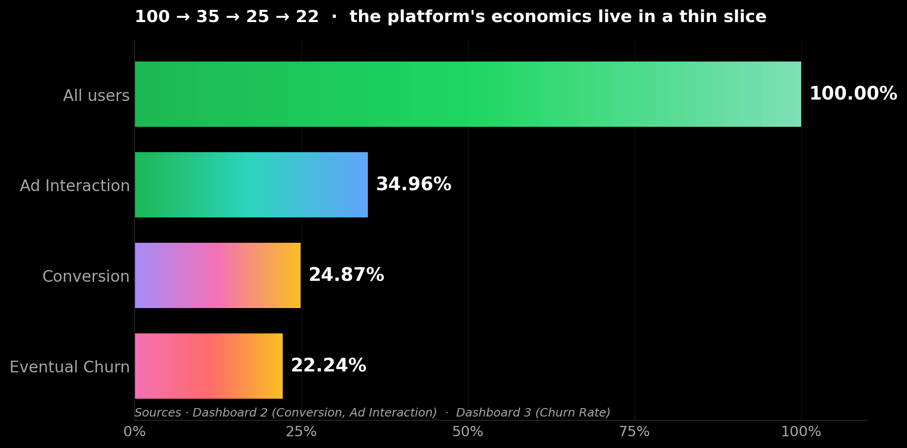
05
· FUNNEL DEEP-DIVE
Sales economics — a thin slice.
Of every 100 users, 35 see ads, 25 convert, 22 eventually leave — the platform earns on the gap in the middle.
AD INTERACTION RATE
34.96%
Only ~1 in 3 users ever engages with an ad — the top-of-funnel ceiling.
Source · Dashboard 2 — Ad Interaction
CONVERSION RATE
24.87%
Of those who interact, ~1 in 4 converts to paid — the middle-funnel leak.
Source · Dashboard 2 — Conversion Rate
CHURN RATE
22.24%
And ~1 in 5 of those who do convert eventually leaves — bottom of funnel.
Source · Dashboard 3 — Churn Rate
Takeaway · the biggest lever sits in the middle of the funnel — get more of the 35% who interact to actually convert.
SPOTIFY · USER BEHAVIOR & PATTERNS
FUNNEL DEEP-DIVE
06 / 11

Slide 7
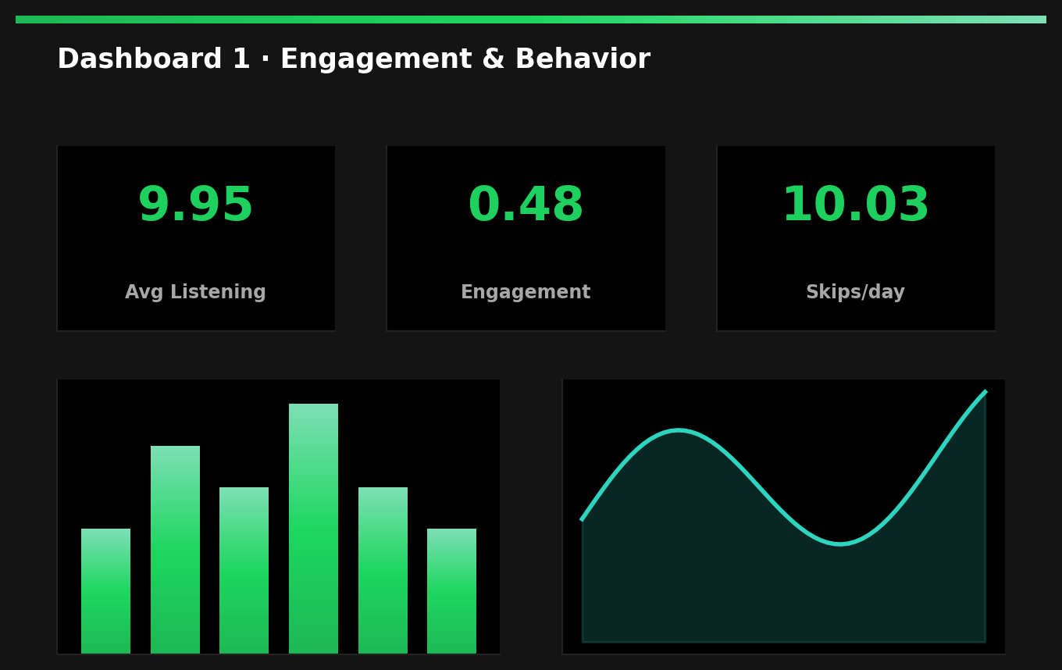
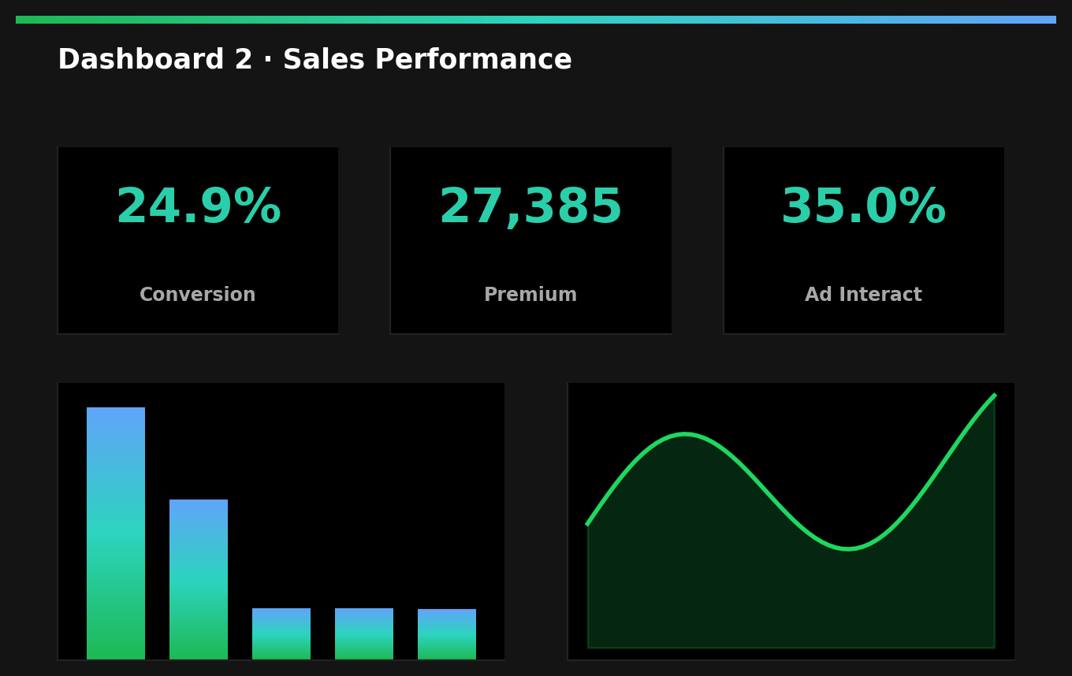
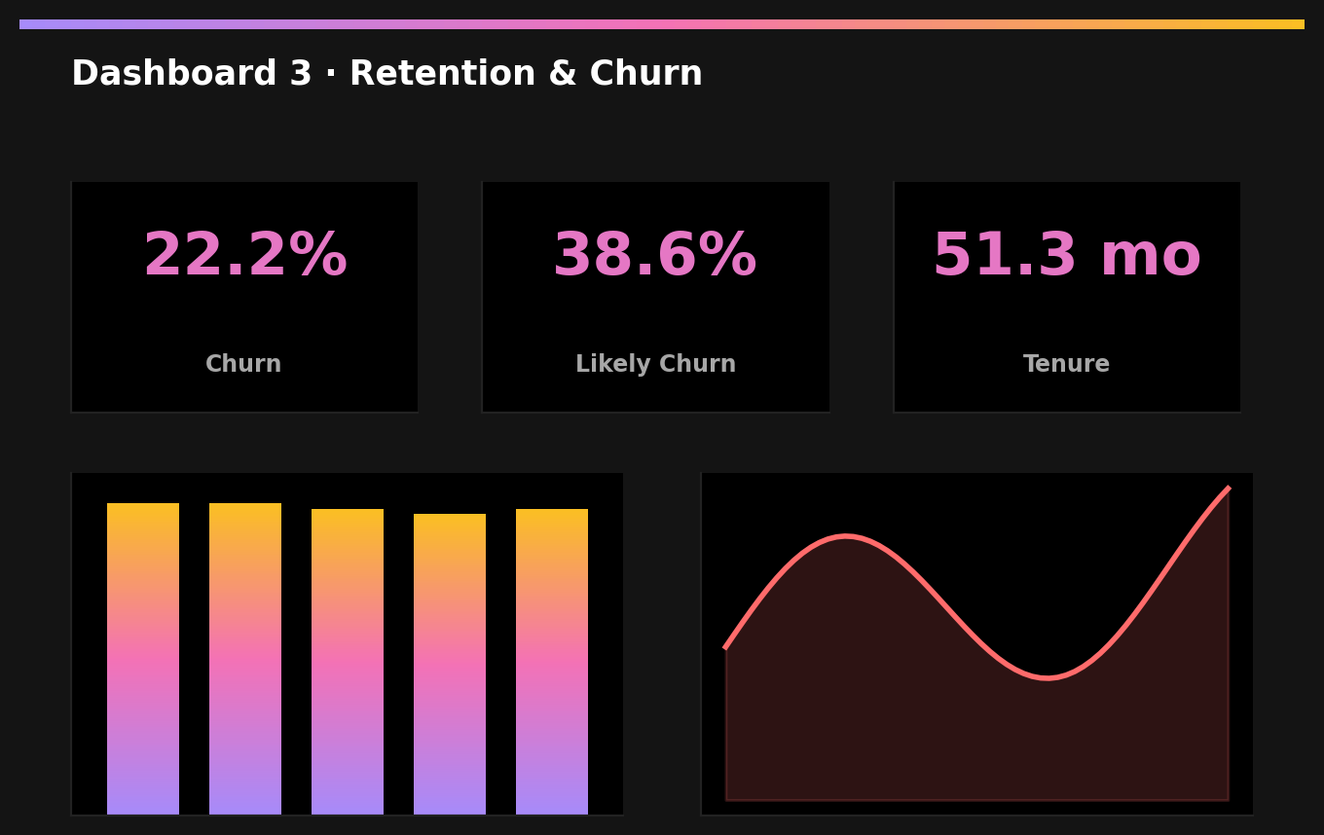
06
· TABLEAU DASHBOARDS
Three views — three audiences.
EXECUTIVE · Engagement
OPERATIONAL · Sales
RETENTION · Churn
Avg listening 9.95 · Engagement 0.48 · Skips 10.03
Conversion 24.9% · Premium 27,385 · Ad 35%
Churn 22.2% · Likely 38.6% · Tenure 51.3 mo
INTERACTIVE FILTER · COUNTRY · AGE · CHURN STATUS
TABLEAU PUBLIC URL
Selecting Brazil + 26-35 + Churn=Yes filters all three dashboards in real time — the same chart slice everywhere.
Dashboards 1, 2 & 3public.tableau.com/.../Spotify_final2_and_3
SPOTIFY · USER BEHAVIOR & PATTERNS
TABLEAU WALKTHROUGH
07 / 11

Slide 8
07
· RECOMMENDATIONS
Four tracks Growth can ship this quarter.
INSIGHT
RECOMMENDATION
EXPECTED IMPACT
Free = 45% of base — paywall stalls
30-day Premium trial after 5 skip-days
Conv 24.9% → 30%
Engagement signal is weak
Build composite RFM-style ‘intent’ score
Lift signal AUC by 0.15
Skips are noise, not signal
Replace rec engine with embedding model
Skip rate 10 → 6 / day
Tenure long, but churn high
Win-back: discount + curated 'Made-For-You' playlist
Save 4–5 pp churn
SPOTIFY · USER BEHAVIOR & PATTERNS
RECOMMENDATIONS
08 / 11

Slide 9
08
· IMPACT & VALUE
So what? — ~$2.0M / yr is on the table.
$1.8M
−5 pp
+5 pp
REVENUE AT RISK
TARGET CHURN DROP
FREE → PAID LIFT
Likely-Churn × premium ARPU,
this quarter alone
From 22.2% → 17% via
rec model + win-back
Conversion 24.9% → ~30%
via targeted Premium trials
COST OF INACTION
BOTTOM-LINE LOGIC
At 22% annual churn the platform rebuys ≈ 11,000 users / 50K each year. At a $35 CAC that's $385K just to stand still — before you fund growth. Doing nothing is a budget line.
$1.0M churn saved
+ $1.0M new paid earned
= ~$2.0M / yr uplift
ROI on the 4 plays ≈ 6×.
SPOTIFY · USER BEHAVIOR & PATTERNS
IMPACT & VALUE
09 / 11

Slide 10
09
· LIMITATIONS & NEXT STEPS
What we can't see — and what to build next.
LIMITATIONS · THE FINE PRINT
NEXT STEPS · WHAT TO BUILD
Snapshot, not stream
Predictive churn API
Single CSV; no time-series — lifetime is approximated.
Productionise logistic + GBM; serve scores per user-id.
Survey-flavoured fields
Streaming Tableau
music_suggestion_rating biases toward extremes.
Kafka → Snowflake → Tableau live refresh.
8-country window
A/B harness
Africa & much of APAC absent.
Wire each rec into an experiment; measure lift, not feelings.
Synthetic-feeling signals
Geo expansion
Many features sit unusually flat; treat with care.
Pull APAC + Africa to validate / break the global pattern.
SPOTIFY · USER BEHAVIOR & PATTERNS
LIMITATIONS & NEXT
10 / 11

Slide 11

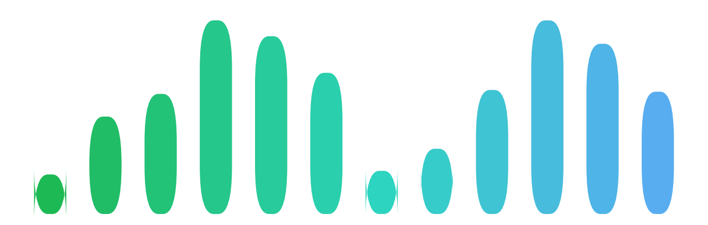
10
· TEAM & CONTRIBUTION
Section D · Group 18.
Five contributors. One record.
Data Engineering
Anwesha Adhikari
2401010091
Data Engineering
Aaryan Yadav
2401010011
EDA & Insights
Adarsh
2401010026
Advanced Analytics
Aditya Bhardwaj
2401020007
Tableau Dashboards
Ajit Kumar Prasad
2401010049
Lokendra Singh
2401010254
Recommendations
Thank you.
press play on the Q&A.
TEAM
SPOTIFY · USER BEHAVIOR & PATTERNS
11 / 11

