Slide 1





CANADIAN AI 2026
39th Canadian Conference on Artificial Intelligence
PAPER 210
A Meta-Analysis of Evaluation Framework
Reliability and Cross-Domain Generalization
Asif Ahmed Neloy
MD Nazmul Islam
Senior AI Engineer, Delta Controls
Adjunct Professor, Faculty of Land and Food Systems
University of British Columbia
Instructor, Computer Systems Technology
University Studies, Keyano College
asif.neloy@ubc.ca
View code, paper, and interactive slides on GitHub
01

Slide 2
MOTIVATION
A faithfulness score matters only when the evaluator is reliable
Retrieved context
Generated answer
Faithfulness score
>
>
Evidence selected for the question.
The answer should remain grounded in context.
The score supports research and deployment claims.
Paper scope
Reliability question
Faithfulness asks whether the answer is supported by the retrieved context.
Do different frameworks give compatible conclusions on the same answer?
Talk focus
The paper tests the measurement tools used to judge RAG faithfulness.
02

Slide 3
PROBLEM
The evaluation ecosystem makes interchangeability a testable assumption
LLM-as-judge
NLI based
Embedding and QA
Interpretability
Prompted judge model
Claim entailment
Semantic overlap
Context reliance signals
If these frameworks measure the same construct, scores should align on identical inputs.
- Prior work validates individual tools or compares small subsets.
- This paper asks whether framework choice is interchangeable across the broader ecosystem.
03

Slide 4
CONTRIBUTION
The paper tests faithfulness frameworks under matched conditions
Twenty frameworks, the same 200 question-context-answer triples, three domains.
Gaps
Contributions
- No comprehensive pairwise agreement study on identical RAG inputs.
- No matched test across general knowledge, finance, and biomedicine.
- Formal heterogeneity analysis remains rare in RAG evaluation.
- Controlled reliability comparison of twenty frameworks.
- Meta-analytic heterogeneity and pairwise agreement analysis.
- Three clusters plus domain, human, and consensus analyses.
04

Slide 5
DEFINITIONS
The study narrows faithfulness before it measures reliability
Working definition of faithfulness
Every claim in the answer is entailed by context X, and no claim contradicts X.
Excluded from this definition
Meta-analysis for reliability
Completeness, fluency, and relevance to the query.
Cochran's Q and I-squared test whether variation across instruments exceeds sampling error.
Why this axis
Faithfulness is the property all twenty frameworks claim to measure.
05

Slide 6
STUDY DESIGN
Twenty frameworks span the paper's framework set
Group
Frameworks
LLM-as-judge
RAGAS, G-Eval, DeepEval, FaithJudge
NLI based
RAGChecker, HALT-RAG
Embedding and QA
BERTScore, UniEval, QAFactEval
Token and classifier
TRACe, ARES, LettuceDetect
Interpretability
ReDeEP, LRP4RAG, LUMINA, HSAD, SIRG
Other
GaRAGe, MetaRAG, KG-RAG
Coverage
The study spans six years of development, from 2020 through 2026.
06

Slide 7
STUDY DESIGN
Every framework sees the same 200 RAGBench samples
General Knowledge
Finance
Biomedicine
67
67
66
HotpotQA, MS MARCO, HAGRID
FinQA, DelucionQA
CovidQA, PubMedQA
- Each framework sees the same question-context-answer triples.
- The stratified sample separates domain effects from framework behavior.
Controlled by design
Score differences can be studied under matched inputs.
07

Slide 8
STUDY DESIGN
The analysis moves from scores to reliability evidence
01
02
03
04
Score matrix
>
Agreement
>
Structure
>
Interpretation
Twenty primary scores
Correlations and heterogeneity
Clusters and domains
Human subset and consensus
Protocol
Statistics
- Official default configurations
- DeepSeek-V3 judge at temperature 0
- DeBERTa-v3-large for NLI methods
- Primary scores min-max normalized to [0, 1]
- Pearson and Spearman with 1,000 bootstrap resamples
- Cochran's Q and I-squared
- Ward clustering and domain effects
- Cross-cluster consensus and human validation
08

Slide 9
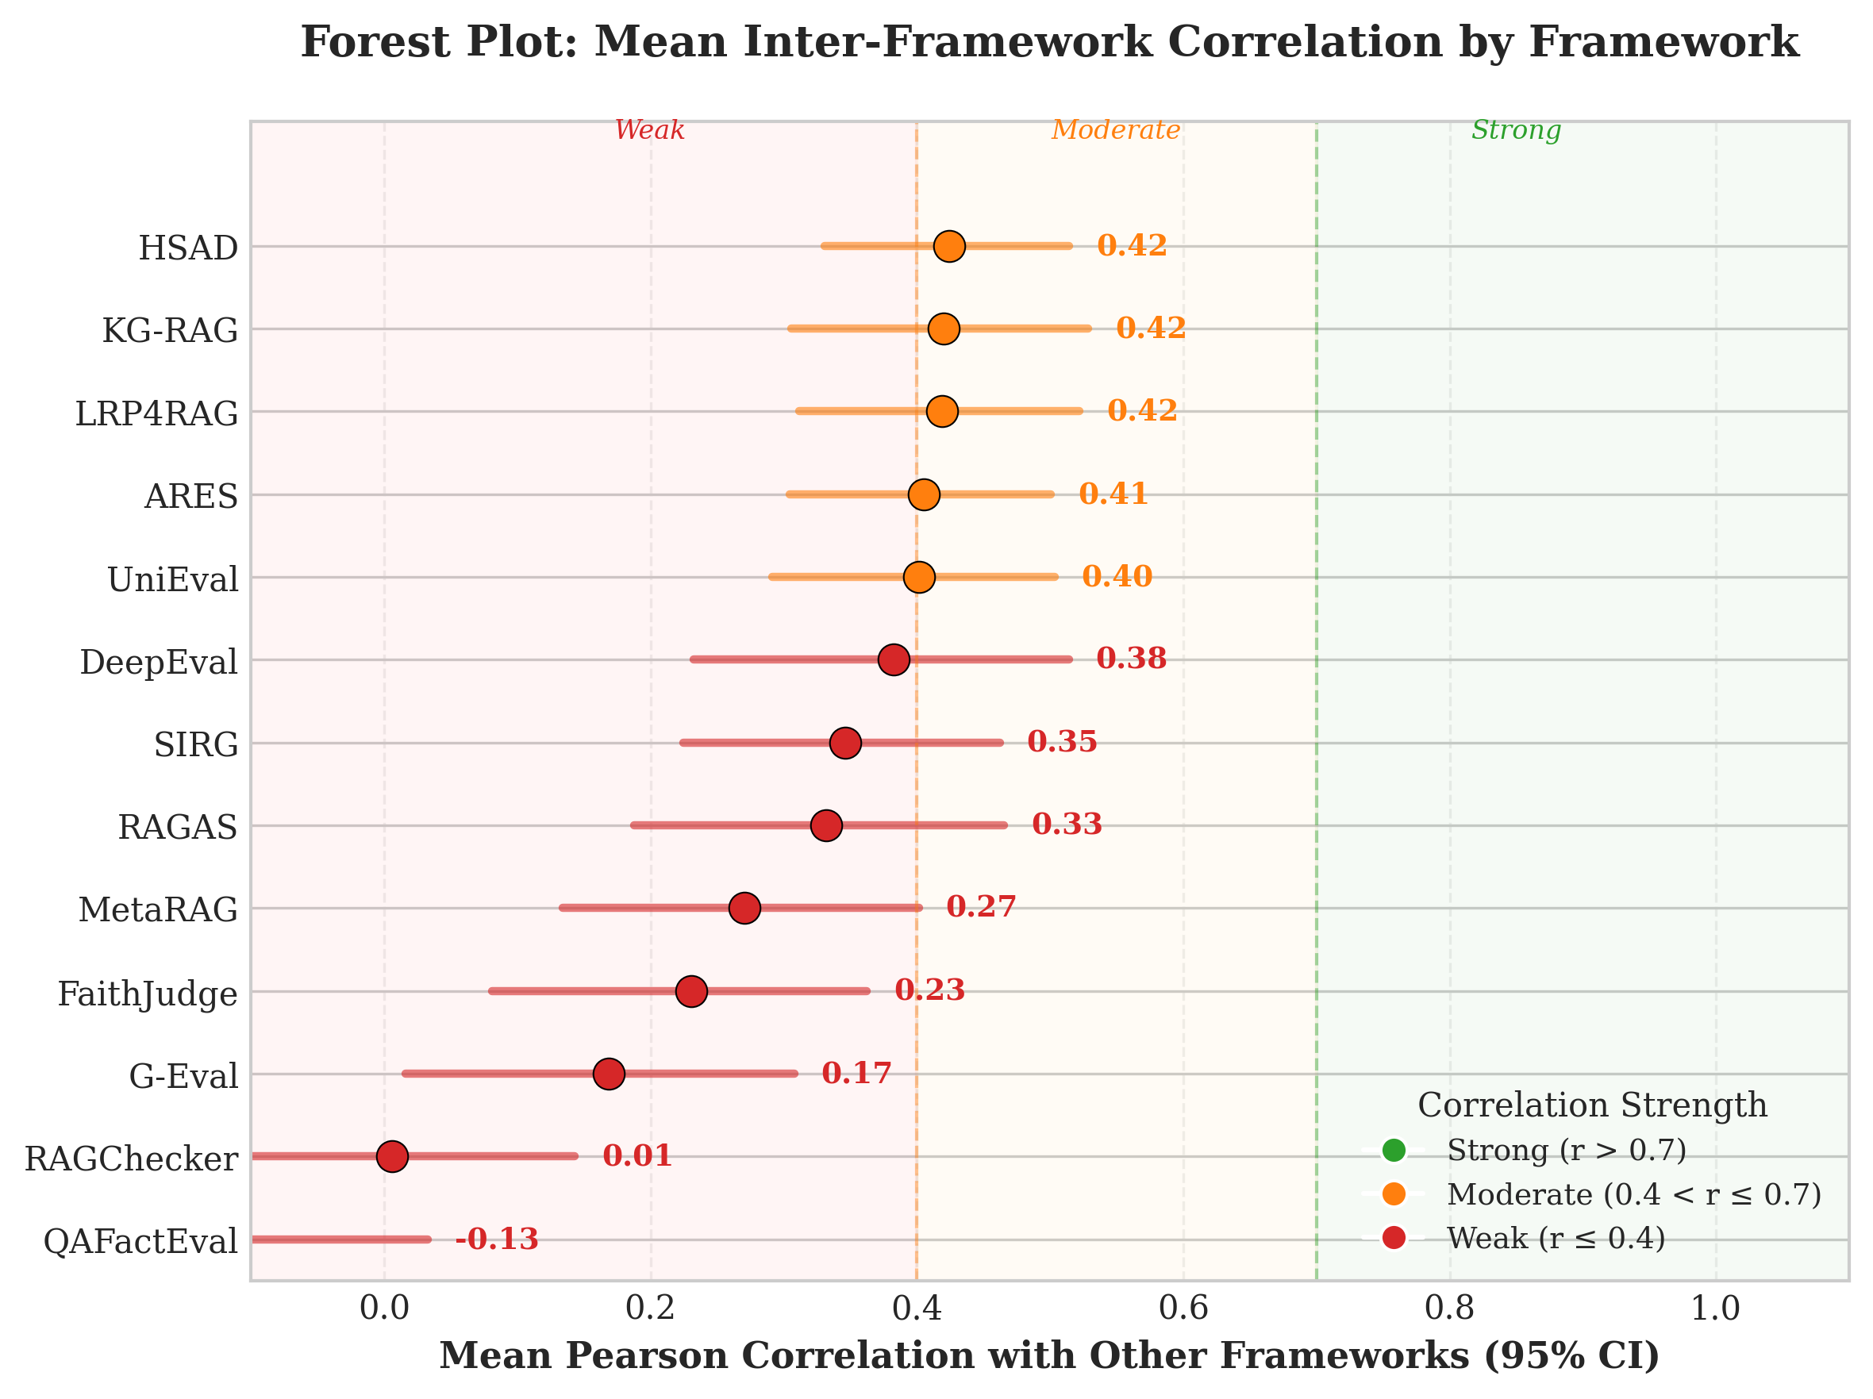
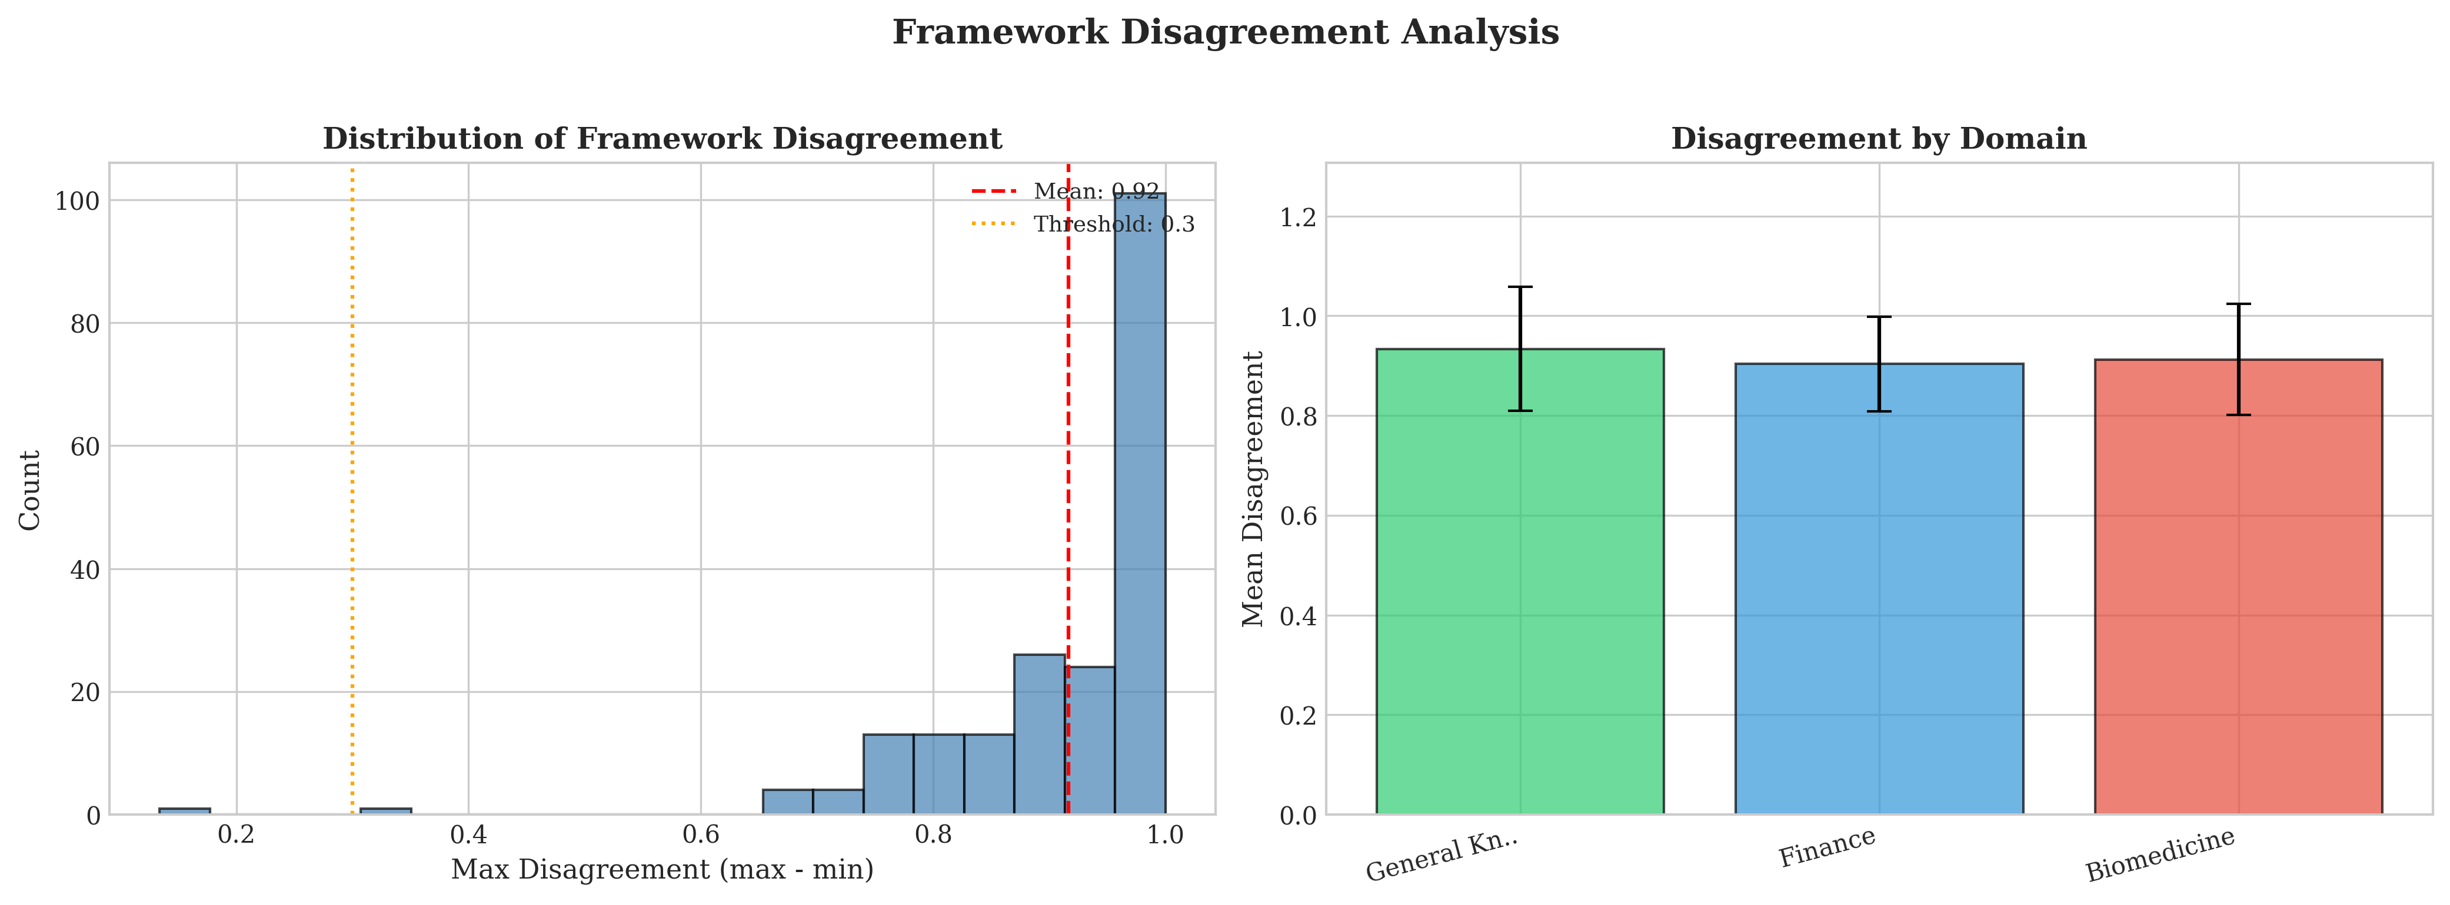
RESULTS 1 OF 8
Inter-framework heterogeneity is substantial
10,055.63
99.81%
167 / 190
0.980
COCHRAN'S Q
I-SQUARED
PAIRS DIFFER
MEAN SCORE RANGE
Forest plot from the paper appendix.
Per-sample disagreement analysis from the paper appendix.
Takeaway
Framework choice materially changes the score observed on identical samples.
09

Slide 10
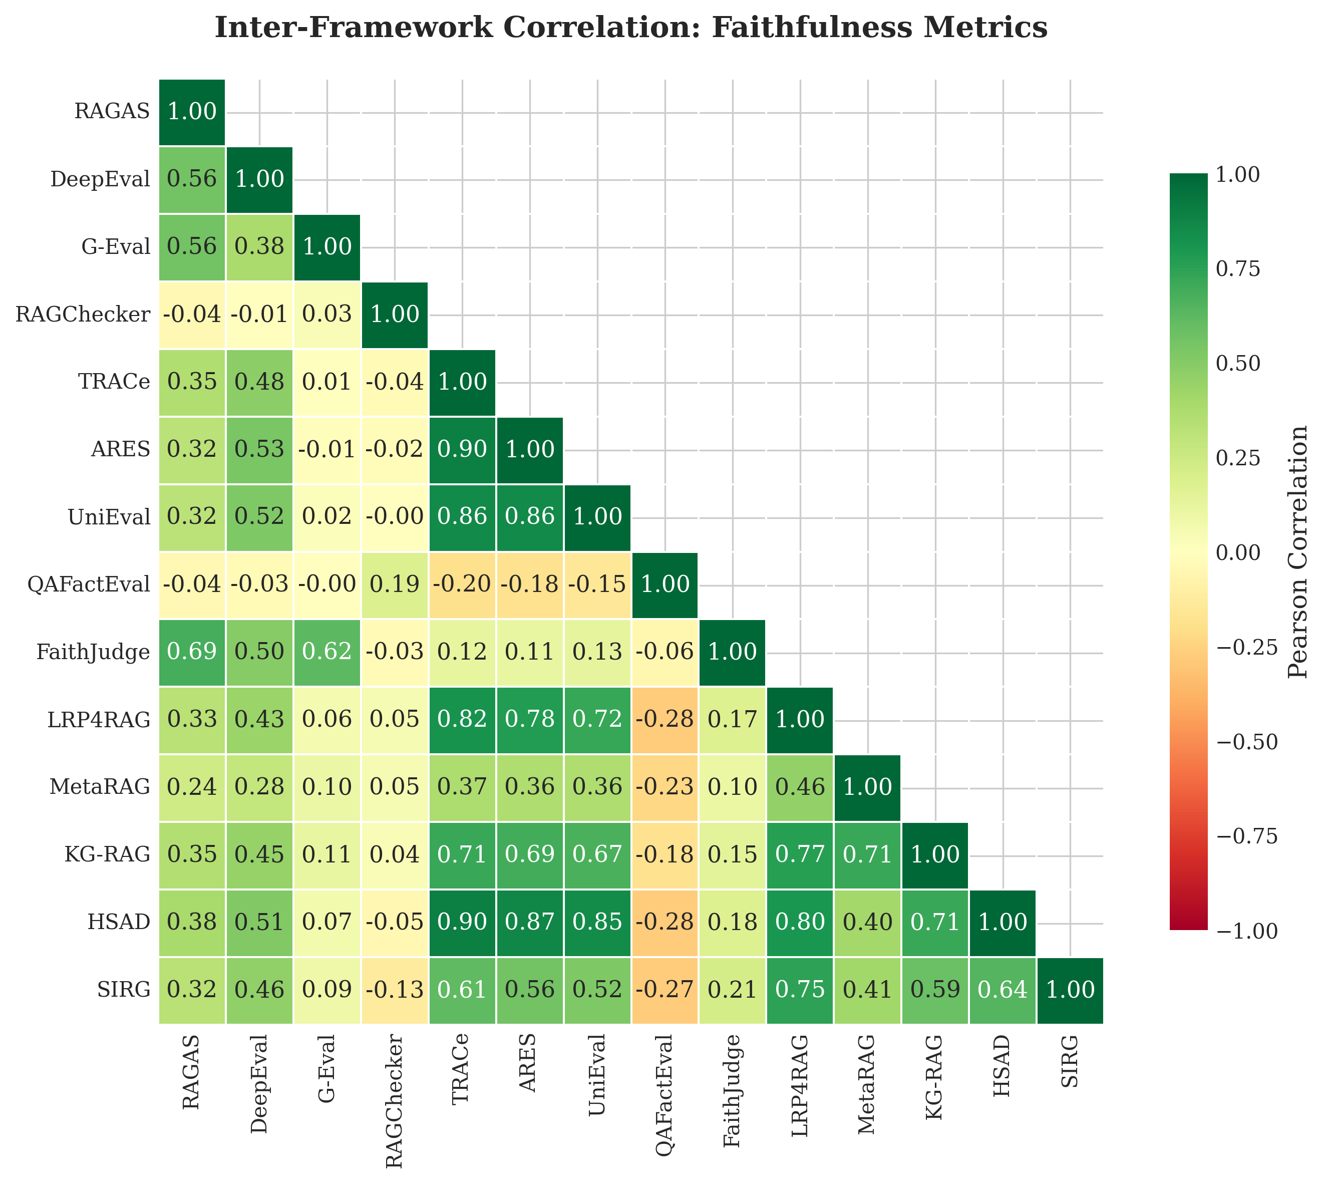
RESULTS 2 OF 8
Pairwise correlations range from -0.28 to 0.90
- Minimum: BERTScore versus MetaRAG, r = -0.28
- Maximum: TRACe versus ARES, r = 0.90
- Median pairwise Pearson correlation is 0.21
- The heatmap shows block structure, not one agreement pattern
Pairwise Pearson correlation across twenty frameworks.
Takeaway
High agreement is local to some pairs, not the full ecosystem.
10

Slide 11
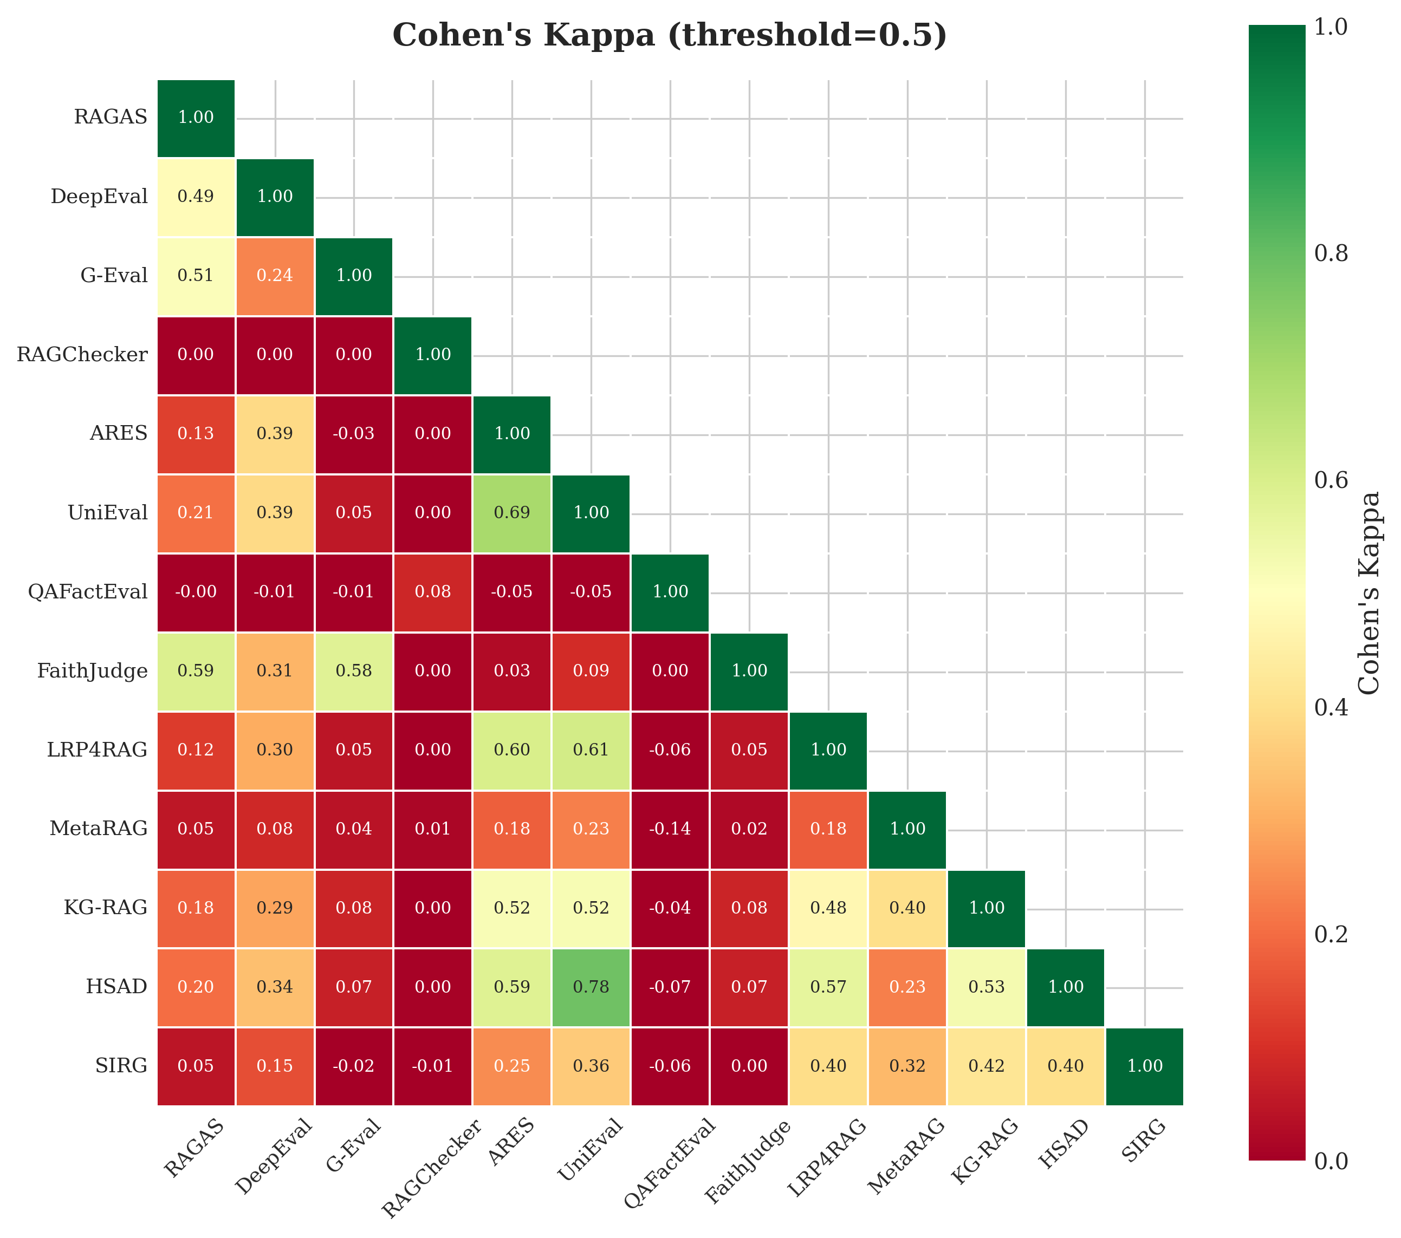
RESULTS 3 OF 8
Binary agreement confirms the score pattern
- Scores are binarized at threshold 0.5.
- ARES and UniEval reach kappa = 0.69 with 90% raw agreement.
- RAGChecker or QAFactEval pairs with LLM-judge methods yield kappa at or below 0.001.
Pairwise Cohen's kappa from the paper appendix.
Takeaway
Disagreement remains after scores become faithful or unfaithful verdicts.
11

Slide 12
RESULTS 4 OF 8
The frameworks form three empirical clusters
Cluster
k
Within r
Normalization check
Raw, min-max, z-score, and rank transformations return identical cluster assignments. Pairwise ARI is 1.0.
LLM-as-Judge
4
0.55
Mixed Methods
11
0.63
Cluster count check
Outlier
5
0.01
The gap statistic peaks at k = 3. Bootstrap co-assignment is at least 0.75 in the LLM-as-judge and mixed-methods clusters.
Between clusters
n/a
0.10
Outlier group
BERTScore, GaRAGe, HALT-RAG, QAFactEval, and RAGChecker.
Takeaway
The paper reports a stable three-cluster pattern across score transformations.
12

Slide 13
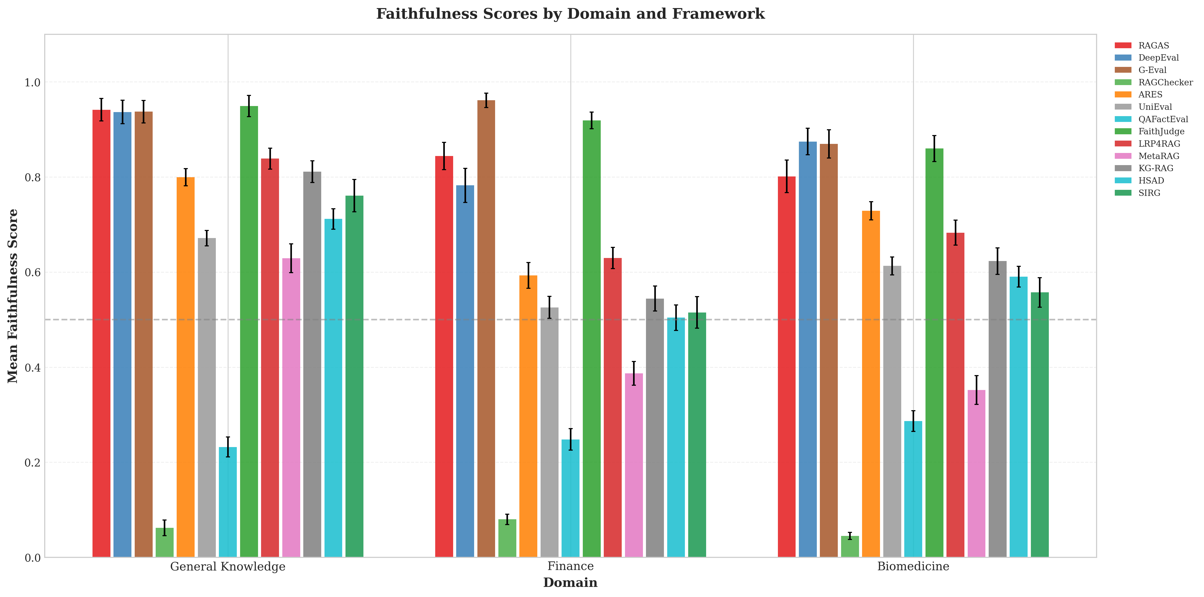
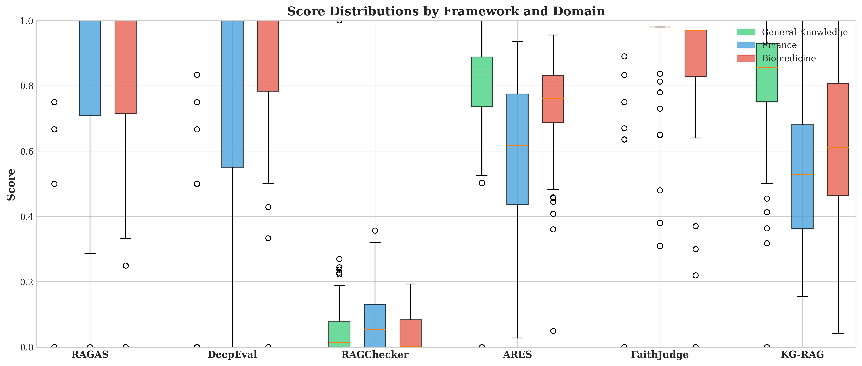
RESULTS 5 OF 8
Domain difficulty depends on the method
Largest reported eta-squared effects: KG-RAG 0.225, MetaRAG 0.222, TRACe 0.198, ARES 0.190.
Mean score by domain.
Representative domain score distributions.
Takeaway
Finance scores lower for most frameworks, while domain effect size depends on the framework.
13

Slide 14
RESULTS 6 OF 8
The human subset favors the LLM-as-judge cluster
- LLM-as-Judge cluster mean r = 0.51.
- FaithJudge r = 0.596 and G-Eval r = 0.564.
- Mixed Methods cluster mean r = 0.19.
- Outlier cluster mean r = 0.05.
Cluster
Mean r
Highest reported r
LLM-as-Judge
0.51
FaithJudge 0.596
Mixed Methods
0.19
SIRG 0.361
Outlier
0.05
RAGChecker 0.243
Human validation subset
Pearson correlations use binary human annotations for n = 50 RAGBench samples.
Takeaway
The paper treats this human-alignment result as directional evidence.
14

Slide 15
RESULTS 7 OF 8
Cross-cluster consensus is usually contested
Representatives: LRP4RAG, FaithJudge, and QAFactEval.
A verdict requires all three representatives to agree at threshold 0.5.
92.5%
6.0%
1.5%
Contested
Faithful
Unfaithful
185 of 200 samples
12 samples
3 samples
Takeaway
The consensus protocol quantifies how rarely the three clusters converge.
15

Slide 16
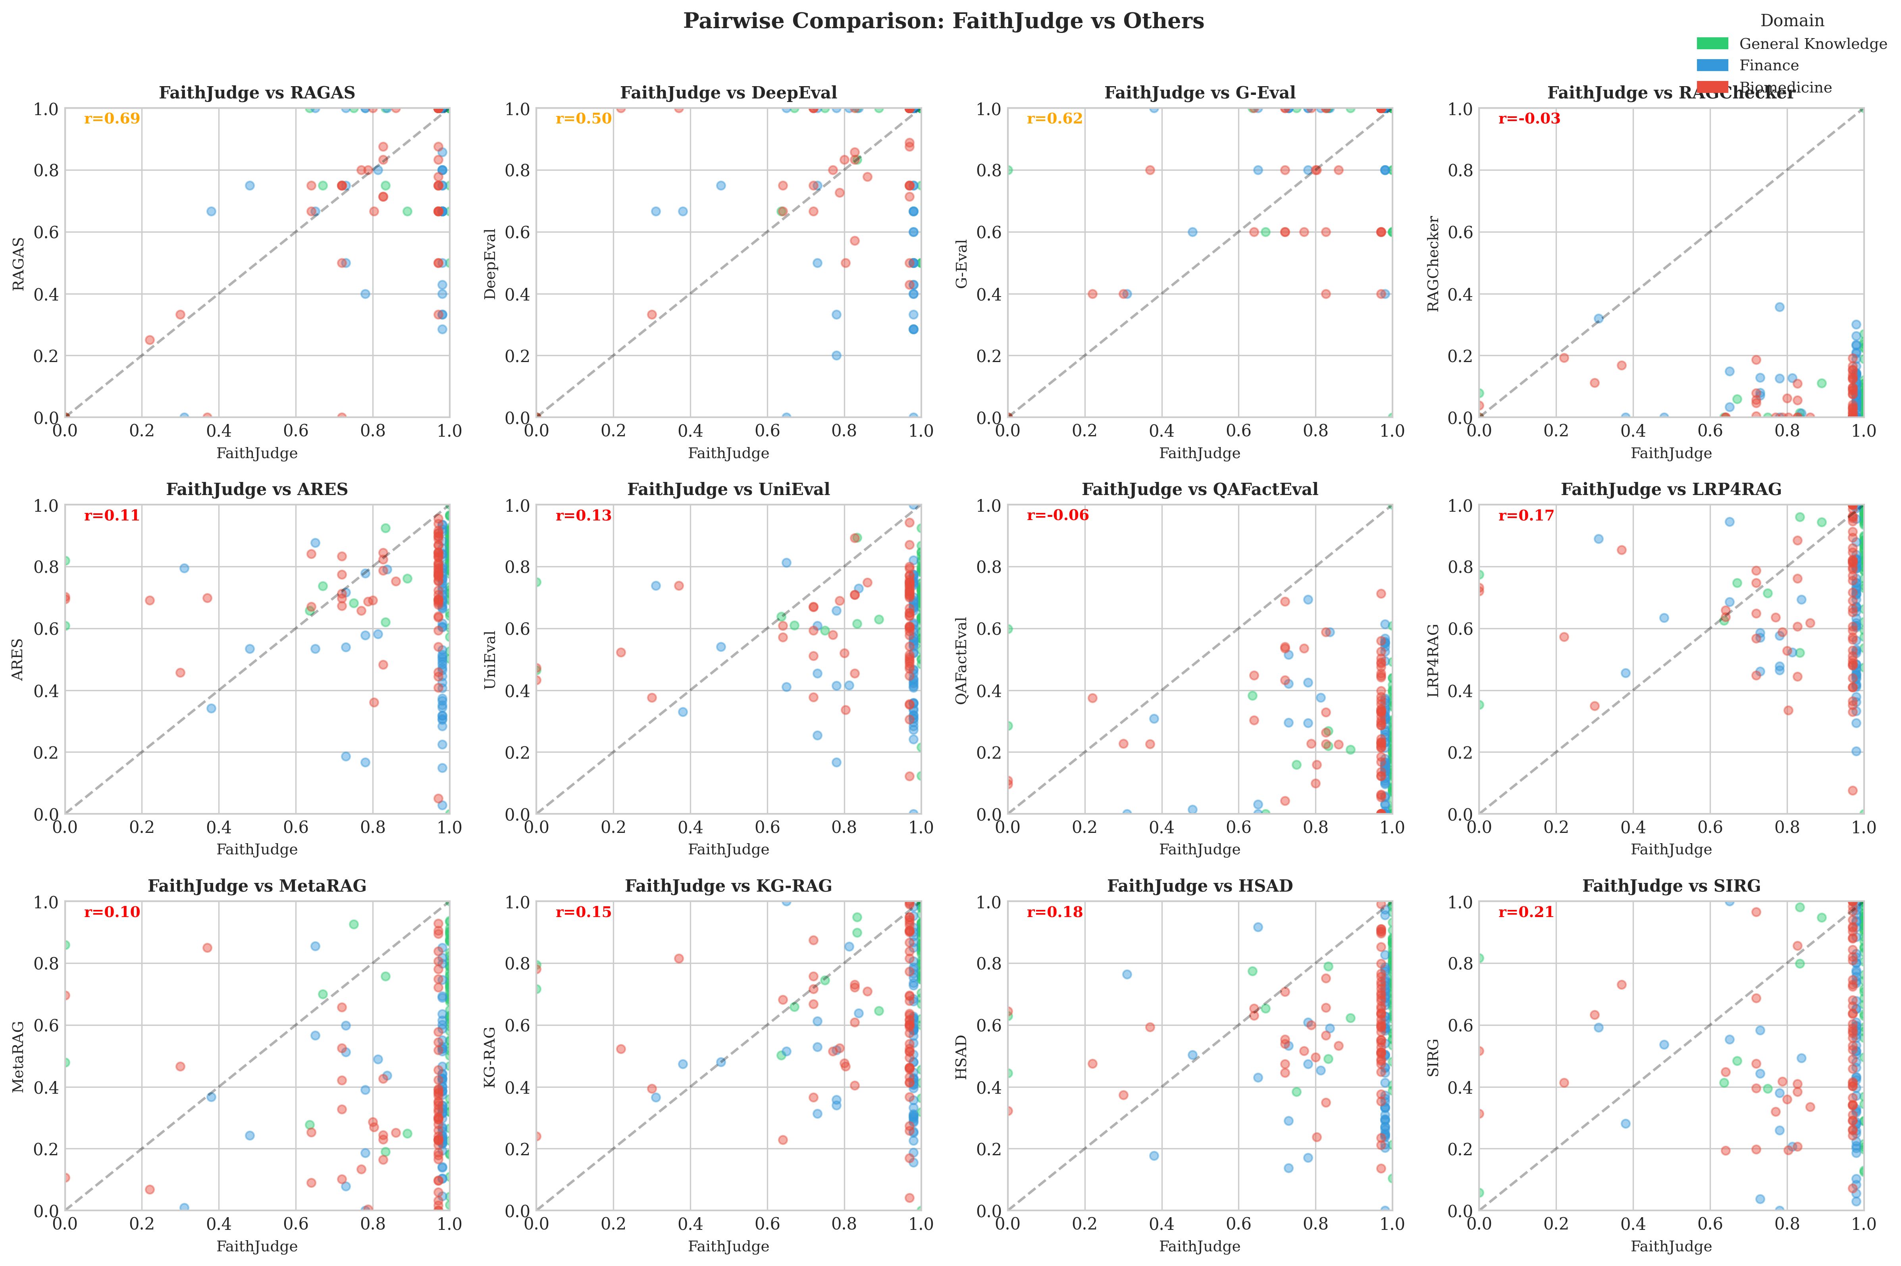
RESULTS 8 OF 8
One framework, seen against the rest
- FaithJudge has the highest human correlation in Table 4.
- It aligns most strongly with LLM-judge peers.
- Agreement weakens for mixed methods and outlier members.
FaithJudge against twelve frameworks, colored by domain.
16

Slide 17
DISCUSSION
One faithfulness metric is insufficient evidence
Single-metric reporting
On identical samples, mean scores range from 0.923 for G-Eval to 0.063 for RAGChecker.
Cross-study comparison
Observed score differences may reflect framework choice rather than system quality.
Evaluation-driven optimization
Low between-cluster agreement means improvement on one metric may not carry to another.
Bottom line
Framework identity belongs next to every faithfulness claim.
17

Slide 18
DISCUSSION
Choose the evaluator by the question it can answer
Why disagreement appears
Paper guidelines
The clusters treat different evidence as faithfulness:
holistic judgment,
claim-level entailment,
semantic overlap,
or context reliance signals.
- General scoring: G-Eval or FaithJudge
- Claim-level diagnosis: RAGChecker or HALT-RAG
- Process-level analysis: ReDeEP or LRP4RAG
- Multi-perspective reporting: one method from each cluster
Practice
Cross-cluster agreement is stronger than agreement inside one family.
18

Slide 19
DISCUSSION
Limitations point directly to the next reliability study
Limitations
Next work
- 200 samples may miss rare failure modes.
- RAGBench draws from specific benchmarks.
- LLM-judge results depend on the backbone.
- The human subset has n = 50.
- Separate the sub-constructs bundled under faithfulness.
- Adopt meta-analytic reporting for new frameworks.
- Build domain-adapted calibration procedures.
The paper concludes that faithfulness is not a single construct as currently measured.
19

Slide 20
REFERENCES
Selected references
- Friel et al. RAGBench. 2024.
- Es et al. RAGAS. EACL 2024.
- Liu et al. G-Eval. EMNLP 2023.
- Tamber et al. FaithJudge. EMNLP 2025.
- Ru et al. RAGChecker. NeurIPS 2024.
- Saad-Falcon et al. ARES. NAACL 2024.
- Zhang et al. BERTScore. ICLR 2020.
- Sun et al. ReDeEP. ICLR 2025.
- Cochran. Combination of estimates. 1954.
- Higgins et al. Measuring inconsistency. BMJ 2003.
- Tibshirani et al. Gap statistic. 2001.
- Full list in the paper and repository.
20

Slide 21
Thank you
Asif Ahmed Neloy
MD Nazmul Islam
Instructor, Keyano College
Senior AI Engineer, Delta Controls
Adjunct Professor, University of British Columbia
Interactive deck and repository
available on GitHub.
asif.neloy@ubc.ca
21

