Slide 1
Machine Learning Approaches for Diabetes Prediction
A Comparative Study of Class Balancing Techniques and Model Performance
Alexandros Angelakis
University of Crete

Slide 2
Introduction
Machine learning is widely applied in healthcare.
This study focuses on diabetes prediction using different models.
Evaluates class balancing techniques and hyperparameter tuning.

Slide 3
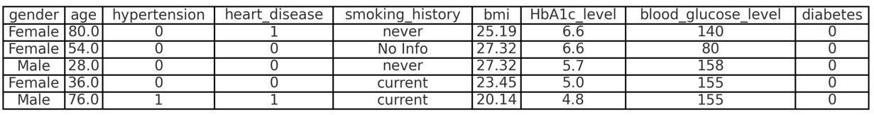
Problem Definition
Dataset: 100,000 patient records (large sample size).
Class Imbalance: 91,544 non-diabetic vs. 8,456 diabetic samples.
- Imbalance Ratio: ≈10.82 (heavily imbalance)
Goal: Develop models for early diabetes detection.

Slide 4
Data Processing and Preprocessing
No missing values in the dataset.
Categorical features one-hot encoded (except smoking history - frequency encoded).
Numerical features standardized (zero mean, unit variance).
Addressing class imbalance using:
- Random undersampling
- Class weighting
- SMOTE (computationally intensive, not tested)

Slide 5
Machine Learning Pipeline
Feature selection:
- LASSO Regression
- Backward Elimination
Evaluated models:
- Logistic Regression, SVM, Random Forest, Decision Tree, XGBoost, KNN, GNB.
- Each model was implemented using scikit-learn or XGBoost. The dataset was split into 90-10.
Hyperparameter tuning with nested cross-validation (outer loop 10-fold stratified cross-validation, inner loop 5-fold stratified cross-validation).
Best overall model selected based on its average AUC score across all outer folds. Final model trained on the entire training dataset.
Total number of trained models: 6801.

Slide 6
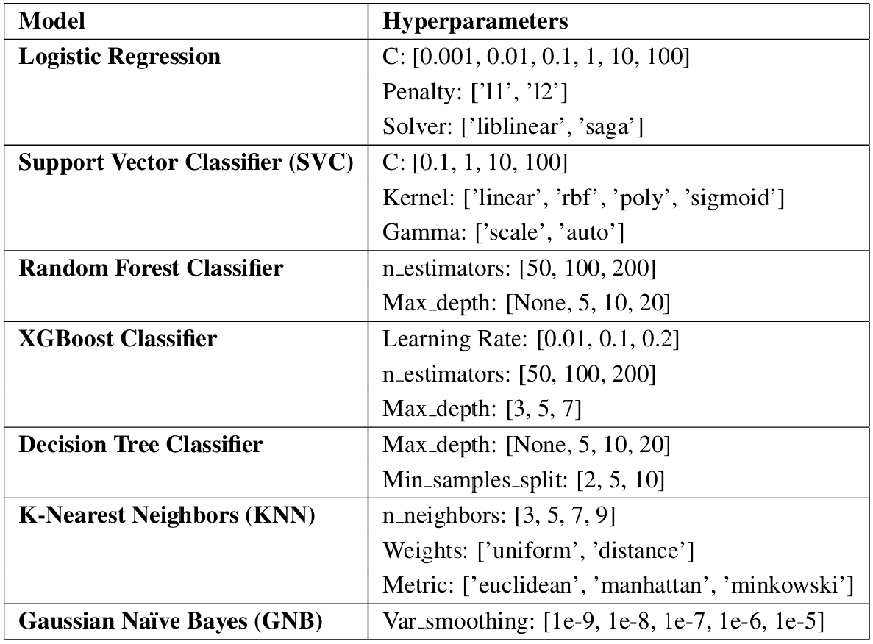
The configurations tested using nested cross-validation

Slide 7
Model Performance
Without balancing:
- Best Model: XGBoost (AUC = 0.9805)
- High precision but low recall (0.6712)
In medical applications, recall is often prioritized to avoid missing critical cases. Need for less Type II errors.
Low recall due to class imbalance (model more sensitive to majority class)
With balancing:
- Best model: XGBoost (AUC = 0.9831)
- Recall improved (0.9349) but lower precision (0.4871)
Best efficiency: Random undersampling (faster execution).

Slide 8
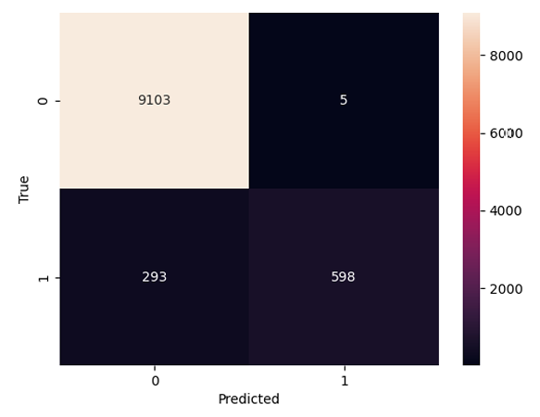
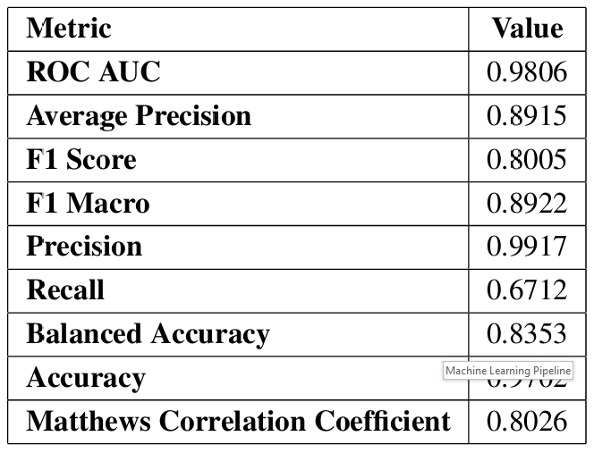
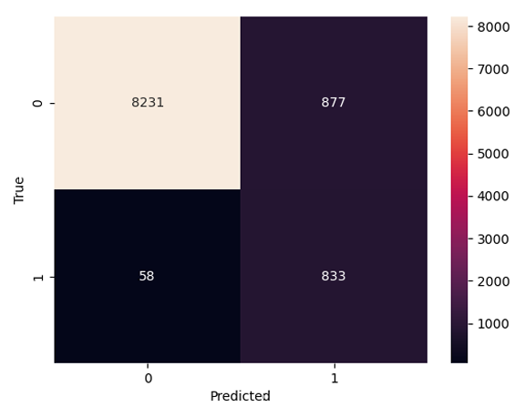
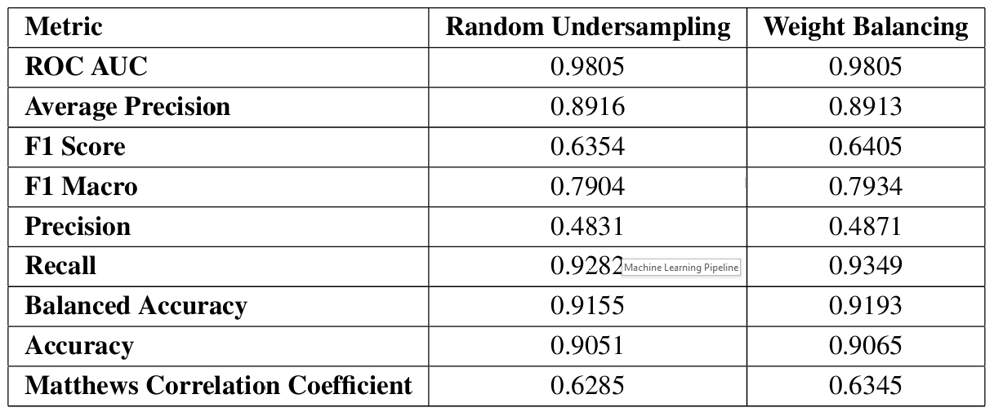
Confusion matrix and performance metrics without using class balancing:
Confusion matrix and performance metrics using class balancing:

Slide 9
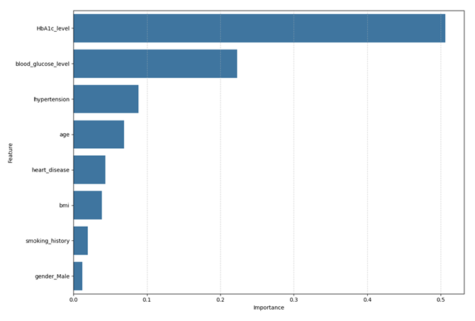
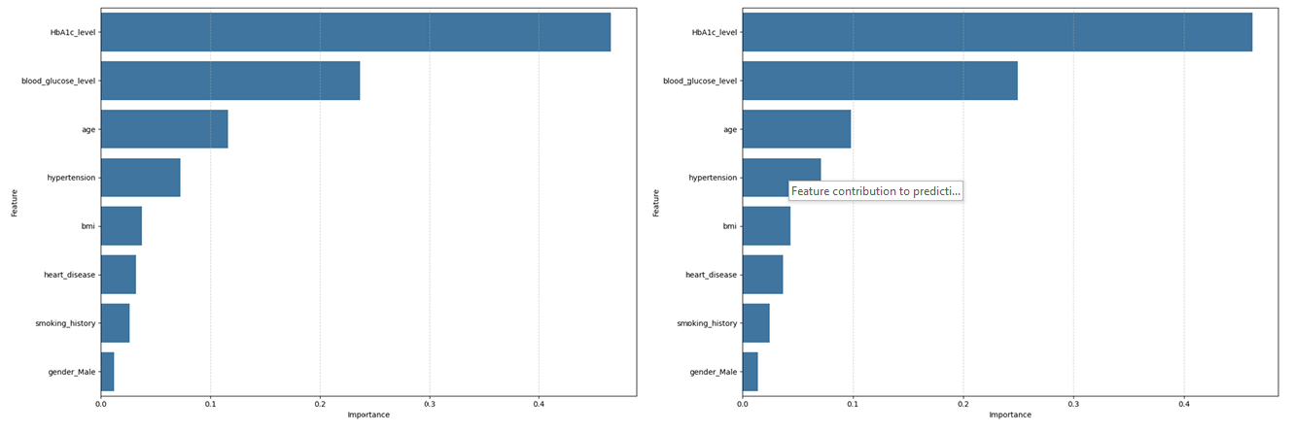
Feature contribution to prediction without using class balancing:
Feature contribution to prediction using class balancing:

Slide 10
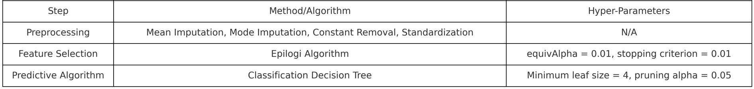
AutoML - JADBio
Used AutoML for comparison.
Configurations using 90% - 10% hold-out method. Total number of models trained: 171.
Best model configuration:
JADBio selected all the features for classification as well.

Slide 11
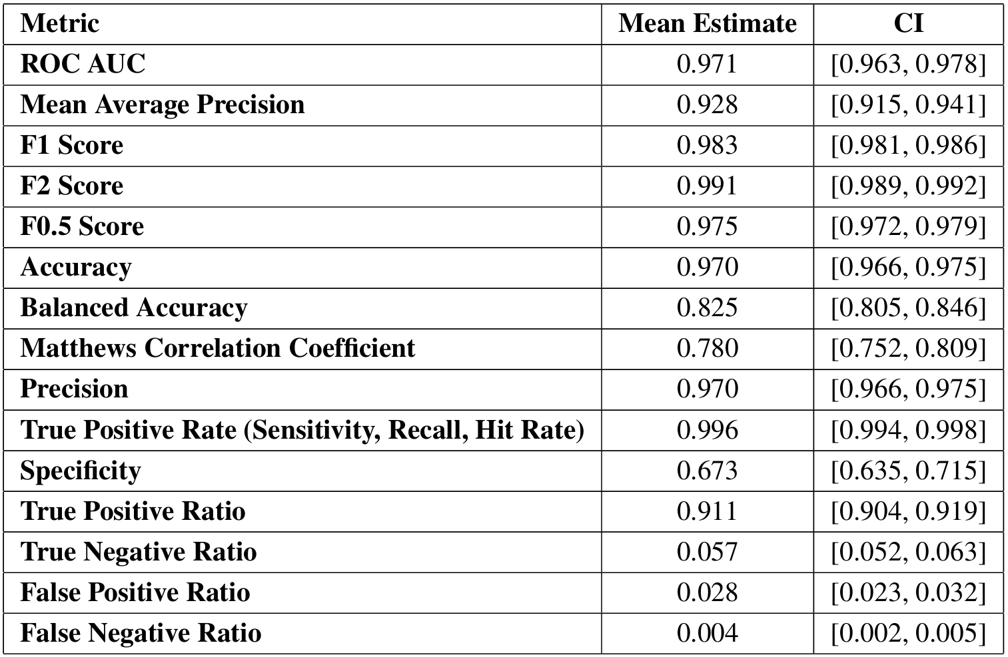
Performance metrics of JADBio with confidence intervals:
JADBio achieved high precision along with high recall, but did not manage to attain a high balanced accuracy.

Slide 12
Conclusion
Class imbalance affects diabetes prediction.
Random undersampling is efficient and effective.
Tree based models, and especially XGBoost, performed best overall.
Decreasing false negatives (Type II errors) in medical applications is crucial.
Future work:
- Improve balance between precision and recall.
- Explore advanced resampling techniques (SMOTE or GANs)

