Slide 1
Algo Validation Metrics

Slide 2
Metrics Interface
function [score, results] = metrics(frames, params)
frames =
1×100 struct array with fields:
z: 480x640 uint16
i: 480x640 uint16
c: 480x640 uint16
0.04
0.04
0.8
params =
struct with fields:
roi: 0.8
isRoiRect: 0
roiCropRect: 0.04
verbose: 1
camera: [1×1 struct]

Slide 3
Metrics Interface: Results
function [score, results] = fillRate(frames, params)
score =
99.9295
res =
struct with fields:
frameFillRate: 99.9295
meanFillRate: 99.9314
stdFillRate: 0.0217
score: 'frameFillRate'
units: 'percentage'
error: 0

Slide 4
Metrics: LOS Grid Drift
Check how the checkboard corners move over time
Detect checkboard
Use linear fit of the corners x’s and y’s to measure drift
meanStdX: 0.3621
meanStdY: 0.1345
meanDriftX: 0.6088
meanDriftY: 0.0568
maxDriftX: 0.9846
maxDriftY: 0.2847
score: 'maxDriftX'
units: 'pixels'

Slide 5
Metrics: LOS FOV and Laser Drift
Check how FOV and Laser ON/OFF move over time
Detect FOV and Nest boundaries
Use linear fit to measure drift
stdFovL: 0.2043
stdFovR: 0.5291
stdFovT: 0.1291
stdFovB: 0.1490
stdLdOnL: 0.2514
stdLdOnR: 0.5356
stdLdOnT: 0.1563
stdLdOnB: 0.1541
driftFovL: 0.0802
driftFovR: -1.3084
driftFovT: 0.0191
driftFovB: 0.1201
driftLdOnL: -0.1796
driftLdOnR: -1.2650
driftLdOnT: 0.1133
driftLdOnB: 0.0437
score: 'driftLdOnL'
units: 'pixels'

Slide 6
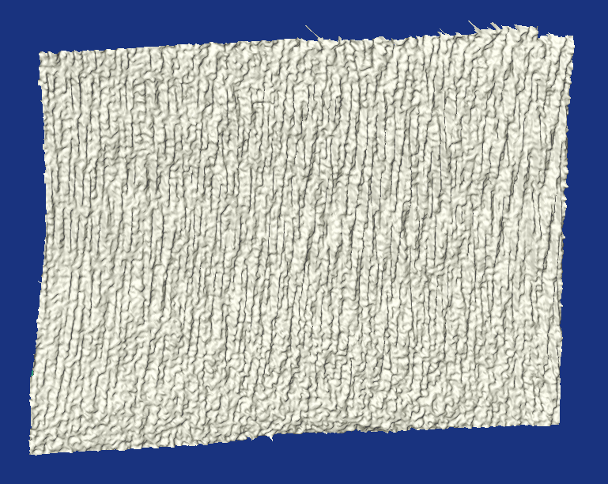
Metrics: PlaneFit (zStd)
Check how far the points of the wall from the fit plane
Fit plane for every frame
Measure distances (z only) from the plane
score =
3.3555
res =
struct with fields:
rmsPlaneFitDist: 3.3555
maxPlaneFitDist: 13.7116
score: 'rmsPlaneFitDist'
units: 'mm'
error: 0

Slide 7
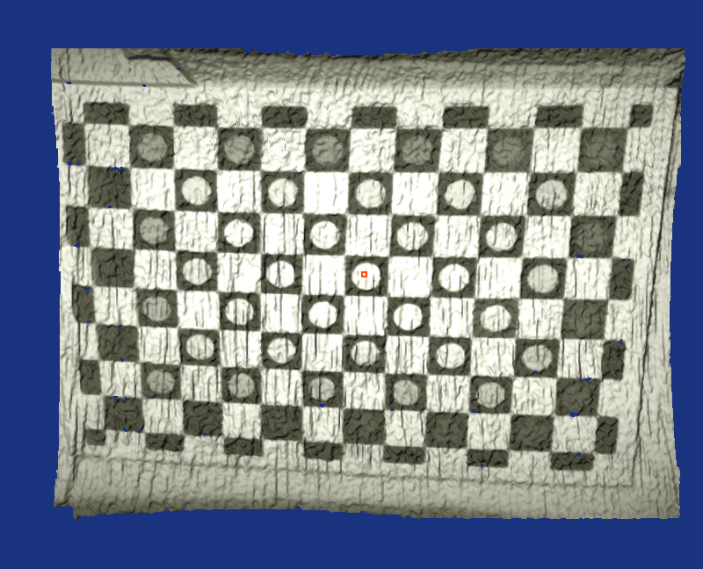
Metrics: Grid Inter Distances (Alex’s error)
Check how far the distances between all possible corners in 3D from the real distances
Unproject corners into 3D
Compare the distances
score =
2.0547
res =
struct with fields:
meanError: 2.0547
rmsError: 2.5894
score: 'meanError'
units: 'mm'
error: 0

Slide 8
Metrics: Grid Edge Sharpness
Check how sharp the edges of the grid
Find the checkboard
Measure the width of the edges
score =
2.1709
res =
struct with fields:
gridSize: [9 13]
points: [117×2 double]
horizMin: 1.8635
horizMax: 2.5828
horizMean: 2.1709
horizStd: 0.1772
vertMin: 1.8842
vertMax: 3.7097
vertMean: 2.4070
vertStd: 0.3450
meanFrame: [1×1 struct]
score: 'horizMean'
units: 'pixels'
error: 0

Slide 9
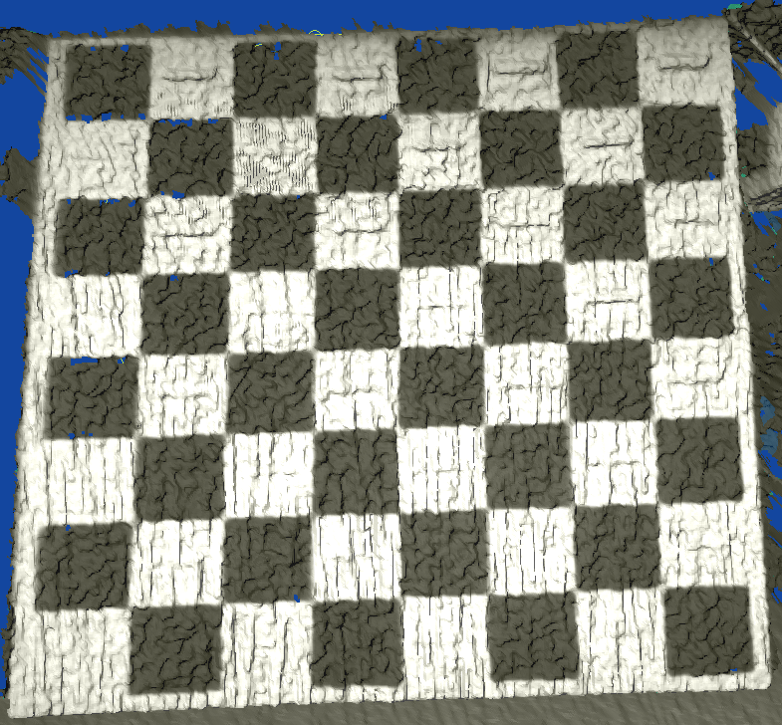
Metrics: MOS (1)
MOS: Minimal Object Si
Find the checkboard
Find the width and height of every bar
Find the minimal (w.r.t to width/height) distinguishable bar relative to the local noise
Currently minimal means ares of the bar cut: width*height
score =
2.1709
res =
gridSize: [7 7]
points: [49×2 double]
minArea: 20.9962
meanBlobNoise: 4.0524
score: 'minArea'
units: 'mm^2'

Slide 10
Metrics: MOS (2)
MOS: Minimal Object Si
Find the checkboard
Find the width and height of every bar
Find the minimal (w.r.t to width/height) distinguishable bar relative to the local noise
Currently minimal means ares of the bar cut: width*height
score =
2.1709
res =
gridSize: [7 7]
points: [49×2 double]
minArea: 20.9962
meanBlobNoise: 4.0524
score: 'minArea'
units: 'mm^2'

