Slide 1
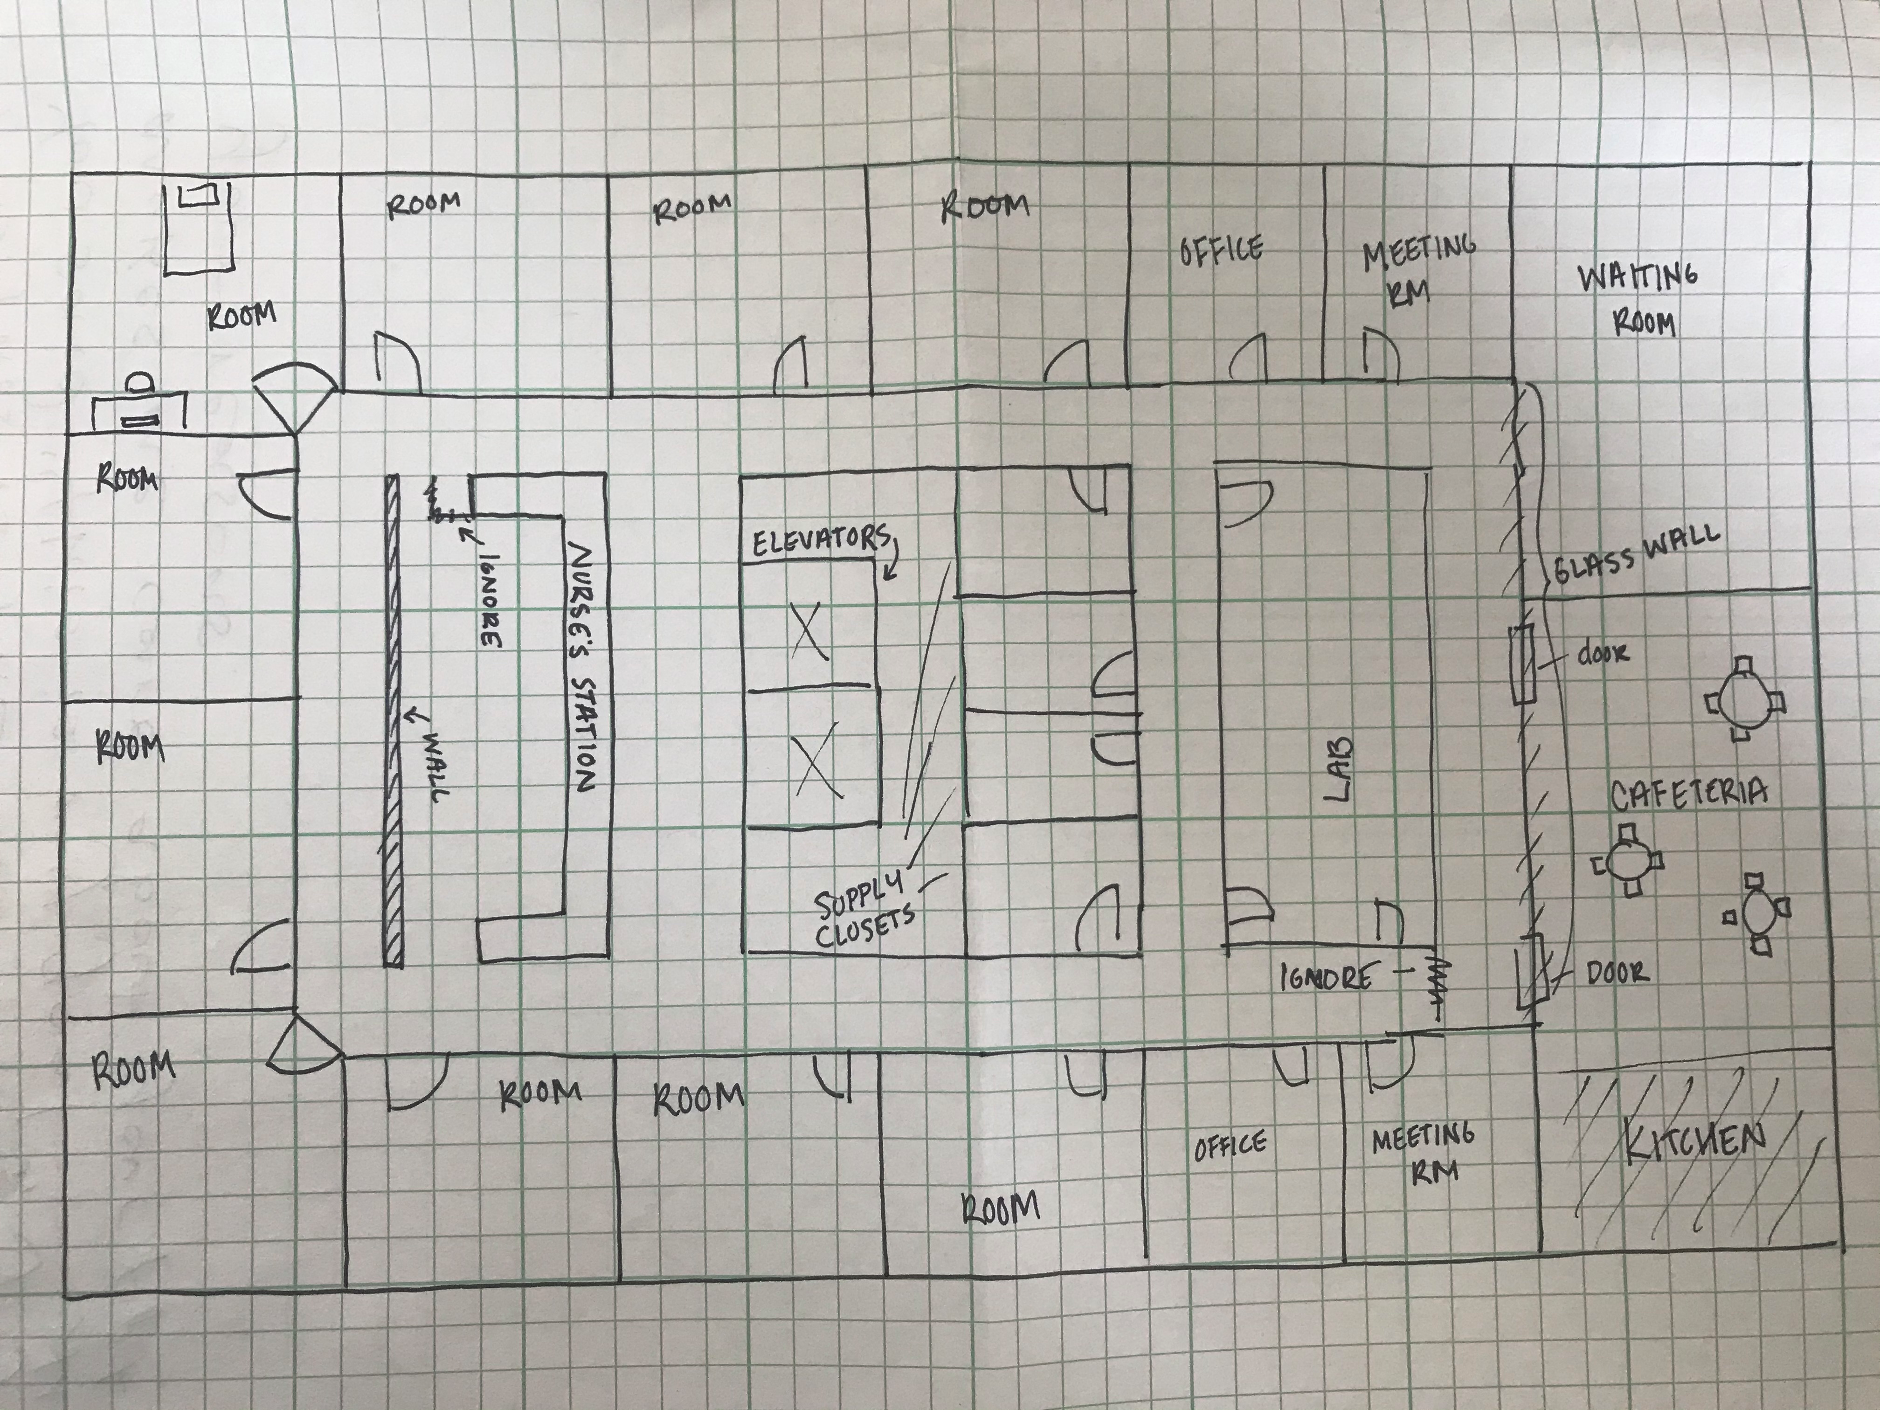

Slide 3
1
2
3
4
5
0
6
1
0
0
15
17
18
0
0
16
4
21
2
19
14
7
20
1
2
1
1
3
13
12
11
10
9
8

