Slide 1
Cross Platform Game Development
With Unity3D and C#

Slide 2
Who
Anish Acharya
CEO@crazytech.eu.org
anish9978@gmail.com

Slide 3
What
Introduction to developing production quality video games with Unity3D and C#
Explore the Unity3D Interface
Developing on a PC or Mac
Unity and C#
Scenes
GameObjects
Components
Scripts
Deployment
PC/Mac
Mobile

Slide 4

Why
You have been training for this your whole career!

Slide 5
The Setup
Download and Install Unity3D
http://unity3d.com/unity/download (Hopefully I have brought along thumb drives)
PC/MAC
A Web Browser
iOS
Xcode
Android
Android SDK and JDK
WP8
WP8 SDK
Most Importantly Have an Idea

Slide 6
Additional Tools
Image Editor
Photoshop, Gimp, Paint.Net
Video Editor
Adobe Premiere, Lightworks
3D Editor
3ds Max, Blender
Sound Editor
Adobe Audition, Audacity

Slide 7
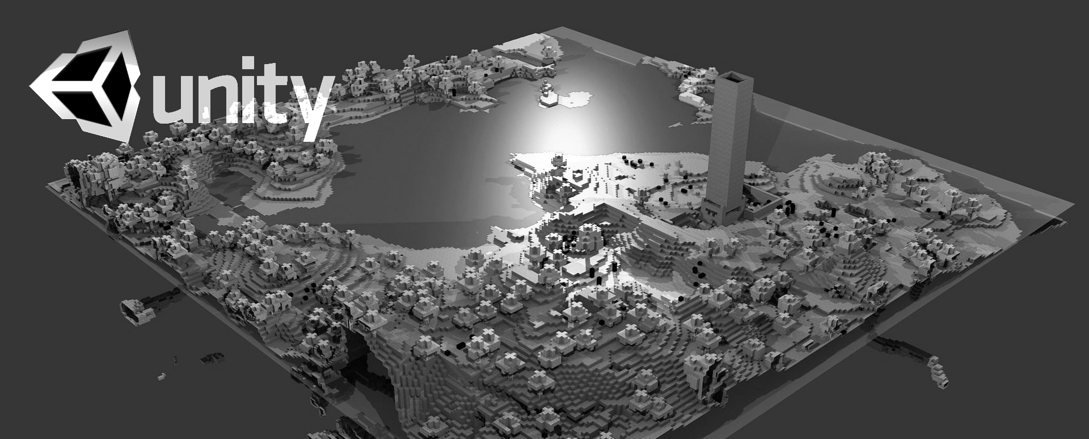
Unity 3D
Let us build a Voxel Engine

Slide 8
Unity3D Tour
Integrated Editor Overview

Slide 9
Adding to the Scene
Let us begin doing something!
Examine the Camera
Add a GameObject (Cube) to the Hierarchy
View the Cube within the Scene
View the Cube within the Game
View the Cube within the Inspector
View the Cube’s Gizmos
Manipulate the Cube with the Transform Tools (Pan, Transform, Rotate, Scale)

Slide 10
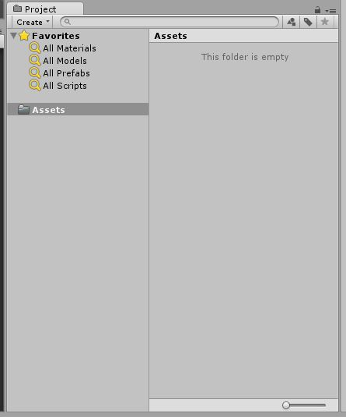
Project Browser
Highlights
Assets
Preview
Favorites
Search

Slide 11
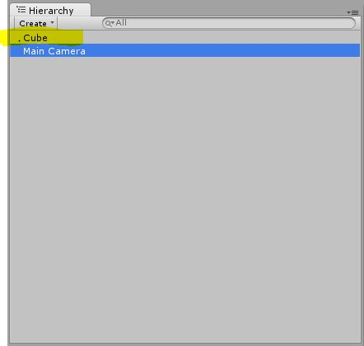
Hierarchy
Contains all GameObjects in the current scene.
Shows Parenting
Inherits movement and rotation

Slide 12
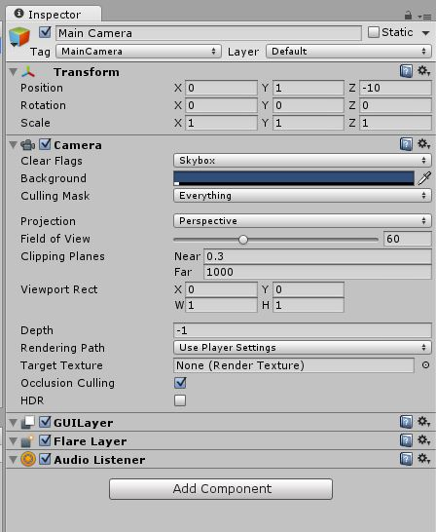
Inspector
GameObjects are made up of multiple Components
Public Properties of the Components can be manipulated
Icons

Slide 13
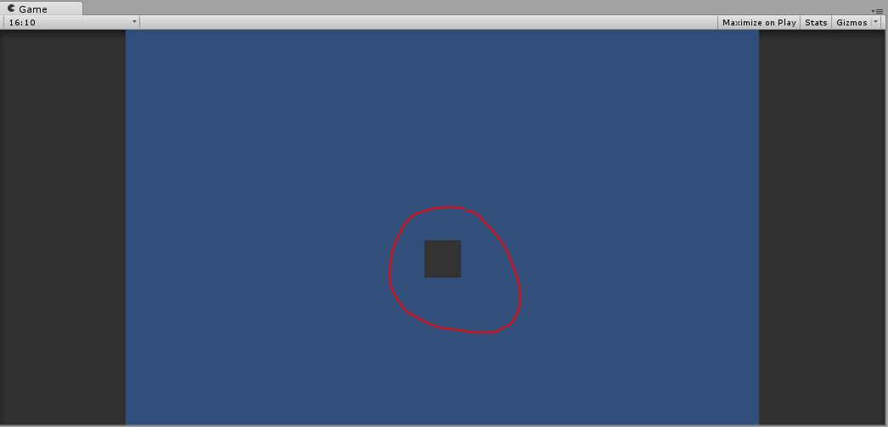
Game
The Game View is rendered from the Camera(s) in your game.

Slide 14
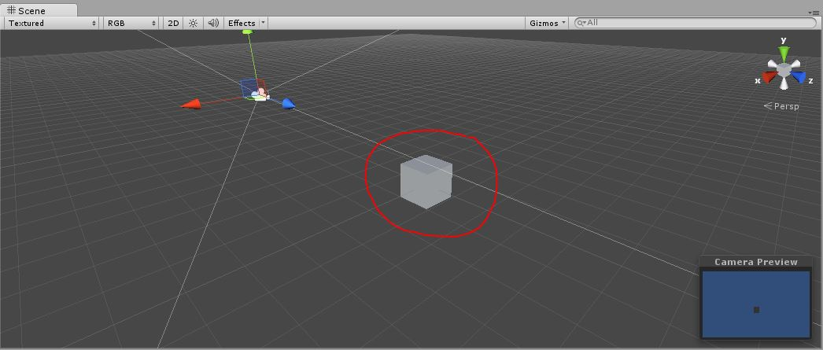
Scene
The Scene View is your primary interaction surface with Unity

Slide 15
GameObjects
Every object in your game is a GameObject
Without Components GameObjects are more of an organizational tool using Parenting
GameObjects contain Components
All GameObjects contain a Transform Components
Transform Components tell Unity where to put the GameObject in the Scene, more later
Transform are essential for Parenting

Slide 16
Components
Components are the functional pieces of every GameObject.
Component Properties can be changed by the Editor or Scripts.
Components can be; Added, Copied, Removed, Reordered, Reset, and Required
Unity tries to choose the best Editor for the Properties. Hints or Custom Editors can be used with Properties to make the Inspector incredibly useful.
!Important: Changes made to the Unity while Running the Game are reverted once the Game is stopped. More on this when start looking at Scripts.

Slide 17
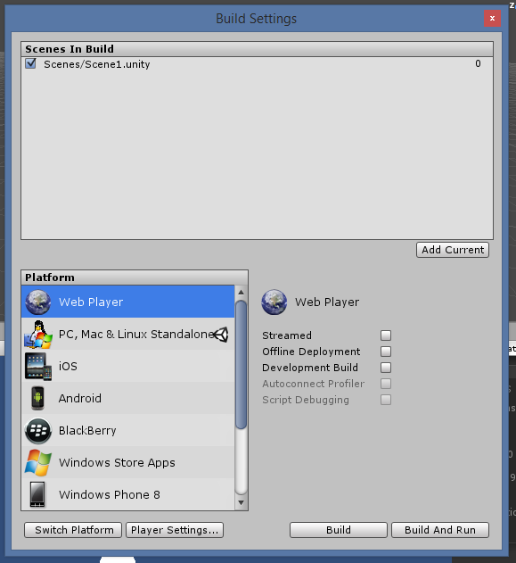
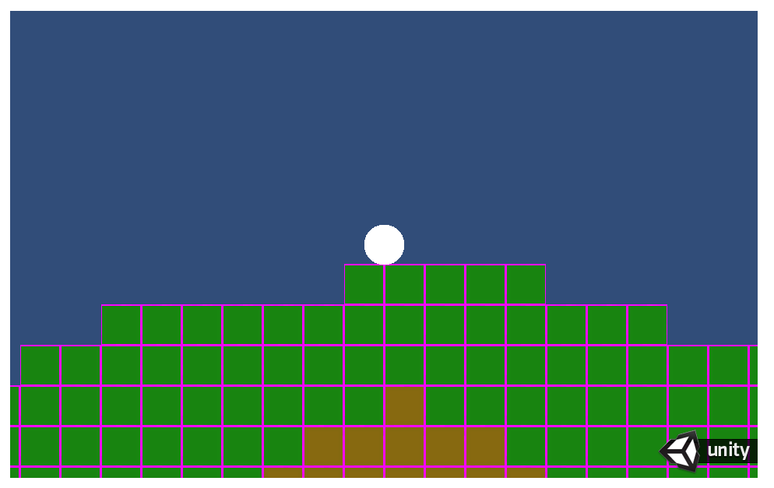
Exporting the Web
Lets Take our app and ship it out to the Web
Ctrl+Shift+B
Add Current (to add the current scene)
Platform Web Player
Switch Platform (if your current platform isn’t web)
Create Folder “Web”
Build And Run

Slide 18
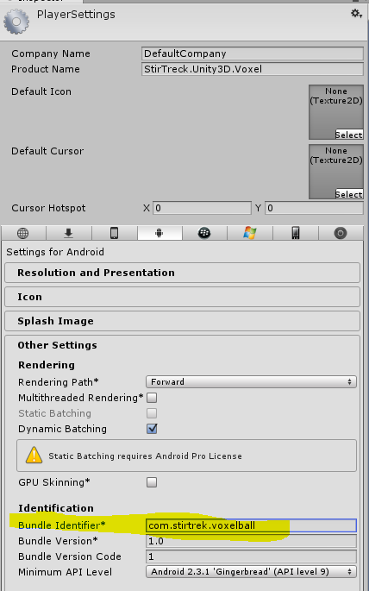
Exporting to Mobile
Well the web was nice, now lets kick it out to Android
Create a Bundle Identifier
Ctrl+Shift+B
Platform Android
Switch Platform (if your current platform isn’t Android)
Create Folder “Android”
Build And Run

Slide 19
Thank You!
Ask your questions!

