Slide 1
INTERNSHIP AT DATAKALP
Presented by
AANISH.P
E18CSE003
Guide
Dr. Kalpit Desai
Submitted
to
DEPARTMENT OF COMPUTER SCIENCE ENGINEERING
BENNETT UNIVERSITY, GREATER NOIDA, 201310, UTTAR PRADESH, INDIA

Slide 2
OUTLINE
Introduction
Objectives
Work Done
Gstreamer
Inference API
Deepstream
AWS
Device Comparison
Outcome
Performance Gstreamer
Best Inference Python API
Performance of DeepStream
Best Device for Deployment
Skills acquired

Slide 3
Brief
Started August 2nd, 2021
Edge device deployment Task
Data science models deployment
Platform comparison
AWS S3 maintenance and deployment

Slide 4
Objectives (initial)
Understanding of Gstreamer
Build custom Gstreamer plugins and pipelines
Model inference API comparison
Port model to Jetson platform
Port Vajra Hands to Jetson Nano

Slide 5
Work Done

Slide 6
Gstreamer
Made custom motion detection plugin
Made custom inference plugin
Made end to end media pipeline

Slide 7
Inference API
Tested models on,
Onnx
TF-TRT
TRT API
Frozen Graph
DeepStream

Slide 8
DeepStream
Scripted custom model inference
Scripted custom object detector inference
TF-TRT hybrid model inference

Slide 9
AWS Work
S3 Bucket download scripts
EC2 instance

Slide 10
Device Comparison
Platform Comparison
Model Computation Measure
ASIC (Application specific integrated circuit)
Device Benchmarking for comparison

Slide 11
Results and Conclusions

Slide 12
Performance Gstreamer
Modular
Faster
Building block of many libraries

Slide 13
Best Inference Python API
TensorRT is the best among all Python API’s
TensorRT is native and gives optimized GPU inference
TensorRT is NVidia device specific
TensorRT doesn’t support sequential models.

Slide 14
Performance of DeepStream
DeepStream inference plugins are better optimized and couple of mili secs faster than TRT python engine.
DeepStream has media pipeline architecture making it easy for data encoding and decoding.

Slide 15
Best Device for Deployment
ASIC and computation measure discrepancy.
Multi model inference estimation is difficult, need to run to verify.
Jetson Nano 4Gb variant is best suited for the product.

Slide 16
Skills Acquired or Enhanced
Pycuda
TensorRT
Onnx
Gstreamer
Deepstream
Nvidia Jetson
AWS
Tensorflow

Slide 17
YouTube Video, GitHub and Twitter Links
https://youtu.be/5ATpRphjk80
https://twitter.com/AanishParuchuri/status/1464195732525617153
https://github.com/aanishnaidu/milestone3

Slide 18
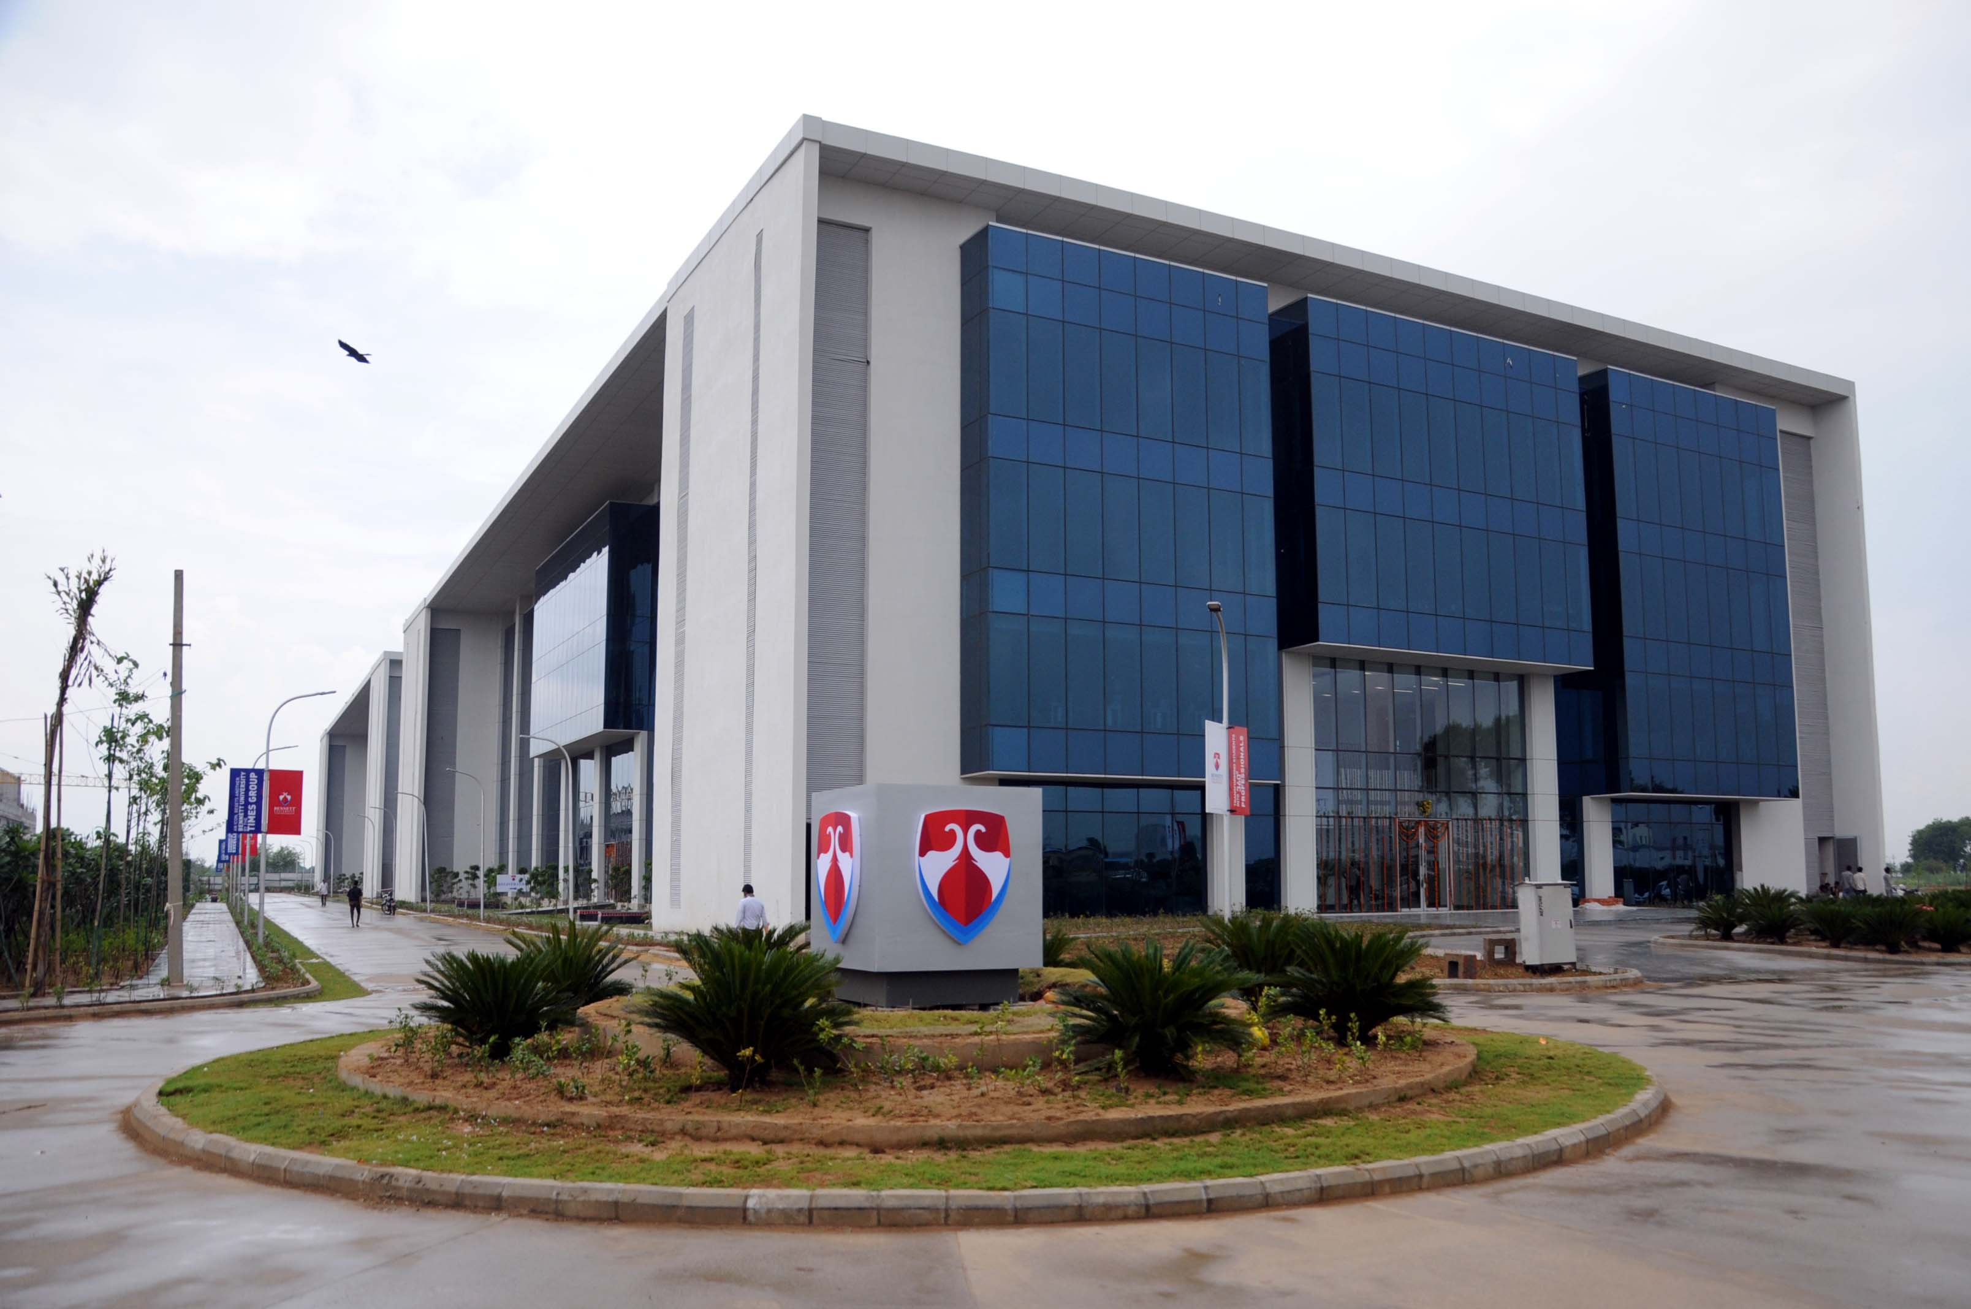
Question Please Thank You

