Slide 1
BANTRLY
Lesson Generator
Creative ELA lesson generation for K–12 speaking practice
12 MODULES
80 SKILLS
4 GRADE BANDS
Guardrails + Generator
CCSS-aligned taxonomy
K–2 through 9–12
Aankit Das · Candidate Trial

Slide 2
THE PROBLEM
Generic lessons bore students.
Engagement without structure wastes time.
Too generic
Too unstructured
One-size-fits-all content ignores developmental stage, skill level, and student context. Students disengage. Teachers lose trust in the tool.
Free-form AI generation produces entertaining content with no clear skill objective, no feedback anchor, and no measurable outcome.
The answer: narrative-driven lessons with a single measurable skill, grounded in learning science.

Slide 3
RESEARCH FOUNDATION
Every design decision is evidence-backed
Bruner (1990)
Rosenshine (2012)
Narrative mode improves encoding and recall
One clear objective per lesson is the strongest predictor of effectiveness
→ Hook stage: every lesson is story-driven
→ Single-skill rule + CCSS taxonomy
Sweller (1994)
Vygotsky (1978)
Worked examples reduce extraneous cognitive load
Scaffolded → independent practice mirrors ZPD
→ Model stage in every lesson
→ Practice progression + scaffold fading by grade
Hattie & Timperley (2007)
Hamari et al. (2014)
Specific, targeted feedback is the highest-leverage learning intervention
Gamification works — immediate feedback is its most reliable element
→ Reflect stage: named voice marker + growth signal
→ Reflect stage; avoided leaderboards (Hanus & Fox, 2015)

Slide 4
COMPETITOR ANALYSIS
Where Bantrly sits in the landscape
Borrow
Avoid
Bantrly gap
Duolingo
Short sessions, spaced repetition, immediate feedback
Compliance streaks, imitation not production
Production-based voice practice
+
Narrative-driven lessons
+
Real-time voice signal feedback
None of the three do all three.
Khan Academy
Mastery progression, single-skill clarity
Passive ELA, no voice component
IXL
Standards alignment, granular skill tracking
Punitive scoring, drill without narrative
Hanus & Fox (2015): leaderboards undermine intrinsic motivation — deliberately avoided.

Slide 5
LESSON BLUEPRINT
4 stages. 7 components. 5–8 minutes.
HOOK
MODEL
PRACTICE
REFLECT
60–90s
60–120s
90–180s
30–60s
Set the narrative scene. Curiosity before skill.
Name the skill. Show a worked example.
Student speaks. Scaffolded → independent.
Target one voice marker. Name what's next.
7 CORE COMPONENTS
5 LESSON TYPES
1. Grade Band
· Story Retell
2. ELA Domain
· Mission Brief
3. Primary Skill
· Debate Drop
4. Narrative Frame
5. Lesson Flow
· Text Explorer
6. Speaking Prompt
· Listen & Judge
7. Feedback Anchor

Slide 6
GRADE BAND DIFFERENTIATION
Same skill. Four completely different lessons.
K–2
3–5
6–8
9–12
Story & Say
Explore & Explain
Argue & Analyze
Persuade & Perform
Vocab ceiling
Vocab ceiling
Vocab ceiling
Vocab ceiling
30 words
60 words
100 words
150 words
Scaffold
Scaffold
Scaffold
Scaffold
Always
First prompt only
Framework only
None
Response
Response
Response
Response
1–2 sentences
2–4 sentences
4–6 sentences
5–8 sentences
Voice markers
Voice markers
Voice markers
Voice markers
Pronunciation, Volume
Fluency, Task Adherence
Prosody, Task Adherence
Prosody, Fluency, Rate
Tone
Tone
Tone
Tone
Warm, playful, character-driven
Curious, mission-framed
Direct, real-stakes framing
Collegiate, nuance rewarded
Sweller (1988): cognitive load constraints tighten with developmental stage. Chall (1983): vocab ceilings derived from stages of reading development.

Slide 7
GENERATOR ARCHITECTURE
Hybrid: Rule-Based Guardrails + LLM + Few-Shot RAG
Pre-gen guardrail
Dedup check
Skill selection
1
2
3
Grade, domain, theme validation
Theme × skill × grade × domain
CCSS taxonomy, coverage tracking
Prompt build
Groq API call
Output validation
4
5
6
System + few-shot + skill injected
llama-3.3-70b-versatile (default)
Parse → field check → guardrail flags
ID assignment
Save lesson
Update registry
7
8
9
Programmatic — never LLM-assigned
data/generated/ as JSON
Skill coverage + dedup store
Model: llama-3.1-8b-instant on Groq · Why not Claude API? Free tier sufficient for structured JSON output at prototype stage.

Slide 8
SKILL TAXONOMY
80 CCSS-aligned skills. Controlled, progressive, measurable.
Before taxonomy:
LLM invented skill strings freely. Two lessons with the same theme produced different skill descriptions — unverifiable, inconsistent, unteachable.
K–2
3–5
6–8
9–12
5 skills × 4 domains
5 skills × 4 domains
5 skills × 4 domains
5 skills × 4 domains
e.g. 'Use sequence words: first, then, last'
e.g. 'State a claim and give one supporting reason'
e.g. 'Acknowledge a counterargument explicitly'
e.g. 'Adapt register and vocabulary to audience'
SELECTION LOGIC
→ Auto-selects next uncovered skill for the requested band + domain
→ Tracks coverage via flat JSON registry
→ When all skills covered: deterministic cycling (production: student performance data)
→ Reading → Speaking interleaves Reading and Speaking skill lists

Slide 9
GUARDRAILS
Some guardrails warn. One blocks.
PRE-GENERATION — RAISES VALUEERROR, STOPS API CALL
Invalid grade band
Invalid ELA domain
Empty or malformed theme
POST-GENERATION — FLAGS RESULT (CULTURAL BIAS BLOCKS + RETRIES)
Single skill check
Vocabulary ceiling
Detects 'and' in skill strings — compound objectives blocked
K-2: 30w · 3-5: 60w · 6-8: 100w · 9-12: 150w
Cognitive load
Cultural bias
K-2 hook length validated against age constraints
30+ terms, 6 categories — BLOCKS and retries up to 5×
Cultural bias retry loop:
On flag → inject flagged terms back into prompt as explicit warning → retry. After 5 failures → RuntimeError, nothing saved.

Slide 10
WHAT WE LEARNED BUILDING IT
Four bugs. Four design principles.
01
The ID Bug
02
The Practice Dict Bug
LLM kept generating the same lesson ID because the few-shot example had that ID.
8B model returned practice as {"prompts": [...]}. 70B returned {"P1": {...}}. Same prompt, different structure.
Few-shot examples teach format AND specific values. Never let the LLM assign IDs — generate programmatically.
LLMs are non-deterministic on structure. Defensive validation is non-negotiable.
03
The Skill Taxonomy
04
The Bias Retry
Free-form skill generation produced different strings for the same skill across lessons — unverifiable and inconsistent.
Initial bias check flagged and saved anyway. Expanded to 30+ terms and changed to block-and-retry.
For educational content, LLM creativity is a bug not a feature when it comes to learning objectives.
Some guardrails should block, not warn. Biased lessons should never be saved.

Slide 11
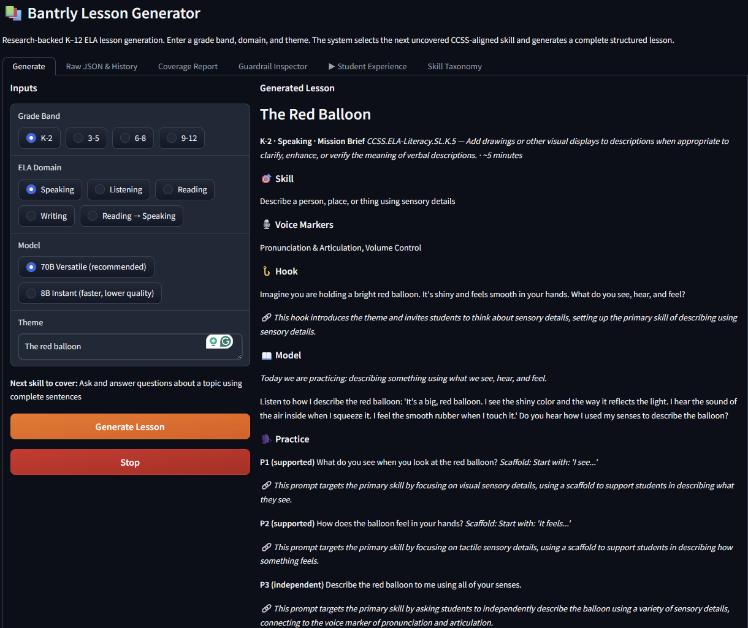
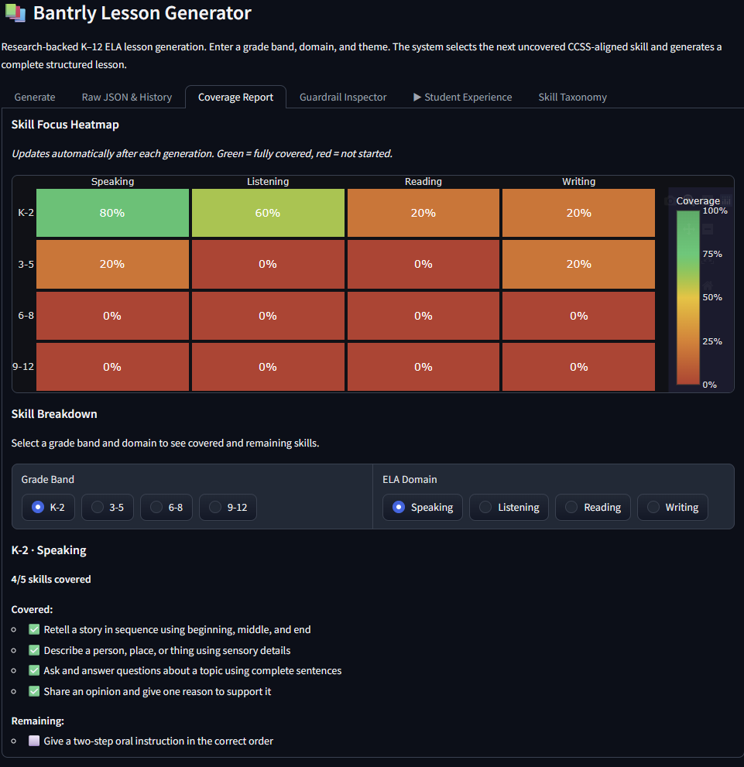
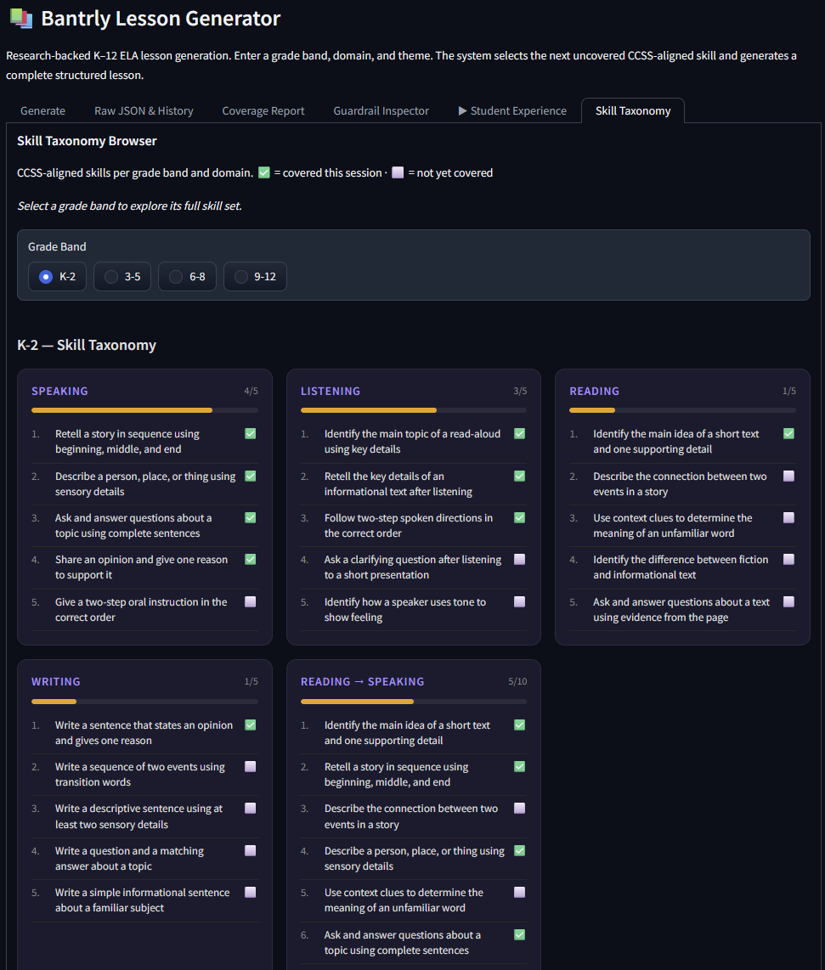
LIVE DEMO
Bantrly Lesson Generator — HF Spaces
https://huggingface.co/spaces/aankitdas/bantrly-lesson-generator
① Generate tab — pick grade band, domain, theme → watch lesson appear
② Student Experience tab — step through Hook → Model → Practice → Reflect
③ Coverage Report — skill heatmap, what's been taught
④ Raw JSON — show the actual data structure

Slide 12
LIMITATIONS & V2 ROADMAP
Honest about what doesn't work yet.
KNOWN LIMITATIONS
V2 ROADMAP
Cultural bias detection
Structured output mode
Keyword-based — misses subtle bias, may false-positive
response_format: json_schema eliminates validator edge cases
One few-shot example per band
Embeddings-based RAG
True RAG would use embeddings and a vector store
Vector similarity for few-shot retrieval, not hardcoded examples
No structured output mode
Student performance routing
Would eliminate practice dict auto-correction entirely
Skill cycling toward gaps, not deterministic index cycling
Flat JSON registry
Persistent storage
Production needs a database with concurrent write safety
Database-backed registry — survive HF Spaces restarts
Deterministic skill cycling
Voice pipeline integration
Production would use student performance data
Connect to Bantrly's speech processing for real marker scoring
No voice analysis
Formalise learning_goal_connection
Prototype shows prompts only — no speech recording or processing
Add Optional[str] to Hook, PracticePrompt, Reflect in schema.py

Slide 13



V2 ARCHITECTURE
Production-ready. AI-agentic.
INFRASTRUCTURE
S3
Kendra
Bedrock
AgentCore
→
→
Prompts, lesson files,
skill taxonomy
Vector knowledge base
+ data connector
AI agents
orchestration
AGENTIC LAYER
MCP
Lambda Skills
Agent Memory
Voice Pipeline
Model Context Protocol
for tool integration
Serverless functions
as callable agent tools
Student performance
routing + skill history
Bantrly speech signals
feed back into agents
Notes:
S3 — store prompts, lessons, and taxonomy outside the codebase so updates don't require redeployment
Kendra — vector knowledge base that retrieves the most relevant few-shot examples at generation time, replaces hardcoded examples
S3 → Kendra connector — Kendra automatically indexes whatever lands in S3, no manual ingestion pipeline
Bedrock AgentCore — orchestrates multi-step reasoning across tools instead of a single linear LLM call
MCP — standard protocol for defining tools the agent can discover and call, not locked to one model or framework
Lambda Skills — guardrails, skill selection, validation each become independent serverless functions that scale to any load
Agent Memory — tracks what each student has practiced, so skill selection is driven by individual gaps not deterministic index cycling

Slide 14
BANTRLY
Questions.
GitHub
github.com/aankitdas/bantrly-lesson-generator
HF Spaces
huggingface.co/spaces/aankitdas/bantrly-lesson-generator
Aankit Das · Bantrly Candidate Trial · March 2026

