Slide 1
Анализ современных подходов сжатия LLMs
Воронова Анастасия & Носков Андрей

Slide 2
Пространство для исследований:
Изучение современных методов сжатия моделей
Локальный запуск сжатых решений (open-source решения)
HW Limitations (!)
Сравнительный анализ результатов
требуемая память
возможность локального развертывания
inference time

Slide 3
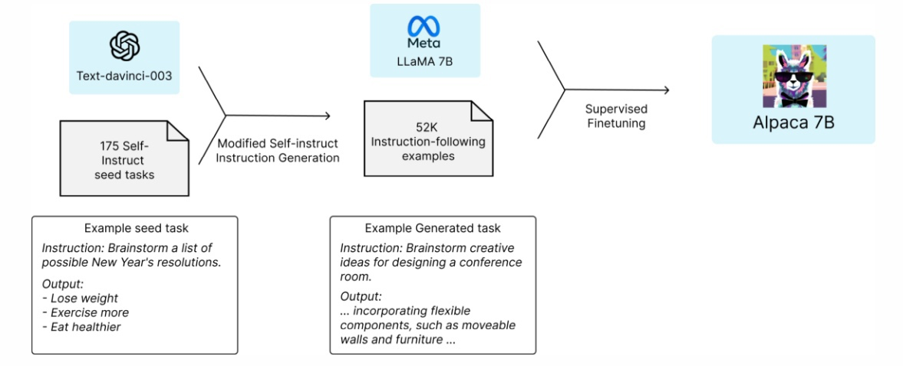
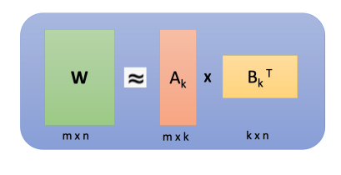
Методы сжатия моделей
Квантизация
Knowledge distillation
Материалы:
https://arxiv.org/pdf/2106.09685.pdf
https://arxiv.org/pdf/2305.14314.pdf
https://crfm.stanford.edu/2023/03/13/alpaca.html
https://arxiv.org/pdf/2305.11627v2.pdf
https://pytorch.org/docs/stable/quantization.html
https://docs.openvino.ai/2022.3/pot_default_quantization_usage.html
Low rank decomposition

Slide 4
Квантизация LLMs
Воронова Анастасия & Носков Андрей

Slide 5
Типы квантизации:
Post-training quantization
Naive 8-bit quantization
LLM.int8() (https://arxiv.org/pdf/2208.07339.pdf)
4-bit quantization with GPTQ (https://arxiv.org/pdf/2210.17323.pdf)
Quantization-Aware training

Slide 6

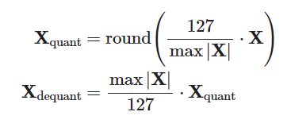
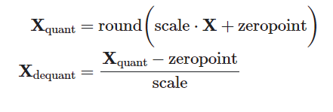
Naive 8-bit quantization:
Absolute maximum (absmax) quantization
Zero-point quantization

Slide 7
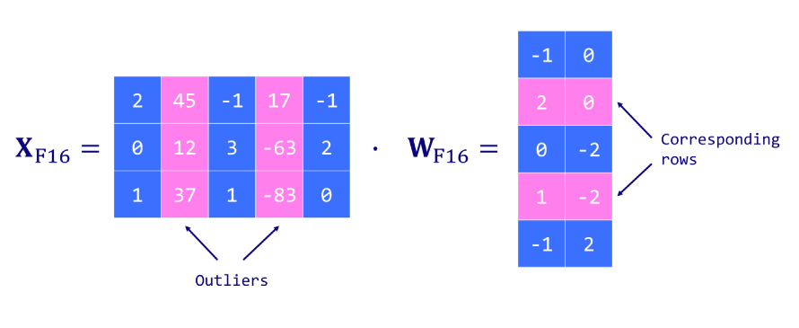
LLM.int8():
Method is based on absolute maximum (absmax) quantization

Slide 8
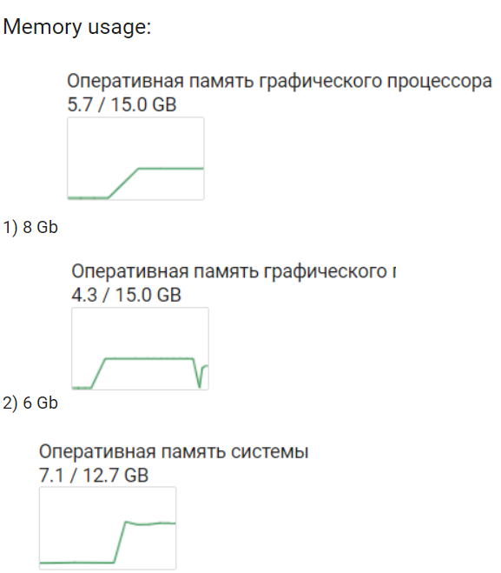
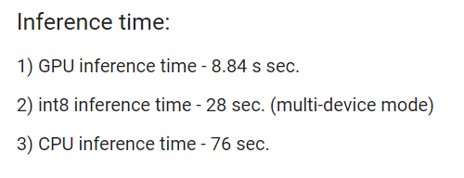
Практическая часть:
RedPajama-Chat-3B
Next models:
MPT-7B
Llama-2-7b

Slide 9

4-bit quantization with GPTQ (https://arxiv.org/pdf/2210.17323.pdf):
GPTQ is a model quantization method that allows language models to be quantized to precision levels like INT8, INT4, INT3, or even INT2 without significant performance loss
We need to:
minimize the loss function from the quantization
know how to compute the best parameter values for this quantization

Slide 10
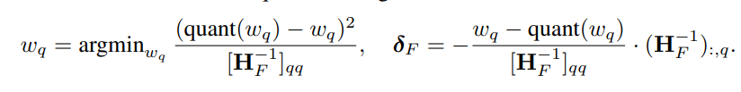
4-bit quantization with GPTQ (https://arxiv.org/pdf/2210.17323.pdf):
We use:
Hessian
Layer-wise + optimal brain quantization
Cholesky decomposition

Slide 11
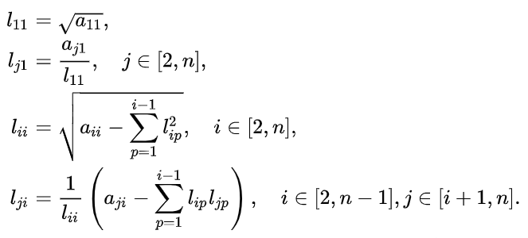
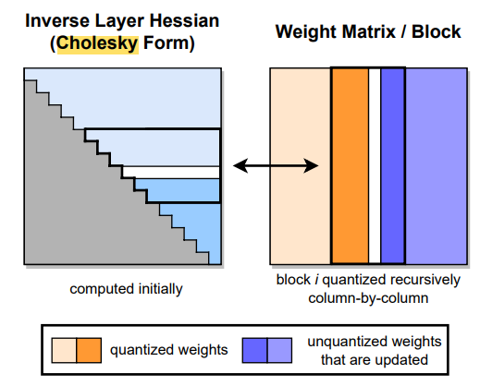
4-bit quantization with GPTQ (https://arxiv.org/pdf/2210.17323.pdf):
We use:
Hessian
Optimal brain quantization
Cholesky decomposition

Slide 12
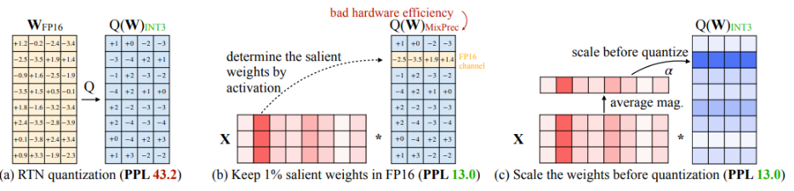
Activation-aware Weight Quantization (AWQ) (https://arxiv.org/pdf/2306.00978.pdf):
Два основных шага:
Взвешивание ответов: на каждом слое нейронной сети определяются веса ответов, которые представляют важность каждого ответа для итоговой оценки модели.
Квантизация: после определения весов ответы квантуются, сохраняя только наиболее значимые биты. Количество сохраняемых битов определяется весами ответов.

Slide 13
Практическая часть:
RedPajama-Chat-3B

Slide 14
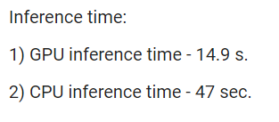

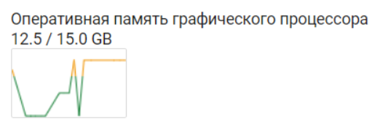

Практическая часть:
Llama-2-7b with GPT-Q (4 bit)
Llama-2-7b with AWQ (4 bit)

Slide 15
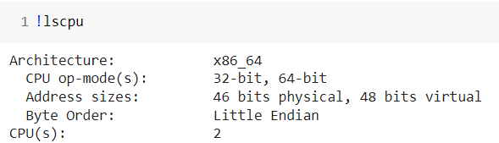
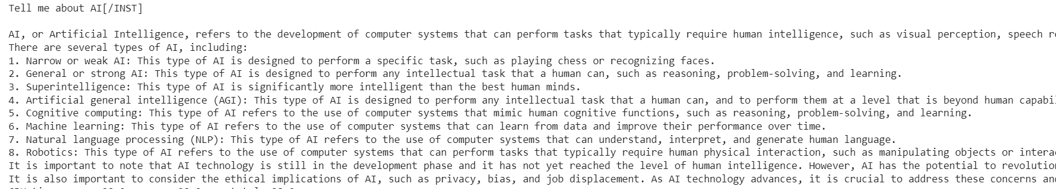
Generation example with Llama-2
Alan Turing was a British mathematician, computer scientist, and codebreaker who lived from 1912 to 1954. He made significant contributions to the fields of mathematics, logic, and computer science, including the development of the theoretical foundations of modern computer science and the design of the Automatic Computing Engine, an early electronic computer. Turing is also known for his work on artificial intelligence and the concept of the Turing test, which is used to measure a machine's ability to exhibit intelligent behavior equivalent to, or indistinguishable from, that of a human. His life and legacy have been recognized through numerous awards, tributes, and films, including the 2014 film "The Imitation Game," starring Benedict Cumberbatch as Turing.
CPU, ~1 min 40 sec
GPU, ~40 sec.

Slide 16
Метрики качества
Результаты:
Датасет:
WikiText
https://huggingface.co/datasets/wikitext
~4k sample from testing sample
Model | BLUE score
RedPajama-Chat-3B (float16) | 0.48
RedPajama-Chat-3B (bfloat16) | 0.48
RedPajama-Chat-3B (int8) | 0.48
Llama-2-7b GPT-Q | 0.57
Llama-2-7b AWQ | 0.58

