Slide 1
Introduction to Linux
Joseph Anthony C. Hermocilla
jchermocilla@up.edu.ph
Systems Research Group
ICS-UPLB
20 May 2014

Slide 2
Objectives
At the end of this training you will
Be able to explain what Linux is and how it works
Be able to effectively use the command line interface (CLI) to execute commands and navigate around the file system
Have an overview of Linux tools useful for bioinformatics

Slide 3
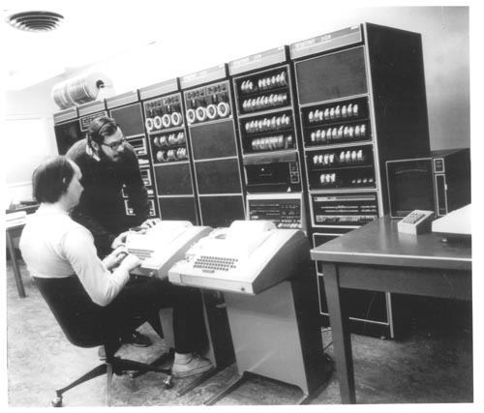
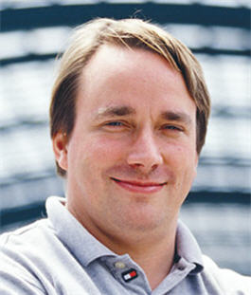
Why Linux
Free open source operating system based on UNIX specifications
Popular in servers and in bioinformatics
UNIX created in 1970s by Bell Labs
Ken Thompson and Dennis Ritchie inventors of UNIX at Bell labs in front of PDP-11
Linux: Linus Torvalds in 1990s

Slide 4
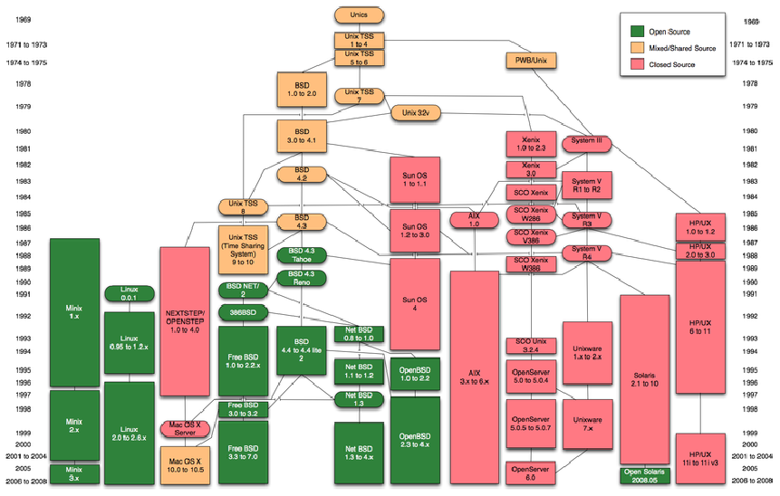
Unix Timeline

Slide 5
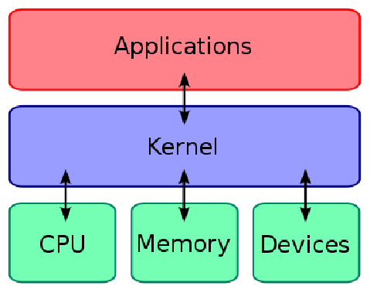
Operating Systems

Slide 6
Linux Distributions
Around the Linux kernel, several distributions (distros) were created
Contain administration tools (package managers) and other software
Main Distros
Red Hat (rpm)
Debian (apt)
Ubuntu (derived from Debian)
Lots of others

Slide 7
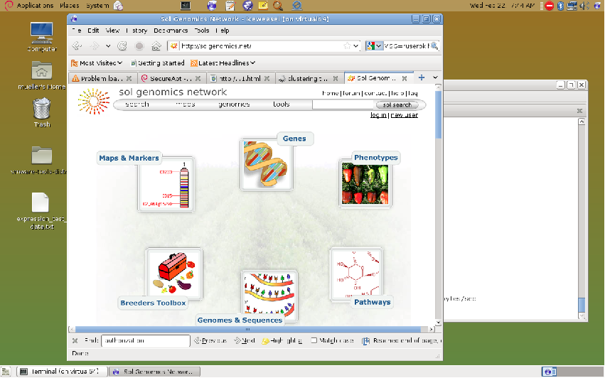
A Debian Linux System

Slide 8
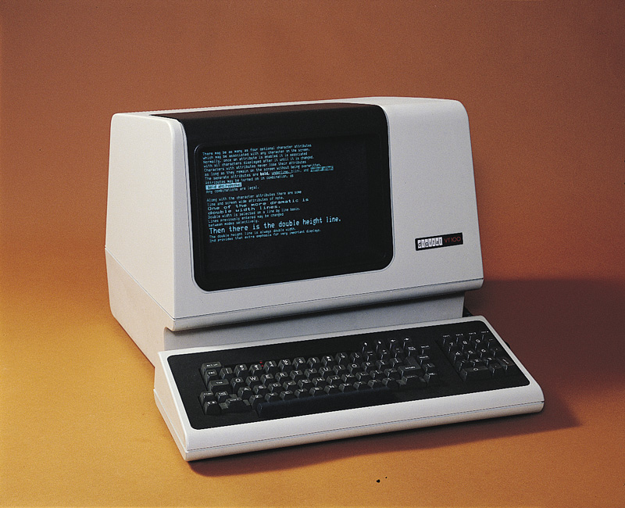
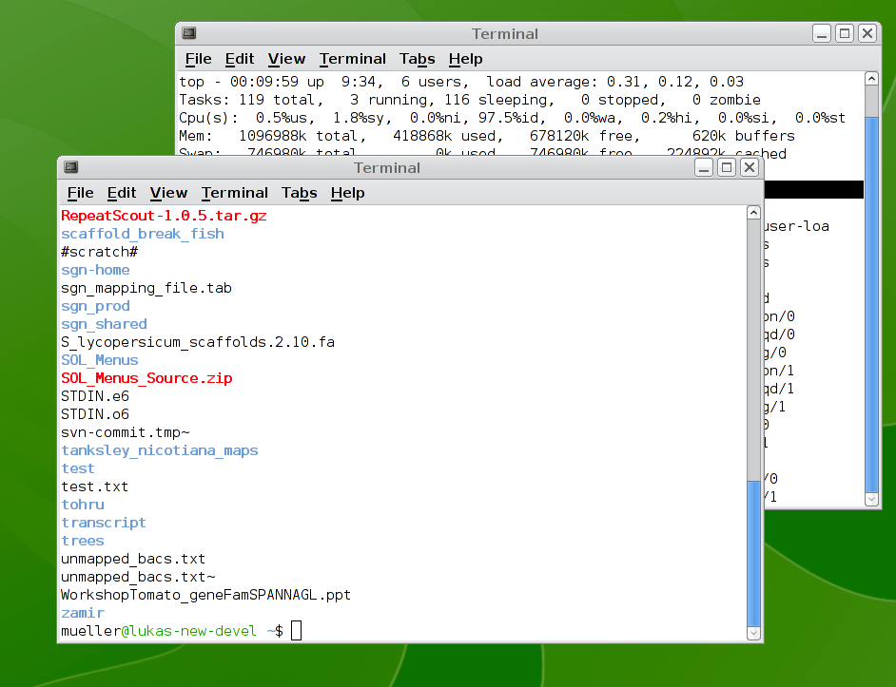
Unix- the terminal

Slide 9
Shells
Run in a terminal
“Command Line Interface” (CLI)
executing commands (such as ls )
Built-in scripting language
Different types
sh, csh, tcsh, bash
Linux and MacOS both use bash by default

Slide 10
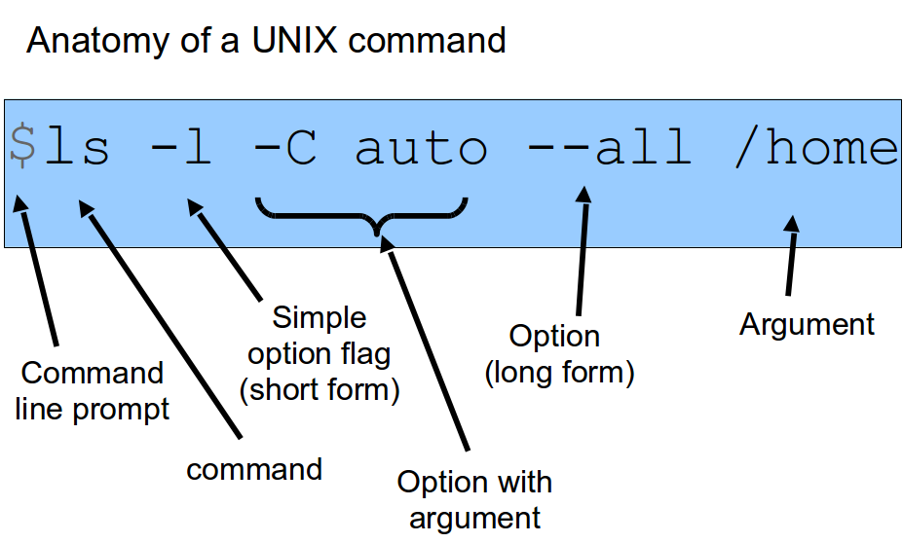
Unix Commands

Slide 11
Working with the shell
Type and execute commands
Interrupting, terminating execution (control-Z , control-C )
Viewing running jobs (jobs )
Background/foreground jobs (bg , fg, & )
History (up key, control-R , history , !, !!, etc)
Autocompletion (tab and tab-tab )

Slide 12
Multiuser System
UNIX can accommodate several users on a system
Every user can “own” files and processes (permissions)
Users can also be part of one or more groups
Groups also have permissions
Users need to login before using the system (authentication)

Slide 13
File System
Hierarchical filesystem
Folders (directories in UNIX-speak) are separated by “/”
“/” is the root
Paths starting with “/” are “absolute” (ie /etc/apt/sources.list)
Paths not starting with “/” are “relative” (ie Desktop/ ) to the current directory
Commands: pwd, ls, cd
“~/” denotes the home directory, for example /home/bioinfo/
“..” refers to the directory above the current directory

Slide 14
File System
File conventions
Files starting with a “.” are not readily visible (.bashrc)
File extensions (.txt, .pdf, etc) denote the file type

Slide 15
File System Layout
Main higher-level system dirs (exact layout depends on distribution
/bin & /lib - code and code libraries
/usr - more code and libraries
/var - logs and other data
/home – user directories, eg. /home/bioinfo/
/tmp - temporary files
/etc - configuration information
/proc - special file system in Linux

Slide 16
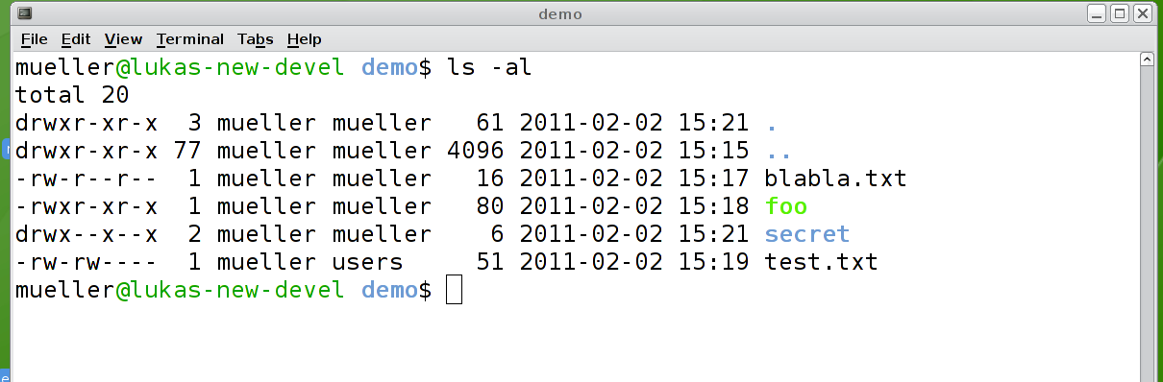
Owners, Groups, and Permissions
The command ls lists files
drwxrwxrwx are type, user, group, and others permissions; r read, w write, x execute, - means no permission
Commands: chmod, chown, chgrp

Slide 17
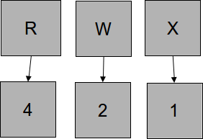
chmod
chmod +x tst.pl # make it executable
chmod ugo+rwx test.txt # give full perms
chmod o+x test.txt # 'other' can execute
chmod 755 test.txt # corresponds to rwxr-xr-x
chmod -R g+w . # recurse through subdirs

Slide 18
Superuser permissions
UNIX has one superuser, called root
Root has infinite privileges
On modern systems like Ubuntu and MacOS, this user has been deactivated (security hazard)
These systems use sudo instead
Prefix command to be run as superuser with sudo
sudo ls -al /var/log/
Or, obtain a root shell: sudo -s
The password is your account password.
Be careful with sudo!!!!!!! Only use when necessary!

Slide 19
Processes
Every running program is treated as a process
Every process has a process ID and an environment
Processes are created only from other processes through fork . (parent ID)
First process is init, with process ID 1
Viewing processes: ps , jobs , top
Terminating processes: kill

Slide 20
Viewing Running Processes
top
Shows all processes as a self updating list
ps
Outputs process information to STDOUT.
Try: ps -elF
Linux: The /proc filesystem
Do an ls /proc – every number is a dir correspondig to a running process. The dir contains more data.

Slide 21
Environment Variables
Variables built into the shell
Assigning environment variables (bash)
export TEST=”this is a test”
Retrieving the values (bash)
echo $TEST
Popular environment variables
$HOME
$SHELL
$EDITOR

Slide 22
Commands
Any executable can be run as a command
Any executable in the $PATH can be run without specifying the full path
Finding out $PATH
echo $PATH
Finding out which executable is run
which ls

Slide 23
Man pages
Man pages are the documentation for UNIX commands
man <command>
man ls
Searching man pages
Use the apropos command
apropos “text editor”

Slide 24
less
less textfile.txt
less commands
Searching: /
Page down: spacebar, Page up: b
Beginning of file: <
End of file: >
Goto line: line number
Quit: q

Slide 25
grep
Matches a pattern in a file
grep <pattern> <file>
Or
cut -f1 <file> | grep pattern | less
Options
-v the complement set (non-matching lines)
-i case insensitive matching
Pattern
Is a regular expression (see later)

Slide 26
Pipes “|” and redirects “<“,”>”
STDIN and STDOUT
STDIN is by default the keyboard
STDOUT is by default the screen
Pipes can capture the STDOUT output of a program and feed it into the STDIN of another program
For example
ls | sort | less

Slide 27
sed
“Stream editor”
Allows to modify streams
Match and replace:
cat README.txt | sed 's/Linux/XXXXX/' | less

Slide 28
Command Summary
Help: man, info, apropos
File system: ls, cd, mkdir, rmdir, cp, mv, find, rm
Files: more, less, cat, wc, ln
Permissions: chmod, chown, chgrp
Processes: jobs, top, ps, fg, bg
Text handling: grep, cut, sort, uniq
Internet: ftp

Slide 29
FTP
ftp ftp.solgenomics.net
“Anonymous” access
Username: ftp (or anonymous)
Password: your email address
List files: ls
Change directories: cd
Change local directory: lcd
Toggle passive mode: passive
Download a file: get <file>

Slide 30
Editing programs
Why not use Microsoft Word?
Embedded control characters in file formats
No syntax highlighting / auto indentation
No integration with other development tools
Some tools:
Emacs
Vi, vim, gvim
Eclipse
Xcode (Apple)
Nano

Slide 31
Using emacs
Command: emacs
Opens a new window if X-window system present
Visit file: control-x control-f
Save file: control-x control-s
Save as another file: control-x control-w
Close program: control-x control-c
Cancel operation: control-G
Search forward: control-S
Modes: automatic detection of Perl-mode

Slide 32
Vim
Command: vim
Modes
Command mode (when starting vim) – alphanumeric keys are bound to commands (for navigation, copy/paste), press “Esc” to enter this mode
Insert mode (when “i” is pressed in command mode) – alphanumeric characters are treated as is (text and numbers), press “Esc” to return to command mode
Last-line mode (when “:” is pressed) – for saving and quitting, a “:” will appear at the bottom-left of the screen

Slide 33
Moving vim(must be in command mode)
h – one character to the left
j – down one line
k – up one line
l – one character to the right
0 (zero) – beginning of line
$ - end of line
w – move forward one word
b – move backward one word
G – move to the end of file
gg – move to beginning of file
(note: preface command with numbers to execute multiple times)

Slide 34
Editing in vim(must be in command mode)
x- delete the character on cursor
d– starts the delete operation
dw –delete a word
d0 – delete to the beginning of line
d$ - delete to the end of line
dgg – delete to the beginning of file
dG – delete to the end of file
u – undo the last operation
Ctrl-r – redo the last undo

Slide 35
Searching/Replacing in vim(must be in command mode)
/<text> - search forward
N – move cursor to the next instance of the text from the last search
N – move cursor to the previous instance of the text from last search
?<text> - search backward
:%s/<text>/<replacement>/g – search and replace (last-line mode)
:%s/<text>/<replacement>/gc – search and replace (last-line mode)

Slide 36
Copying/Pasting in vim(must be in command mode)
v – highlight one character at a time
V – highlight one line at a time
Ctrl-v – highlight by columns
p – paste after the current line
P – paste on the current line
Y – copy text

Slide 37
Saving/Quitting in vim(must be in last-line)
:w – save to current filename
:w <new name> - save to new name
:q – quit vim (will prompt if file has not been saved)
:q! – forced quit (no prompt)

Slide 38
Simple system admin tasks
Changing the account password
passwd

Slide 39
The .bashrc file
Is executed every time a bash shell is opened
Customize shells and commands
Set environment variables ($EDITOR etc)
Use aliases of commands using alias
alias “ls”=”ls -l”
Embed other shell code
Command to source modified file: source
source ~/.bashrc

Slide 40
Installing programs in Ubuntu
Debian package manager
Central repository of programs/code
Knows about dependencies
Searching packages:
apt-cache search gvim
Installing packages:
sudo apt-get install vim-gnome
Updating the package index
sudo apt-get update

Slide 41
Checking list of installed files
Checking the list of installed files
$dpkg-query –L <package name>

Slide 42
Compressing files
Create a new folder to contain the files
$mkdir backup
Copy the files to the folder using cp
Zip
$zip backup.zip backup/*
Tar Gzip
$tar czvf backup.tar.gz backup/*
Tar Bzip2
$tar cjvf backup.tar.bz2 backup/*

Slide 43
Uncompressing files
Zip
$unzip backup.zip
Tar Gzip
$tar xzvf backup.tar.gz
Tar Bzip2
$tar xjvf backup.tar.bz2

Slide 44
Remote Shell Access
Allows you to gain access to the CLI of a machine outside of your institution (provided that the machine is accessible through the Internet)
Secure Shell (SSH)
$ssh <username>@<machine name/IP>
$ssh jachermocilla@10.0.3.10
Secure Copy (SCP)
$scp <file to copy> <username>@<machine name/IP>:./
$scp test.txt jachermocilla@10.0.3.10:./

