Slide 1
Graduate Seminar
Experiences in deploying an Openstack private cloud
Joseph Anthony C. Hermocilla
Professor: Dr. Vladimir Y. Mariano
3 April 2014

Slide 2
Outline
Cloud computing definition (revisited)
Openstack (revisted)
The Peak-Two private cloud
INSTANT on Peak-Two
HPC with MPI
Deploying an MPI cluster with vcluster
Some benchmark results
Future work

Slide 3
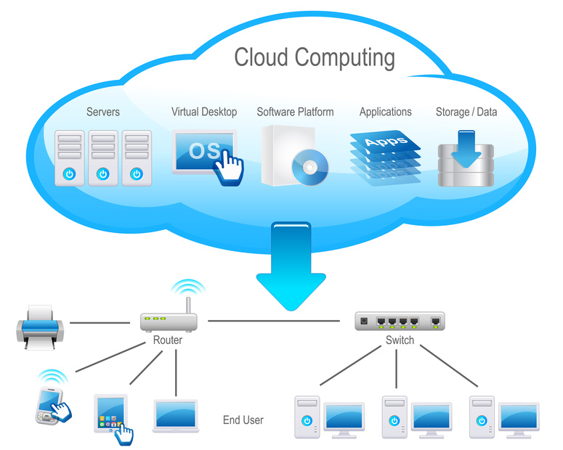
Cloud Computing (CC)
“is a model for enabling ubiquitous, convenient, on-demand network access to a shared pool of configurable computing resources (e.g. networks, servers, storage, applications, and services) that can be rapidly provisioned and released with minimal management effort or service provider interaction.” - NIST
img src:http://www.cloudcomputinginindia.in/

Slide 4
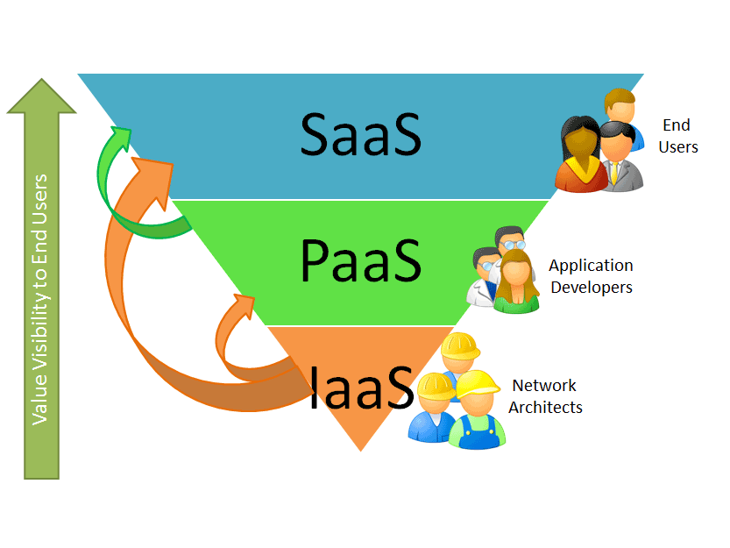
CC Service Models
Software-as-a-Service (SaaS)
  ex. Google Docs, Dropbox
Platform-as-a-Service (PaaS)
  ex. Google App Engine, Heroku
Infrastructure-as-a-Service (IaaS)
  ex. Amazon EC2, Rackspace, Microsoft Azure
http://natishalom.typepad.com/nati_shaloms_blog/saas/

Slide 5
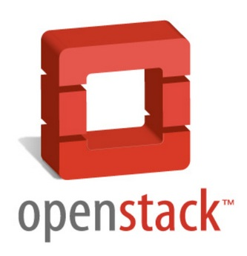
OpenStack
“OpenStack is a cloud operating system that controls large pools of compute, storage, and networking resources throughout a datacenter, all managed through a dashboard that gives administrators control while empowering their users to provision resources through a web interface.”

Slide 6

OpenStack

Slide 7
OpenStack Components
Object Store(“Swift”) - provides object storage
Image(“Glance”) - provides a catalog and repository for virtual disk images
Compute(“Nova”) - provides virtual servers upon demand
Dashboard(“Horizon”) - provides a modular web-based user interface for all the OpenStack services
Identity(“Keystone”) - provides authentication and authorization for all the OpenStack services
Network(“Quantum”) - provides “network connectivity as a service”
Block Storage(“Cinder”) - provides persistent block storage for guest VMs

Slide 8
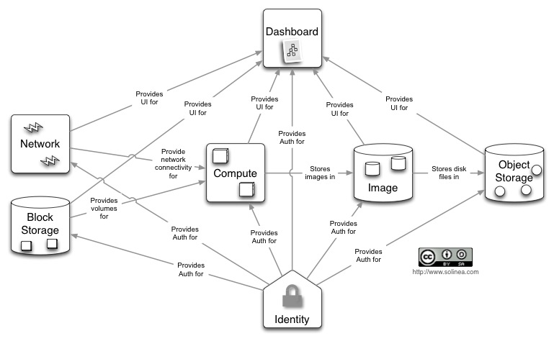
OpenStack Conceptual Architecture

Slide 9
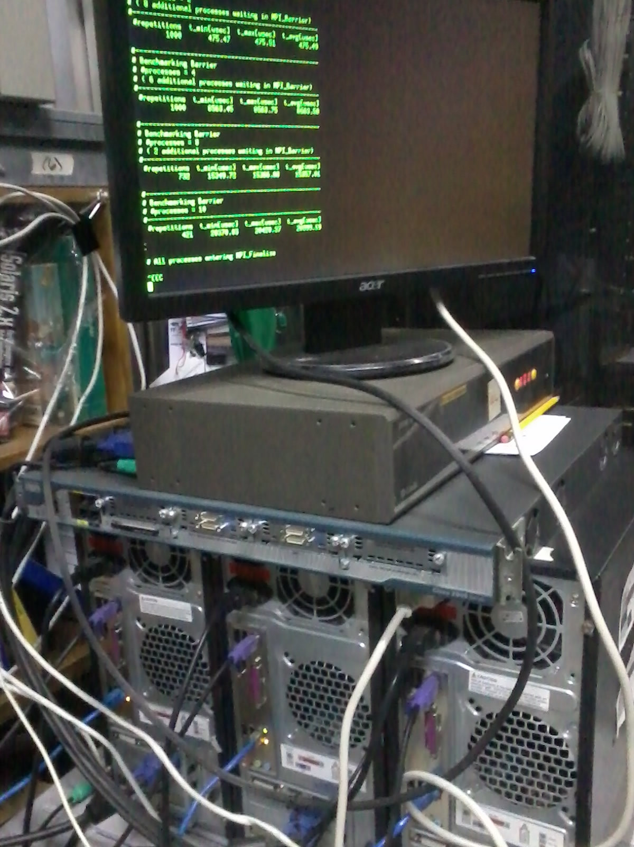
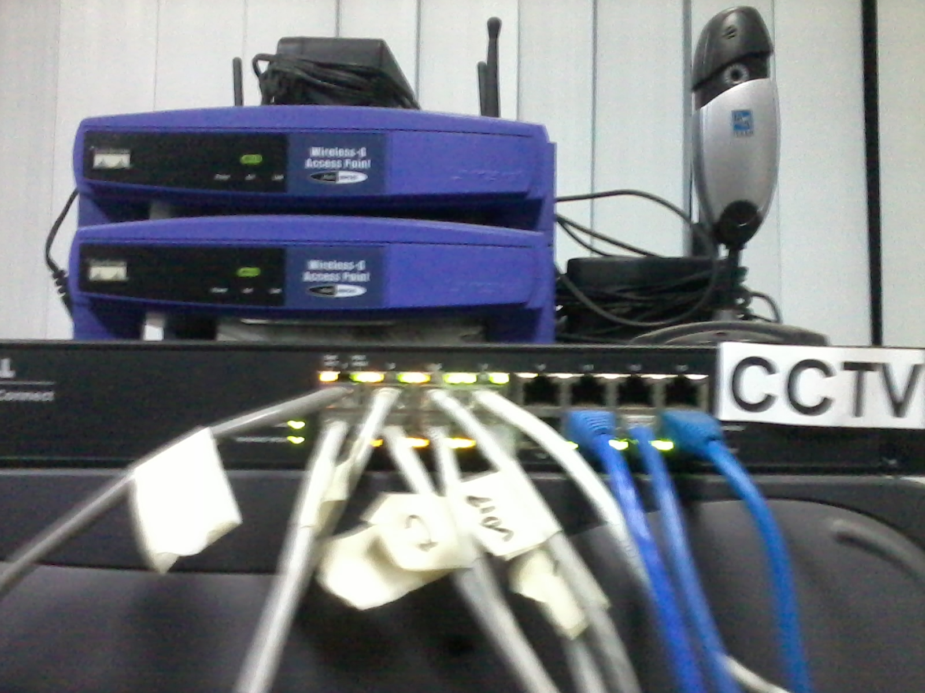
Peak-Two Cloud (PTC)
Main objective is to deploy an experimental private cloud based on OpenStack for research
Use commodity hardware
Cloud instances are accessible from the ICS Network (10.0.3..x)

Slide 10
PTC Hardware
Four-core Intel i3 @ 3.10 GHz
4GB RAM
1 Gigabit Ethernet NIC (1000 Mbps)
1 Fast Ethernet NIC (100 Mbps)

Slide 11
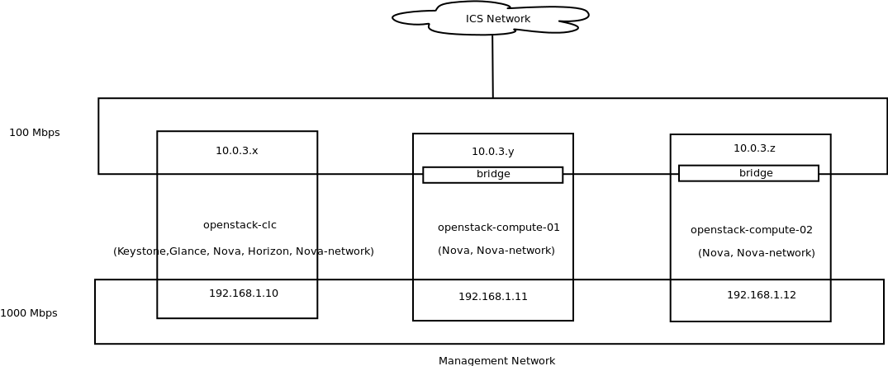
PTC Network

Slide 12
Research Challenges [4]
Automated Service Provisioning
Virtual Machine Migration
Server consolidation
Energy Management
Traffic Management and Analysis
Data security
Software frameworks
Storage Technologies and data management
Novel Cloud Architectures

Slide 13
Conclusion
This seminar has presented an introduction to cloud computing using two open source frameworks: Eucalyptus and OpenStack
Cloud Computing will have a very important role and impact in UPLB

Slide 14
References

Slide 15
References

