Slide 1
Graduate Seminar
Experiences in deploying an Openstack private cloud
Joseph Anthony C. Hermocilla
Professor: Dr. Vladimir Y. Mariano
3 April 2014

Slide 2
Outline
Cloud computing definition (revisited)
Openstack (revisited)
The Peak-Two Cloud
INSTANT on Peak-Two Cloud
HPC,MPI short intro
Deploying an MPI cluster with vcluster
IMB benchmark results
Future work

Slide 3
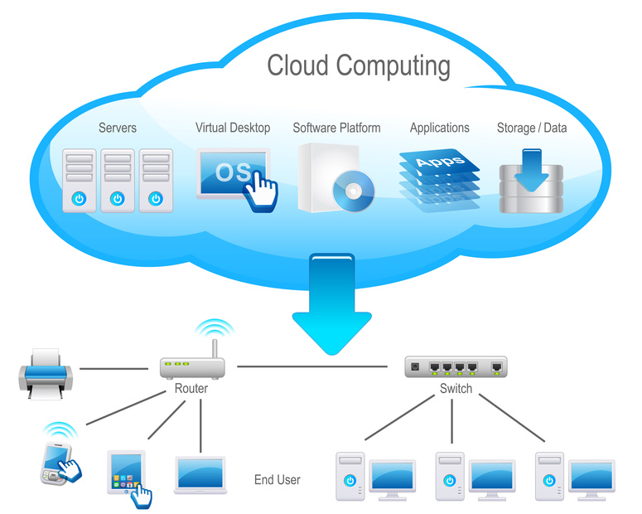
Cloud Computing (CC)
“is a model for enabling ubiquitous, convenient, on-demand network access to a shared pool of configurable computing resources (e.g. networks, servers, storage, applications, and services) that can be rapidly provisioned and released with minimal management effort or service provider interaction.” - NIST
img src:http://www.cloudcomputinginindia.in/

Slide 4
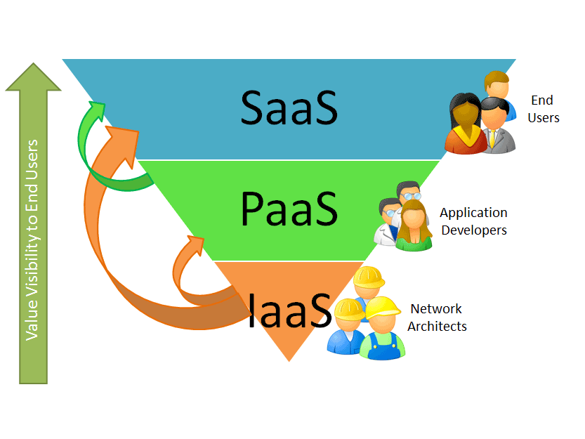
CC Service Models
Software-as-a-Service (SaaS)
  ex. Google Docs, Dropbox
Platform-as-a-Service (PaaS)
  ex. Google App Engine, Heroku
Infrastructure-as-a-Service (IaaS)
  ex. Amazon EC2, Rackspace, Microsoft Azure
http://natishalom.typepad.com/nati_shaloms_blog/saas/

Slide 5

OpenStack
“OpenStack is a cloud operating system that controls large pools of compute, storage, and networking resources throughout a datacenter, all managed through a dashboard that gives administrators control while empowering their users to provision resources through a web interface.”

Slide 6

OpenStack

Slide 7
OpenStack Components
Object Store(“Swift”) - provides object storage
Image(“Glance”) - provides a catalog and repository for virtual disk images
Compute(“Nova”) - provides virtual servers upon demand
Dashboard(“Horizon”) - provides a modular web-based user interface for all the OpenStack services
Identity(“Keystone”) - provides authentication and authorization for all the OpenStack services
Network(“Quantum”) - provides “network connectivity as a service”
Block Storage(“Cinder”) - provides persistent block storage for guest VMs

Slide 8
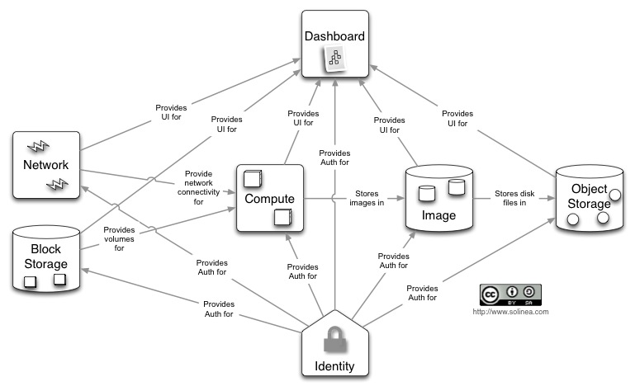
OpenStack Conceptual Architecture

Slide 9
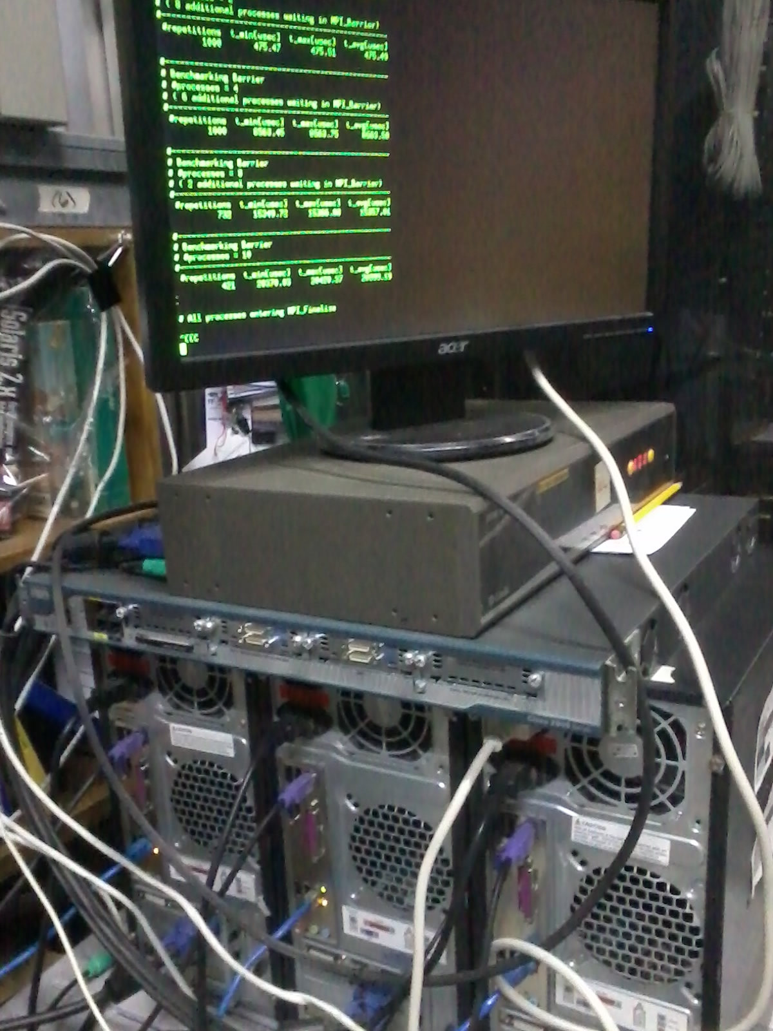
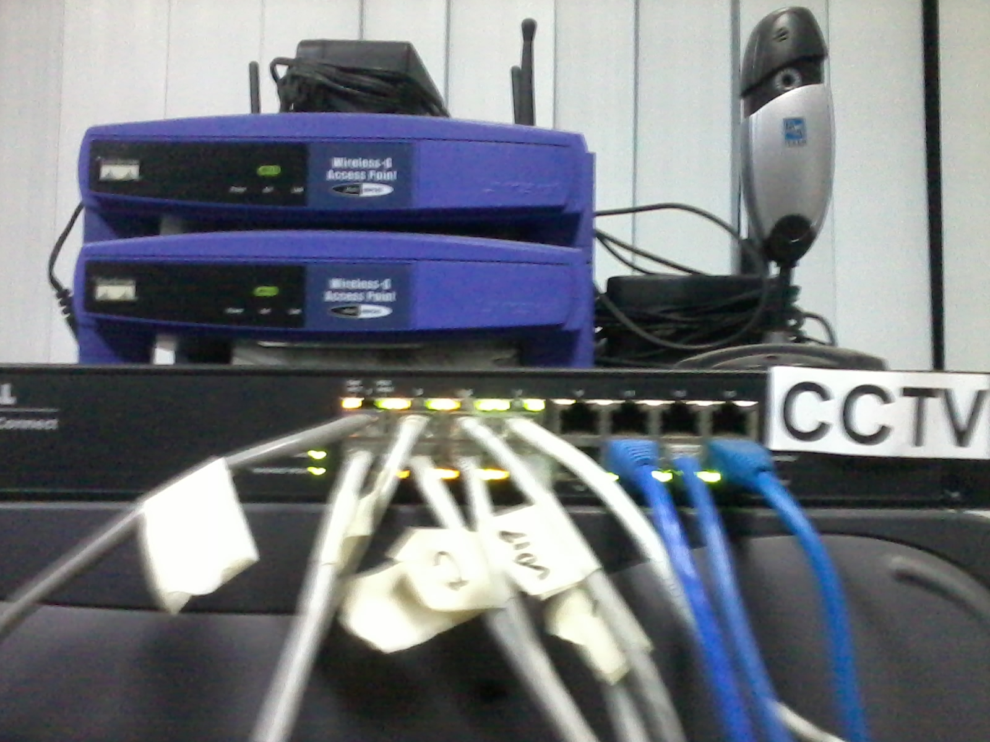
Peak-Two Cloud (PTC)
Main objective is to deploy an experimental private cloud based on OpenStack for research
Use commodity hardware
Cloud instances are accessible from the ICS Network (10.0.3.x)

Slide 10
PTC Hardware
Intel i3 @ 3.10 GHz Four-core
4GB RAM
1 Gigabit Ethernet NIC (1000 Mbps)
1 Fast Ethernet NIC (100 Mbps)

Slide 11
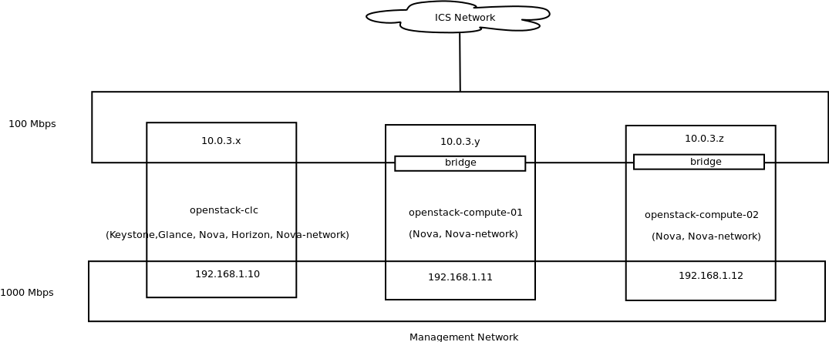
PTC Network

Slide 12
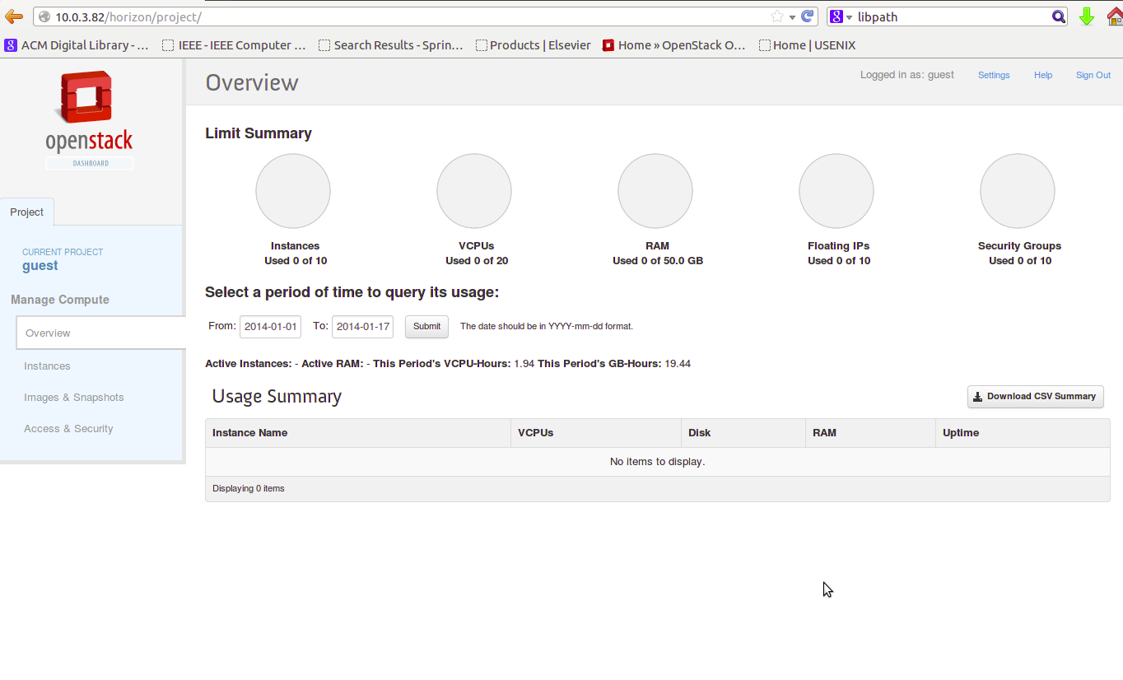
PTC Guest Dashboard

Slide 13
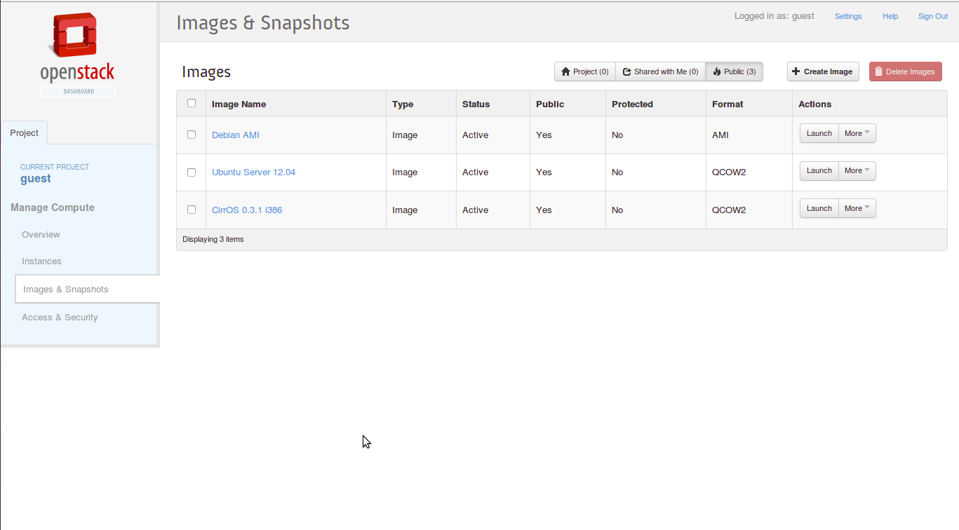
Available Machine Images

Slide 14
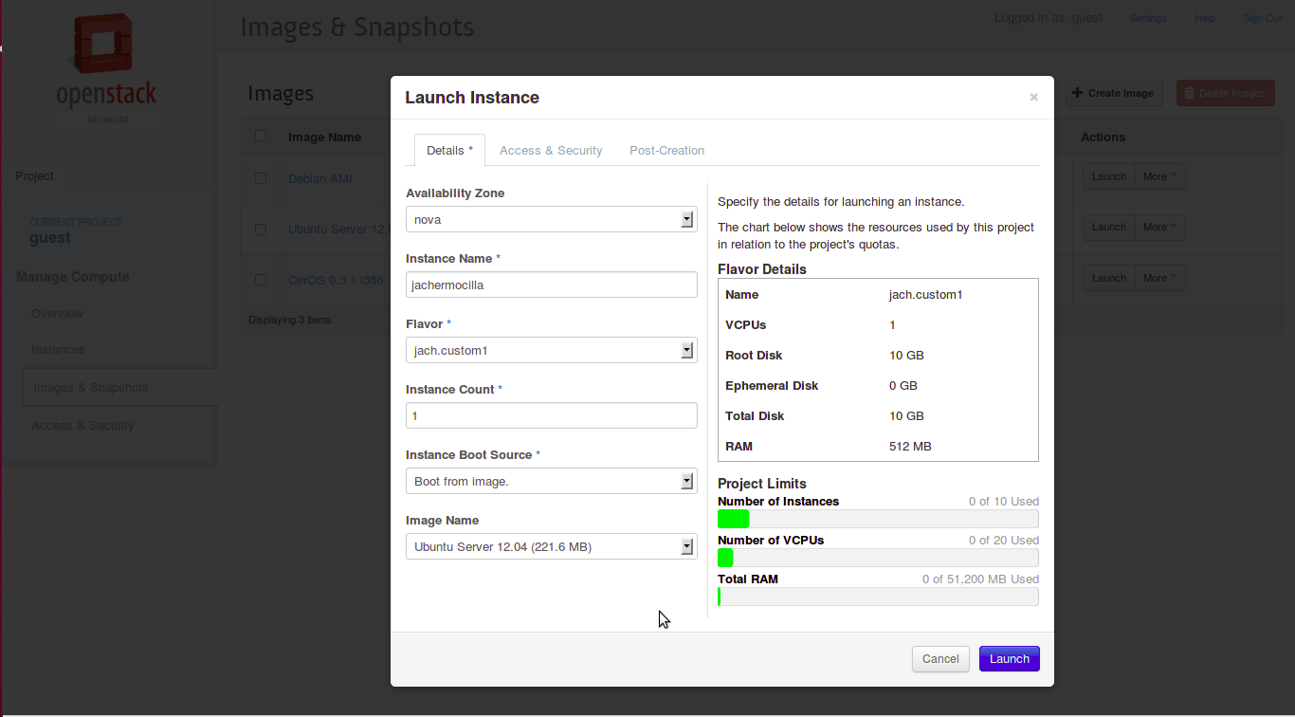
Starting an instance

Slide 15
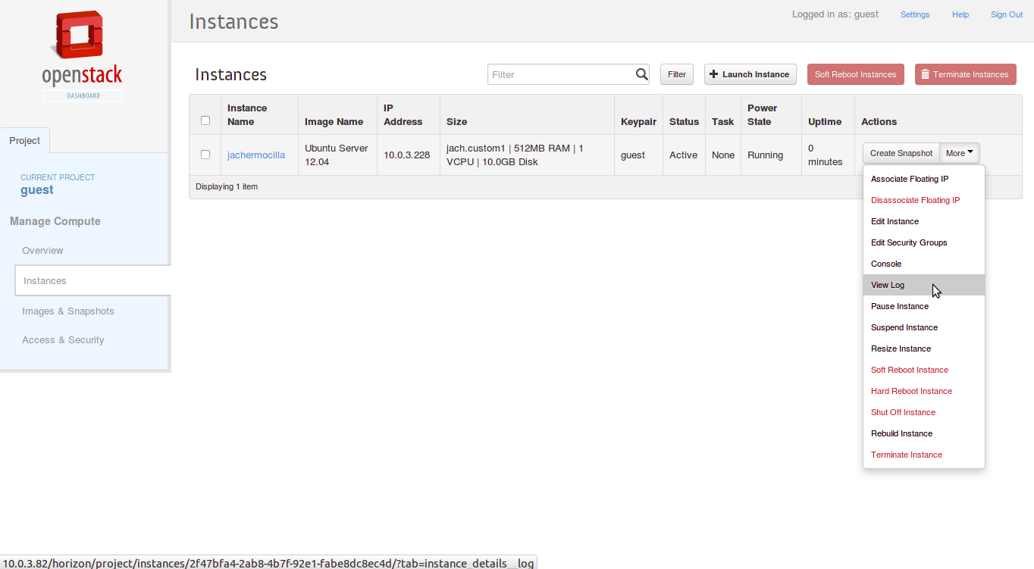
Instance Details

Slide 16
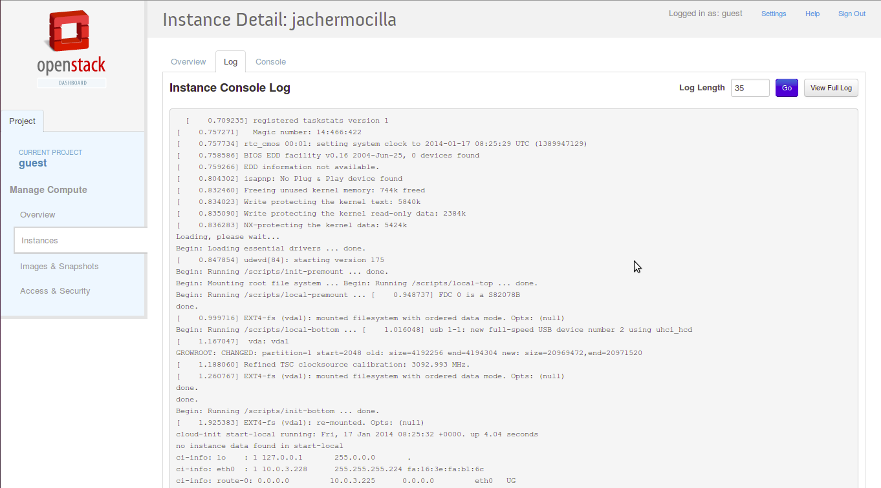
Console Log

Slide 17
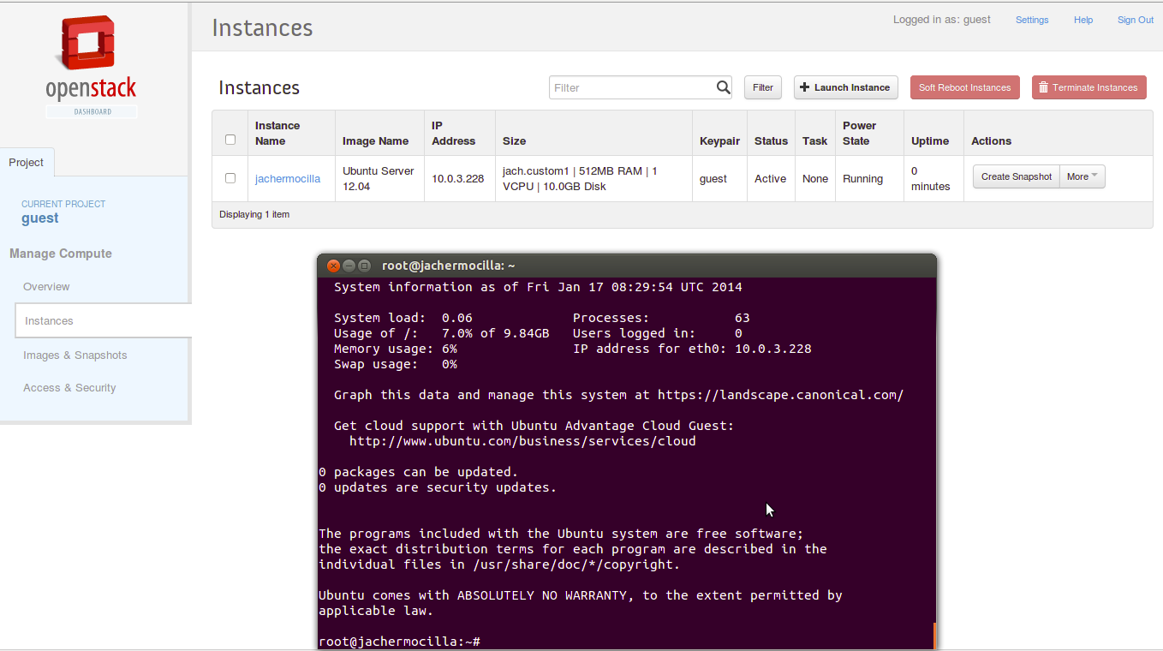
Connecting to the instance

Slide 18
Observations
Setup and configuration requires time
Extensive knowledge in networking and operating sytems is required to troubleshoot
The goal is to make the end user happy

Slide 19

INSTANT on PTC

Slide 20
INSTANT on PTC
Instance configuration : 4 VCPU, 1GB RAM, 10GB disk space
150 students concurrently access from the lab network (10.0.4.y) the instance running a LAMP stack for 1.5 hours (7-8:30pm)

Slide 21
INSTANT on PTC
AWSTATS statistics
  Unique visitors: 225
  Number of visits: 395 (1.75 visits/visitor)
  Pages: 146,032 (369.7 Pages/Visit)
  Hits: 158,237 (400.6 Hits/Visit)
  Bandwidth: 700.77 MB
Bottleneck: MySQL unable to serve connection requests even after adjusting max_connections directive

Slide 22
High Performance Computing (HPC)
“most generally refers to the practice of aggregating computing power in a way that delivers much higher performance than one could get out of a typical desktop computer or workstation in order to solve large problems in science, engineering, or business.”
Src: http://insidehpc.com/hpc-basic-training/what-is-hpc/

Slide 23
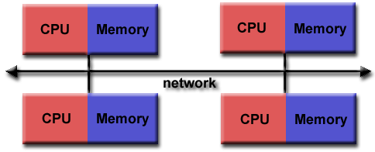
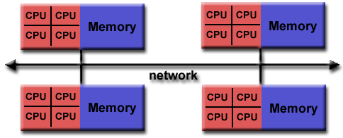
Message Passing Interface (MPI)
A specification
Addresses message-passing parallel programmig model, uses distributed memory
Most recent version is MPI-3
MPICH, OPENMPI, MVAPICH
Src: https://computing.llnl.gov/tutorials/mpi/#What

Slide 24
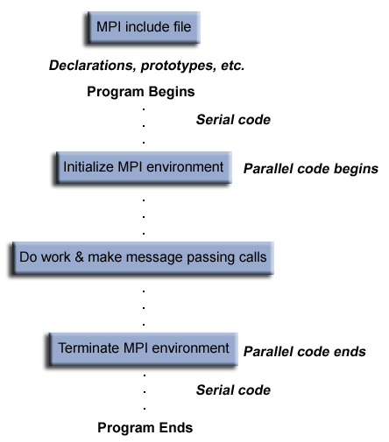
MPI
Src: https://computing.llnl.gov/tutorials/mpi/#What

Slide 25
MPI
#include <stdio.h>
#include <mpi.h>
int main(int argc, char** argv) {
int myrank, nprocs;
MPI_Init(&argc, &argv);
MPI_Comm_size(MPI_COMM_WORLD, &nprocs);
MPI_Comm_rank(MPI_COMM_WORLD, &myrank);
printf("Hello from processor %d of %d\n", myrank, nprocs);
MPI_Finalize();
return 0;
}

Slide 26
vcluster
A set of scripts to automate the deployment of an MPI cluster on PTC
A user who needs to run an MPI program does not need to manually setup the cluster
Cluster of one user is independent of the cluster used by another user – isolation and protection – some scientists do not want to share data/code with others :(
Cluster can be removed after use – reduce hardware maintenance cost

Slide 27
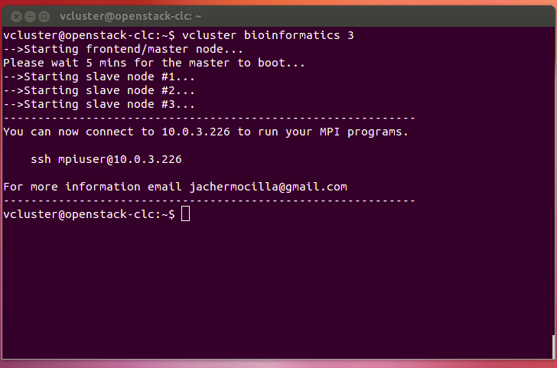
vcluster

Slide 28
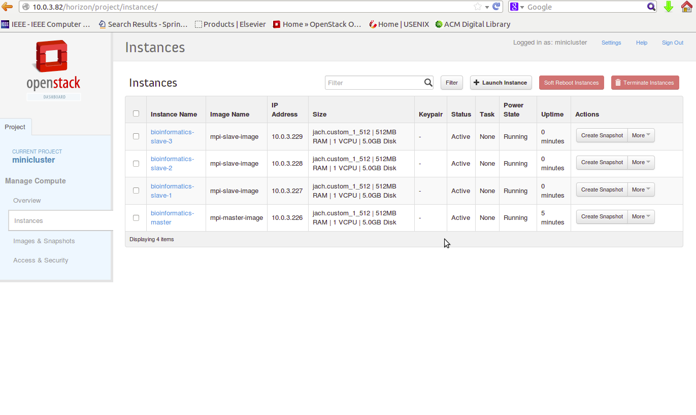
vcluster

Slide 29
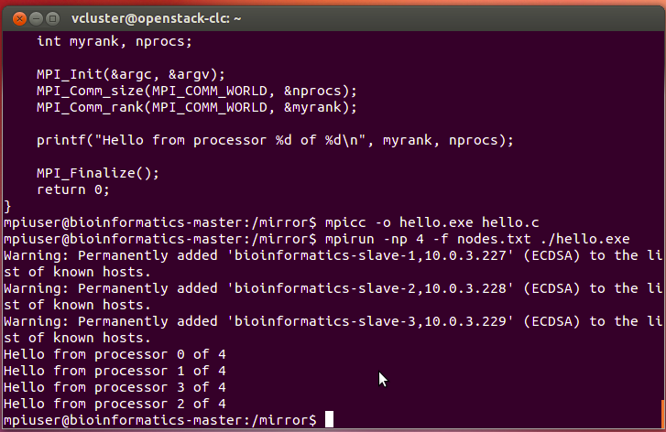
vcluster

Slide 30
Intel MPI Benchmarks
Single Transfer – involves two active processes into communication, others wait
  PingPong – single message between two procs
Parallel Transfer – involves more than two processes into communication
  Sendrecv – proc receives from left sends to right
Collective – collective operations
  Bcast – root process broadcasts bytes to all others

Slide 31
Cluster Specification for Benchmark
10 nodes – 1 master, 9 slaves
Each node: 1 VCPU, 512MB RAM, 5GB disk
Uses NFS to share user directory
MPICH2 on Ubuntu Server 12.04
Deployed using vcluster

Slide 32
PingPong (latency)

Slide 33
PingPong (throughput)

Slide 34
SendRecv(latency, 10 nodes)

Slide 35
SendRecv(throughput, 10 nodes)

Slide 36
Bcast(latency,10 nodes)

Slide 37
Future Work
Add additional machine images (Windows, Bio Linux)
Explore advanced openstack components: Quantum, Swift
Configure teaching laboratory computers as compute nodes of PTC
Explore nova-scheduler
Request for funding
Training
HPL Benchmark

Slide 38
For more info
http://srg.ics.uplb.edu.ph/projects/peak-two-cloud

Slide 39
Thank you!
Enjoy the Coke!

