Slide 1
Eucalyptus and OpenStack: A comparison of two open source cloud computing software
Joseph Anthony C. Hermocilla
CMSC 399
Graduate Seminar
Professor: Dr. Vladimir Y. Mariano

Slide 2
Outline
Introduction
Some definitions of cloud computing
Eucalyptus
OpenStack
Future of Cloud Computing in UPLB
Research Challenges in Cloud Computing
Deadly Sins of Cloud Computing Research
Conclusion

Slide 3
RAD Lab UCB [1]
“Cloud Computing refers to both the applications delivered as services over the Internet and the hardware and systems software in the datacenters that provide those services. The services themselves have long been referred to as Software as a Service (SaaS), so we use the term. The datacenter hardware and software is what we will call a Cloud.”

Slide 4
RAD Lab UCB [1]
Public Cloud – a cloud that is made available in a pay-as-you-go manner to the public
Utility Computing – service being sold to the public in a public cloud
Private Cloud – internal datacenters of a business or organization that are not made available to the public

Slide 5
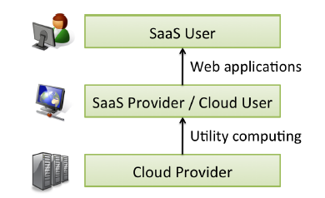
RAD Lab UCB [1]

Slide 6
New aspects in Cloud Computing from hardware point of view[1]
Illusion of infinite computing resources available on demand
Elimination of up-front commitment by Cloud users
Pay for use of computing resource on a short-term basis as needed and release them as needed
Notes:
-eliminate the need for users to plan far ahead for provisioning
-can start small, increase hardware resources when needs increase
-rewards conservation

Slide 7
National Institute of Standards and Technology [2]
“Cloud computing is a model for enabling ubiquitous, convenient, on-demand network access to a shared pool of configurable computing resources (e.g. networks, servers, storage, applications, and services) that can be rapidly provisioned and released with minimal management effort or service provider interaction.”

Slide 8
National Institute of Standards and Technology[2]
Essential characteristics: On-demand self-service, Broad network access, Resource pooling, Rapid elasticity, Measured service
Service Models: Cloud Software as a Service (SaaS), Cloud Platform as a Service (PaaS), Cloud Infrastructure as a Service (IaaS)
Deployment Models: Private cloud, Community cloud, Public cloud, Hybrid cloud

Slide 9
Why Cloud Computing is becoming a hit? [1]
New business models (ex. PayPal)
Selling of hardware-level virtual machine cycles
Mobile interactive applications
Parallel batch processing
Rise of analytics
Extension of compute-intensive desktop applications

Slide 10
What is needed to become a cloud provider? [1]
“A necessary but not sufficient condition for a company to become a Cloud Computing provider is that it must have existing investments not only in very large datacenters, but also in large-scale software infrastructure and operational expertise required to run them.”

Slide 11
Classes of Utility Computing[1]
Amazon EC2 – allows the user to control the entire software stack from the kernel upwards running on virtual machines
Google AppEngine – application-domain specific platforms, not suitable for general-purpose computing
Microsoft Azure – Users's get a choice of language, but cannot control the underlying operating system or runtime

Slide 12
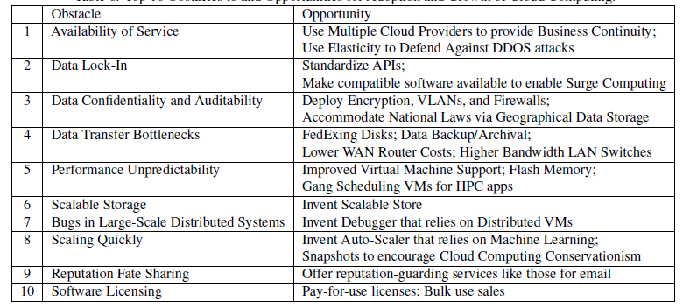
Obstacles and Opportunities[1]

Slide 13
Eucalyptus[3]
“An open-source cloud-computing framework that uses computational and storage infrastructure commonly available to academic research groups to provide a platform that is modular and open to experimental instrumentation and study.”
Addresses the following: VM Scheduling, VM and user data storage, cloud computing administrative interfaces, construction of virtual networks, definition and execution of service level agreements, cloud computing interfaces

Slide 14
Grid Computing vs. Cloud Computing[3]
Grid systems are architected so that individual user requests can (and should) consume large fractions of the total resource pool. Cloud systems limit the size of the individual request and focus on scaling to support large number of users
Grid systems took a middleware-based approach to promote resource federation among cooperating but separate administrative domains. Cloud systems is operated by a single entity with the administrative authority

Slide 15
What makes Eucalyptus different from existing VM Management Solutions?[3]
It is designed from the ground up to be as easy to install and as non-intrusive as possible, without requiring sites to dedicate resources to it exclusively
It is highly modular, with industry-standard, language-agnostic communication mechanism
External interface is based on Amazon EC2 API
Provides a virtual network overlay that both isolates network traffic of different users and allows two or more clusters to appear to belong to the same LAN

Slide 16
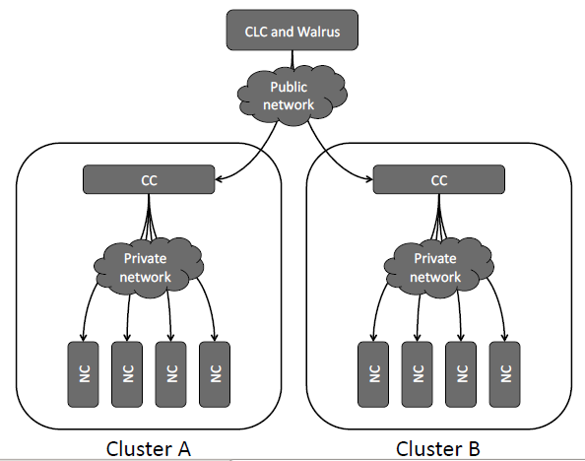
Eucalyptus hierarchical design[3]

Slide 17
Eucalyptus Components[3]
Node Controller
  Controls the execution, inspection, and terminating of VM instances on the host where it runs
Cluster Controller
  Gathers information about and schedules VM execution on specific node controllers, as well as manages virtual instance network
Storage Controller (Walrus)
  Is a put/get storage service that implements Amazon's S3 interface, providing a mechanism for storing and accessing virtual machine images and user data
Cloud Controller
  The entry-point into the cloud for users and administrators

Slide 18
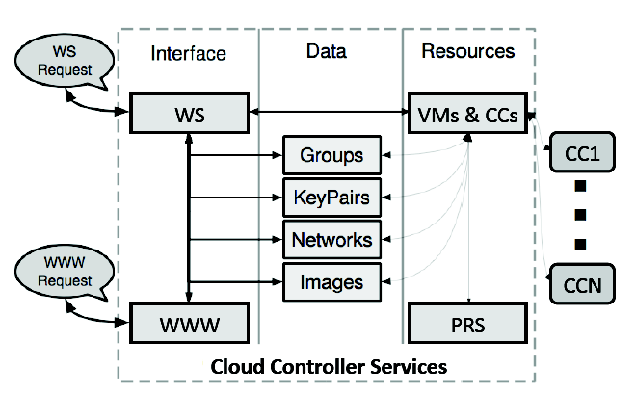
Cloud Controller Services[3]

Slide 19
Eucalyptus Demo

Slide 20
Eucalyptus-Related Work @ICS
Duldulao, Banacia, Belaguin, Hermocilla (NCITE 2011)
  An Accounting Solution for the Open-Source Eucalyptus Cloud Computing Framework
Cabigting, Hermocilla (TR 2012)
  Eucalyptus LSS: Load-Based Scheduling on Virtual Servers Using Eucalyptus Private Cloud
Lo, Jacildo (UG THESIS 2012)
  Evaluation of a Eucalyptus Private Cloud Performance on Flash Crowd Effect

Slide 21
OpenStack[5][6]
“OpenStack is a cloud operating system that controls large pools of compute, storage, and networking resources throughout a datacenter, all managed through a dashboard that gives administrators control while empowering their users to provision resources through a web interface.”

Slide 22

OpenStack[5][6]

Slide 23
OpenStack Components[5][6]
Object Store(“Swift”) - provides object storage
Image(“Glance”) - provides a catalog and repository for virtual disk images
Compute(“Nova”) - provides virtual servers upon demand
Dashboard(“Horizon”) - provides a modular web-based user interface for all the OpenStack services
Identity(“Keystone”) - provides authentication and authorization for all the OpenStack services
Network(“Quantum”) - provides “network connectivity as a service”
Block Storage(“Cinder”) - provides persistent block storage for guest VMs

Slide 24
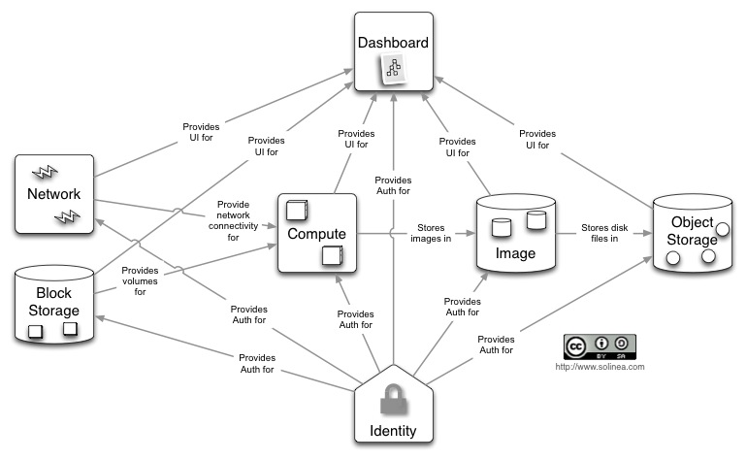
OpenStack Conceptual Architecture[5][6]

Slide 25
OpenStack Demo

Slide 26
Future of Cloud Computing in UPLB
UPLB is an academic institution: research, teaching, extension
Collaborative/Multidisciplinary/Interdisciplinary Research
Large amount of research data (“Big Data”) can be generated from research and must be managed
High-Performance Computing
UPLB Private Cloud

Slide 27
Research Challenges [4]
Automated Service Provisioning
Virtual Machine Migration
Server consolidation
Energy Management
Traffic Management and Analysis
Data security
Software frameworks
Storage Technologies and data management
Novel Cloud Architectures

Slide 28
Deadly Sins of Cloud Computing Research[7]
Unncessary distributed parallelism
Assuming performance homogeneity
Picking the low-hanging fruit
Forcing the abstraction
Unrepresentative workloads
Assuming perfect elasticity
Ignoring fault tolerance

Slide 29
Conclusion
This seminar has presented an introduction to cloud computing using two open source frameworks: Eucalyptus and OpenStack
Cloud Computing will have a very important role and impact in UPLB

Slide 30
References
[1] M. Armbrust, A. Fox, R. Griffith, A. D. Joseph, R. Katz, A. Konwinski, G. Lee, D. Patterson, A. Rabkin, and I. Stoica, “A view of cloud computing,” Communications of the ACM, vol. 53, no. 4, pp. 50–58, 2010.
[2] P. Mell and T. Grance, “The NIST definition of cloud computing (draft),” NIST special publication, vol. 800, no. 145, p. 7, 2011.
[3] D. Nurmi, R. Wolski, C. Grzegorczyk, G. Obertelli, S. Soman, L. Youseff, and D. Zagorodnov, “The Eucalyptus Open-Source Cloud-Computing System,” 2009, pp. 124–131.
[4] Q. Zhang, L. Cheng, and R. Boutaba, “Cloud computing: state-of-the-art and research challenges,” Journal of Internet Services and Applications, vol. 1, no. 1, pp. 7–18, Apr. 2010.

Slide 31
References
[5] O. Sefraoui, “OpenStack: Toward an Open-source Solution for Cloud Computing,” International Journal of Computer Applications, vol. 55, no. 3, pp. 38–42, Oct. 2012.
[6] “Home » OpenStack Open Source Cloud Computing Software.” [Online]. Available: http://www.openstack.org/. [Accessed: 01-Sep-2013].
[7] M. Schwarzkopf, D. G. Murray, and S. Hand, “The seven deadly sins of cloud computing research,” HotCloud, June, 2012.

