Slide 1
Lab 2
ECE 568
an141

Slide 2
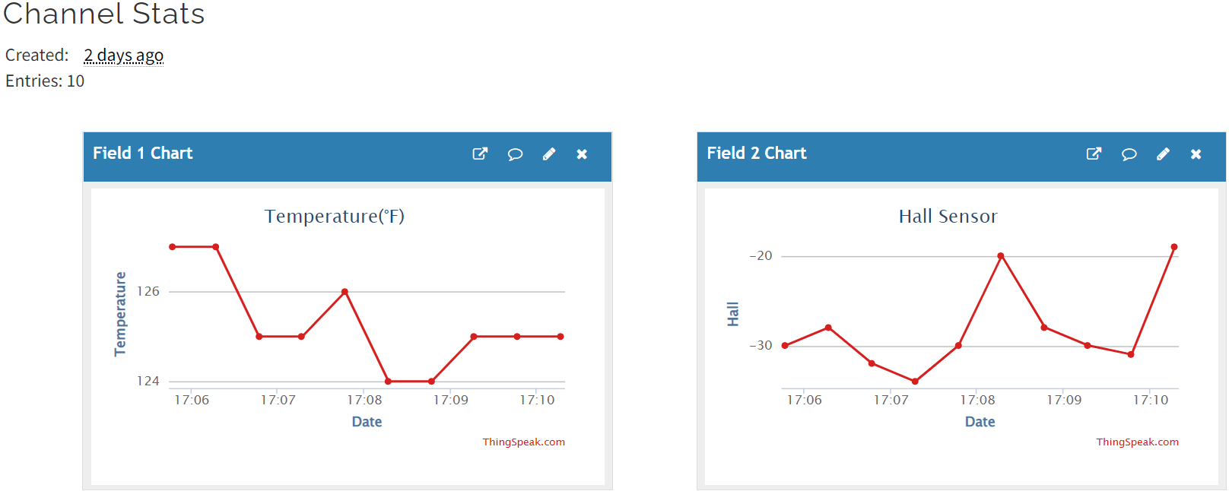
espclient
The client uses the wifi to send ESP32’s temperature sensor and hall sensor to the thingspeak.com
The video is shown in this link: https://youtu.be/_9GKTP7rZzs
The result is shown below:
  Ten data sets are collected
  There are 30 secs period controlled by a timer interrupt
Reference: https://pythonforundergradengineers.com/micropython-wifi.html

Slide 3
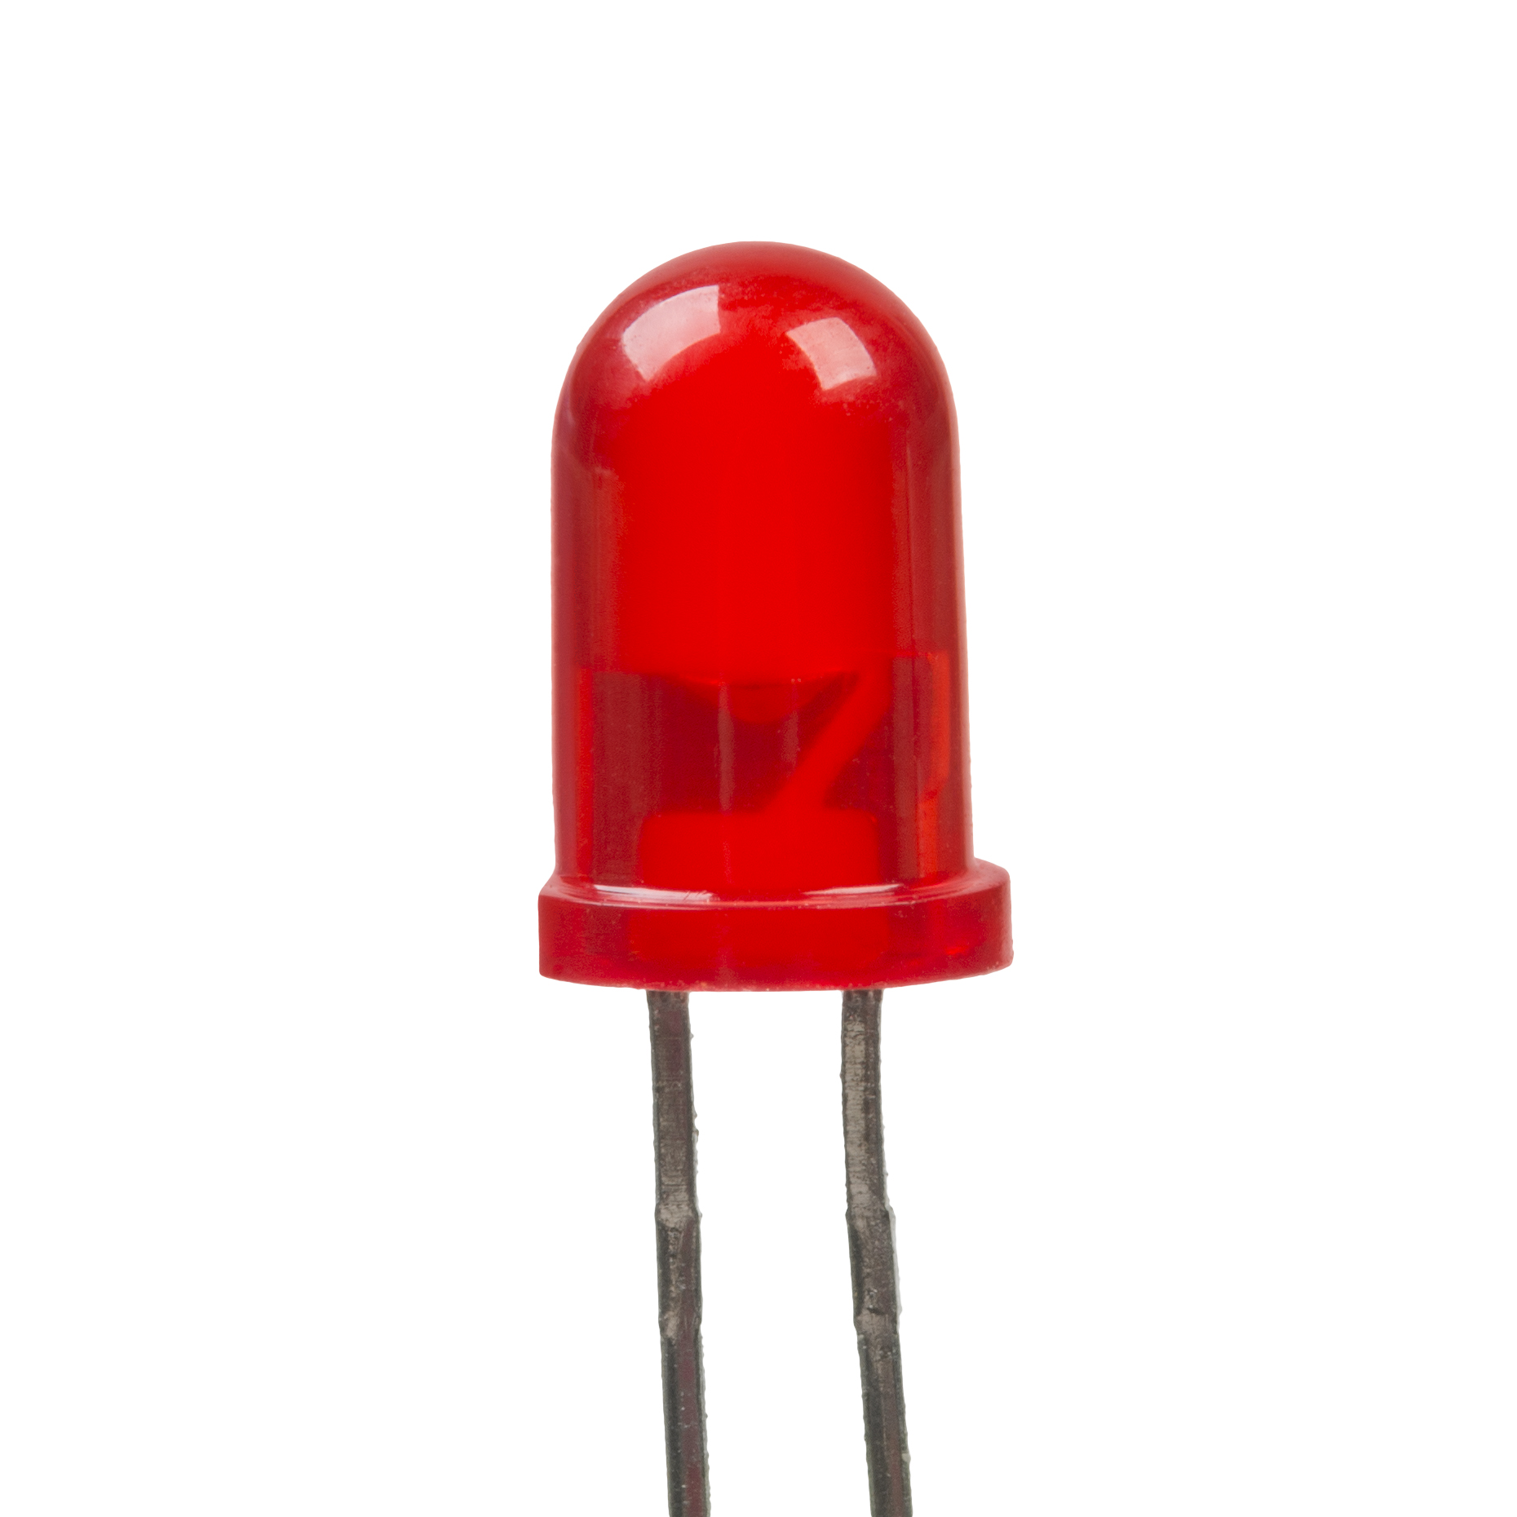
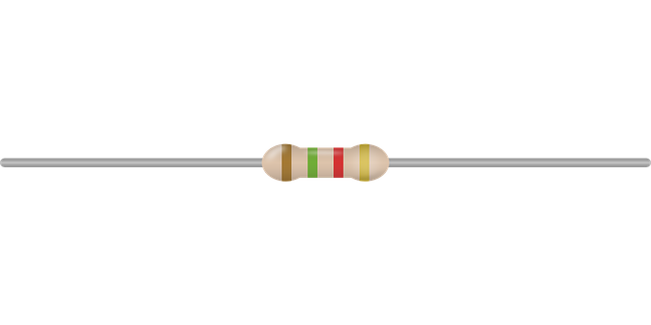
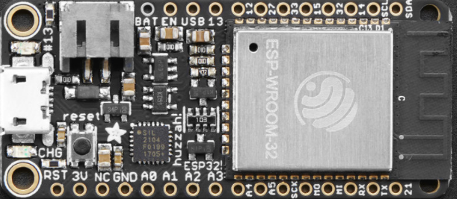


espserver
Schematics:
  The pin 32 generates an on/off signal to drive the LED
  A 220Ω resistor is used to protect the LED from burn out
  The black wire is connected to the ground from the LED
The detailed video is from this link below:
https://youtu.be/WDW4A_5UYaI
The ESP board will serve as a server. It will receive
and send data
The browser will show the interaction between the
client and the ESP32 server
Reference: https://randomnerdtutorials.com/esp32-esp8266-micropython-web-server/

Slide 4
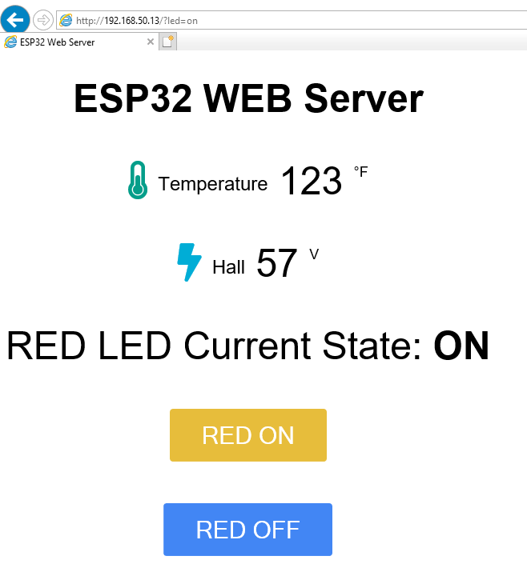
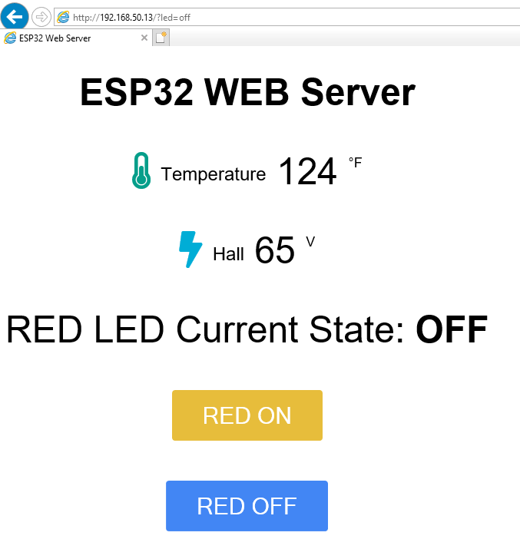
espserver
The webpage result is shown in the below image:
RED ON button was clicked
RED OFF button was clicked

