Slide 1
Lab 3
Motion Detector

Slide 2
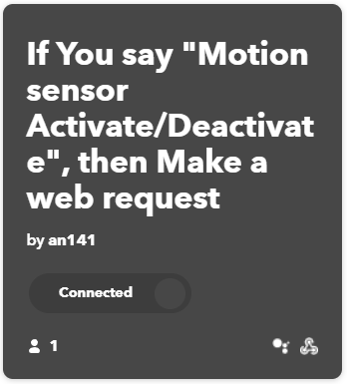
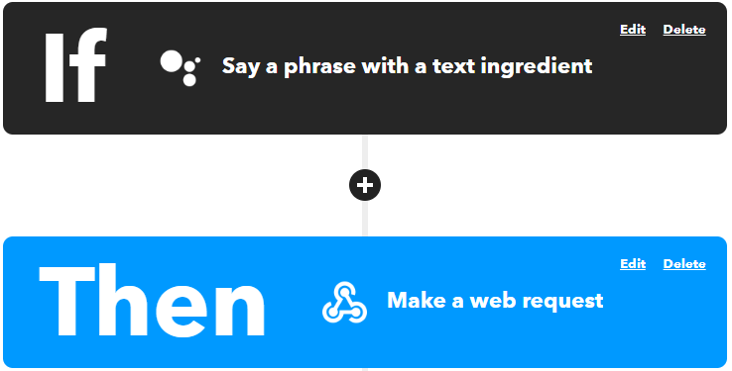
IFTTT Design
The motion sensor applet receives a google voice command from google assistant and transmit the data to thingspeak

Slide 3
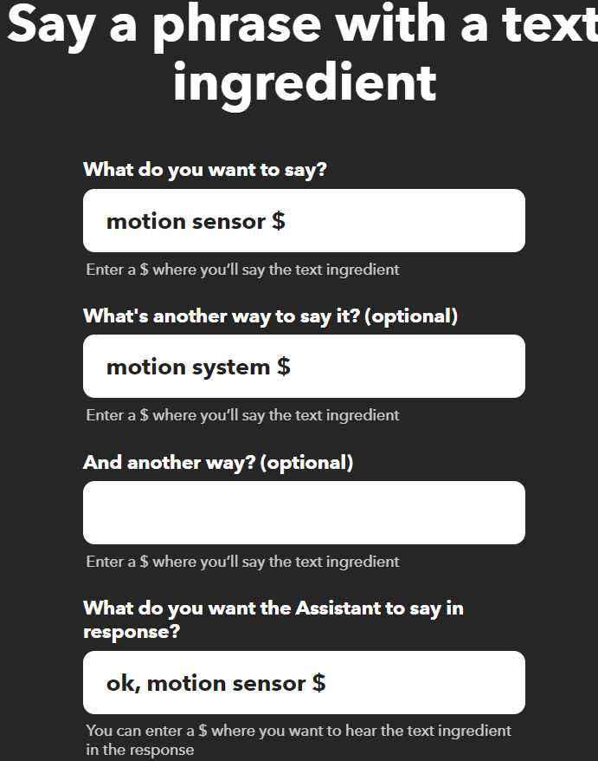
IFTTT Design
The google assistant setup is shown below
The user can say ‘motion sensor’ + ‘activate/deactivate’
The google assistant will respond with ‘ok, motion sensor activate/deactivate’

Slide 4
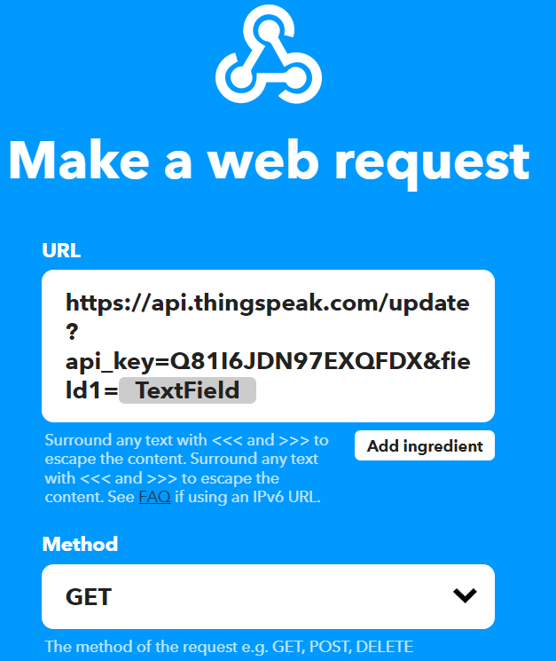
IFTTT Design
The webhooks can receive the data from the google assistant and send the data to thingspeak through a URL

Slide 5
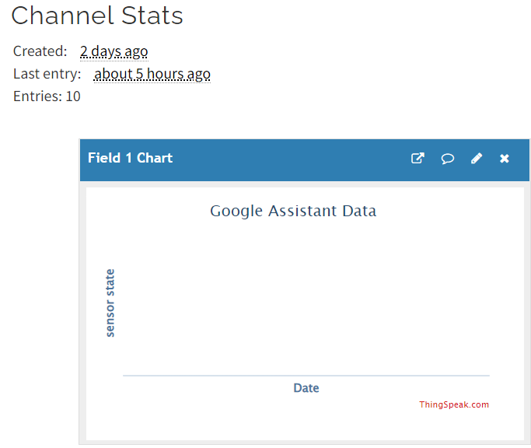
ThingSpeak Design
I created a channel in ThingSpeak
There is a Field 1 to receive data from IFTTT

Slide 6
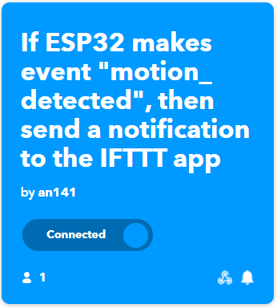
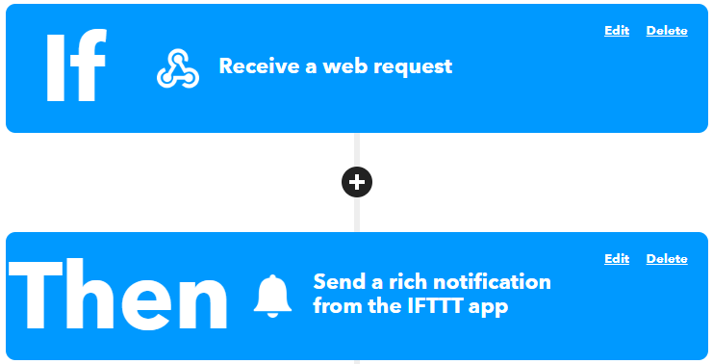
IFTTT Design
The notification applet uses webhooks to received data
The notification applet uses google notification to notify my phone

Slide 7
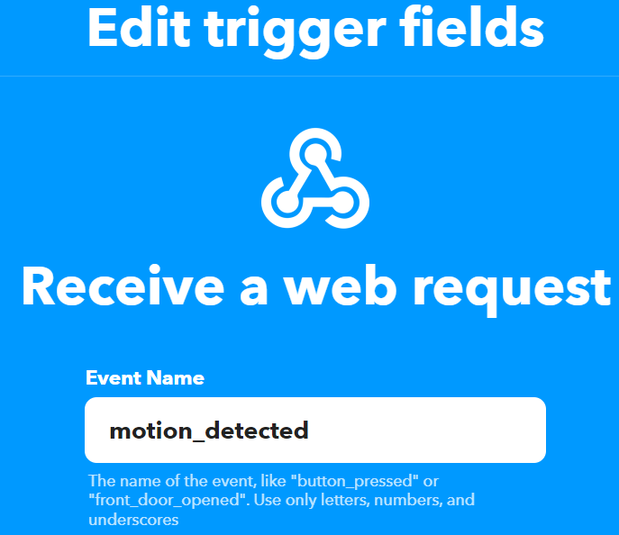
IFTTT Design
The webhooks set up is shown below
The event name is ‘motion_detected’
The webhooks has a special url. ESP32 can use this url to send data to the IFTTT

Slide 8
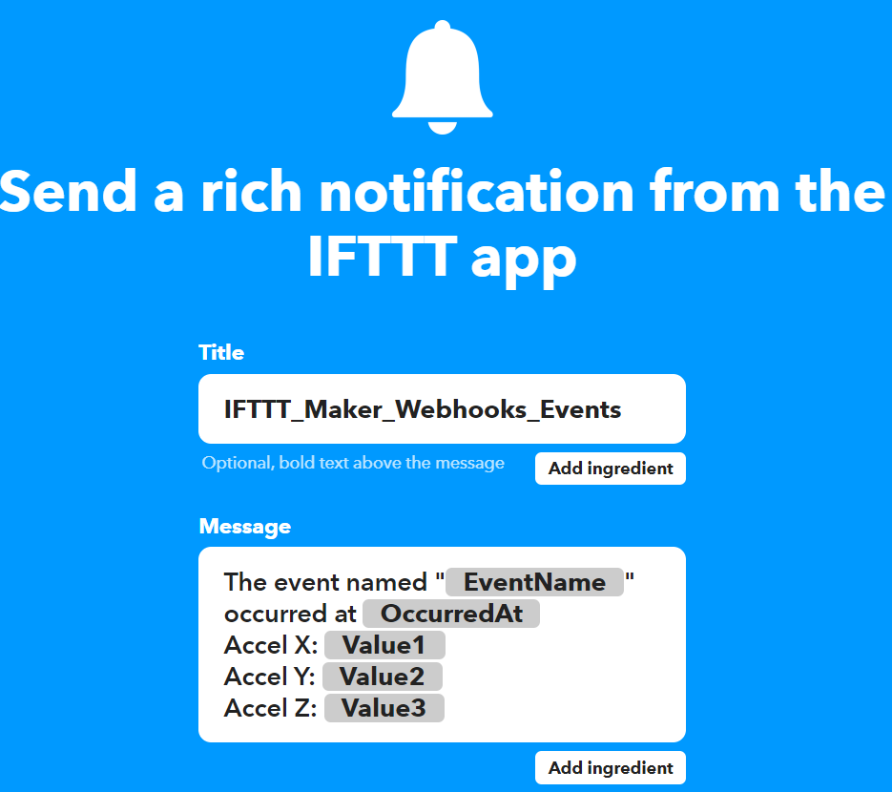
IFTTT Design
The notification set up is shown below
The phone notification will show the current sensor reading, the event name, and the time when the notification is triggered

Slide 9
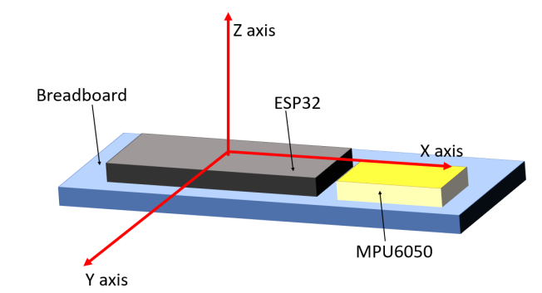
Sensor Calibration
I read sensor data when the sensor facing upwards
In this case, AcZ_faceup should be -9.8 and the other readings should be zero
Then, I read sensor data when the sensor facing downwards
In this case, AcZ_facedown should be 9.8 and the other reading should be zero
Therefore, the sensor gain K = 9.8*2/(AcZ_facedown - AcZ_faceup)
The sensor reading at zero acceleration is also known
AcX_zero = (AcX_faceup + AcX_facedown)/2
AcY_zero = (AcY_faceup + AcY_facedown)/2
AcZ_zero = (AcZ_faceup + AcZ_facedown)/2
The real acceleration reading is
AcX_real = (AcX - AcX_zero)*K
AcY_real = (AcY - AcY_zero)*K
AcZ_real = (AcZ - AcZ_zero)*K

Slide 10
Software Flowchart
At the start point, ESP32 will calibrate the sensor
Once the sensor is calibrated and Wifi is connected, ESP32 will check with Thingspeak to see if the system should be activated or not.
If the system should be activated, ESP32 will use MPU6050 to check the acceleration
If the acceleration has changed, ESP32 will send a phone notification
Start
Send notification to phone
Sensor Calibration and Connect to Wifi
Check Thingspeak to see if system is activate/deactivate
Check if sensor has moved
If activate
If deactivate
Check every 30s
Disarm the system

Slide 11

File Structure
motion_detector.py is the main code to run on the ESP32
mpu6050.py is the MPU 6050 driver library that ESP32 used to communicate with MPU6050 through I²C

Slide 12
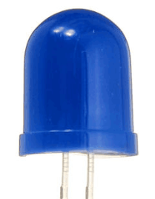

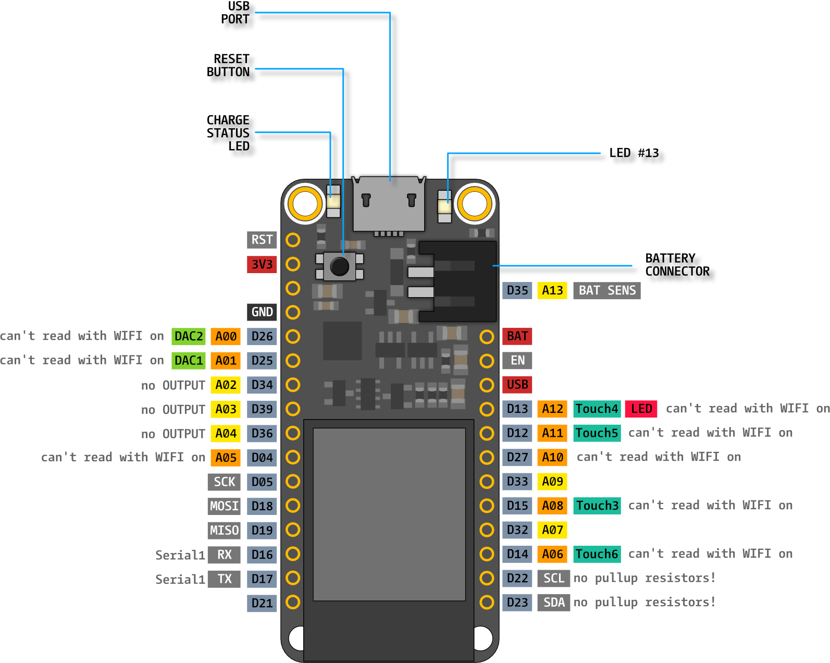
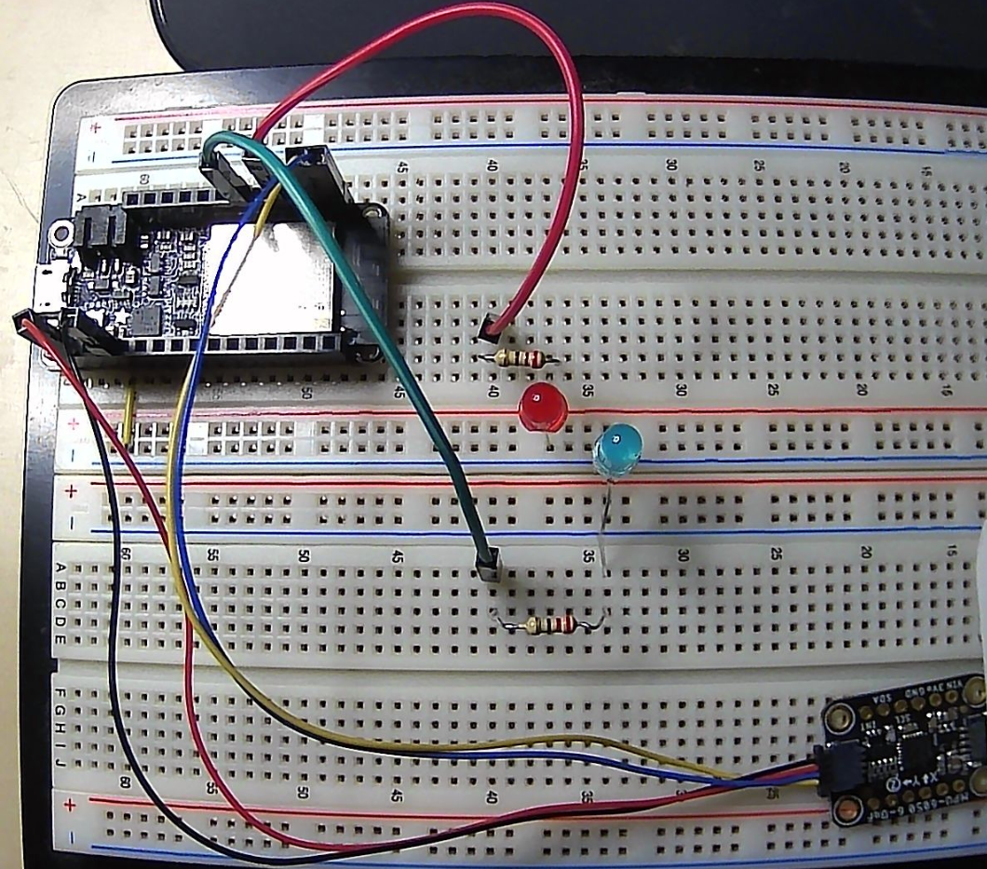









Hardware Connection
The red led is connected to pin 32
Blue led is connected to pin 33
I²C connection is shown blow
Yellow goes to SCL
Blue goes to SDA
Red and black is 3V and ground
Resister
Resister

Slide 13
Video
https://youtu.be/zLkY6vPAUUY
In the video, I showed that
I calibrated the sensor with ESP32
I can use google assistant from my phone to activate and deactivate the system
I can receive a notification with the sensor reading sent from ESP32 when the sensor detects motion
Below are some external reference I used for my design
https://esp32io.com/tutorials/esp32-ifttt
https://www.youtube.com/watch?v=X-_25tzo8Cw
https://makeblock-micropython-api.readthedocs.io/en/latest/public_library/Third-party-libraries/urequests.html

