Slide 1
SuperSearch
Conversational AI shopping assistants for e-commerce websites
book a demo
Aantriksh Pandya . Shalini Mukhopadhyay
Prepared for: {Brand Name}

Slide 2
Ecommerce search is changing forever and AI shopping assistants are here to stay — the numbers are clear
58%
4x
1,300%
of consumers prefer AI shopping assistants over keywords (up from 25% in 2023)
higher conversion rates for
conversational search as compared to keyword search
(12.3% vs 3.1%, Rep AI)
YoY growth in AI-referred
retail traffic
(Adobe, Holiday 2024)
~60% to 64% of online shoppers have used or plan to use AI for shopping in 2026 (~3B AI shoppers).
7-8 word queries nearly doubled since ChatGPT launched (Search Engine Land), 35% of all search queries are now complete sentences, not fragmented keywords. Conversational search is the new norm.
79% of customers say they'd find it helpful if AI understood their specific needs (not just keywords) to recommend products in a chat instead of them having to type keywords into a search bar to discover relevant products.
82% want AI shopping assistants to reduce time spent researching what to buy.
Sources: Rep AI 2025, Adobe Analytics, Search Engine Land, Capgemini, Constructor, Nosto

Slide 3
Competitors are already live with conversational search and seeing massive gains
Global
India (your direct market)
Pandora (Gemma) — AI personal shopper on Salesforce Agentforce (Sep 2025), understands occasions, preferences, budgets. Clara AI handles 60% of service cases (+10% NPS).
Tiffany & Co. — AI recommendations drove 25% conversion rise, 40% AOV increase. AR try-on for rings, bracelets, necklaces: 22% conversion jump, 19% fewer returns.
Cartier — Google Cloud AI image recognition identifies any product from 174-year archive in <2 seconds. “Looking Glass” in-store AR (Jan 2025).
Signet (Kay, Zales, Jared) — world’s largest diamond jeweller, AI personalization across all brands. AR try-on: 67% adoption, 27% higher conversion.
Blue Nile / James Allen / Brilliant Earth — AI diamond recommendation engines, AR ring try-on, 360° diamond video. 20-25% conversion lift across platforms.
CaratLane (Tata/Tanishq) — pioneer AR virtual try-on since 2015, 200% app usage increase, 40% of business from AR app. $100M+ quarterly revenue.
Tanishq — 1,000+ chats/day, Sherpa AI for personalization, Endless Aisle kiosks. 107% uplift in click-to-conversion during Akshay Tritiya.
BlueStone — AI/ML for UX, AR try-on, blockchain authentication. SEBI-approved $120M IPO.
Kalyan (Candere), Malabar Gold — Candere uses AI for behavior analysis. Malabar partnered with Accenture for AI-driven operations. Neither has conversational search.
GIVA, Melorra, PC Jeweller — GIVA has selective AR try-on. No Indian jewellery brand has conversational AI product discovery today.
Platform shift: Walmart, Target, Sephora, Nordstrom, Best Buy, Home Depot, Wayfair, Frasers, Sephora, Etsy, Macy’s all have integrated AI shopping assistants on their websites

Slide 4
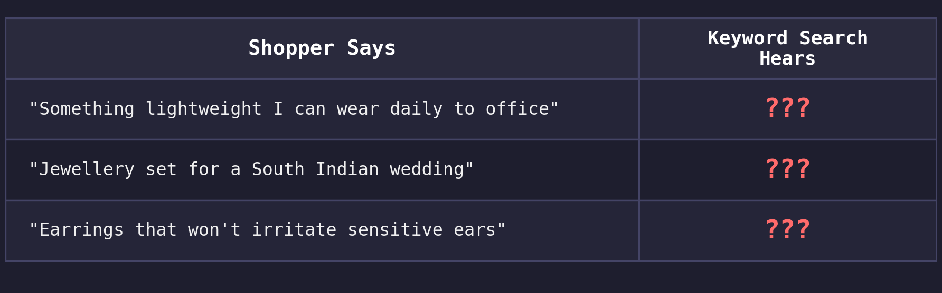
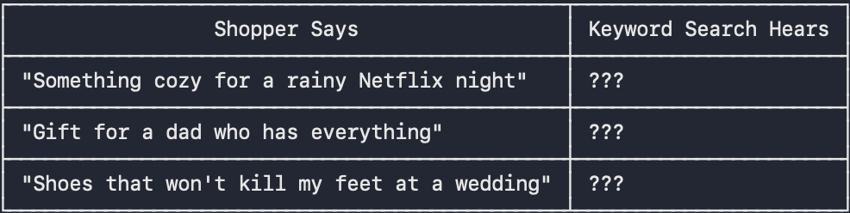
The gap in e-comm search today - shoppers think in problems and intents, search engines think in keywords.
The current search bar on your e-commerce website needs the right keywords. It does not understand human language, it cannot match necklace and mangalsutra, it cannot link “a South Indian wedding” to bridal and bridal to temple jewellery.
But shoppers today do not shop using keywords such as “engagement ring” or “22kt BIS hallmark gold choker”, they shop by intents such as “for daily wear to office” or “that’s hypoallergenic for sensitive ears”.
What is happening is, even if your catalog has all the relevant products, these products are invisible to your buyer.
What an AI Sales Associate changes : “I need a lightweight gold necklace within budget, 22kt BIS hallmark, minimalist for daily wear, that won’t tangle”
An AI sales associate powered by a knowledge graph understands intent + constraints + context, it maps lightweight to under 10g, daily wear to minimalist/durable, adds the conditions for karat, hallmark, and price and returns relevant products from the catalog - exactly what the shopper means and wants, not just what they typed.

Slide 5
Why this gap exists — three structural challenges
1
Catalogs need tagging and enrichment to be AI agent readable
AI agents waste millions of tokens to understand the actual product in the catalog
Catalogs today don't expose attributes such as karat/purity and tags such as “hallmark” or “antique finish” which an AI agent needs to map intent such as “jewellery for a South Indian wedding” to “22kt temple gold jhumka” or “for sensitive ears that won’t react” to “22kt Maharashtrian black-bead mangalsutra”.
2
Conversational search needs a knowledge graph to map intent to keywords
Unlike traditional search bars that only cater to keyword matching for direct queries like “gold choker necklace” or “antique kundan bridal set”, AI chat assistants need to answer intent based queries like “I need jewellery for my wedding” or “I want earrings that won’t irritate sensitive ears”. They have to map buyer intent to keywords using a knowledge graph and then search the catalog for relevant products using keywords, refer to the diagram on slide 11 for an example
3
LLMs alone can't reason over catalogs to answer human queries
LLMs give generic answers, they have not been trained on proprietary e-commerce data.They also take time to give answers(100ms-2s latency vs sub-20ms graph traversal)
Knowledge context graph gives LLM the extra data that they need to map intent to keywords like a human

Slide 6
We ran an audit on the <>website to see what fails today
What the shopper searches | Search returns | What exists in the catalog
Every query is grounded in Google autocomplete — real shoppers type these. The products exist. The search can't connect the two. For a more detailed report see the report attached with the email.

Slide 7
Screenshot of failing query #1
paste the search-results screenshot for the most egregious failing query here
Screenshot of failing query #2
paste the search-results screenshot for the most egregious failing query here
Screenshot of failing query #3
paste the search-results screenshot for the most egregious failing query here
Screenshot of failing query #4
paste the search-results screenshot for the most egregious failing query here

Slide 8
What SuperSearch builds for you - current offerings
AI Sales Associate on your website that guides buyers to the right purchase
Acts as a digital sales associate — asks the right questions, understands what the buyer actually needs, and guides them to the right product
Drives revenue, not just answers — every conversation is a guided selling opportunity that converts browsers into buyers
All intent based queries such as “jewellery for a South Indian wedding”, “lightweight earrings for daily wear” handled just like in ChatGPT and Amazon Rufus, guiding buyers to a purchase just like your best in-store sales associate would.
Catalog Tagging + Enrichment
All merchant catalogs synced to unified schema that AI agents can read with no token wastage
Synonyms, spell check, use-case tagging, intent mapping, attribute enrichment across your catalog
AI agents can directly search the catalog to answer user queries
Intent-Aware Knowledge Graph
Maps user intent to keywords in PDP’s without spending millions of dollars in LLM tokens
Sub-20ms graph traversal vs 100ms-2s for LLM inference, works for 5K-50K+ SKU catalogs
Enables AI shopping assistant to answer all intent/event/activity based queries asked by a buyer facilitating a truly realistic online shopping experience and boosting conversion

Slide 9
The future of e-commerce - shopping assistants, AR jewellery try-on, multilingual queries and discovery through apps on LLM platforms.
Buyers today are increasingly looking for AR jewellery try-on to make more informed decisions.
More and more numbers of queries are being asked in multilingual languages as e-commerce spreads to tier 2 and 3 cities.
40% of shoppers now start their discovery journey on some AI chat agent such as Gemini/ChatGPT/Perplexity.
Before reaching a brand’s website, buyers first discover brands through LLMs. While AEO/GEO ensures that a brand comes up in the LLM’s suggestions, that is just the first part. Brands have to also ensure that buyers can interact with their catalogs within the LLM chat interface itself so they come to their website and buy.
As a result Walmart, Sephora, Instacart, Doordash have already created apps on top of ChatGPT to capture buyers upfront.

Slide 10
What SuperSearch builds for you - upcoming offerings
AR Jewellery Try-On
See the necklace on your neck, the jhumkas on your ears, or the ring on your hand via AR before you commit.
CaratLane pioneered this — 200% app usage increase, 40% of business from AR. Tiffany reports 22% conversion jump and 19% fewer returns. Signet’s VTO has 67% adoption among mobile users.
Higher conversion, fewer returns, and the confidence bridge that brings offline jewellery buyers online.
Vernacular + natural-language queries
Hindi, Tamil, Telugu and Bengali queries mapped to the English catalog — “mangalsutra” vs “thali” vs “minnu”, “nath” vs “mukkuthi”, “jhumka” vs “jhumki”.
Natural-language queries like “something lightweight I can wear daily to office” resolve to minimalist daily-wear pieces instead of 0 results.
India’s $95B jewellery market is only 4% online. Vernacular conversational search bridges the trust gap.
App Storefront on ChatGPT
40% of buyers now start their product research on ChatGPT / Gemini / Perplexity before visiting a brand site.
Your catalog becomes shoppable inside the AI conversation — karat, hallmark, gemstone, weight, and occasion details surfaced natively.
Jewellery has the highest AOV ($436) but lowest conversion (0.87%) of any online category. Conversational AI can close this gap.

Slide 11
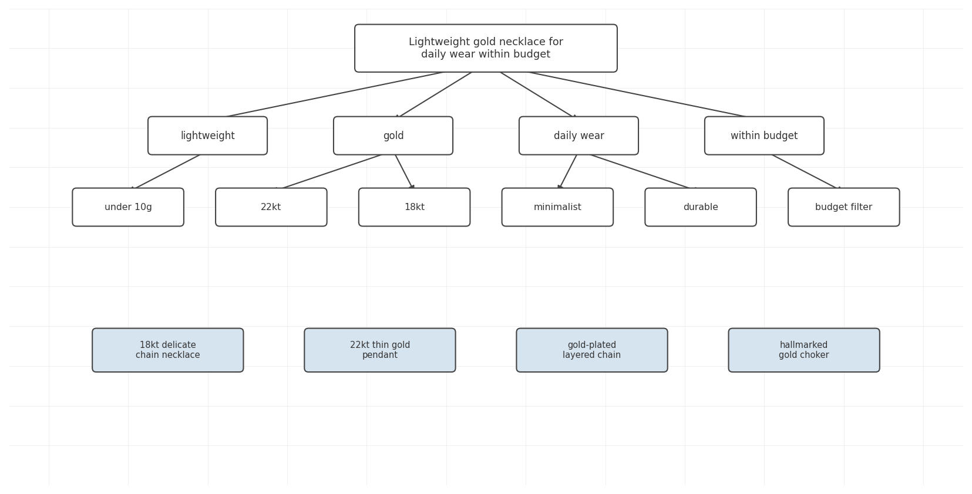
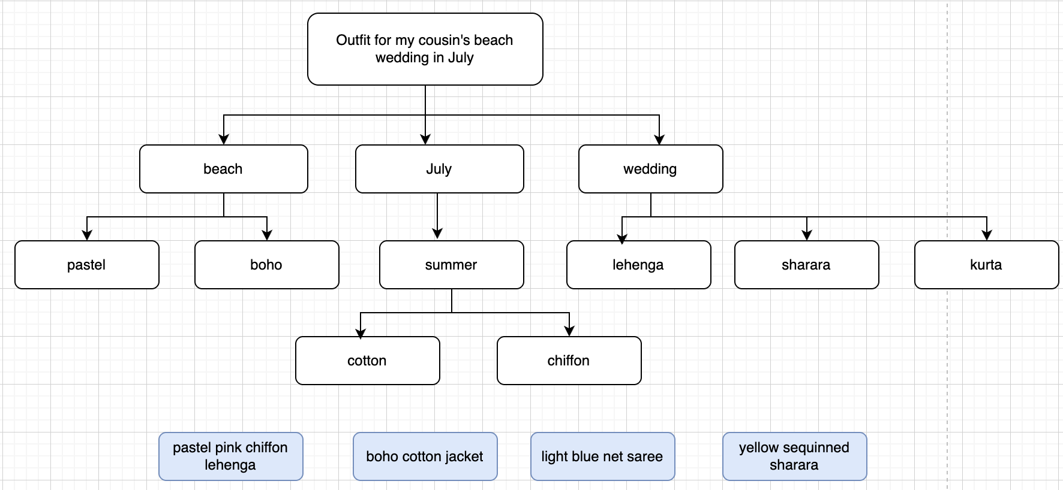
Examples of queries with intent being mapped to keywords using knowledge context graph

Slide 12
Your AI sales associate doesn't just search — it sells
Guided discovery → conversion lift
Like your best sales associate, it clarifies intent instead of dumping a catalog — asks the right follow-up questions (occasion, budget, metal/purity, style) before suggesting anything.
4x conversion uplift for conversational vs keyword — 12.3% vs 3.1% (Rep AI 2025 Ecommerce Shopper Behavior Report).
Zalando's AI assistant rollout tied to 18% YoY profitability lift — proof the impact shows up in the P&L.
Jeweller-grade set-building → AOV lift
Assistant knows what pairs with what — matching accessories, complementary items, a complete bridal set — necklace plus matching earrings plus bangles — instead of a single piece.
Single-item sessions become complete jewellery sets — every add-to-cart becomes an opening for a second, third, fourth item.
Nosto: when search works, 78% of shoppers also buy an additional item — the assistant is the conversion engine for that second buy.
Intent rescue → keep shoppers on site
Vague, intent-shaped queries become a curated shortlist instead of thousands of random results.
80% of shoppers leave a site due to poor search — the assistant plugs that leak before the session bounces (Nosto).
Myntra's MyFashionGPT: users 3x more likely to purchase through the assistant than through keyword search.

Slide 13
How SuperSearch is different
 | Keyword Search | Pure LLM | SuperSearch (Graph + LLM)
Simple query gold choker necklace | Handles well | Handles well | Handles well
Synonym query mangalsutra / thali / minnu | Not supported (no synonym bridging) | May work (depends on training data) | Handles via vocabulary graph
Occasion query jewellery for a South Indian wedding | Not supported (no intent mapping) | Generic suggestions (not catalog-aware) | Maps to your actual products
Conversational query lightweight daily-wear earrings for sensitive ears | Not supported (not designed for this) | Generic answers (not your catalog) | Returns your actual inventory
Cost at scale | Low | High (LLM call per query) | Low (LLM only for edge cases)
Multi-attribute queries 22kt, BIS hallmark, antique, temple choker, within budget | Accuracy degrades | Prone to hallucinations | Much more accurate than standard RAG

Slide 14
Let's close the gap.
We can run a full 500-query audit on your site in under a week and show you exactly where you are losing crores in revenue.
Every query grounded in Google autocomplete. Every result verified against your actual catalog. We have pasted some of the results we obtained from a smaller audit on your website slide 6.
We can fix your search and upgrade your website from keyword based search bar to intent based AI assistant. book a demo
Shalini Mukhopadhyay · shaliniiitkgp2021@gmail.com
Aantriksh Pandya · aantriksh.pandya1@gmail.com

