Slide 1
SuperSearch
Conversational AI shopping assistants for e-commerce websites
book a demo
Aantriksh Pandya . Shalini Mukhopadhyay
Prepared for: {Brand Name}

Slide 2
Ecommerce search is changing forever and AI shopping assistants are here to stay — the numbers are clear
58%
4x
1,300%
of consumers prefer AI shopping assistants over keywords (up from 25% in 2023)
higher conversion rates for
conversational search as compared to keyword search
(12.3% vs 3.1%, Rep AI)
YoY growth in AI-referred
retail traffic
(Adobe, Holiday 2024)
~60% to 64% of online shoppers have used or plan to use AI for shopping in 2026 (~3B AI shoppers).
7-8 word queries nearly doubled since ChatGPT launched (Search Engine Land), 35% of all search queries are now complete sentences, not fragmented keywords. Conversational search is the new norm.
79% of customers say they'd find it helpful if AI understood their specific needs (not just keywords) to recommend products in a chat instead of them having to type keywords into a search bar to discover relevant products.
82% want AI shopping assistants to reduce time spent researching what to buy.
Sources: Rep AI 2025, Adobe Analytics, Search Engine Land, Capgemini, Constructor, Nosto

Slide 3
Competitors are already live with conversational search and seeing massive gains
Global
India (your direct market)
Best Buy — GenAI shopping assistant (Google Cloud + Accenture, 2024), agentic AI expansion in 2025, catalog live on ChatGPT via the Agentic Commerce Protocol.
MediaMarktSaturn — Smart Manual chatbot for ~1,900 private-label SKUs plus MyBuddy in-store voice agent on Azure OpenAI.
Amazon Rufus — live across Amazon India and globally, 250M shoppers, +$10B downstream sales, 60% higher purchase likelihood.
Walmart Sparky — live in ChatGPT and Google Gemini with integrated checkout.
Home Depot, Lowe’s, Wayfair — all with ChatGPT storefronts and native AI advisors for complex-catalog verticals.
Amazon India (Rufus) — rolled out to all India customers on app and desktop in late 2025, now answering spec and use-case questions natively.
Flipkart (Flippi / SLAP) — Flippi live; SLAP, the next-gen conversational assistant, announced for early 2026.
Ajio (Reliance Retail) — visual search via Rezolve live across the storefront.
Tata Neu / Croma — multilingual chatbot in the Tata super-app; exploring conversational product discovery.
Reliance Digital, Vijay Sales, Poorvika — no on-site conversational assistants today. The category is still wide open in Indian consumer electronics.
Platform shift: Walmart, Target, Sephora, Nordstrom, Best Buy, Home Depot, Wayfair, Frasers, Sephora, Etsy, Macy’s all have integrated AI shopping assistants on their websites

Slide 4
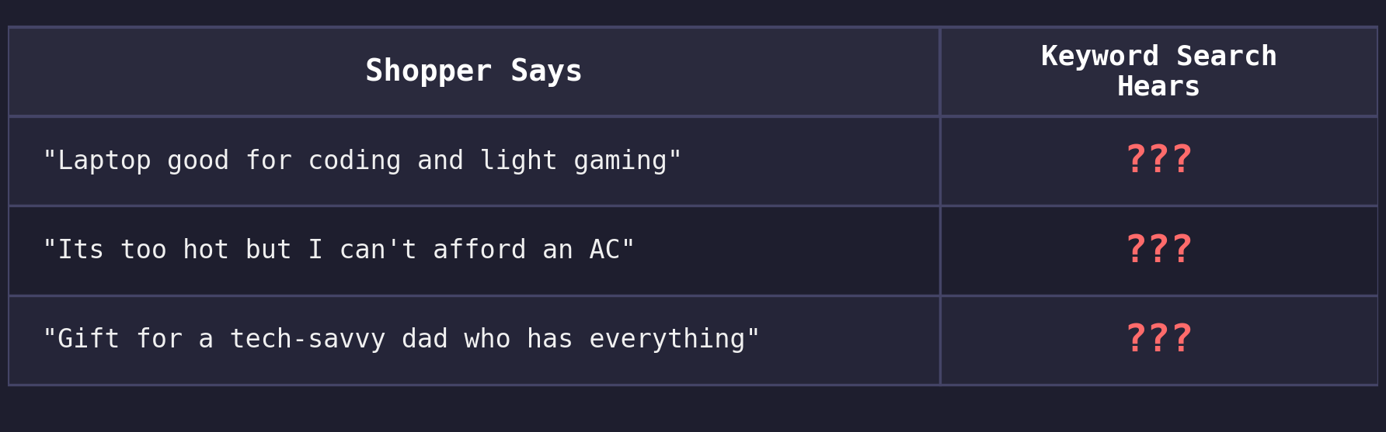
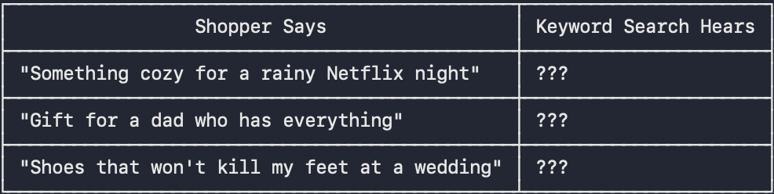
The gap in e-comm search today - shoppers think in problems and intents, search engines think in keywords.
The current search bar on your e-commerce website needs the right keywords. It does not understand human language, it cannot match phone and smartphone, it cannot link “hot summer in Chennai” to cooling and cooling to energy-efficient inverter AC.
But shoppers today do not shop using keywords such as “split AC” or “gaming laptop”, they shop by intents such as “for a small 10x12 bedroom” or “that won’t spike my electricity bill”.
What is happening is, even if your catalog has all the relevant products, these products are invisible to your buyer.
What an AI Sales Associate changes : “I need a laptop with Intel i5, 16GB RAM and SSD for college coding and light gaming, within budget”
An AI sales associate powered by a knowledge graph understands intent + constraints + context, it maps college coding to: Intel i5 / 16GB RAM / SSD / dedicated GPU, adds the conditions for budget and returns relevant products from the catalog - exactly what the shopper means and wants, not just what they typed.

Slide 5
Why this gap exists — three structural challenges
1
Catalogs need tagging and enrichment to be AI agent readable
AI agents waste millions of tokens to understand the actual product in the catalog
Catalogs today don't expose attributes such as processor/energy-rating and tags such as “inverter” or “copper coil” which an AI agent needs to map intent such as “laptop for a college coder” to “i5 16GB SSD laptop” or “for a small bedroom” to “5-star copper-coil inverter AC”.
2
Conversational search needs a knowledge graph to map intent to keywords
Unlike traditional search bars that only cater to keyword matching for direct queries like “smart TV 55 inch 4K” or “refrigerator”, AI chat assistants need to answer intent based queries like “I want appliances for my new flat” or “I want a laptop good for Photoshop and light gaming”. They have to map buyer intent to keywords using a knowledge graph and then search the catalog for relevant products using keywords, refer to the diagram on slide 11 for an example
3
LLMs alone can't reason over catalogs to answer human queries
LLMs give generic answers, they have not been trained on proprietary e-commerce data.They also take time to give answers(100ms-2s latency vs sub-20ms graph traversal)
Knowledge context graph gives LLM the extra data that they need to map intent to keywords like a human

Slide 6
We ran an audit on the <>website to see what fails today
What the shopper searches | Search returns | What exists in the catalog
Every query is grounded in Google autocomplete — real shoppers type these. The products exist. The search can't connect the two. For a more detailed report see the report attached with the email.

Slide 7
Screenshot of failing query #1
paste the search-results screenshot for the most egregious failing query here
Screenshot of failing query #2
paste the search-results screenshot for the most egregious failing query here
Screenshot of failing query #3
paste the search-results screenshot for the most egregious failing query here
Screenshot of failing query #4
paste the search-results screenshot for the most egregious failing query here

Slide 8
What SuperSearch builds for you - current offerings
AI Sales Associate on your website that guides buyers to the right purchase
Acts as a digital sales associate — asks the right questions, understands what the buyer actually needs, and guides them to the right product
Drives revenue, not just answers — every conversation is a guided selling opportunity that converts browsers into buyers
All intent based queries such as “appliances for a new flat”, “quiet washing machine that fits my bathroom” handled just like in ChatGPT and Amazon Rufus, guiding buyers to a purchase just like your best in-store sales associate would.
Catalog Tagging + Enrichment
All merchant catalogs synced to unified schema that AI agents can read with no token wastage
Synonyms, spell check, use-case tagging, intent mapping, attribute enrichment across your catalog
AI agents can directly search the catalog to answer user queries
Intent-Aware Knowledge Graph
Maps user intent to keywords in PDP’s without spending millions of dollars in LLM tokens
Sub-20ms graph traversal vs 100ms-2s for LLM inference, works for 5K-50K+ SKU catalogs
Enables AI shopping assistant to answer all intent/event/activity based queries asked by a buyer facilitating a truly realistic online shopping experience and boosting conversion

Slide 9
The future of e-commerce - shopping assistants, AR room visualization, multilingual queries and discovery through apps on LLM platforms.
Buyers today are increasingly looking for AR room visualization to make more informed decisions.
More and more numbers of queries are being asked in multilingual languages as e-commerce spreads to tier 2 and 3 cities.
40% of shoppers now start their discovery journey on some AI chat agent such as Gemini/ChatGPT/Perplexity.
Before reaching a brand’s website, buyers first discover brands through LLMs. While AEO/GEO ensures that a brand comes up in the LLM’s suggestions, that is just the first part. Brands have to also ensure that buyers can interact with their catalogs within the LLM chat interface itself so they come to their website and buy.
As a result Walmart, Best Buy, Home Depot, Lowe’s have already created apps on top of ChatGPT to capture buyers upfront.

Slide 10
What SuperSearch builds for you - upcoming offerings
AR Room Visualization
See the 55-inch TV on your actual wall, the 1.5 ton split AC above your bed, or the double-door fridge in your kitchen via AR before you commit.
The #1 return reason in large appliances is “doesn’t fit the space.” AR fit tools cut this dramatically in furniture and are now moving into appliances.
Higher conversion, fewer returns, lower reverse-logistics cost on high-ticket SKUs.
Vernacular + natural-language queries
Hindi, Tamil, Telugu and Bengali queries mapped to the English catalog — “geyser” → water heater, “cooler” → air cooler, “chimney” → kitchen chimney, “fridge” → refrigerator.
Natural-language queries like “its too hot in my room but i cant afford an ac what are my options” resolve to budget coolers and fans instead of expensive split ACs.
Unlocks tier-2 and tier-3 buyers for whom vernacular and conversational phrasing are the first language of search.
App Storefront on ChatGPT
40% of buyers now start their electronics research on ChatGPT / Gemini / Perplexity before visiting a retailer site.
Your catalog becomes shoppable inside the AI conversation — specs, prices, energy ratings and compatibility surfaced natively.
Best Buy, Walmart, Home Depot, Lowe’s and Wayfair are already live on ChatGPT via OpenAI’s Agentic Commerce Protocol. Indian electronics retail is still wide open.

Slide 11
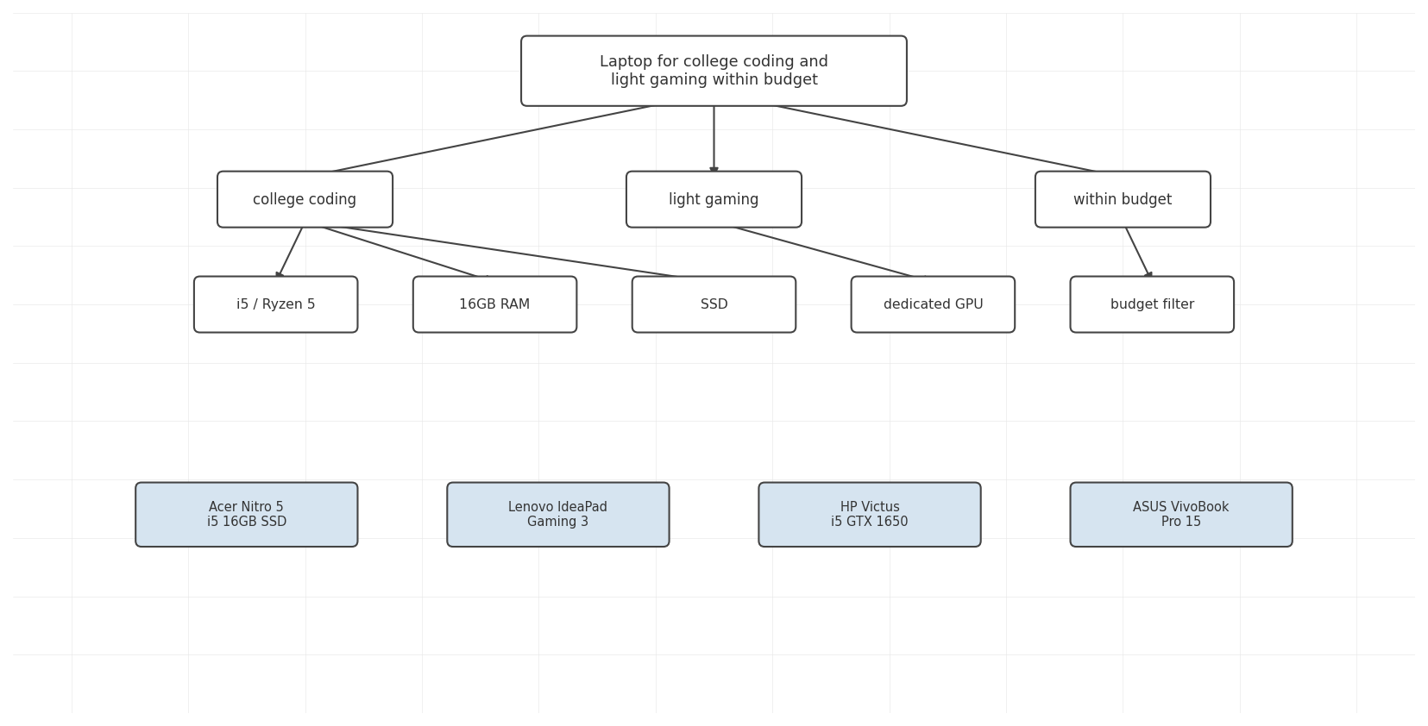
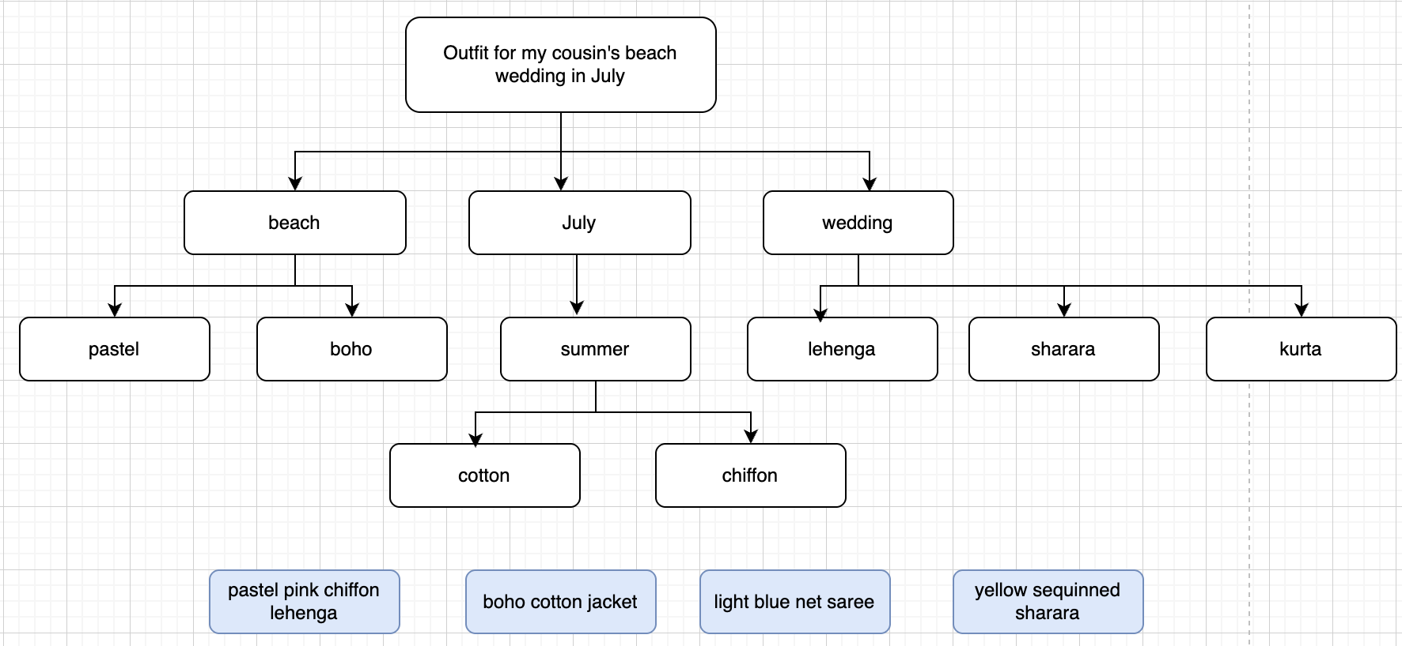
Examples of queries with intent being mapped to keywords using knowledge context graph

Slide 12
Your AI sales associate doesn't just search — it sells
Guided discovery → conversion lift
Like your best sales associate, it clarifies intent instead of dumping a catalog — asks the right follow-up questions (occasion, budget, use-case, specs/compatibility) before suggesting anything.
4x conversion uplift for conversational vs keyword — 12.3% vs 3.1% (Rep AI 2025 Ecommerce Shopper Behavior Report).
Best Buy’s GenAI assistant drove agentic AI expansion across the storefront — proof the impact shows up in the P&L.
Expert-grade bundling → AOV lift
Assistant knows what pairs with what — matching accessories, complementary items, a matched bundle — TV plus soundbar, camera plus lens plus mic — instead of a single SKU.
Single-item sessions become full set-ups — every add-to-cart becomes an opening for a second, third, fourth item.
Nosto: when search works, 78% of shoppers also buy an additional item — the assistant is the conversion engine for that second buy.
Intent rescue → keep shoppers on site
Vague, intent-shaped queries become a curated shortlist instead of thousands of random results.
80% of shoppers leave a site due to poor search — the assistant plugs that leak before the session bounces (Nosto).
Amazon Rufus: shoppers 60% more likely to complete a purchase through the assistant than through keyword search.

Slide 13
How SuperSearch is different
 | Keyword Search | Pure LLM | SuperSearch (Graph + LLM)
Simple query smart tv 55 inch 4K | Handles well | Handles well | Handles well
Synonym query geyser / chimney / cooler | Not supported (no synonym bridging) | May work (depends on training data) | Handles via vocabulary graph
Occasion query appliances for a new 2bhk flat | Not supported (no intent mapping) | Generic suggestions (not catalog-aware) | Maps to your actual products
Conversational query quiet washing machine that fits my bathroom | Not supported (not designed for this) | Generic answers (not your catalog) | Returns your actual inventory
Cost at scale | Low | High (LLM call per query) | Low (LLM only for edge cases)
Multi-attribute queries inverter, 1.5 ton, 5 star, copper coil, split ac, within budget | Accuracy degrades | Prone to hallucinations | Much more accurate than standard RAG

Slide 14
Let's close the gap.
We can run a full 500-query audit on your site in under a week and show you exactly where you are losing crores in revenue.
Every query grounded in Google autocomplete. Every result verified against your actual catalog. We have pasted some of the results we obtained from a smaller audit on your website slide 6.
We can fix your search and upgrade your website from keyword based search bar to intent based AI assistant. book a demo
Shalini Mukhopadhyay · shaliniiitkgp2021@gmail.com
Aantriksh Pandya · aantriksh.pandya1@gmail.com

