Slide 1
SuperSearch
Conversational AI shopping assistants for e-commerce websites
book a demo
Aantriksh Pandya . Shalini Mukhopadhyay
Prepared for: {Brand Name}

Slide 2
Ecommerce search is changing forever and AI shopping assistants are here to stay — the numbers are clear
58%
4x
1,300%
of consumers prefer AI shopping assistants over keywords (up from 25% in 2023)
higher conversion rates for
conversational search as compared to keyword search
(12.3% vs 3.1%, Rep AI)
YoY growth in AI-referred
retail traffic
(Adobe, Holiday 2024)
~60% to 64% of online shoppers have used or plan to use AI for shopping in 2026 (~3B AI shoppers).
7-8 word queries nearly doubled since ChatGPT launched (Search Engine Land), 35% of all search queries are now complete sentences, not fragmented keywords. Conversational search is the new norm.
79% of customers say they'd find it helpful if AI understood their specific needs (not just keywords) to recommend products in a chat instead of them having to type keywords into a search bar to discover relevant products.
82% want AI shopping assistants to reduce time spent researching what to buy.
Sources: Rep AI 2025, Adobe Analytics, Search Engine Land, Capgemini, Constructor, Nosto

Slide 3
Competitors are already live with conversational search and seeing massive gains
Global
India (your direct market)
Puma (AI Shopping Assistant) — 7x higher conversion for AI-assisted shoppers vs non-users, 8x higher revenue per visitor. 42% of queries are about sizing/fit.
Nike (Nike Fit) — AR foot-scanning in the Nike App, 13-point measurement system for personalized size recommendations. 500K+ sizing calls/year eliminated.
Zappos — AI-rebuilt search engine using genetic algorithms, personal shopping assistant on Sneakers tab, conversational chatbot for size recommendations.
Steve Madden — AI shopping optimization via Fast Simon across 25 stores on 5 continents (Sep 2024).
Volumental (New Balance, Hoka, On, Adidas) — 3D foot scanning + AI fit engine, 25% return reduction, 32.5% basket size increase across retailers.
Myntra (Maya) — ChatGPT-powered conversational stylist, covers 2.3M styles across fashion and footwear.
Flipkart (Flippi / SLAP) — Flippi live; SLAP standalone conversational AI shopping app launched Jan 2026.
Amazon India (Rufus) — live across all categories including footwear, but only 32% accuracy on product matching.
Ajio — AI-powered personalization and visual search across fashion and footwear.
Bata, Metro, Woodland, Campus, Relaxo — no on-site conversational assistants or AI fit tools today. Indian footwear D2C is entirely unserved.
Platform shift: Walmart, Target, Sephora, Nordstrom, Best Buy, Home Depot, Wayfair, Frasers, Sephora, Etsy, Macy’s all have integrated AI shopping assistants on their websites

Slide 4
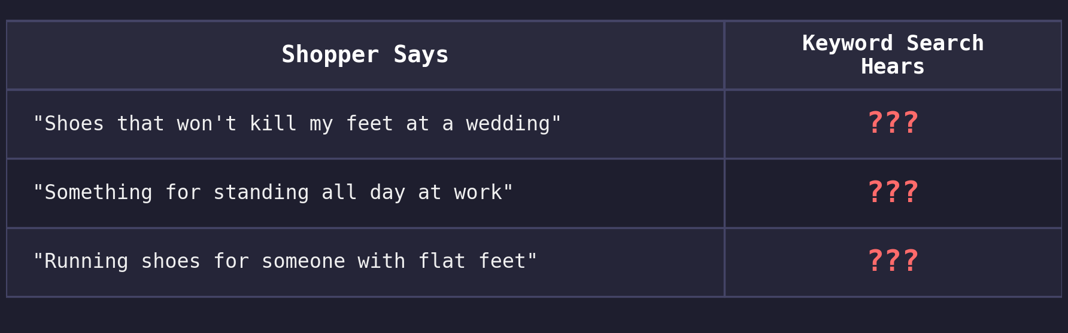
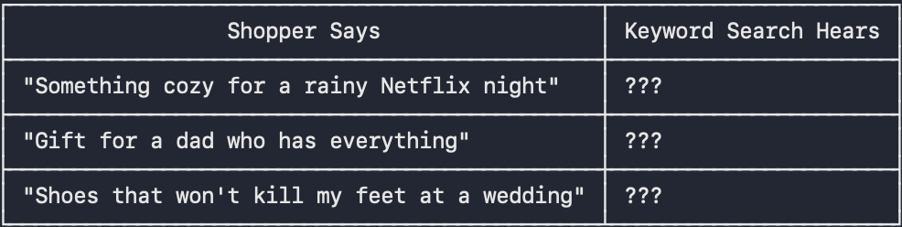
The gap in e-comm search today - shoppers think in problems and intents, search engines think in keywords.
The current search bar on your e-commerce website needs the right keywords. It does not understand human language, it cannot match sneakers and trainers, it cannot link “standing all day at work” to cushioned and cushioned to memory foam.
But shoppers today do not shop using keywords such as “formal shoes for office” or “white cushioned running shoes”, they shop by intents such as “with arch support for flat feet” or “that won’t hurt my plantar fasciitis”.
What is happening is, even if your catalog has all the relevant products, these products are invisible to your buyer.
What an AI Sales Associate changes : “I need white cushioned running shoes with arch support for flat feet, wide toe box, within budget”
An AI sales associate powered by a knowledge graph understands intent + constraints + context, it maps flat feet to arch support/stability, wide toe box to wide-fit, adds the conditions for price and cushioning and returns relevant products from the catalog - exactly what the shopper means and wants, not just what they typed.

Slide 5
Why this gap exists — three structural challenges
1
Catalogs need tagging and enrichment to be AI agent readable
AI agents waste millions of tokens to understand the actual product in the catalog
Catalogs today don't expose attributes such as arch/cushioning and tags such as “cushioned” or “breathable” which an AI agent needs to map intent such as “shoes for standing all day at work” to “memory foam arch support shoe” or “for a beach wedding in Goa” to “embellished block-heel sandal”.
2
Conversational search needs a knowledge graph to map intent to keywords
Unlike traditional search bars that only cater to keyword matching for direct queries like “white running shoes” or “wide-fit walking shoes”, AI chat assistants need to answer intent based queries like “I need shoes for my bad knees” or “I want running shoes for overpronation”. They have to map buyer intent to keywords using a knowledge graph and then search the catalog for relevant products using keywords, refer to the diagram on slide 11 for an example
3
LLMs alone can't reason over catalogs to answer human queries
LLMs give generic answers, they have not been trained on proprietary e-commerce data.They also take time to give answers(100ms-2s latency vs sub-20ms graph traversal)
Knowledge context graph gives LLM the extra data that they need to map intent to keywords like a human

Slide 6
We ran an audit on the <>website to see what fails today
What the shopper searches | Search returns | What exists in the catalog
Every query is grounded in Google autocomplete — real shoppers type these. The products exist. The search can't connect the two. For a more detailed report see the report attached with the email.

Slide 7
Screenshot of failing query #1
paste the search-results screenshot for the most egregious failing query here
Screenshot of failing query #2
paste the search-results screenshot for the most egregious failing query here
Screenshot of failing query #3
paste the search-results screenshot for the most egregious failing query here
Screenshot of failing query #4
paste the search-results screenshot for the most egregious failing query here

Slide 8
What SuperSearch builds for you - current offerings
AI Sales Associate on your website that guides buyers to the right purchase
Acts as a digital sales associate — asks the right questions, understands what the buyer actually needs, and guides them to the right product
Drives revenue, not just answers — every conversation is a guided selling opportunity that converts browsers into buyers
All intent based queries such as “running shoes for flat feet”, “comfortable heels for a 12-hour office day” handled just like in ChatGPT and Amazon Rufus, guiding buyers to a purchase just like your best in-store sales associate would.
Catalog Tagging + Enrichment
All merchant catalogs synced to unified schema that AI agents can read with no token wastage
Synonyms, spell check, use-case tagging, intent mapping, attribute enrichment across your catalog
AI agents can directly search the catalog to answer user queries
Intent-Aware Knowledge Graph
Maps user intent to keywords in PDP’s without spending millions of dollars in LLM tokens
Sub-20ms graph traversal vs 100ms-2s for LLM inference, works for 5K-50K+ SKU catalogs
Enables AI shopping assistant to answer all intent/event/activity based queries asked by a buyer facilitating a truly realistic online shopping experience and boosting conversion

Slide 9
The future of e-commerce - shopping assistants, AR fit prediction, multilingual queries and discovery through apps on LLM platforms.
Buyers today are increasingly looking for AR fit prediction to make more informed decisions.
More and more numbers of queries are being asked in multilingual languages as e-commerce spreads to tier 2 and 3 cities.
40% of shoppers now start their discovery journey on some AI chat agent such as Gemini/ChatGPT/Perplexity.
Before reaching a brand’s website, buyers first discover brands through LLMs. While AEO/GEO ensures that a brand comes up in the LLM’s suggestions, that is just the first part. Brands have to also ensure that buyers can interact with their catalogs within the LLM chat interface itself so they come to their website and buy.
As a result Walmart, Sephora, Instacart, Doordash have already created apps on top of ChatGPT to capture buyers upfront.

Slide 10
What SuperSearch builds for you - upcoming offerings
AR Fit Prediction
Scan your feet with your phone camera, get AI-powered size recommendations matched to each shoe model.
67% of shoe returns are due to sizing issues, costing $12-19 per return. Volumental’s 3D scanning cuts returns 25-38%, and Puma reports 42% of AI queries are about sizing/fit.
Higher conversion, dramatically fewer returns, lower reverse-logistics cost.
Vernacular + natural-language queries
Hindi, Tamil, Telugu and Bengali queries mapped to the English catalog — “joota” → shoes, “chappal” → sandal, “sports ka joota” → sports shoes.
Natural-language queries like “shoes that won’t hurt my plantar fasciitis” resolve to arch-support shoes instead of 0 results.
Unlocks tier-2 and tier-3 buyers for whom vernacular and conversational phrasing are the first language of search.
App Storefront on ChatGPT
40% of buyers now start their product research on ChatGPT / Gemini / Perplexity before visiting a brand site.
Your catalog becomes shoppable inside the AI conversation — size, cushioning, arch support, and activity fit surfaced natively.
Puma’s AI assistant drives 7x conversion. Indian footwear e-commerce ($5B, growing 9.7% CAGR) is ready for the same.

Slide 11
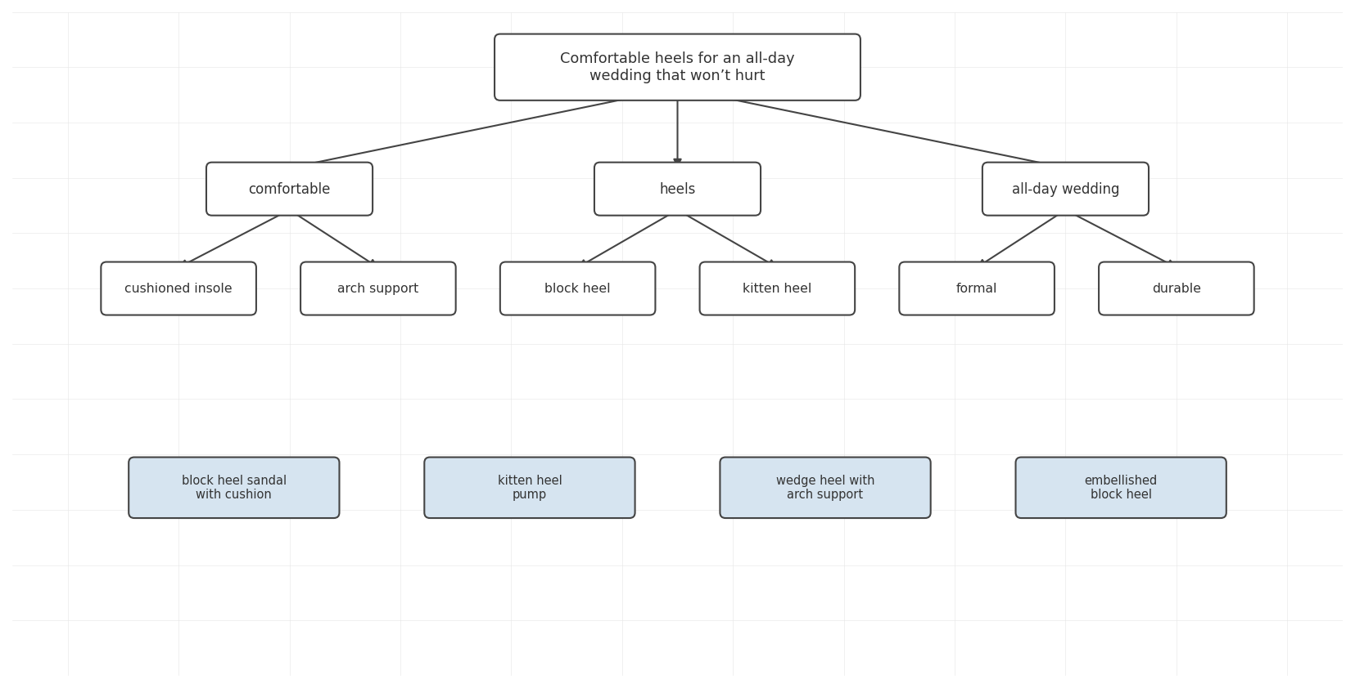
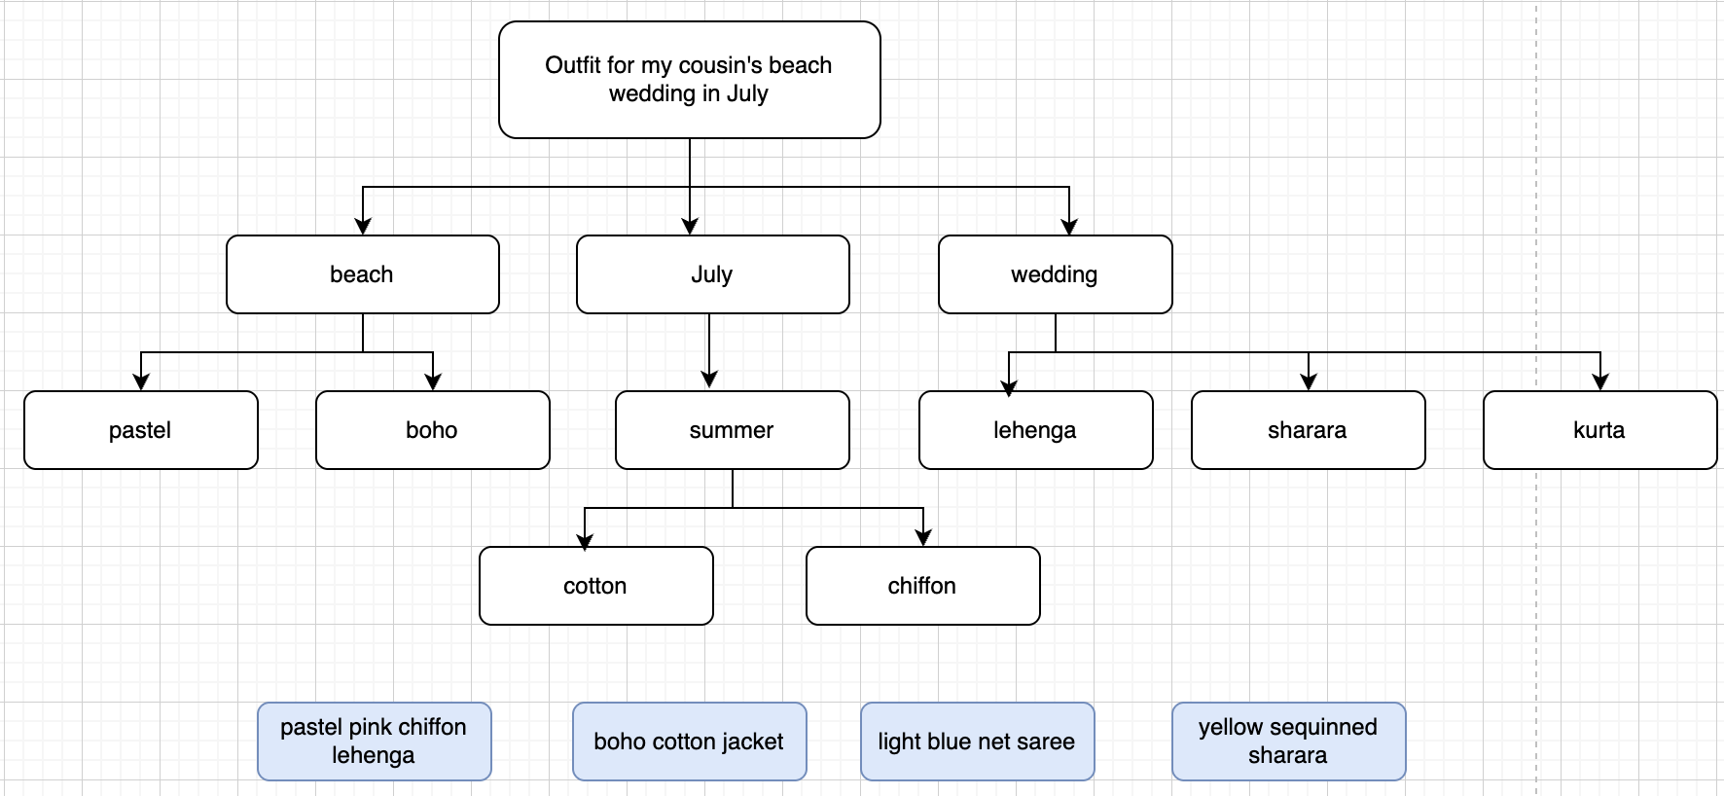
Examples of queries with intent being mapped to keywords using knowledge context graph

Slide 12
Your AI sales associate doesn't just search — it sells
Guided discovery → conversion lift
Like your best sales associate, it clarifies intent instead of dumping a catalog — asks the right follow-up questions (activity, budget, terrain, size/fit) before suggesting anything.
4x conversion uplift for conversational vs keyword — 12.3% vs 3.1% (Rep AI 2025 Ecommerce Shopper Behavior Report).
Zalando's AI assistant rollout tied to 18% YoY profitability lift — proof the impact shows up in the P&L.
Activity-kit cross-sell → AOV lift
Assistant knows what pairs with what — matching accessories, complementary items, a matched set — running shoes plus socks plus insoles plus care kit — instead of a single SKU.
Single-item sessions become complete activity kits — every add-to-cart becomes an opening for a second, third, fourth item.
Nosto: when search works, 78% of shoppers also buy an additional item — the assistant is the conversion engine for that second buy.
Intent rescue → keep shoppers on site
Vague, intent-shaped queries become a curated shortlist instead of thousands of random results.
80% of shoppers leave a site due to poor search — the assistant plugs that leak before the session bounces (Nosto).
Myntra's MyFashionGPT: users 3x more likely to purchase through the assistant than through keyword search.

Slide 13
How SuperSearch is different
 | Keyword Search | Pure LLM | SuperSearch (Graph + LLM)
Simple query white running shoes | Handles well | Handles well | Handles well
Synonym query sneakers / trainers / sports shoes | Not supported (no synonym bridging) | May work (depends on training data) | Handles via vocabulary graph
Occasion query shoes for a beach wedding in Goa | Not supported (no intent mapping) | Generic suggestions (not catalog-aware) | Maps to your actual products
Conversational query comfortable heels for standing all day at work | Not supported (not designed for this) | Generic answers (not your catalog) | Returns your actual inventory
Cost at scale | Low | High (LLM call per query) | Low (LLM only for edge cases)
Multi-attribute queries cushioned, wide toe box, arch support, running shoe, within budget | Accuracy degrades | Prone to hallucinations | Much more accurate than standard RAG

Slide 14
Let's close the gap.
We can run a full 500-query audit on your site in under a week and show you exactly where you are losing crores in revenue.
Every query grounded in Google autocomplete. Every result verified against your actual catalog. We have pasted some of the results we obtained from a smaller audit on your website slide 6.
We can fix your search and upgrade your website from keyword based search bar to intent based AI assistant. book a demo
Shalini Mukhopadhyay · shaliniiitkgp2021@gmail.com
Aantriksh Pandya · aantriksh.pandya1@gmail.com

