Slide 1
SuperSearch
Conversational AI shopping assistants for e-commerce websites
Aantriksh Pandya · Shalini Mukhopadhyay
Prepared for: Tata CLiQ

Slide 2
Ecommerce search is changing forever and AI shopping assistants are here to stay — the numbers are clear
58%
4x
1,300%
of consumers prefer AI shopping assistants over keywords (up from 25% in 2023)
higher conversion rates for
conversational search as compared to keyword search
(12.3% vs 3.1%, Rep AI)
YoY growth in AI-referred
retail traffic
(Adobe, Holiday 2024)
~60% to 64% of online shoppers have used or plan to use AI for shopping in 2026 (~3B AI shoppers).
7-8 word queries nearly doubled since ChatGPT launched (Search Engine Land), 35% of all search queries are now complete sentences, not fragmented keywords. Conversational search is the new norm.
79% of customers say they'd find it helpful if AI understood their specific needs (not just keywords) to recommend products in a chat instead of them having to type keywords into a search bar.
82% want AI shopping assistants to reduce time spent researching what to buy.
80% of shoppers leave a site due to poor search experience (Nosto)
Sources: Rep AI 2025, Adobe Analytics, Search Engine Land, Capgemini, Constructor, Nosto

Slide 3
Competitors are already live with conversational search and seeing massive gains
Global
India (your direct market)
Amazon Rufus — live globally across all Amazon categories, 60% higher purchase likelihood
Walmart Sparky — live in ChatGPT + Gemini with checkout, higher conversion rate in months
Zalando : 18% YoY profitability increase due to AI shopping assistant rollout
Albertsons — 10% basket size increase, 21% digital sales growth
Sephora, Target, Wayfair, eBay, Etsy — all on OpenAI/Google commerce protocols
Instacart : 4+ more orders per month per user for users using AI assistant compared to ones not using it
Myntra (Maya / MyFashionGPT) — users 3x more likely to purchase through AI assistant.
Meesho (Vaani) — 1.5M users, 22% higher conversion, lower returns
Flipkart, Ajio, Nykaa — all actively building AI search infrastructure
Amazon Rufus India — live with 250M shoppers globally, 60% higher purchase likelihood
Platform shift: Walmart, Target, Sephora, Nordstrom, Best Buy, Home Depot, Wayfair, Frasers, Sephora, Etsy, Macy’s all have integrated AI shopping assistants on their websites

Slide 4
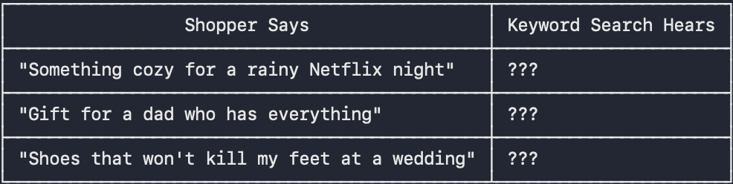
The gap in e-comm search today - shoppers think in problems and intents, search engines think in keywords.
The current search bar on your e-commerce website needs the right keywords. It does not understand human language, it cannot match scarf and dupatta, it cannot link “Jaipur in May” to summer and summer to cotton, it cannot match a white sofa for a living room to white curtains.
But shoppers today do not shop using keywords such as “padded shoes” or “blazer”, they shop by problems such as “foot pain” or intents such as “for an office party” or “for a wedding in India in May”.
What is happening is, even if your catalog has all the relevant products, these products are invisible to your buyer. 43% of site visitors go straight to search, >50% use intent to search today over keywords and ~68% leave after a failed search result
What an AI Shopping Assistant changes : “I need shoes under 200$ for myself, size 6 and I have knee pain”
An AI shopping assistant powered by a knowledge graph understands intent + constraints + context, it maps knee pain to : rocker bottom soles, lower heel-to-toe drop and return relevant shoes from the catalog - exactly what the shopper means and wants, not just what they typed.

Slide 5
Why this gap exists — three structural challenges
1
Catalogs need normalization, tagging and enrichment to be AI agent readable
AI agents waste millions of tokens to understand different merchants schemas (fabric vs material, product vs type)
Catalogs today don't expose attributes such as fit/cut and tags such as “summer” or “running” which an AI agent needs to map intent such as “outfit for pear shaped body” to “aline kurta” or “for a marathon” to “running shoes”.
e.g. “mixer grinder 750 watt” returns only 1 result on tatacliq.com despite 40 mixers in catalog — the engine can’t bridge “mixer” to “mixer grinder”
2
Conversational search needs a knowledge graph to map intent to keywords
Unlike traditional search bars that only cater to keyword matching for direct queries like “red dress” or “16GM RAM”, AI chat assistants need to answer intent based queries like “I want an outfit for my birthday” or “I want a laptop good for Photoshop”. They have to map buyer intent to keywords using a knowledge graph and then search the catalog for relevant products using keywords, refer to the diagram in the next slide for an example
e.g. “diwali outfit for men” returns running shoes and clogs on tatacliq.com instead of kurta sets and sherwanis that CLiQ stocks
3
LLMs alone can't reason over catalogs to answer human queries
LLMs give generic answers, they have not been trained on proprietary e-commerce data.They also take time to give answers(100ms-2s latency vs sub-20ms graph traversal)
Knowledge context graph gives LLM the extra data that they need to map intent to keywords like a human
e.g. “shoes that won’t get ruined in rain monsoon” returns generic running shoes on tatacliq.com, missing waterproof footwear the catalog has

Slide 6
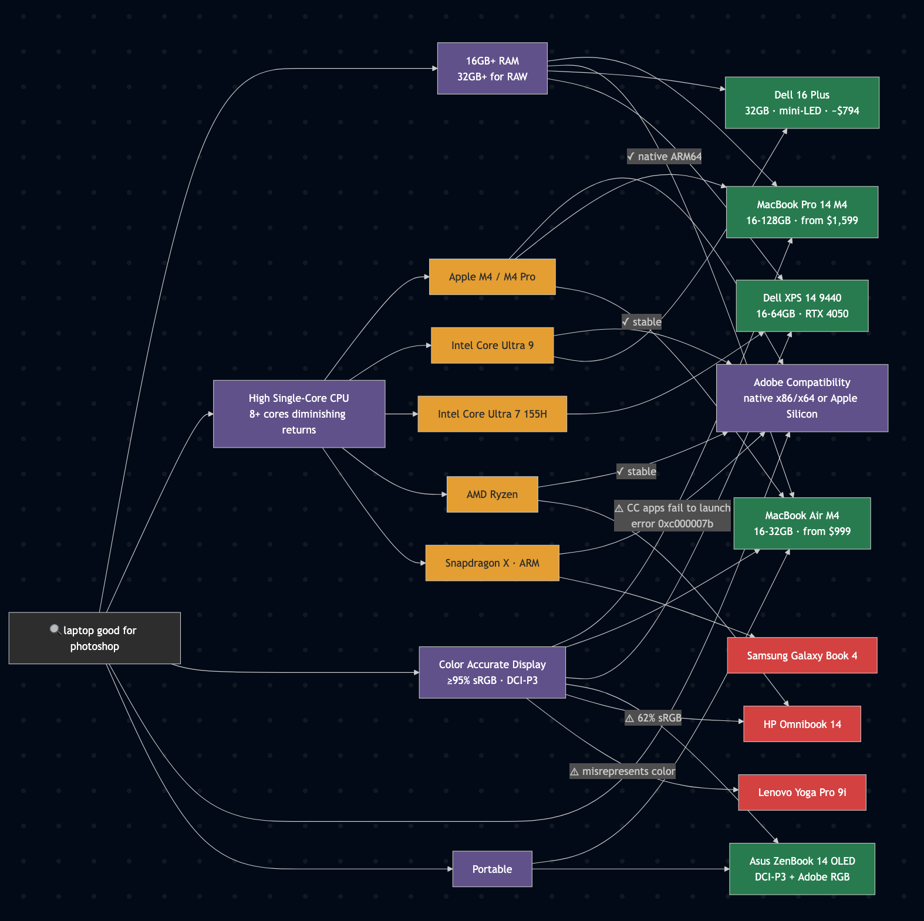
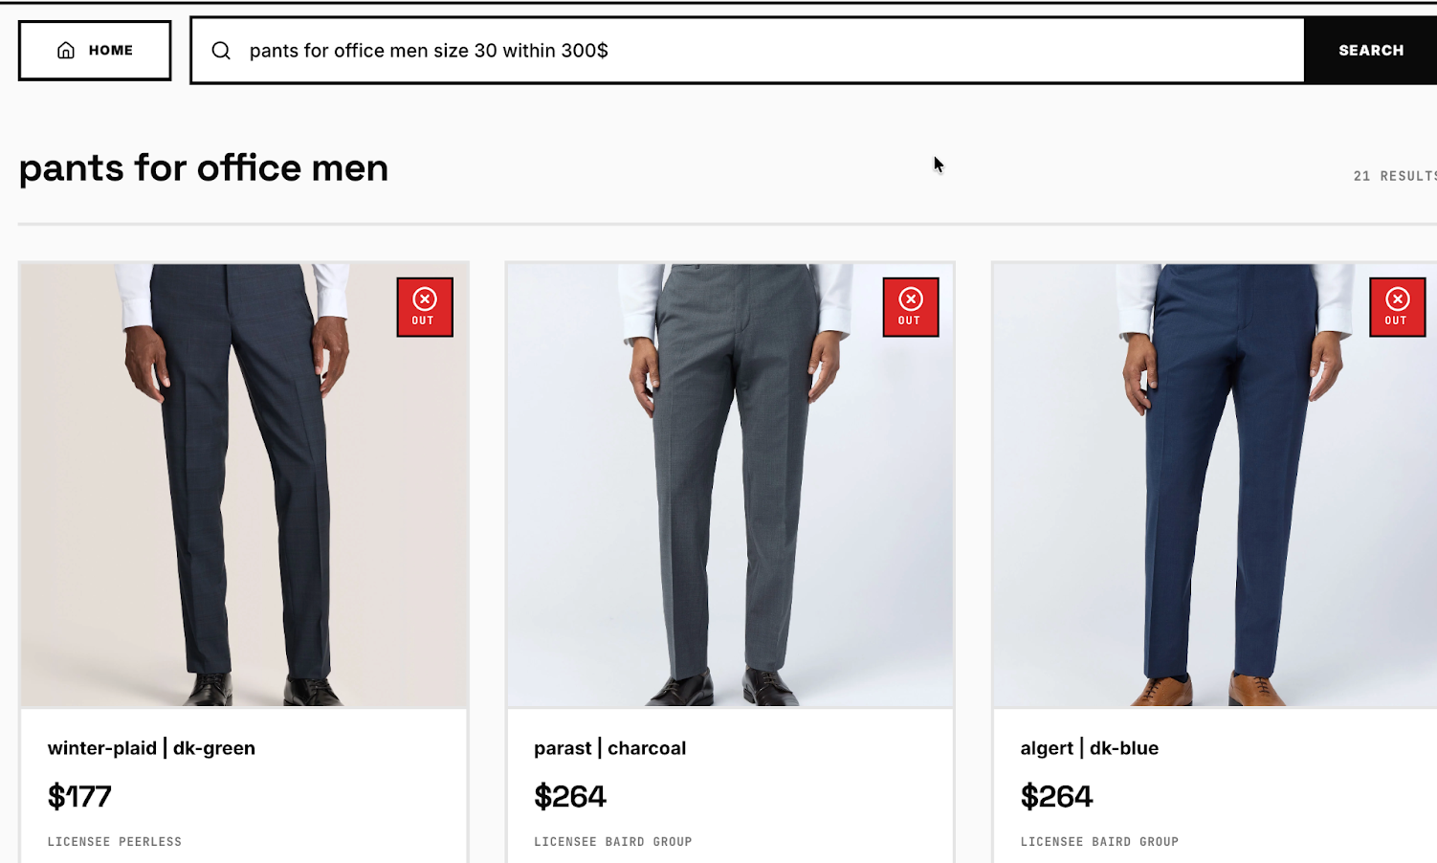
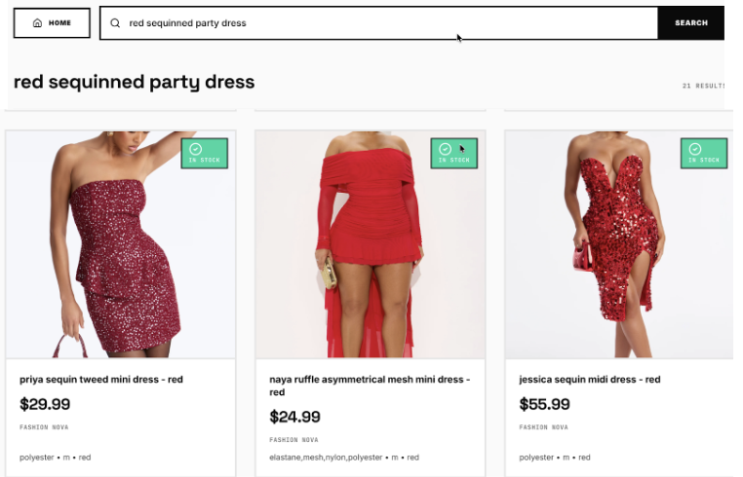
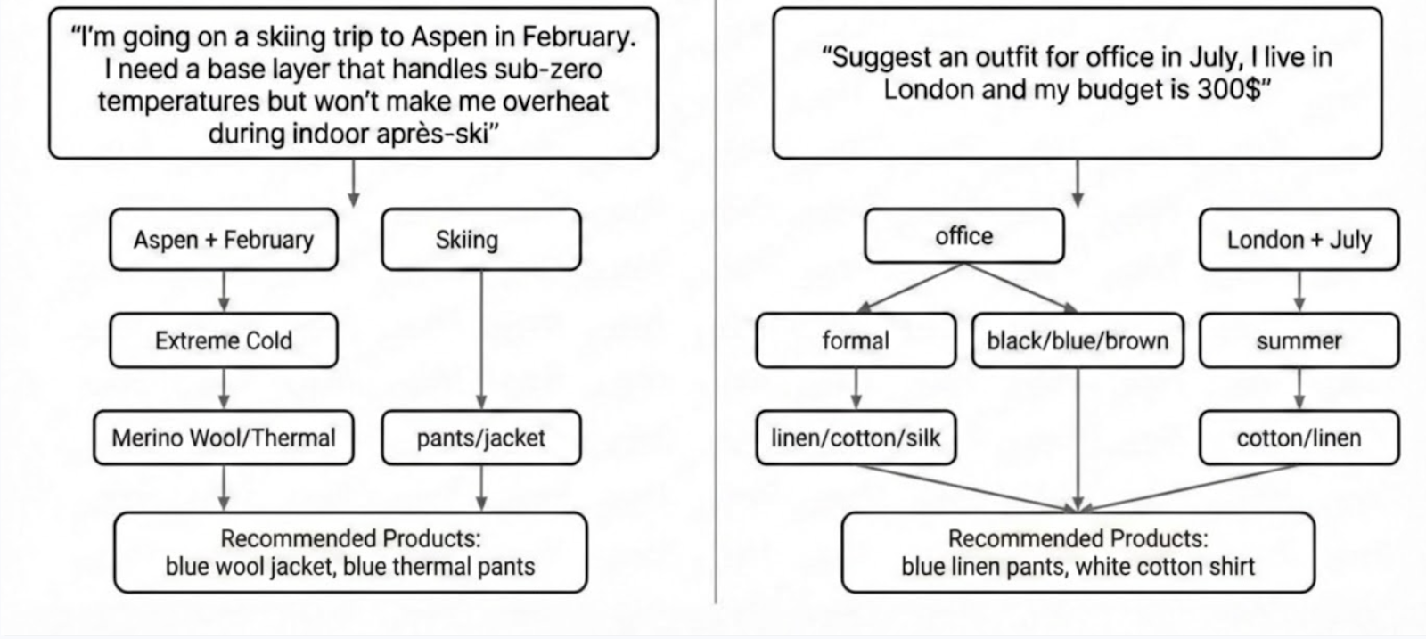

Slide 7
We ran an audit on your website to see what fails today
We ran real shopper queries (sourced from Google autocomplete) on tatacliq.com
What the shopper searches | Search returns | What exists in the catalog
diwali outfit for men | 0/40 relevant — returned running shoes, clogs, sandals instead of ethnic wear | "kurta for men" → 50 relevant results
saree for wedding guest | 18/39 relevant — 54% results were lehengas and shararas, wrong product type | "saree for women" → 32 relevant results
shoes that won't get ruined in rain monsoon | 0/24 relevant — all generic running shoes, no waterproof features | "waterproof shoes" → 21 relevant results
mixer grinder 750 watt | Collapsed from 40 to just 1 result | "mixer" → 40 relevant results
banarasi silk saree for wedding | 3/10 relevant — diluted with lehengas and generic silk sarees | "silk saree" → 25 relevant results
Every query is grounded in Google autocomplete — real shoppers type these. The products exist. The search can't connect the two.

Slide 8
What SuperSearch builds for you
AI Shopping Assistant on Website
Chat-based shopping: voice, image, and text input
Lower cost per query - Graph handles the majority of queries, LLM tokens only for edge cases
All intent based queries such as “outfit for Ladakh trip”, “plan my meals” handled just like in ChatGPT and Amazon Rufus, giving buyer a full conversational experience.
We’re also open to building a full AI sales agent — a guided shopping assistant that helps buyers across CLiQ’s categories (e.g. ‘help me put together a wedding guest outfit under 15,000’ or ‘I need to furnish a 1BHK’).
Catalog Normalization + Enrichment
All merchant catalogs synced to unified schema that AI agents can read with no token wastage
Synonyms, spell check, use-case tagging, intent mapping, attribute enrichment across your catalog
AI agents can directly search the catalog to answer user queries
Intent-Aware Knowledge Graph
Maps user intent to keywords in PDP’s without spending millions of dollars in LLM tokens
Graph traversal designed for sub-20ms latency vs 100ms-2s for LLM inference, works for 5K-50K+ SKU catalogs
Enables AI shopping assistant to answer any and every query asked by a buyer facilitating a truly realistic online shopping experience and boosting conversion

Slide 9
How SuperSearch is different
 | Keyword Search | Pure LLM | SuperSearch (Graph + LLM)
Simple query cotton kurti for women | Handles well | Handles well | Handles well
Synonym query mixer grinder 750 watt | Not supported (no synonym bridging) | May work (depends on training data) | Handles via vocabulary graph
Occasion query diwali outfit for men | Not supported (no intent mapping) | Generic suggestions (not catalog-aware) | Maps to your actual products
Conversational query shoes that won't get ruined in rain monsoon | Not supported (not designed for this) | Generic answers (not your catalog) | Returns your actual inventory
Cost at scale | Low | High (LLM call per query) | Low (LLM only for edge cases)
Multi-attribute queries (5+ constraints) | Accuracy degrades | Prone to hallucinations | 3x more accurate than standard RAG

Slide 10
Let's close the gap.
We can run a full 500-query audit on your site in under a week.
Every query grounded in Google autocomplete. Every result verified against your actual catalog.
No commitment required — the audit speaks for itself.
Aantriksh Pandya · aantriksh.pandya1@gmail.com
Shalini Mukhopadhyay · shaliniiitkgp2021@gmail.com

