Slide 1
California Wildfire Predictor
By Aanvi Goel

Slide 2
Overview
In 2021 there were 5267 wildfires started across the state of California, burning 204,921 acres of land, displacing locals from their homes, causing property destruction, poor air quality and other consequences
Predicting the size of wildfire would help the fire departments and the Forest Services in deploying appropriate resources right at the time of fire discovery, leading to quicker containment times and reduced environmental and infrastructural damage
Notes:
California experiences major wildfires

Slide 3
Project Objective:
Build a Linear Regression model to predict the size of wildfire for occurrences in the state of California based on weather conditions, location and cause factors

Slide 4


1. Methodology
Web Scraping and Data Collection
EDA and Feature Engineering
Building a Baseline Model
Applying Transformations
Scaling Features and Reducing Model Complexity
Regularization
Finalize Model and Test

Slide 5
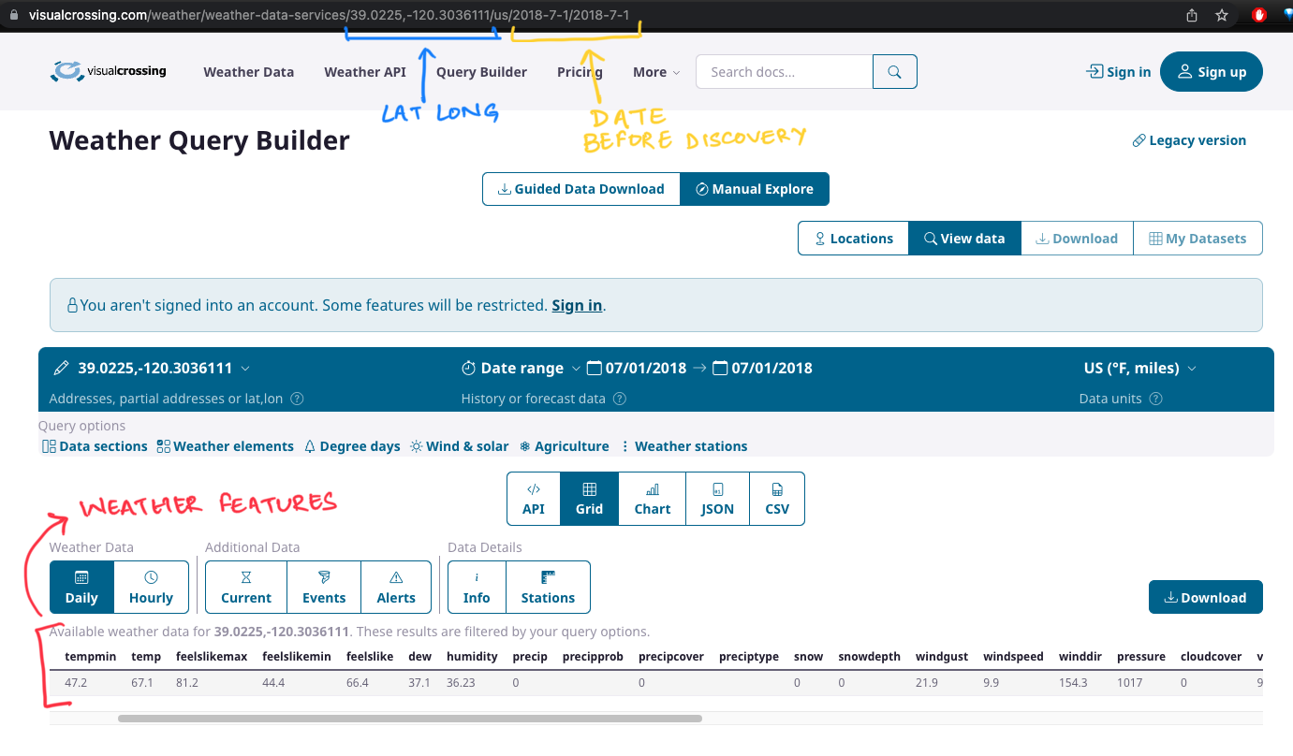
Web Scraping

Slide 6
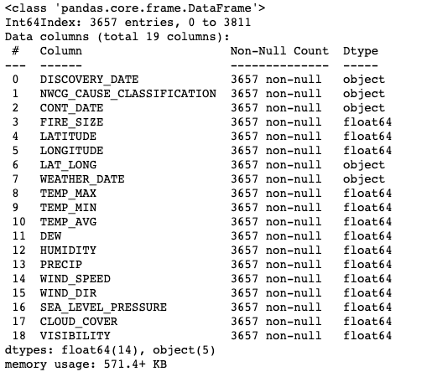
Final Combined Data
Fire Occurrence + Corresponding Weather Data
Notes:
Duplicated dropped, objects converted to float
3657 fire occurrence points, with 18 features
Feature engineering: Converting the Cause feature to numerical encoded feature

Slide 7
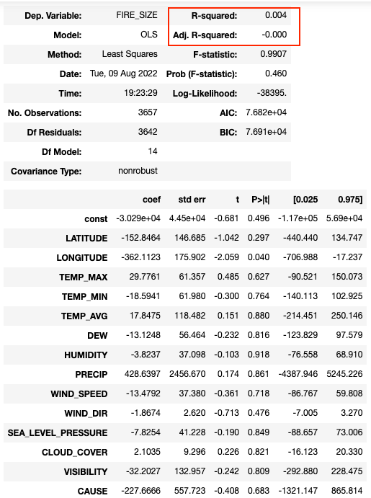
Baseline Model
For 80/20 test and validation data split:
Train score: 0.0066973648088055615
Val score: -0.0022044748479403964
Overfit Model
Notes:
Duplicated dropped, objects converted to float
3657 fire occurrence points, with 18 features

Slide 8
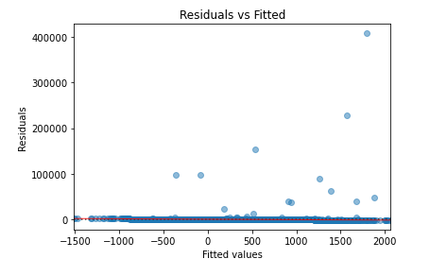

Observations:
Residuals are unbalanced along the Y-axis -> The data is not normally distributed
Target (y) is heavily right skewed -> Fire size values have outliers beyond the std deviation
Notes:
Duplicated dropped, objects converted to float
3657 fire occurrence points, with 18 features

Slide 9
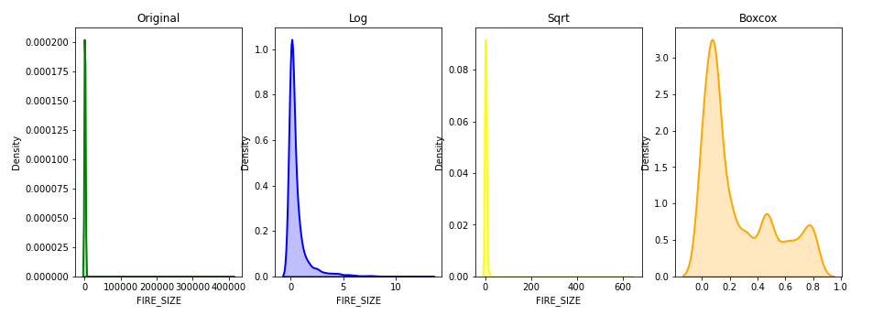
Applying Transformation to Y
Skew: 0.914
Notes:
BoxCox -> Closest to normal distribution

Slide 10
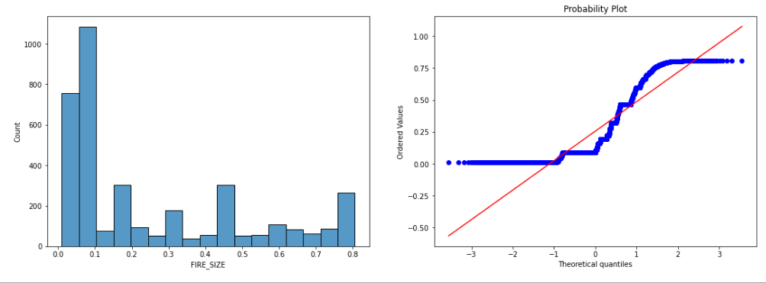
Y data is still not ideal. Fire Size distribution has LIGHT TAIL
Notes:
More like a uniform distr

Slide 11
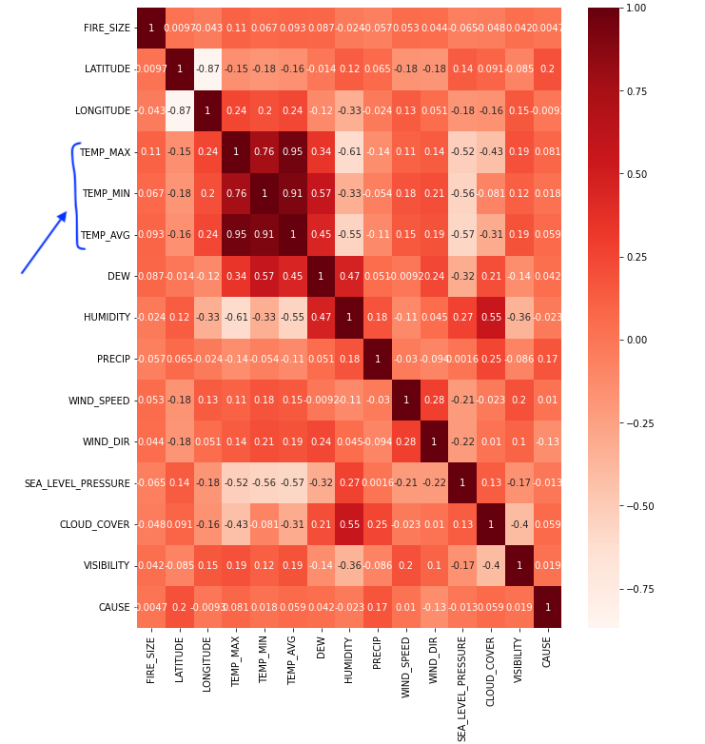
Scaling and MultiCollinearity
Notes:
Duplicated dropped, objects converted to float
3657 fire occurrence points, with 18 features

Slide 12
Regularization
Model: | Lasso | Ridge | Elastic Net
MSE | 0.06072 | 0.06076 | 0.06073
R2 Score | 0.02656 | 0.02594 | 0.02648
Notes:
Lasso does SLIGHTLY better
Regularization was validated with 5 KFold cross validation

Slide 13
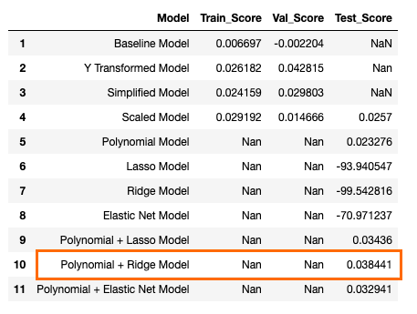
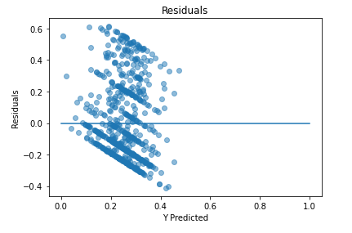
Final Model
Evaluating Performance of Final Model:
R2 score: 0.04
Mean absolute error: 0.21
Mean squared error: 0.06
Root mean squared error: 0.24
Notes:
Lasso does SLIGHTLY better
Regularization was validated with 5 KFold cross validation

Slide 14
Future Improvements
Getting average weather data across multiple days
Get data points across different years
Combine Fire data points from same date and neighbourhood

