Slide 1



POLICYCITE-RAG
Verifiable AI for Healthcare Payment Policy
Aanya Lari | Cotiviti Intern Assessment | Topic 3
Statement-level evidence
Exact policy excerpts
Human-review routing

Slide 2
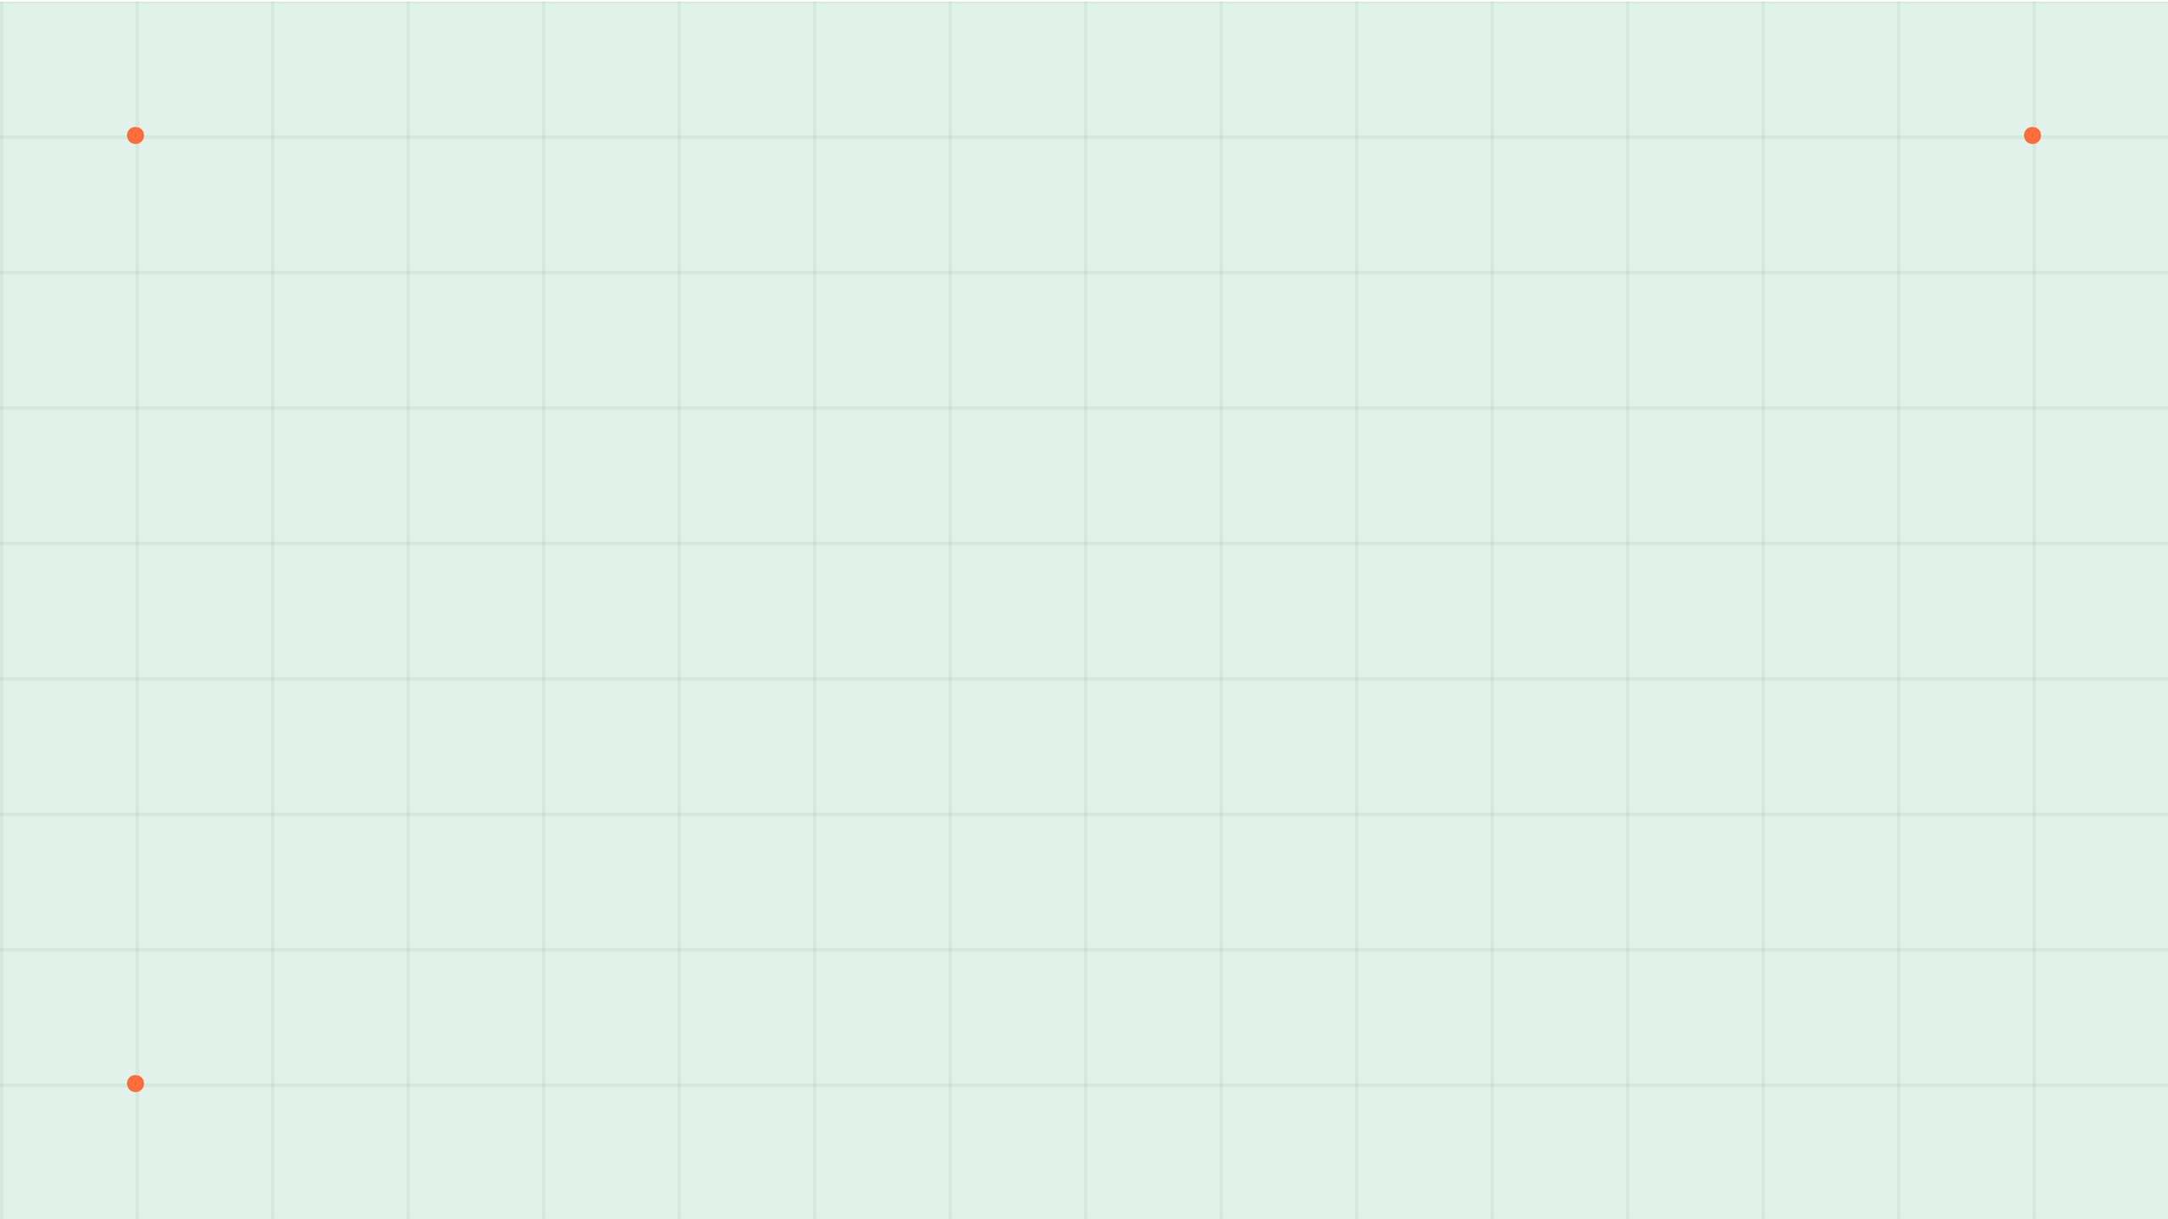
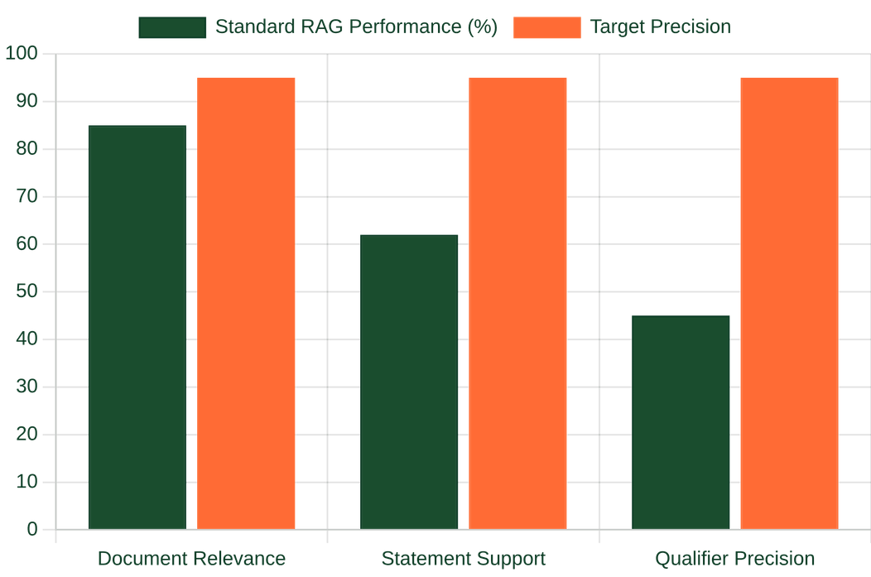
THE CRITICAL GAP IN PAYMENT POLICY AI
Source list ≠ Proof
A relevant document does not guarantee a supported
statement. One missing qualifier can change the entire
payment outcome.
Statement-Level Audit
PolicyCite-RAG verifies each claim against exact
evidence, checking source authority and effective
dates.
Technical Necessity
Verification must be granular to prevent claim denials
or prior-authorization errors caused by AI
Sources: Gao et al. (2023); Chen et al. (2023). Benchmarks: ALCE, RGB.
hallucinations.

Slide 3

EVOLVING RESEARCH IN AI GROUNDING
METHOD
CORE IDEA
FIT FOR POLICYCITE
MedCite
Statement-level citations & multi-pass retrieval
High: Matches need for granular evidence
Self-RAG
Adaptive retrieval and self-critique
Medium: Risk of shared model blind spots
CRAG
Correct weak retrieval via evaluation
Medium: Triggers correction when evidence is low
RARR
Research and revise unsupported text
Low: May hide original generation failures
Opportunity: A Governed Evidence Layer
Cotiviti can combine these methods with approved sources, version metadata, and audit records. This ensures that every AI response is grounded in a verifiable, human-governed evidence layer.

Slide 4
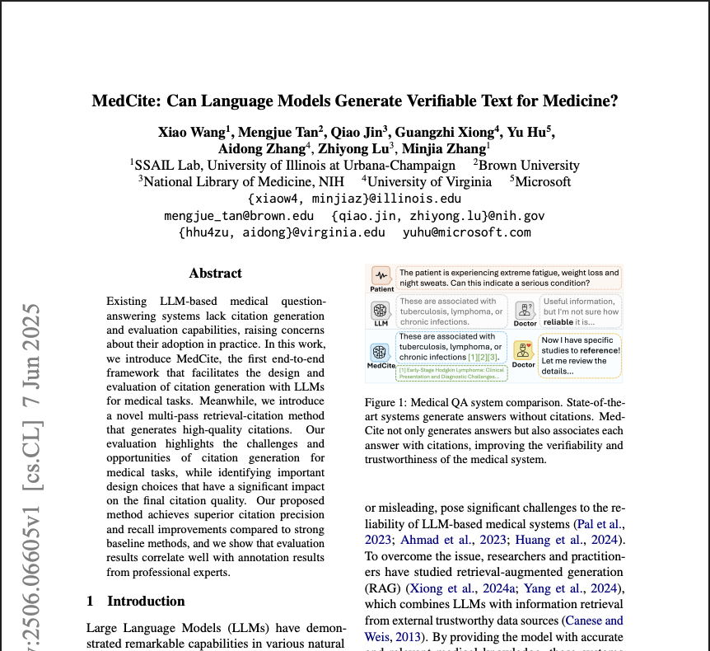

Slide 5
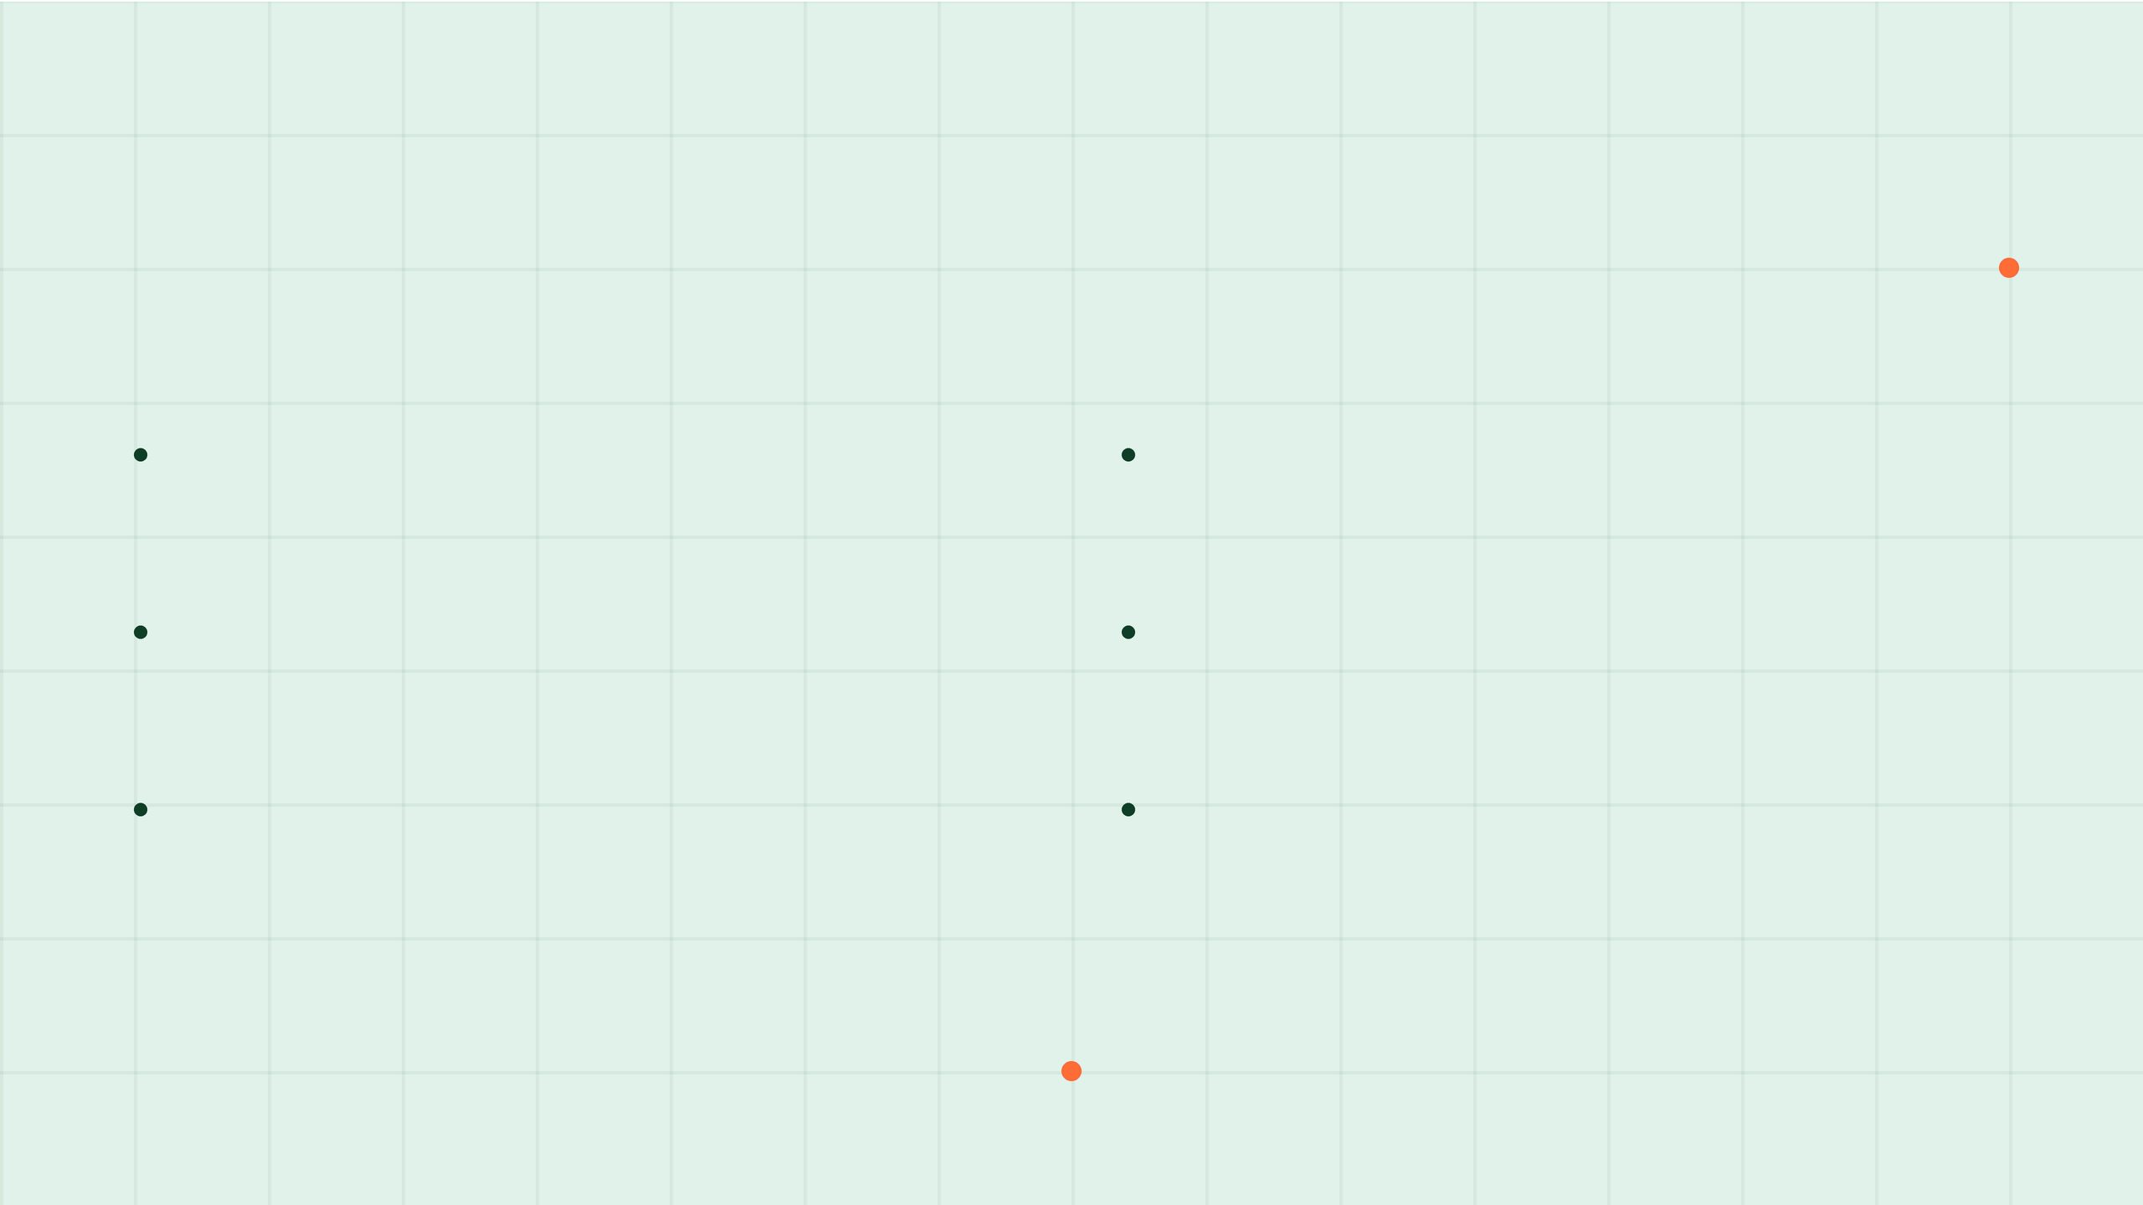



MEDCITE: A VALIDATED FOUNDATION
Published in Findings of ACL 2025
DOI: 10.18653/v1/2025.findings-acl.967
Core Contributions
Fit for PolicyCite-RAG
End-to-End Framework
Statement-Level Evidence
A comprehensive method for generating and evaluating
Directly addresses the need for granular verification in
medical citations in LLM responses.
healthcare payment policy.
Multi-Pass Retrieval
Metric Adaptation
Iterative search strategy that improves citation precision
MedCite's attribution and citation metrics are adapted for
and recall over strong baselines.
the CMS policy corpus.
Expert Alignment
Research Inspiration
Evaluation results correlate strongly with annotations from
Provides a credible, peer-reviewed foundation for the
professional medical experts.
POC's technical architecture.

Slide 6










A TRANSPARENT TECHNICAL ARCHITECTURE
CORPUS & RETRIEVAL
APPLICATION LAYER
AUDIT CONTROLS
CMS Policy Corpus
Local LLMs (Ollama)
Provenance Separation
Three public CMS documents stored as
Llama 3.2 (1B) for generation; Qwen 2.5
Generation and audit evidence stored
JSONL.
(3B) for audit.
independently.
Hybrid Retrieval
FastAPI Backend
Binary Verdicts
FAISS (Dense) + BM25 (Lexical) for high
Exposes baseline and cited-answer
Deterministic support/no-support
recall.
paths.
classification.
RRF Integration
Streamlit UI
Review Routing
Reciprocal Rank Fusion for optimized
Live dashboard for audit trail
Automated flags for human-in-the-loop
ranking.
visualization.
validation.
*Stack intentionally avoids complex agents to maintain a deterministic and inspectable audit trail.

Slide 7
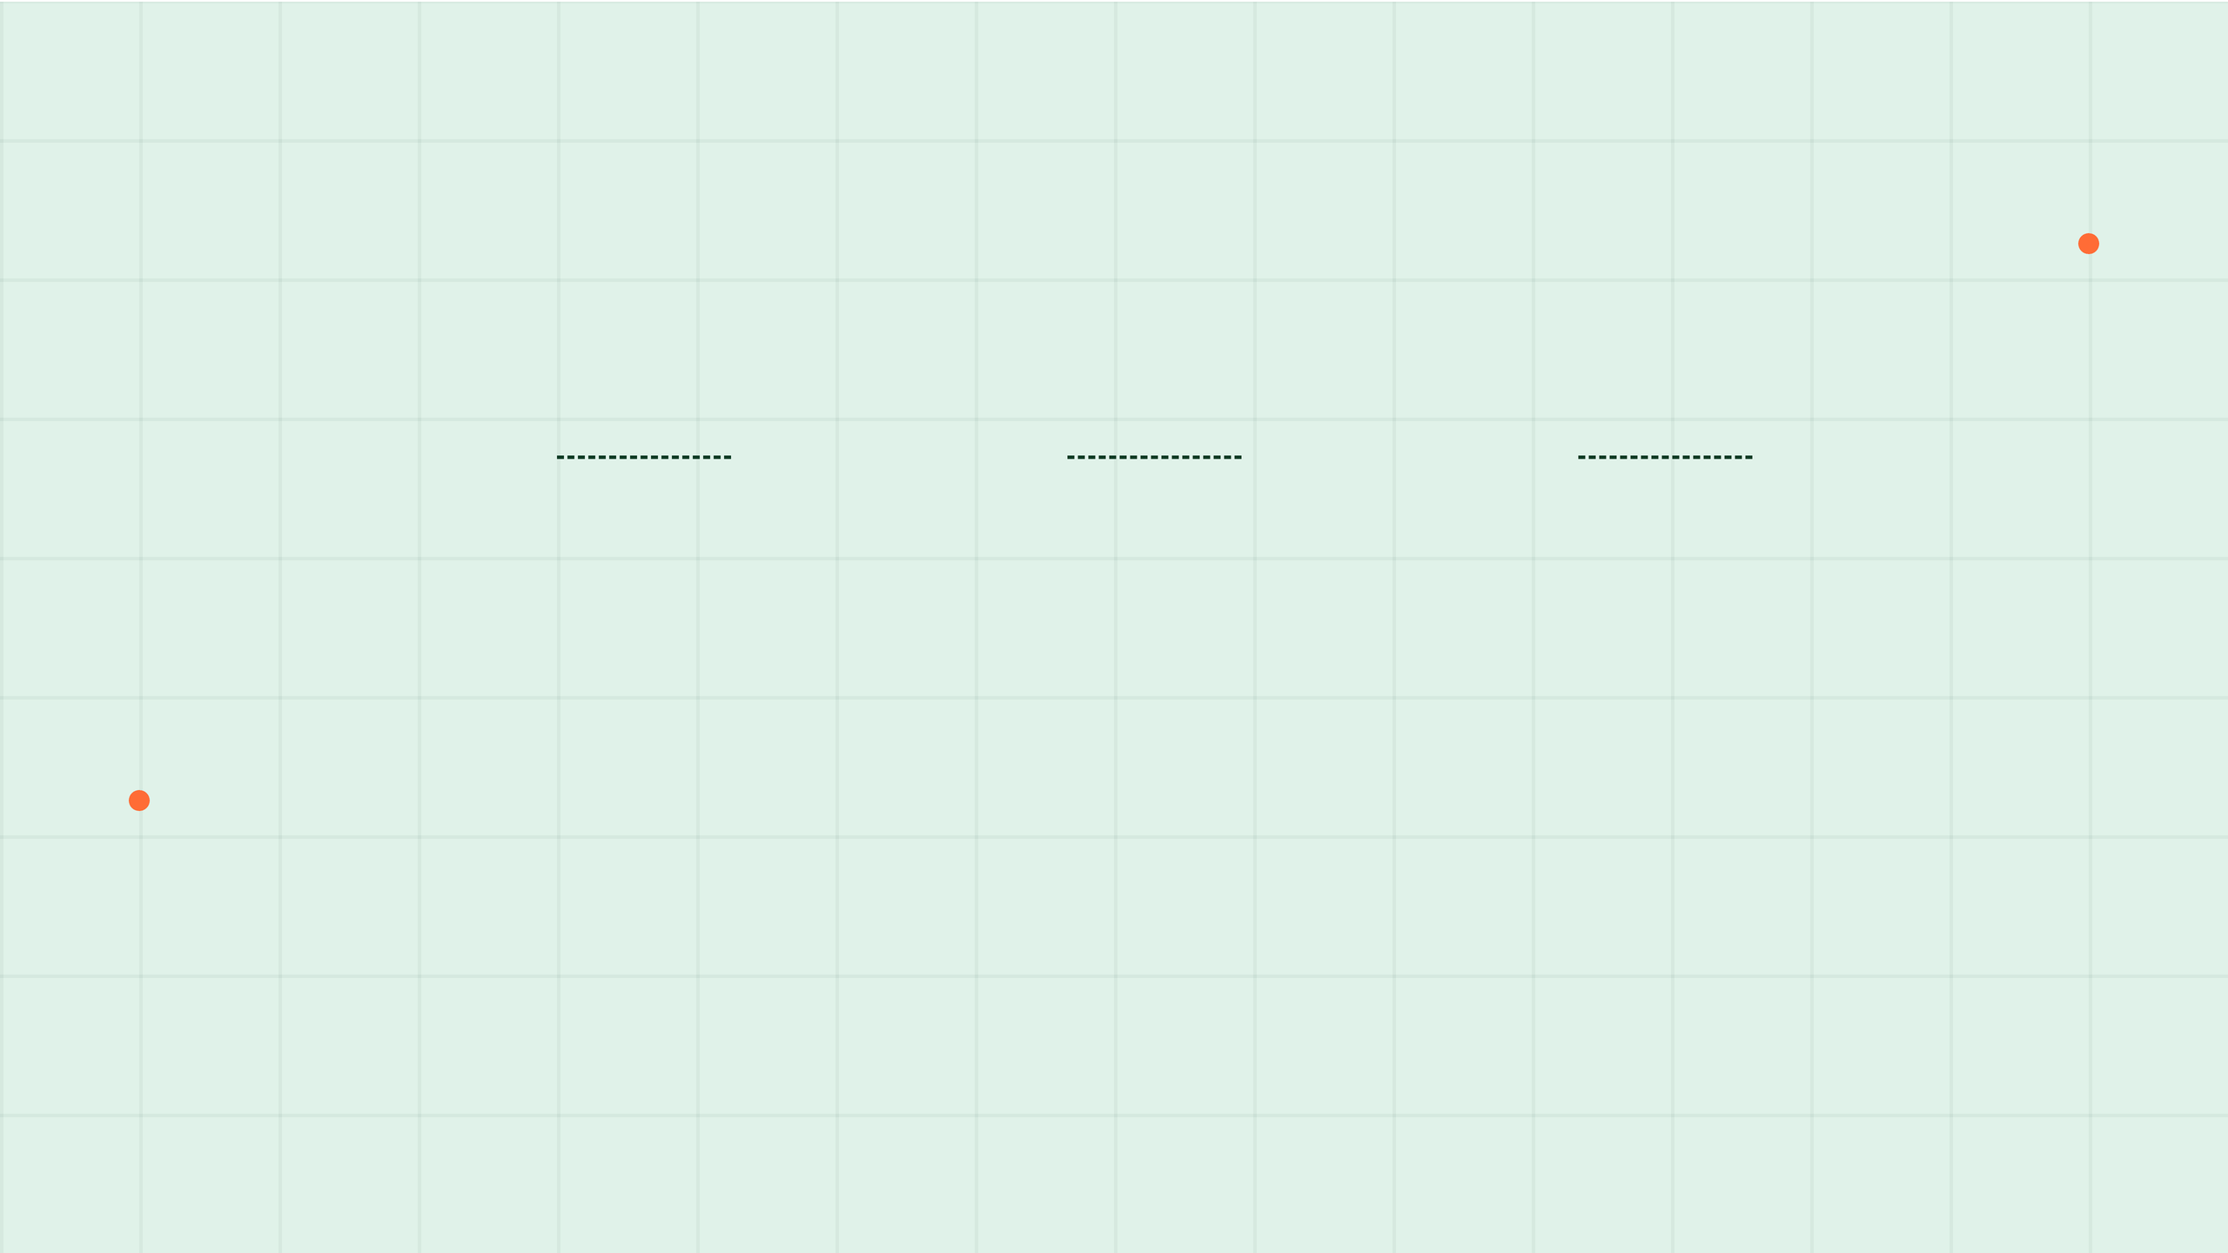




SEPARATING GENERATION FROM PROVENANCE
Hybrid Retrieval
Answer Generation
Statement Extraction
Evidence Audit
FAISS + BM25 search across CMS policy corpus.
Baseline answer created from initial passages.
Answer parsed into individual factual claims.
Dedicated re-retrieval for each statement.
Independent Verification: Evidence retrieved after generation is stored separately to prevent mislabeling.
Audit Provenance: The system substantiates statements without confusing audit evidence with generation context.

Slide 8




RIGOROUS CITATION-ASSURANCE CONTROLS
Deterministic Validation
Model-Based Attribution
ID Verification:
Cross-references returned citation IDs against the master policy corpus.
Qualifier Audit:
Ensures every date, quantity, and modality is explicitly supported by the text.
Verbatim Extraction:
Copies exact excerpts directly from source JSONL to prevent paraphrasing.
Scope Check:
Validates that exclusions and conditions in the answer match the policy evidence.
Metadata Mapping:
Converts internal indices to user-facing display pages and effective dates.
Binary Verdicts:
Forces a strict support/no-support decision to avoid ambiguous grounding.
Human-Review Routing
Any statement flagged as NOT_SUPPORTED—due to missing, partial, or conflicting evidence—is automatically routed to a human reviewer. This prevents the system from inventing metadata or presenting hallucinations as facts.

Slide 9
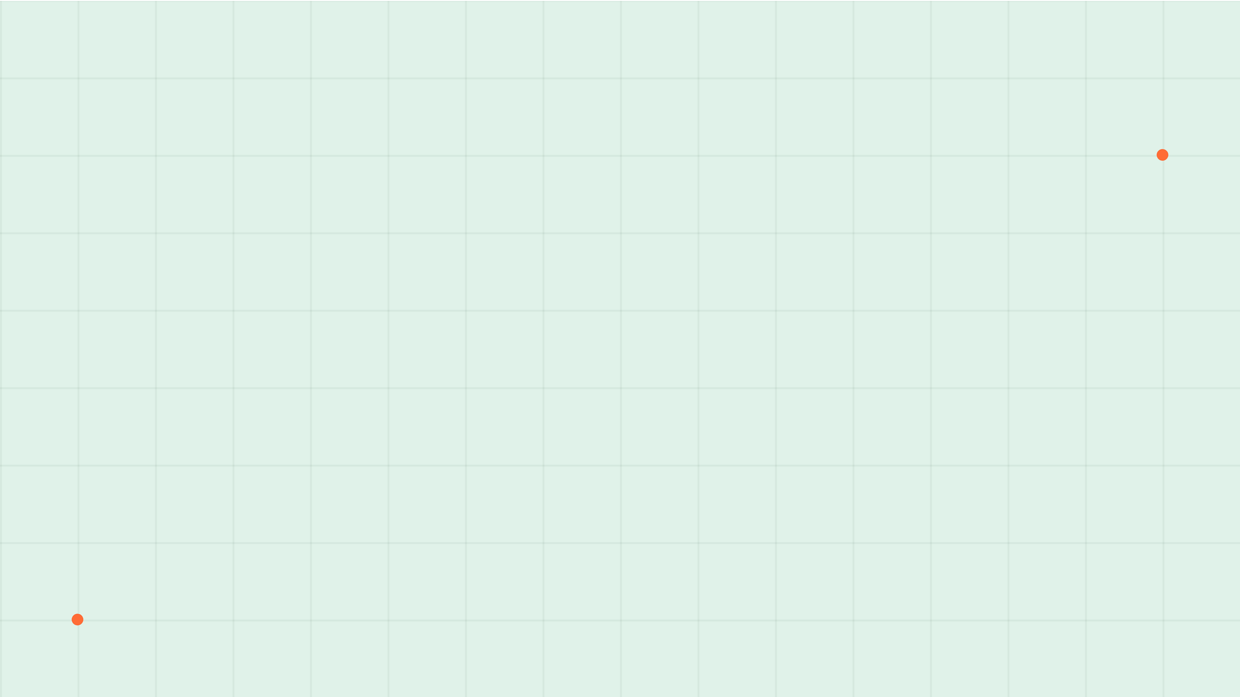
PERFORMANCE AND LATENCY EVALUATION
100%
AUDITED CITATION
PRECISION & COVERAGE
-25%
REDUCTION IN
REDUNDANT CITATIONS
0.15s
MEDIAN LATENCY
OVERHEAD
Artifact: evaluation/results/20260702T041034Z.json
Scope: 10 questions | 3 documents | Author signoff complete.
PolicyCite demonstrates technical feasibility for a compact, inspectable audit trace with minimal performance impact.

Slide 10

STRATEGIC PILOT RECOMMENDATION
1. Bounded Domain Start
Begin with one versioned policy domain restricted to approved, effective-dated sources.
2. Reviewer-in-the-Loop
Core Strategy
Require explicit evidence for every claim and route all flags to human review.
Build the evidence layer before expanding the chatbot.
Expansion should be contingent on high citation precision and measurable workflow value.
3. Versioned Audit Records
Preserve statement, evidence, corpus versions, and reviewer decisions in a permanent log.
4. Success Metrics
Measure qualifier preservation, expert agreement, and reviewer time saved.
Sources: Wang et al. (2025); Xiong et al. (2024); Noy and Zhang (2023)

Slide 11
POLICYCITE-RAG
DEMO

Slide 12
Thank you
Aanya Lari

