Slide 1




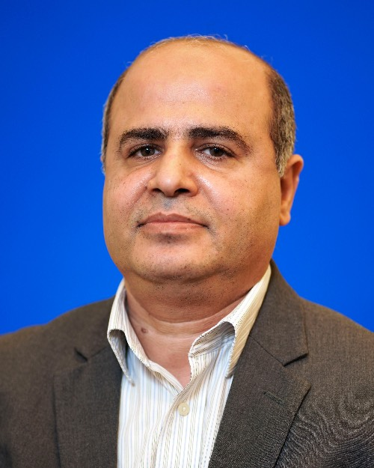
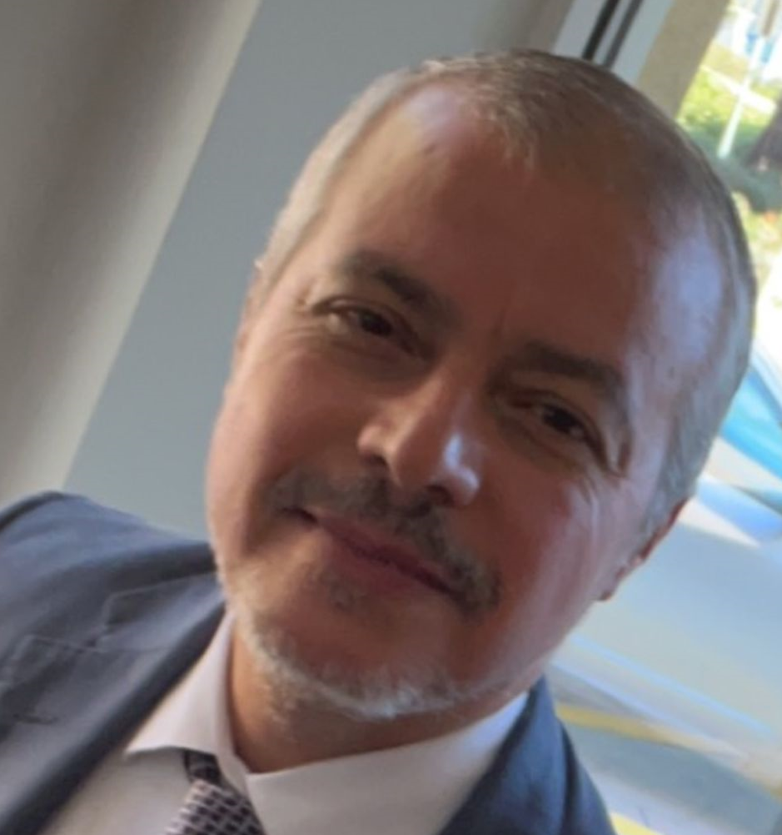
Title: Introduction to HPC and Digital Forensics
(For CISS 3342 Computer Forensics)
SGX3 award # 2231406
Revised Course Description
Sample HPC/Gateways Exercise
Gateway Community Mentor Syllabus Suggestions
This course explores advanced topics in digital forensics, focusing on how High-Performance Computing (HPC) can enhance forensic analysis tasks. Students will learn cutting-edge forensic techniques, including file recovery, memory analysis, and network forensics, and apply these methods using HPC resources to handle large datasets and complex investigations efficiently.
Key topics include digital evidence collection, forensic data processing, incident response, and the ethical and legal considerations of digital forensics. The course also provides hands-on laboratory work, where students will develop scripts and apply digital forensics techniques in HPC environments. The goal is to equip students with practical skills in leveraging advanced computing technologies for real-world cybersecurity challenges.
Additionally, this course is designed to support a diverse learning community of students, faculty, and staff across disciplines, offering flexibility in duration and the opportunity for personalized learning experiences.
In the past I used existing public materials from testbeds such as Fabric, Sphere, etc. Additionally, I provide samples of my experience implementing those experiments and feedback to previous students.
There is one particular gateway I used and liked this year (the ChameleonCloud shared experiments portal):
(https://www.chameleoncloud.org/experiment/share/)
The portal focuses on an excellent idea (reproducibility). This allows students to submit their feedback and experience.
I am also planning to utilize the new TAMU cluster ACES (https://portal- aces.hprc.tamu.edu/pun/sys/dashboard)
High-Performance Computing (HPC) Resources
Chameleon Cloud: An experimental platform for cloud computing research and education. It offers resources for building hands-on labs, particularly for testing digital forensics techniques in HPC environments.
ACCESS: Advanced Cyberinfrastructure Coordination Ecosystem: A platform that provides users access to computational resources, data, and training. It's an ideal resource for students and faculty to engage with large-scale computing environments.
HPRC: High-Performance Research Computing at Texas A&M: Offers access to the ACES cluster, which can be used to run digital forensic analyses and other cybersecurity tasks, providing hands-on training for students.
Temple University MHPC (Mid-Atlantic High Performance Computing Center): Provides HPC technology resources and training for students and researchers, with an emphasis on interdisciplinary collaboration, which is perfect for digital forensics courses.
Cybersecurity & Digital Forensics Testbeds
Fabric (Adaptive ProgrammaBle Research Infrastructure): is an International infrastructure that enables cutting-edge experimentation and research at-scale in the areas of networking, cybersecurity, distributed computing, storage, virtual reality, 5G, machine learning, and science applications.
CloudLab: An open platform for creating custom clouds to experiment with different cloud architectures and services, useful for testing cloud-based digital forensics tasks.
Orbit Wireless Testbed: A wireless testbed that enables wireless network and mobile device forensics labs, ideal for forensic analysis of mobile systems in wireless environments.
TACC: Texas Advanced Computing Center: Provides access to HPC resources along with comprehensive training and educational materials for using HPC in research and education, including cybersecurity and digital forensics.
Datasets
Kaggle Datasets: https://www.kaggle.com/datasets
GitHub Repositories
UNSW-NB15 Dataset: Contains labeled network traffic data, including benign and attack traffic, suitable for testing intrusion detection systems.
KDD Cup 1999 Dataset: A widely-used dataset for network intrusion detection, consisting of simulated network connections labeled as normal or attack.
ADFA Intrusion Detection Datasets
CICIDS: Canadian Institute for Cybersecurity provides various datasets simulating real-world attack scenarios in network traffic.
Possible Expansions
Expanding HPC Education: My long-term goal is to expand beyond this one digital forensics course and offer an introductory HPC course accessible to faculty, students, and staff across OLLU. As I work on integrating HPC into the digital forensics' curriculum, I aim to make HPC resources available to the wider academic community. The primary objective is to develop a flexible course, with a duration ranging from 1 to 16 weeks, allowing for additional training and customized modules tailored to the specific needs of different disciplines. This is a key milestone I aim to achieve in the coming year.
Implementation Schedule
Resource Needs/List
Resources / Science Gateways
I plan to incorporate various hands-on labs using open testbeds such as Geni.net, CloudLab, and ACCESS (formerly Xsede), along with other platforms like Orbit, Deterlab, and Emulab. Each testbed presents its own learning curve and opportunities for student engagement. As I update the CISS 3342 (Computer Forensics) course, I intend to experiment with different modules from these testbeds to improve the learning experience continuously.
Looking ahead, I aim to expand the course by introducing HPC testbeds, such as Chameleon Cloud from TACC and ACES from TAMU, to support high-performance digital forensics tasks. My goal is to increase the integration of HPC resources into the curriculum, guided by student feedback and the availability of testbed credits. Although the availability of credits may present challenges, the recent development of our own CAMSA local cluster will allow me to provide more consistent and robust HPC-based labs in future iterations of the course.
Securing HPC Access: I am currently working on securing HPC credits for me and my students from providers such as ACCESS and TACC. While we have limited resources at the moment, my goal is to ensure consistent availability for educational purposes. This will allow us to incorporate HPC resources into the course and provide students with hands-on experience.
Securing Resources: I plan to secure additional resources from providers such as ACCESS and TACC to ensure a consistent and reliable HPC experience for students.
Educational Material Needs: My focus is on obtaining educational materials that:
Are simple and user-friendly,
Function as described without complex technical setup,
Emphasize user experience rather than technical specifications, and
Are customized to suit the diverse research disciplines, allowing students and researchers to see how HPC can be leveraged in their own fields.
https://access-ci.org/
(In particular chameleoncloud is a great resource for education materials, (https://www.chameleoncloud.org/experiment/share/)
Authors
Ahmad Al-Omari
Our Lady of the Lake University
aal-Omari@ollusa.edu
Use Cases
Teaching Course Materials: I intend to adapt this course to fit students in digital forensics, cybersecurity, and specialized areas such as Computer Networking and Cloud Computing, and Malware Analysis, incorporating HPC resources for hands-on learning.
Teaching the Broader HPC User Community: The course will also be tailored for a broader HPC user base, focusing on practical, user-centric perspectives. The emphasis will be on how to effectively utilize HPC for research and analysis, without delving too deeply into the underlying technology, architecture, or HPC tools.
Mohamed Elbakary
Elizabeth City State University
melbakary@ecsu.edu
HPC/Gateways Mentor
Izzat Alsmadi
Texas A&M, San Antonio
ialsmadi@tamusa.edu
MORE INFORMATION → https://hackhpc.github.io/facultyhack-gateways23 __

