Slide 1
CARDS
AGAINST
TELEGRAM
A CHAT-BASED
PARTY GAME FOR HORRIBLE PEOPLE
BY HORRIBLE PEOPLE
Team 03:
Sagar Patel Amir Omidi Jessica Hoban Balaji Lakshmanan Tanfe Aderemi
Notes:
Team 03
Balaji

Slide 2

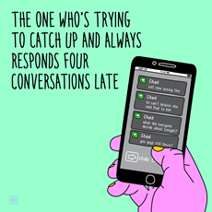
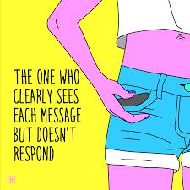
Make Group Chats Great Again
Notes:
Balaji

Slide 3
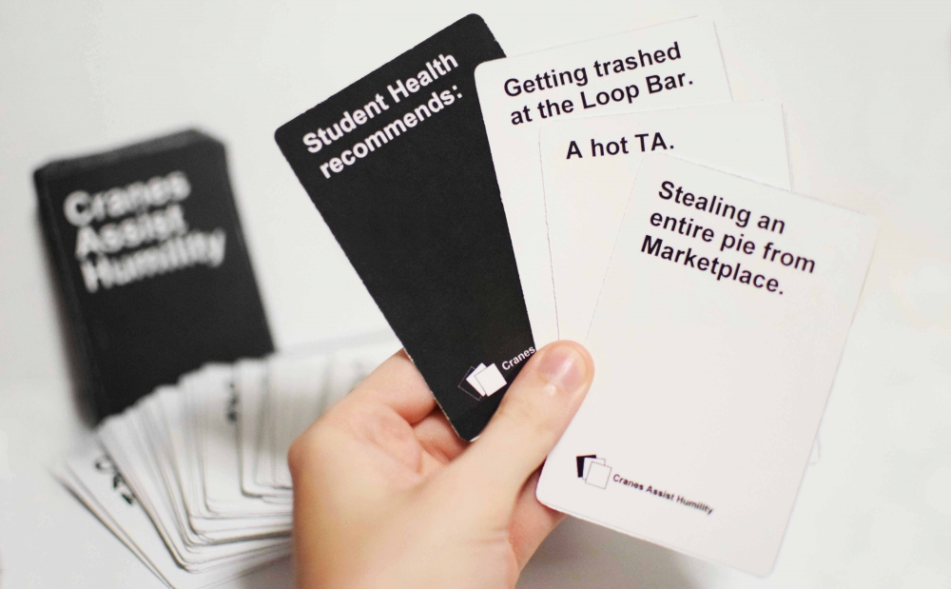

Project Request
Incorporate Cards Against Humanity on Telegram
Multi-platform Accessibility
Multi-player Interface
Notes:
Balaji

Slide 4
Project Request
Basic Game Logic
CZAR selected randomly
Black Prompt cards to be shown at random
White Answer cards “dealt” to all players
Best answer chosen by CZAR
Scores displayed at the end of each turn
Notes:
Balaji

Slide 5
Scope of Effort
Critical Priority:
User Interface on Telegram
Using custom keyboards with card value
Parse JSON card packs to be available for game
Allowing multi-player access for players
Display results at the end of each turn
Notes:
Sagar

Slide 6
Nice-to-Haves
Website
Information on how to play the game and learn about more functionality
Development updates and future ideas
Customized card packs chosen by players
Children friendly version
Creating a player management system to initiate public games
Notes:
Amir

Slide 7
Future Considerations
Global Leaderboard
Shows high scores
Global competition
Games for players with high scores
Platform for “Socializing”
Web-based game
No Telegram dependency!
Play on a website
Notes:
Amir

Slide 8
Approach
Technical:
Bitbucket for version control
Front-end
User Interface and Design
Back-end
Telegram’s Bot API
Java
Notes:
Amir

Slide 9
Major Deliverables
Provide users access to official card packs
Parse official JSON cards into JAVA object
Easy-to-use Interface
Clear difference between white and black cards
Provide response with just a click
Provide multi-player functionality
Handle group chats / game lobbies
Notes:
Sagar

Slide 10
Plan and Schedule
Phase One (Planning)
Finalise critical tasks
Decide game constraints
Assign time frames
Assess project status
Review technological issues
Due: February 5, 2017
Notes:
Tanfe

Slide 11
Plan and Schedule
Phase Two (Development)
Cards Against Humanity software
Game logic
Incorporation of CZAR cycle
Keeping track of scores
Due: February 15th, 2017
Notes:
Tanfe

Slide 12
Plan and Schedule
Phase Three (Testing)
Initial tests for single player
Multi-player testing in group chat
Deployment
Due: March 24th, 2017
Notes:
Jess

Slide 13
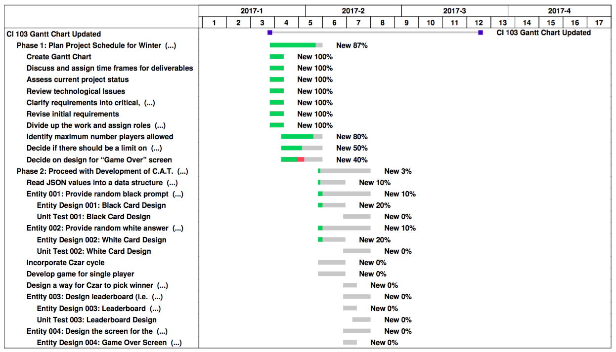
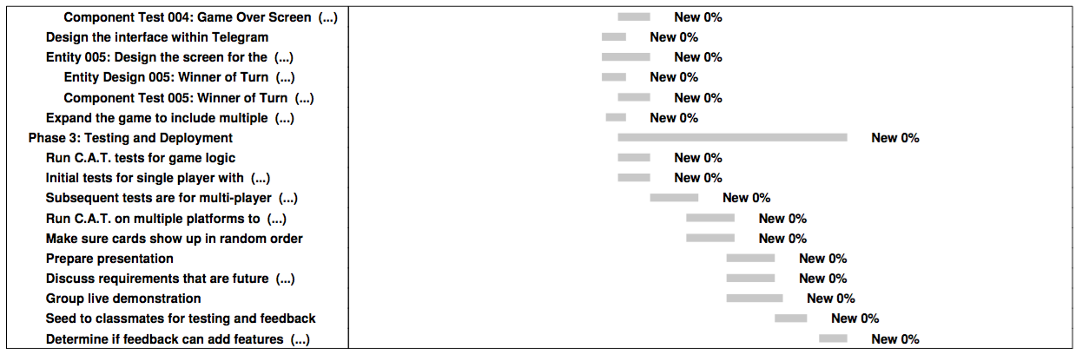
Notes:
Jess

Slide 14
Project
Demonstration

