Slide 1









RPPOOP PROJECT

Slide 2
INTRODUCTION TO PROJECT
A web application made using the Flask library from Python, JavaScript, HTML, CSS, etc. that generates ID cards for students , employees.

Slide 3
The idea for the project.
Reviewing all the problems that a student faces during college fests.
The process of manually typing for ID cards is automated.
Coming up with a programming solution for this.
Applying the concepts learnt in Object Oriented Programming to the solution.

Slide 4
OBJECTIVES
MAIN
OBJECTIVE
SECONDARY
OBJECTIVE
Providing the students of COEP Tech a convenient and efficient way to minimize efforts taken by the students to edit the ID cards during the various fest organized in COEP Technological University
Developing the project in way that
It can be expanded to generate different templates for various domains for real life use

Slide 5
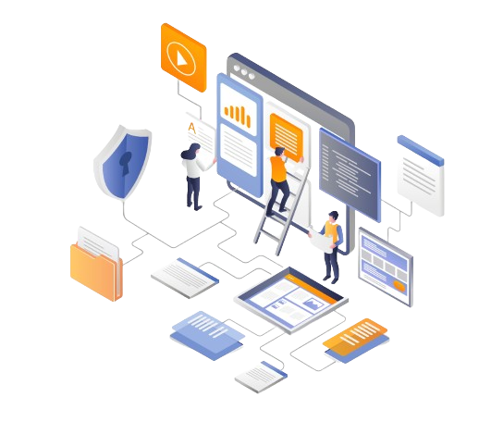
METHODOLOGY: PROCEDURES AND TOOLS
The Project makes use of the following tools:
Flask Library in Python and its functions like
Justify_text,generate_id_cards etc.
Pillow library in python is used to handle the images in python, while zip is used to compile all the downloadable png,jpeg,jpg files
HTML, CSS and JavaScript to make the web application more appealing and convinient.

Slide 6

Timeline
01
Plotting down a basic idea to accomplish the main objectives of the project
Writing down what the application is meant for
and creating a plan to make that into reality.
Discussing all the functionality and what we need to do in order to implement it.

Slide 7

Timeline
02
Learning tools forth mentioned required to make the project.
Learning all the tools
necessary (Python, JS, Flask, etc.) and object oriented
programming principles.
Exploring other methods of making and improving a web application.

Slide 8
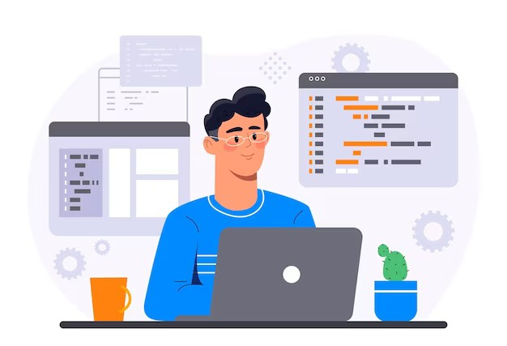
Timeline
03
Implementing the basic idea and create a prototype for developement.
Using the learnt
programming techniques creating the facade and basic idea of the project.
Creating a pleasing structure of the web
application in order to
present the main objective.

Slide 9
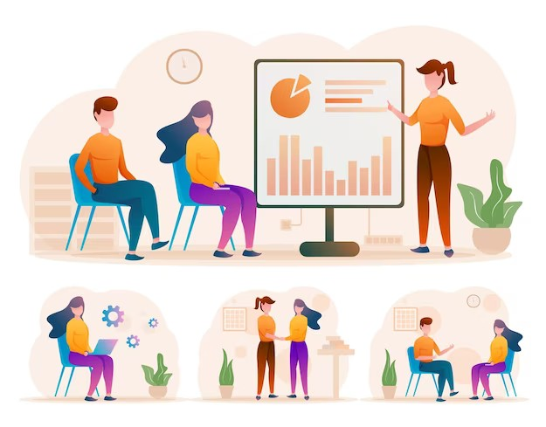
Timeline
04
Testing the application
For improving performance.
Application is tested several times for debugging and proper functioning.

Slide 10

Timeline
05
Creating the final product and making it appealing.
Adding a pleasing appearance and usability to the website so it
is more widely accpeted.
Adding accessibility and convinience to the
application for the user.

Slide 11
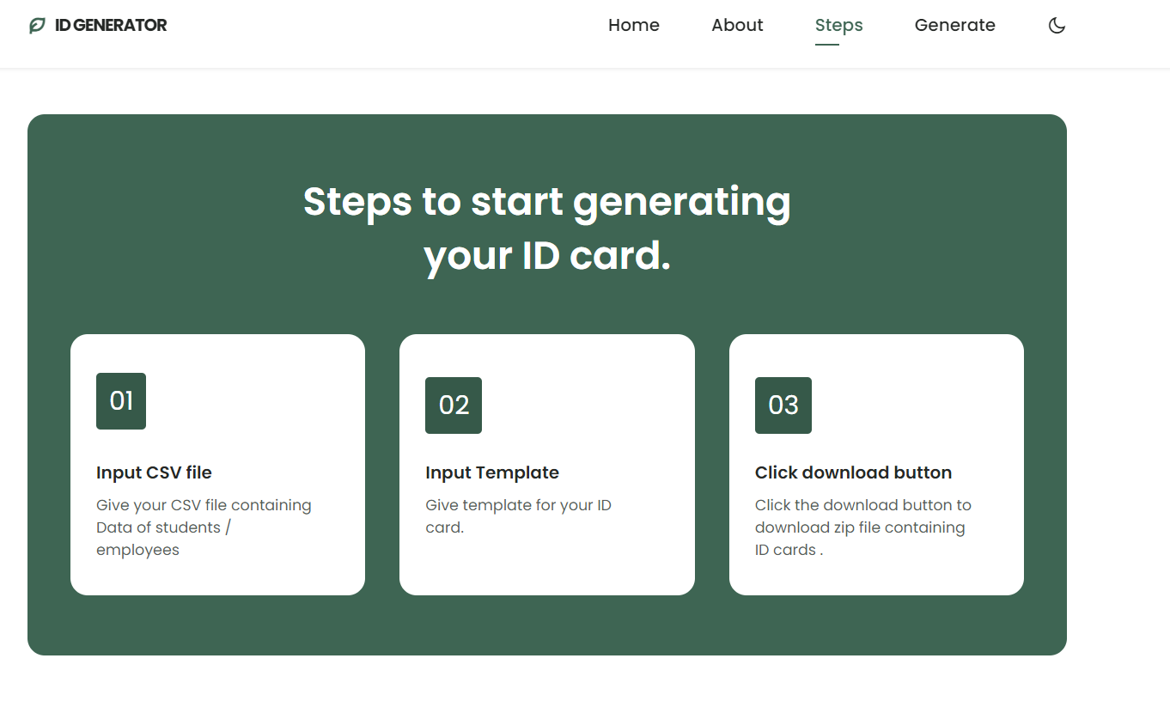
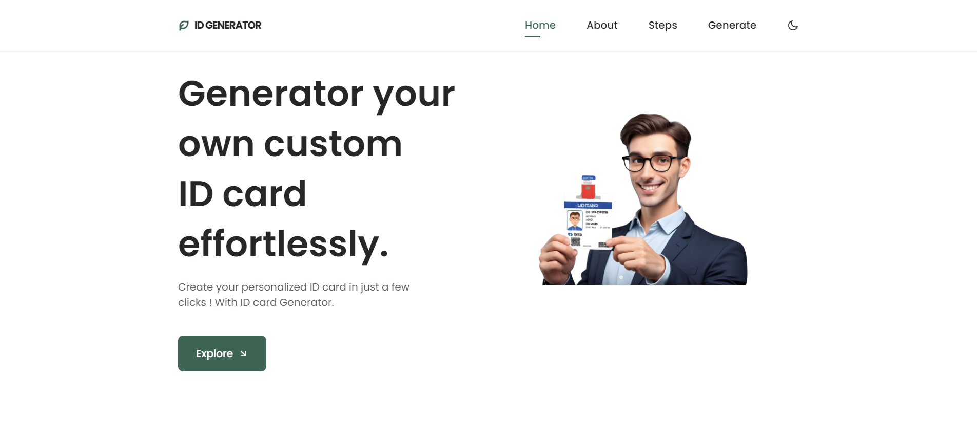
About the web
The Web app features a number of functions including:
It has a Steps page which shows how to use website
User just have to input his CSV file and template.
One zip file is downloaded which contains PNG images which user can directly print

Slide 12

Further Scope
This website is shown to the media heads of various media heads.
They said that the web app was helpful and they will use it in upcoming college fests
This project can be further expanded for generating not only ID cards but also invitation cards, greeting cards for personal customization.

Slide 13

CONCLUSION
This is a simple, convenient and useful web application for generating ID cards for our college as well as any other colleges.

Slide 14








We learned about solving real world problems using progrmming solutions and how to implement them.
What
Did
We
learn
We learnt a number of new programming techniques used in web developement and practical programming practices
We learned about Object Oriented Programming, Encapsulation, Polymorphism, Access Specification, etc. and how to implement them in python.
We learned how to design an application that is GUI and Event based by taking user feedback into consideration

Slide 15
Project By :-
Shreyash Patil (612203137)
Aryan Patil(612203133)

Slide 16
Thank
You
Very
Much

