Slide 1
BLOG-IT
- Prof. Julian Cooper
Team Members
Ajinkya Peshave
Amey Utturkar
Ankur Vora
Kinjal Gada
Krutika Dedhia
Radhika Shroff

Slide 2
BRIEF OVERVIEW
Blog-It is a application that would allow users to create blog in a secure and robust environment.
Purpose of this project is to deploy it on AWS cloud wherein reducing a major load on our local servers.
Allows to scale the server according to user traffic, hence avoiding latency and bottlenecks.
Therefore, providing IAAS to host our applications on cloud.

Slide 3

TECHNOLOGIES USED
Spring Boot
JavaScript
Bootstrap
JQuery
Thymeleaf
CSS3
Ajax
Amazon EC2
Elastic Beanstalk
Dynamo DB

Slide 4
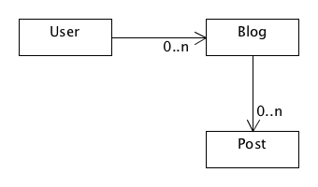
APPLICATION FLOW

Slide 5
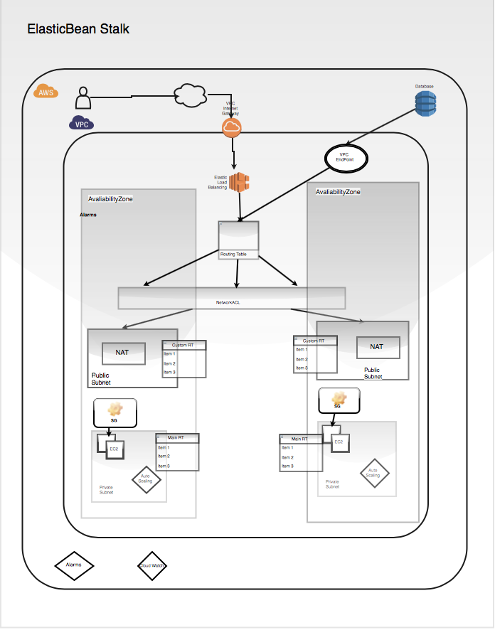
ARCHITECTURE

Slide 6
ARCHITECTURE (contd.)
Architecture involves creation of VPC, creation of public subnet and private subnet.
Public subnet includes NAT gateway along with the custom route table.
Private subnet includes instances and auto scaling group along with main route table.
DynamoDB requests are handled by VPC endpoint making the request secure.
Also included elastic load balancer that would distribute the load through NACL to the availability zones.
Included features like alarm and cloud watch.

Slide 7
SECURITY FEATURES
Access Token
Password Encryption
Validations
Session Management

Slide 8
DYNAMODB
Incorporated DynamoDB in the architecture
DynamoDB is a fast, secure and scalable data store
DynamoDB is backed with Amazon AWS’ robust infrastructure
DynamoDB is reliable and is always available data store
It is very fast and easy to setup a DynamoDB on the AWS
Four parameters to connect to DynamoDB
Region
Endpoint
AWS access key id
AWS secret access key

Slide 9
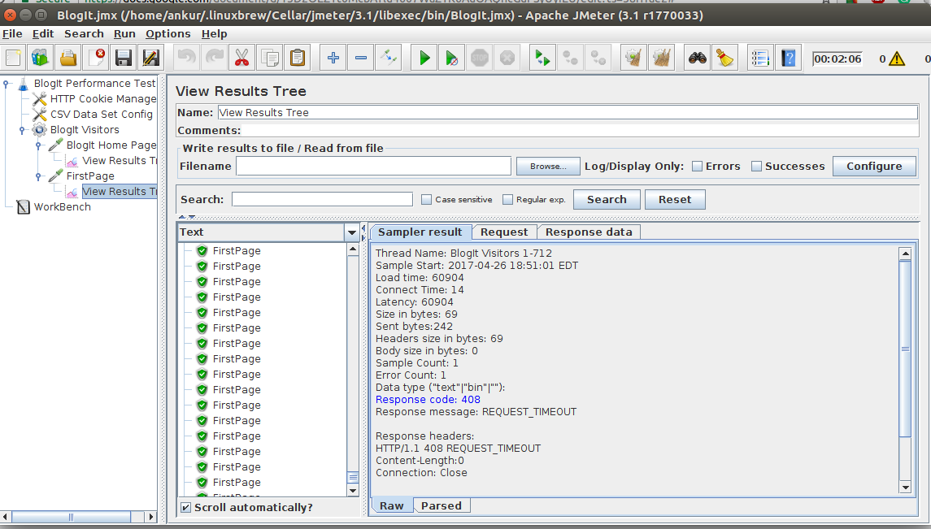
LOAD TESTING
JMeter is open source tool for load and performance testing.

Slide 10
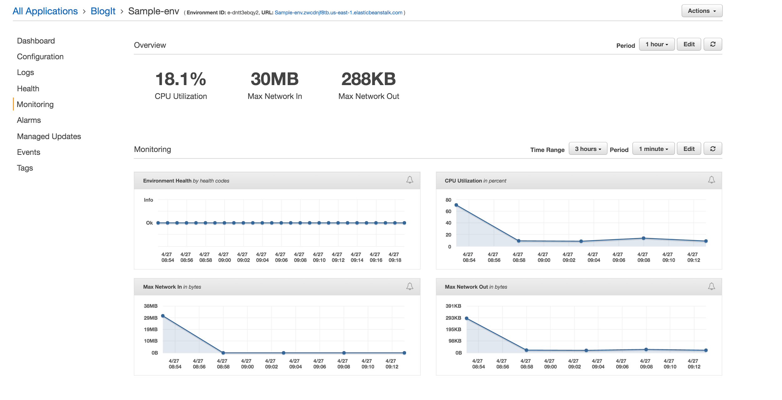
PERFORMANCE STATISTICS

Slide 11
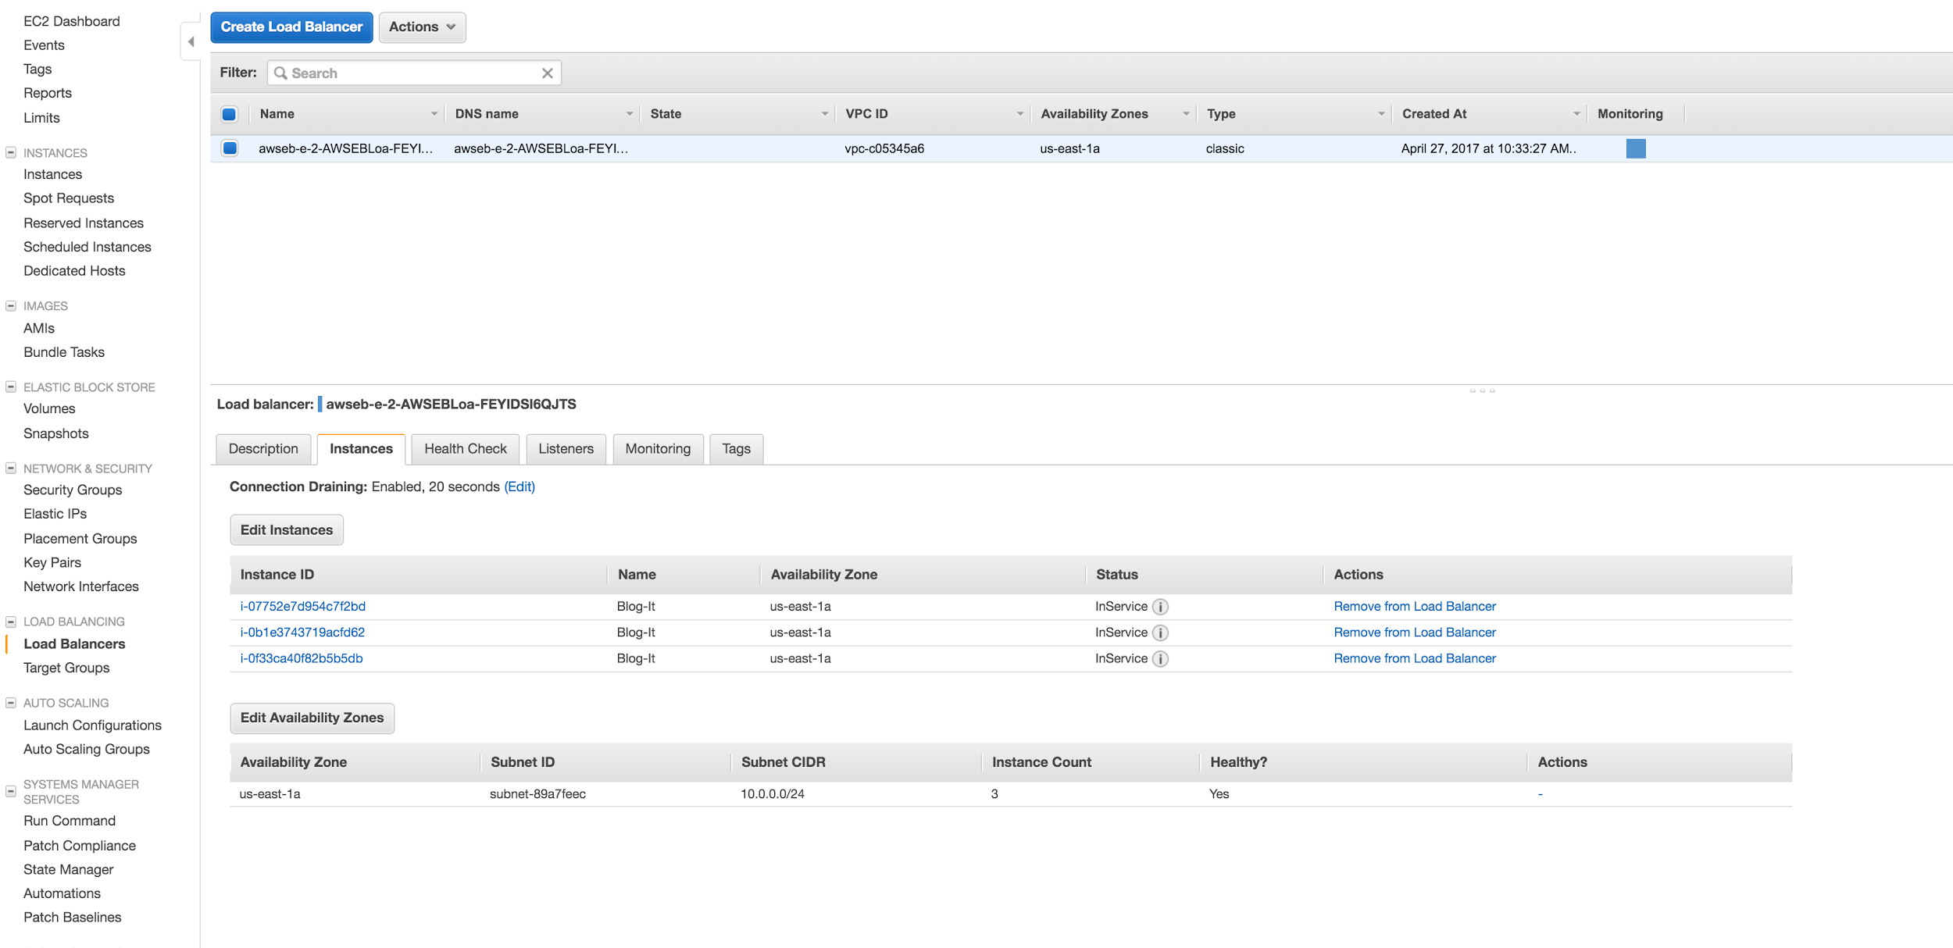
LOAD BALANCER

Slide 12
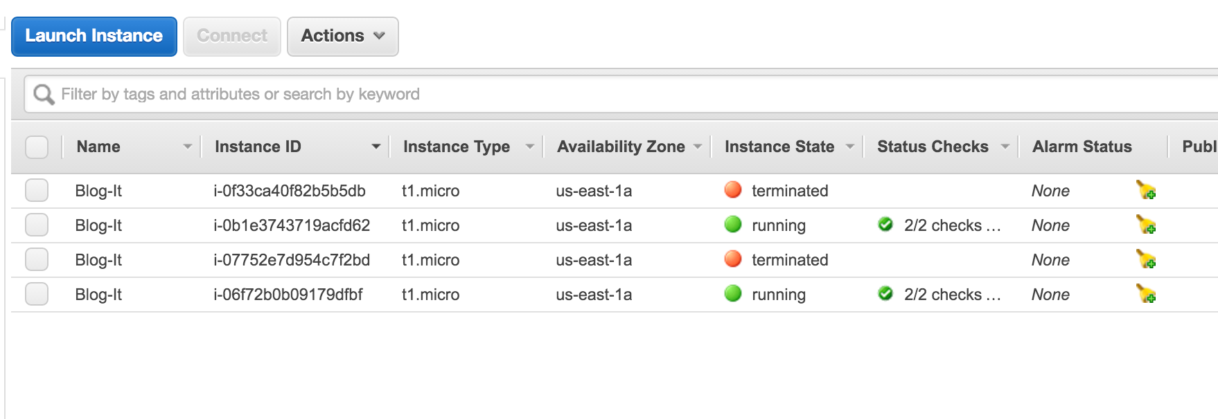
AUTO SCALING

Slide 13
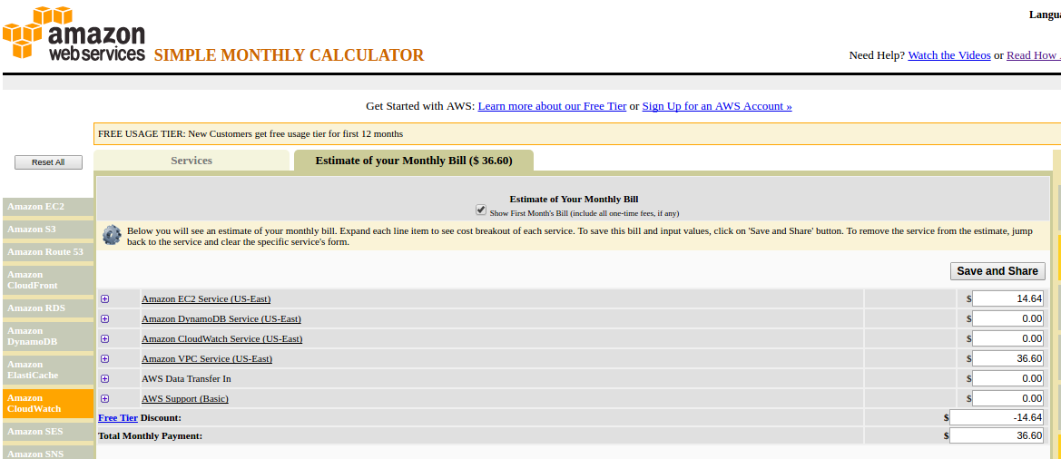
COST STATISTICS
Our estimated cost for the application comes out to be $36.60 which comes out to be $219.6 for 6 months.

Slide 14
REFERENCES
http://google.com
https://aws.amazon.com/documentation/
https://en.wikipedia.org/wiki/
http://docs.aws.amazon.com/AmazonVPC/latest/UserGuide/VPC_Scenario2.html
E. F. Codd, "A relational model of data for large shared data banks," in Communications of ACM, San Jose, 1970.

Slide 15
CONCLUSION
Developed and deployed a blogging application on AWS.
Implemented cloud architecture using AWS services like EC2 instances, DynamoDB, Load Balancers, Auto Scaling, VPC. that served variety of purposes.
VPC improved the overall security of the application while DynamoDB acted as the backbone of the application enabling us to have a secure and scalable data store.
Used simply month calculator feature that helped us to identify areas of development and allows us to choose the services only that we like to pay for and reduce our monthly costs for our application.

Slide 16
Thank You !!

