Slide 1
Safety Meter-An Ultimate Crime Management System
Ajinkya Peshave
NUID - 001626381

Slide 2
Need of the Solution
Increasing Crime Rate
Number of people below poverty line
Number of people carrying FireArms
Inefficient Past Solutions
FireArms License Agency
Nobody can hurt me without my permission
-Mahatma Gandhi

Slide 3
Objectives
Creates portal for obtaining FireArms License
Analyzes criminal activities, poverty in Neighborhood
Helps to reduce crime

Slide 4
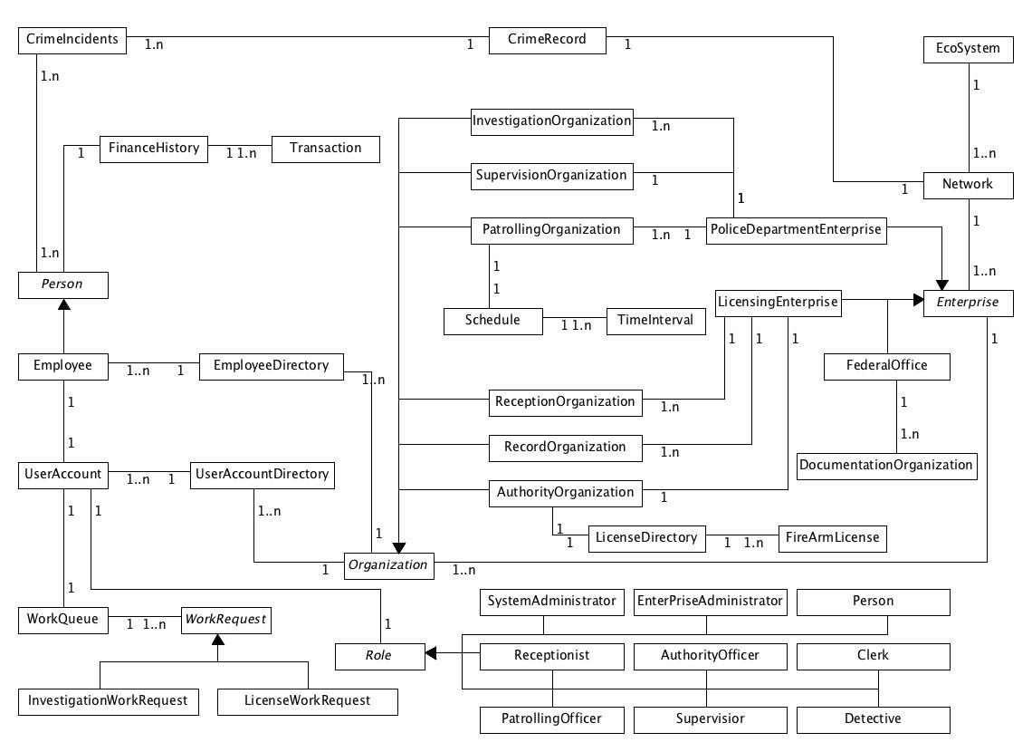

Slide 5
Literature survey
Poverty VS Crime
Number of People carrying FireArms
Total crime incidents in neighborhood

Slide 6
Some uses cases
Obtain firearms license
Design patrolling schedule
Add emergency notification
Report crime
Revoke firearms license
Find criminal records

Slide 7
Demo

