Slide 1

StoryMaps
Team Members:
Abhishek Preman,
Akshat Shah,
Ankita Pise,
Shraddha Naik,
Stuti Nanda.

Slide 2
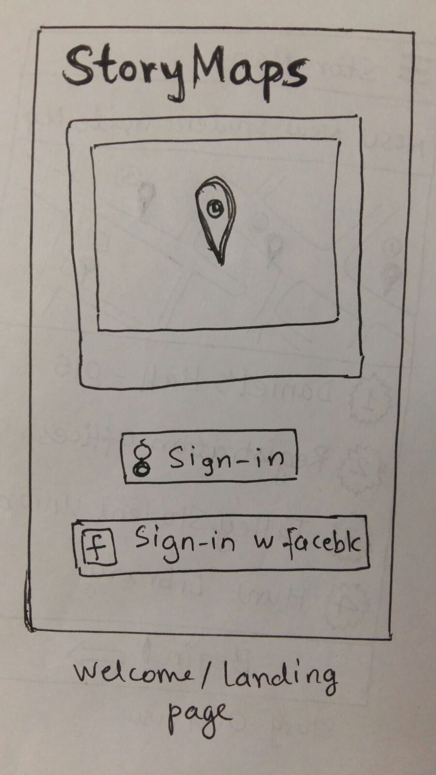
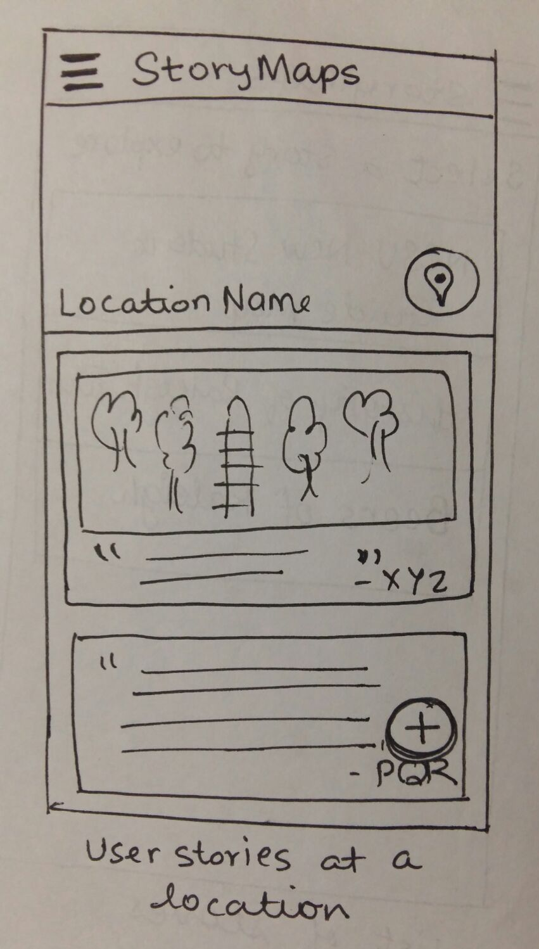
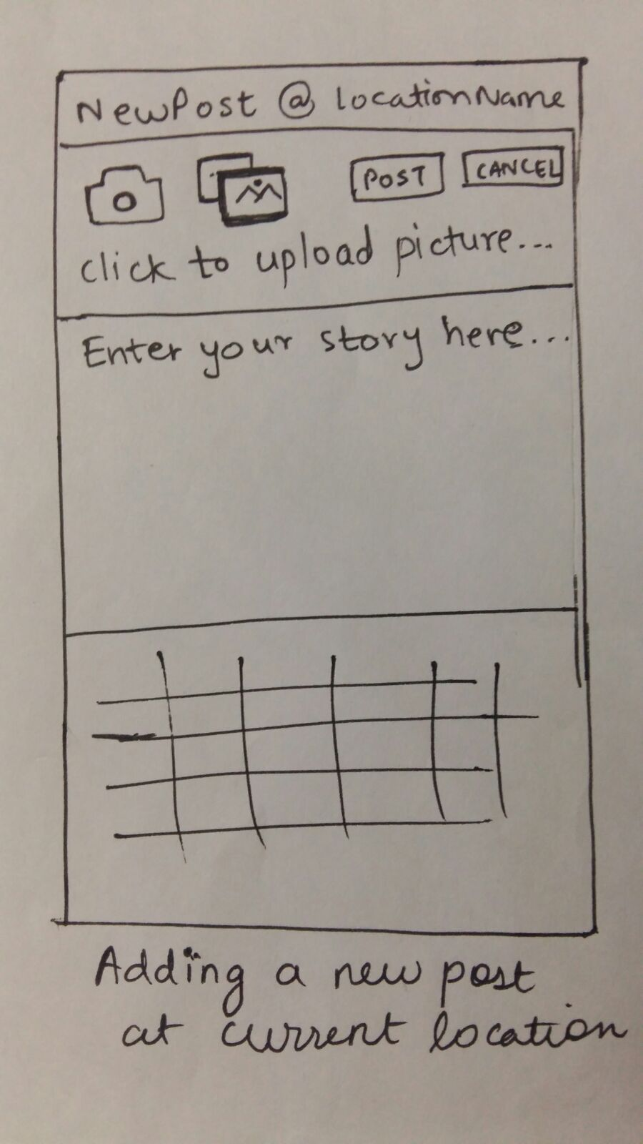
Paper Prototypes

Slide 3

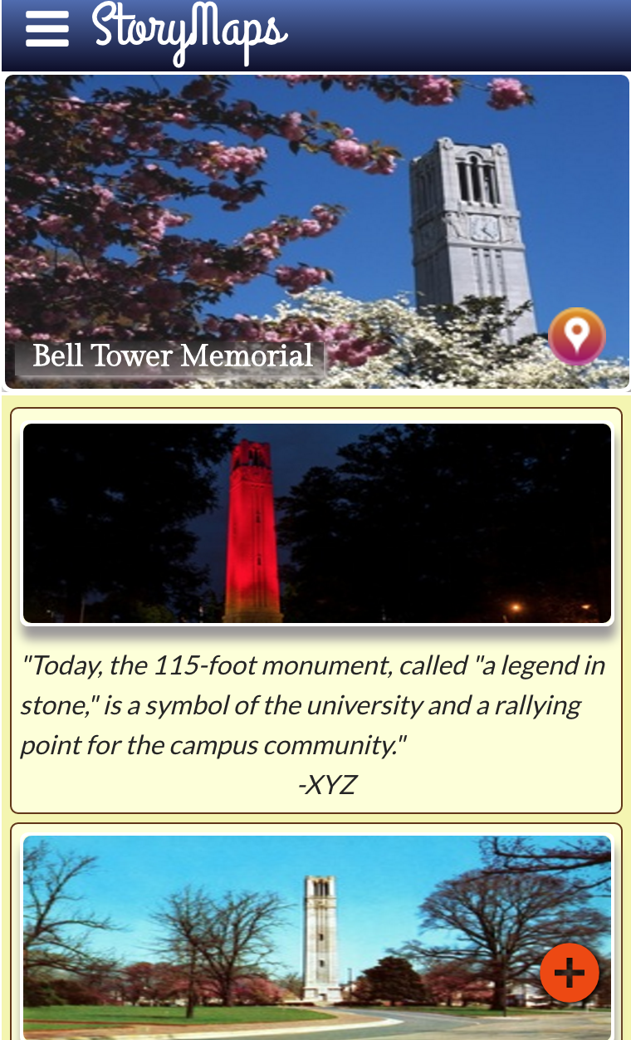
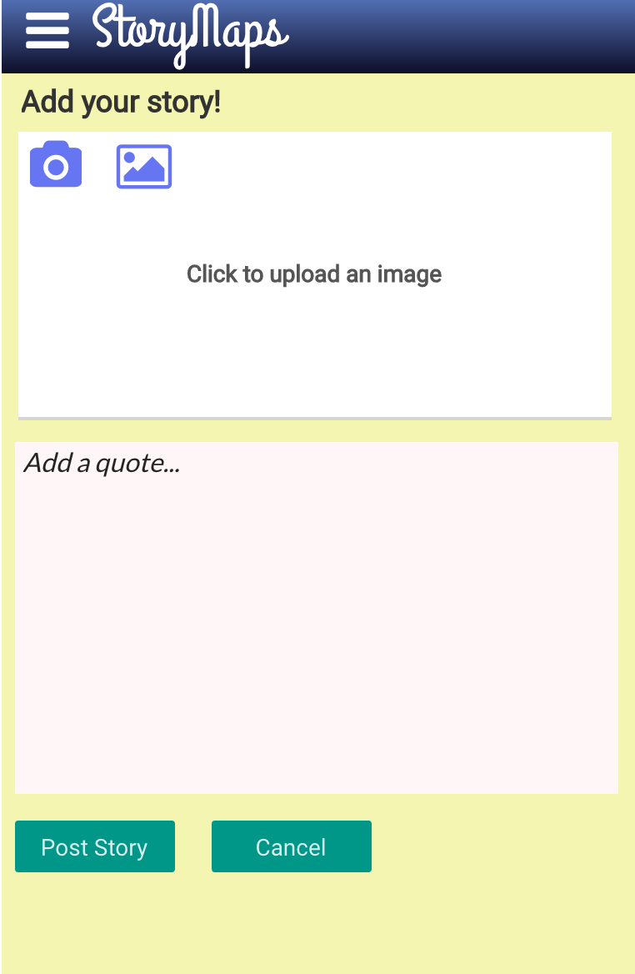
Digital Prototypes

Slide 4
Discovery
Conducted surveys using the digital prototypes:
Curated stories were prefered.
Multiple storylines, trails rather than location specific stories.
Inclusion of videos, images, maps.
Link to the survey

Slide 5
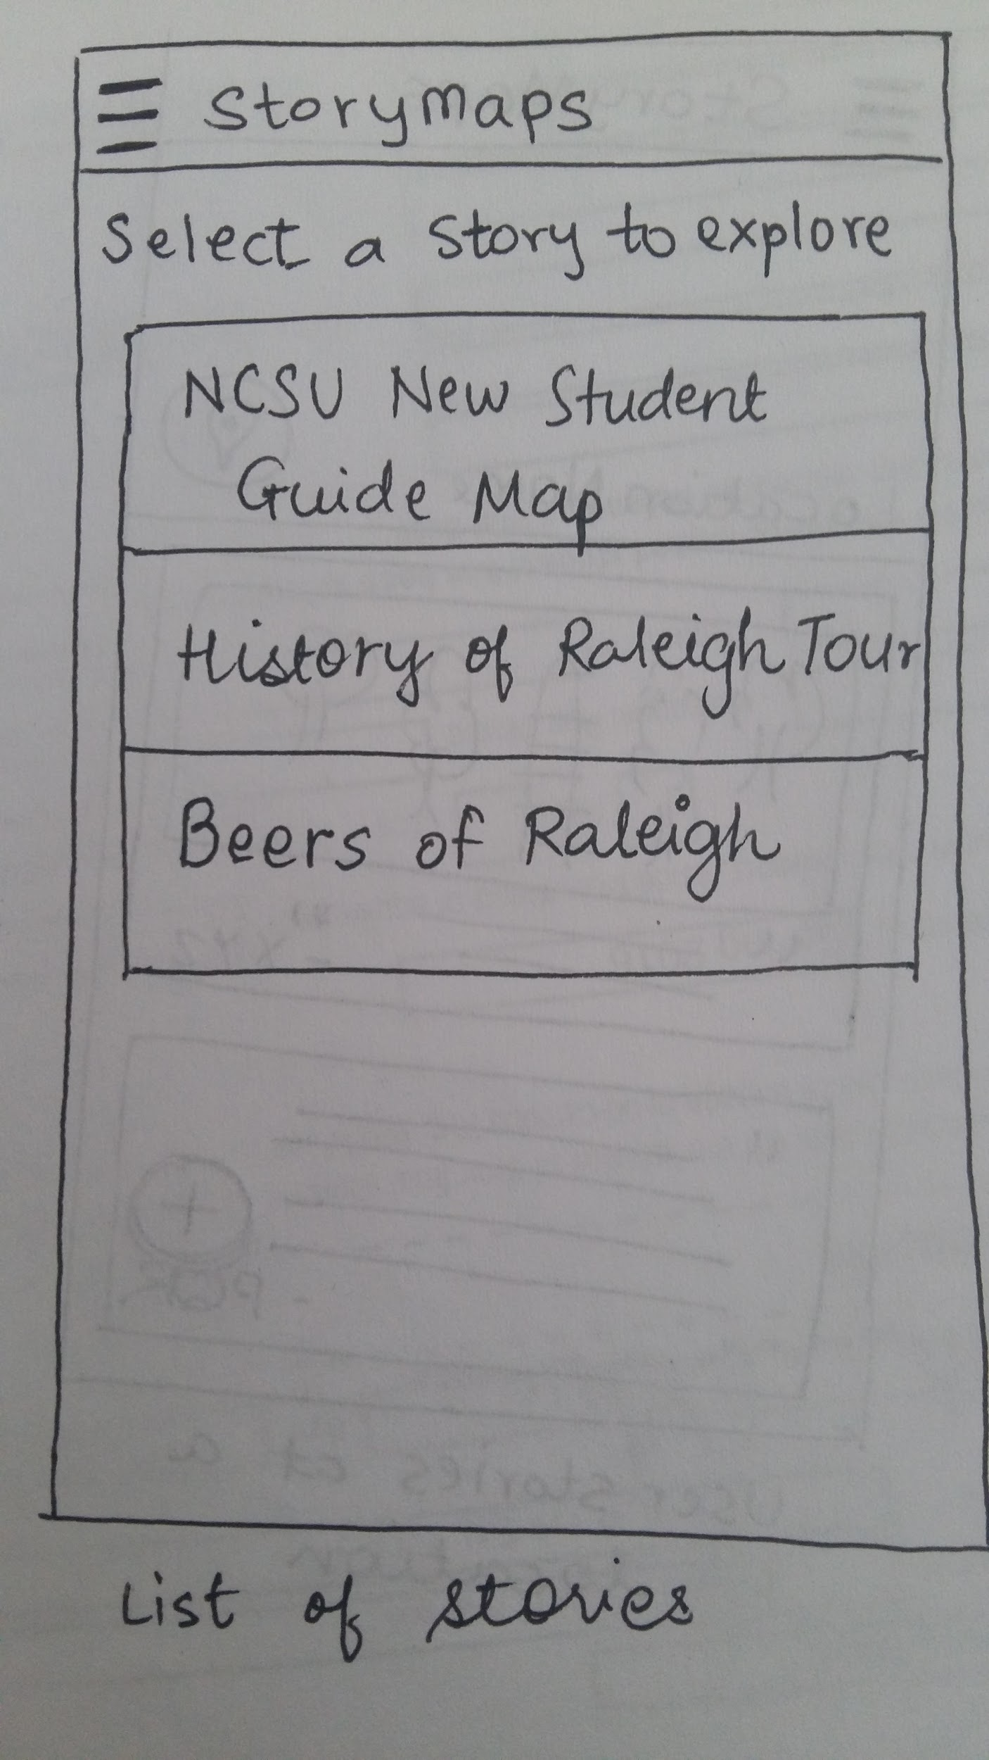
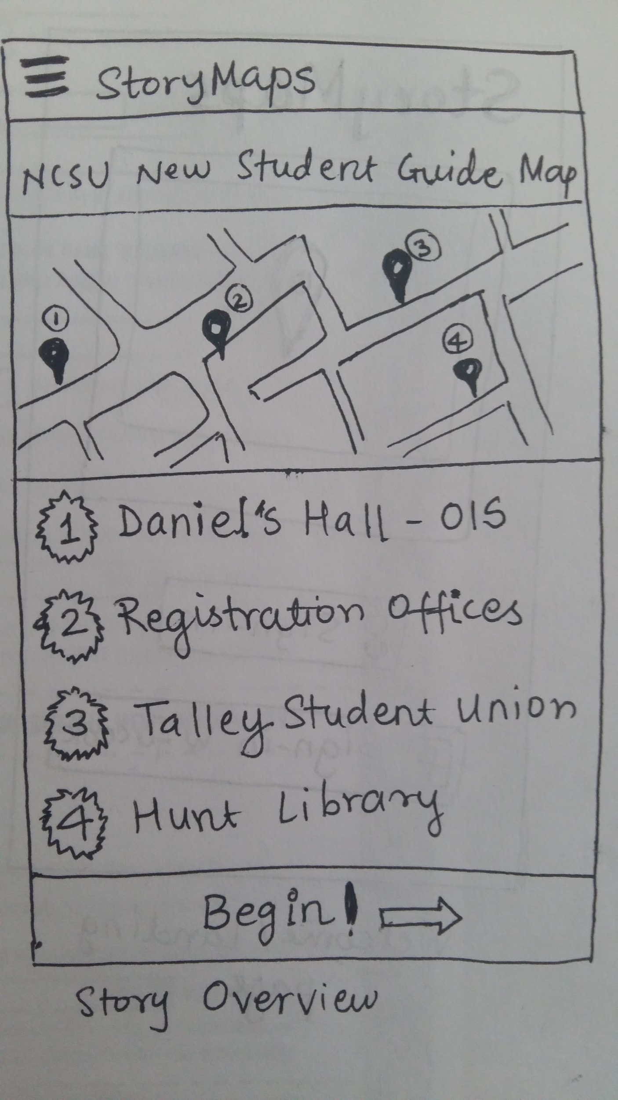
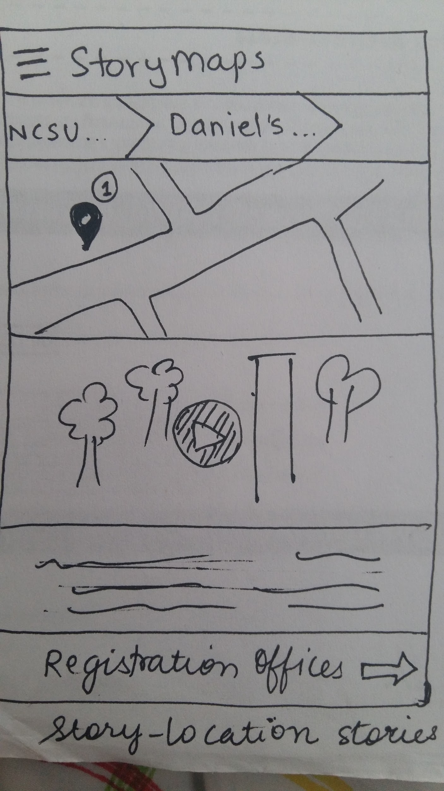
New paper prototype based on Discovery

Slide 6
Technology Used
Ionic Framework
Angular Js
Express Js
Cordova
MongoDb
Amazon Aws
Html-Css (Website)

Slide 7

Application

Slide 8
Usability Evaluation & Testing
Task-based usability evaluation of the final application
Every task rated using the Single Ease Question (SEQ) scale
System Usability Scale (SUS) used to evaluate the application as a whole
Link to the final survey

Slide 9
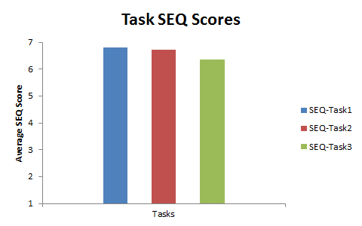
Results
High SEQ scores for all tasks
Average SUS score: 90.23

Slide 10
Future Scope
Search Functionality
Directions
Different Verticals
,

Slide 11


Slide 12
Thank You!

