Slide 1
IMPLENTING BRDF IN SETFORGE
CPRE 557- PROJECT
BY- ANIRUDHA POWADI
ADVISOR- DR. RAFAEL RADKOWSKI

Slide 2
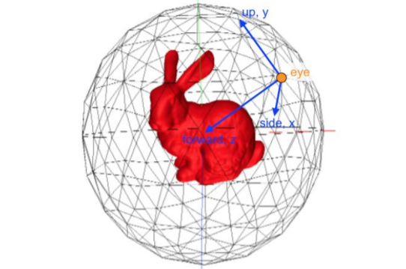
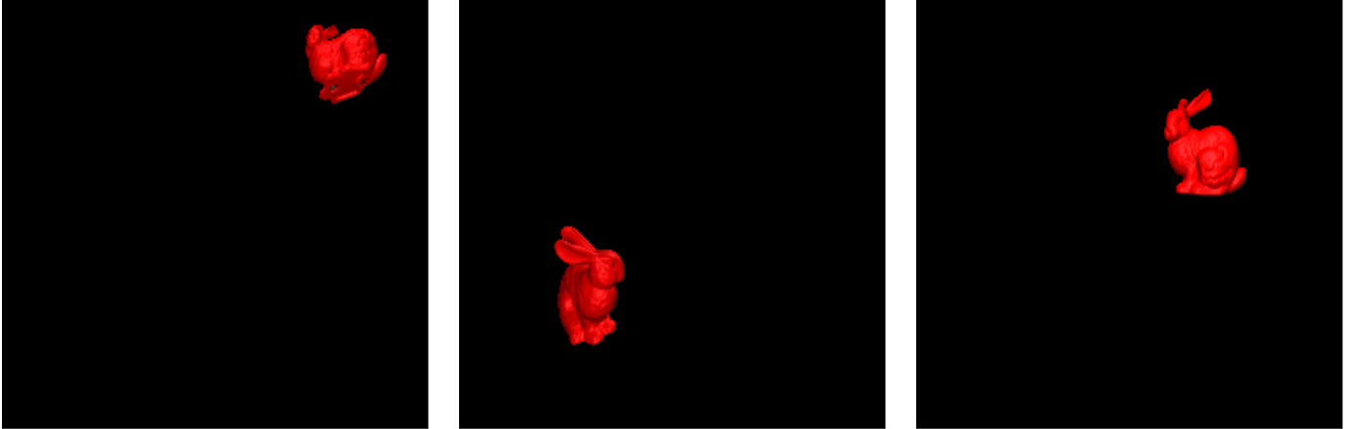
SETFORGE
Polyhedron Renderer
Dataset Renderer Result
CPRE 557- PROJECT

Slide 3
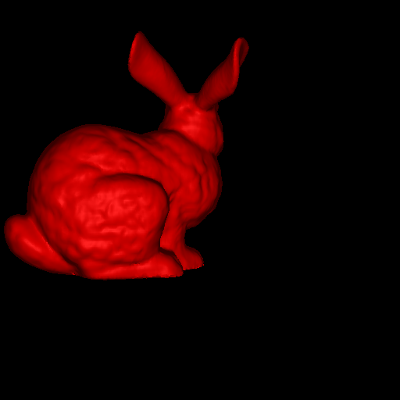
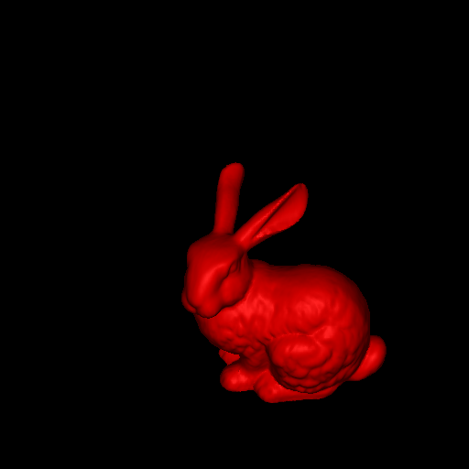
PHONG SHADER
CPRE 557- PROJECT

Slide 4
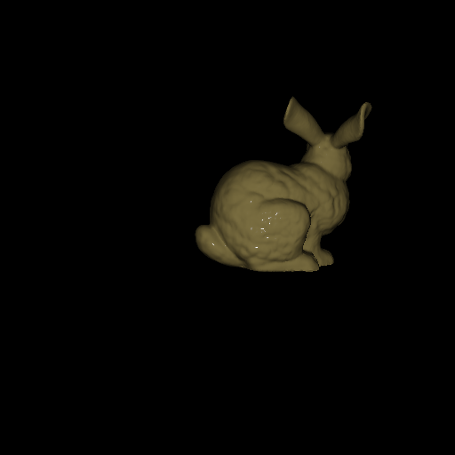
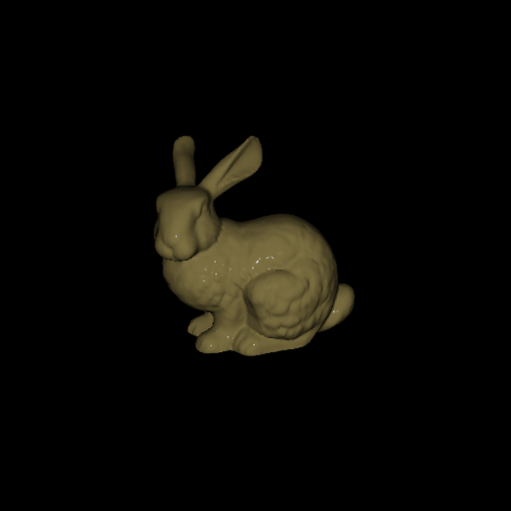
BUNNY WITH SMOOTH METAL TEXTURE
CPRE 557- PROJECT

Slide 5
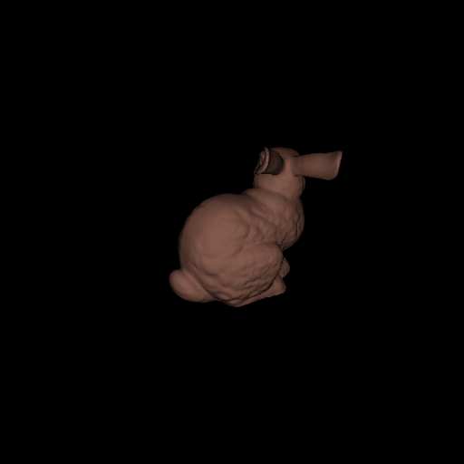
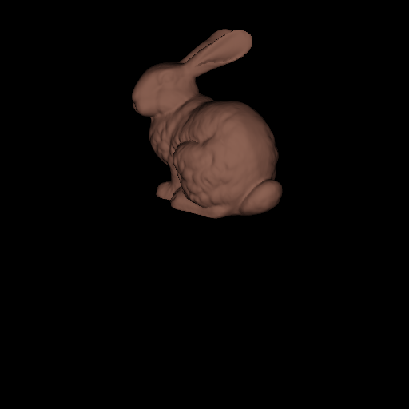
BUNNY WITH ROUGH COPPER TEXTURE
CPRE 557- PROJECT

Slide 6
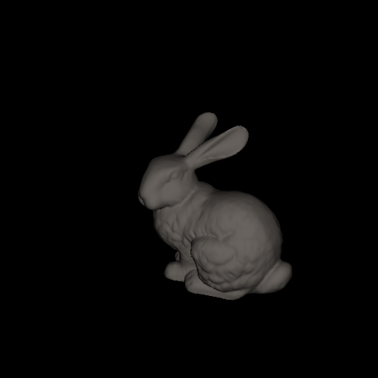
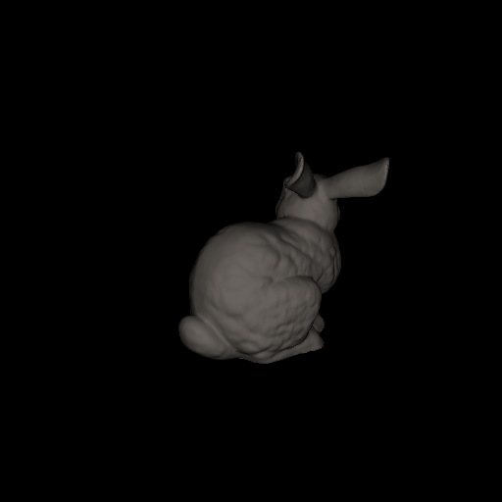
BUNNY WITH ROCK TEXTURE
CPRE 557- PROJECT

Slide 7
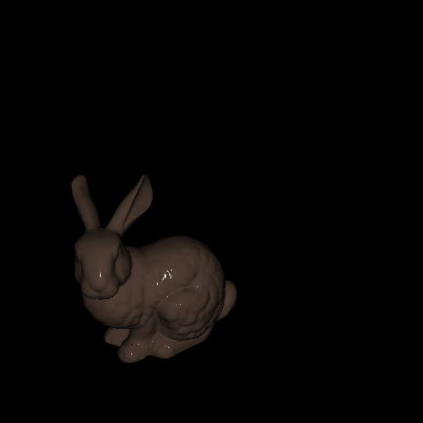
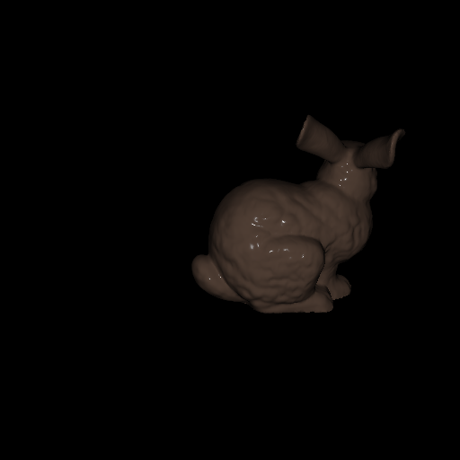
BUNNY WITH WOOD-SEMIGLOSS TEXTURE
CPRE 557- PROJECT

Slide 8
NEXT STEPS
More lights
Multiple Textures
Environment Mapping
Command based operation
CPRE 557- PROJECT

Slide 9
THANK YOU
CPRE 557- PROJECT

