Slide 1



The Value of LLMs For Classifying Patch Types and Automating Data Collection and Processing
Anirudha Powadi
Electrical and Computer Engineering

Slide 2
Outline
Introduction to Patch Classification and LLMs
Related Work
Contribution
Materials and Methods
Results
Conclusion and Future Work

Slide 3
Introduction to Patch Classification and LLMs
Code development for a file system does not stop when the system is released.
Patches are necessary for 'bug fixes', 'performance improvements', 'reliability enhancements', and 'adding new features’.
This study leverages the advanced capabilities of Large Language Models (LLMs):
automate patch classification,
reduce manual effort.
developers can enhance code management and optimize the development cycle.

Slide 4
Background – File Systems
Definition: A file system is a method used by operating systems to organize, store, and manage data on storage devices like hard drives, SSDs, or USB drives. It acts as a framework that controls how data is named, accessed, and retrieved.
Purpose: File systems enable users and applications to create, read, update, and delete files efficiently. They provide a structured way to keep track of files and directories (folders) on a storage medium.
Components: A file system typically includes files (which store data), directories (to organize files), and metadata (information about files, such as size, location, and permissions).
Examples: Common file systems include NTFS (used by Windows), ext4 (common in Linux), and FAT32 (widely used for USB drives). Each has unique features like support for large files, security, or compatibility.
Functionality: File systems handle tasks like allocating space for files, ensuring data integrity, and managing access rights, making them essential for efficient data management on any device.

Slide 5
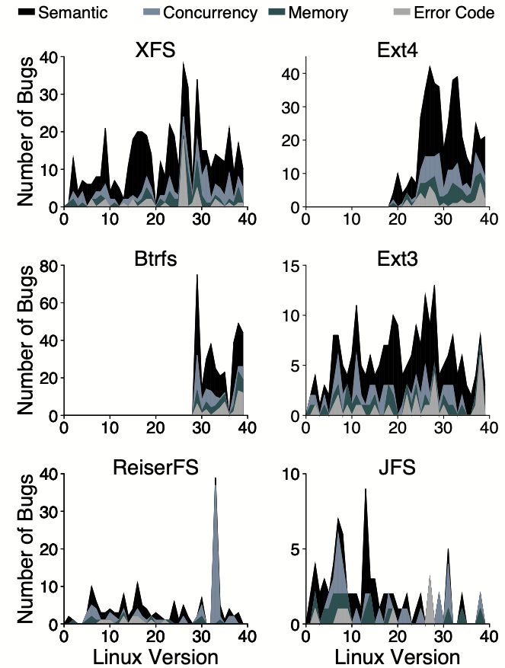
Motivation – Open-source Local File Systems
It has been shown that bug evolution plots do not converge.
This means that there is need for further analysis into bug patterns.
Insights into the bug patterns may help developers reducing the bug occurrences.
Generating these insights takes a lot of manual effort and could be automated.

Slide 6
Related Work
Study by Lu et al. (2013)
Conducted on 5,079 patches over eight years, providing insights into the development lifecycle of Linux file systems. This study reveals the ongoing necessity of understanding dominant patch classes.
LLMs and Text/Code Classification
Techniques like the Clue And Reasoning Prompting (CARP) method enhance LLMs for text classification, achieving state-of-the-art results on benchmarks like SST-2 and AGNews. LLM4PatchCorrect framework assesses patch correctness by using LLMs, achieving significant accuracy.
Data Collection and Processing
LLMs have automated data extraction from scientific texts, achieving high F1 scores through fine-tuned models like GPT-3 and Llama-2. LLMDA model identifies security patches, contributing to this research by classifying various patch types.

Slide 7
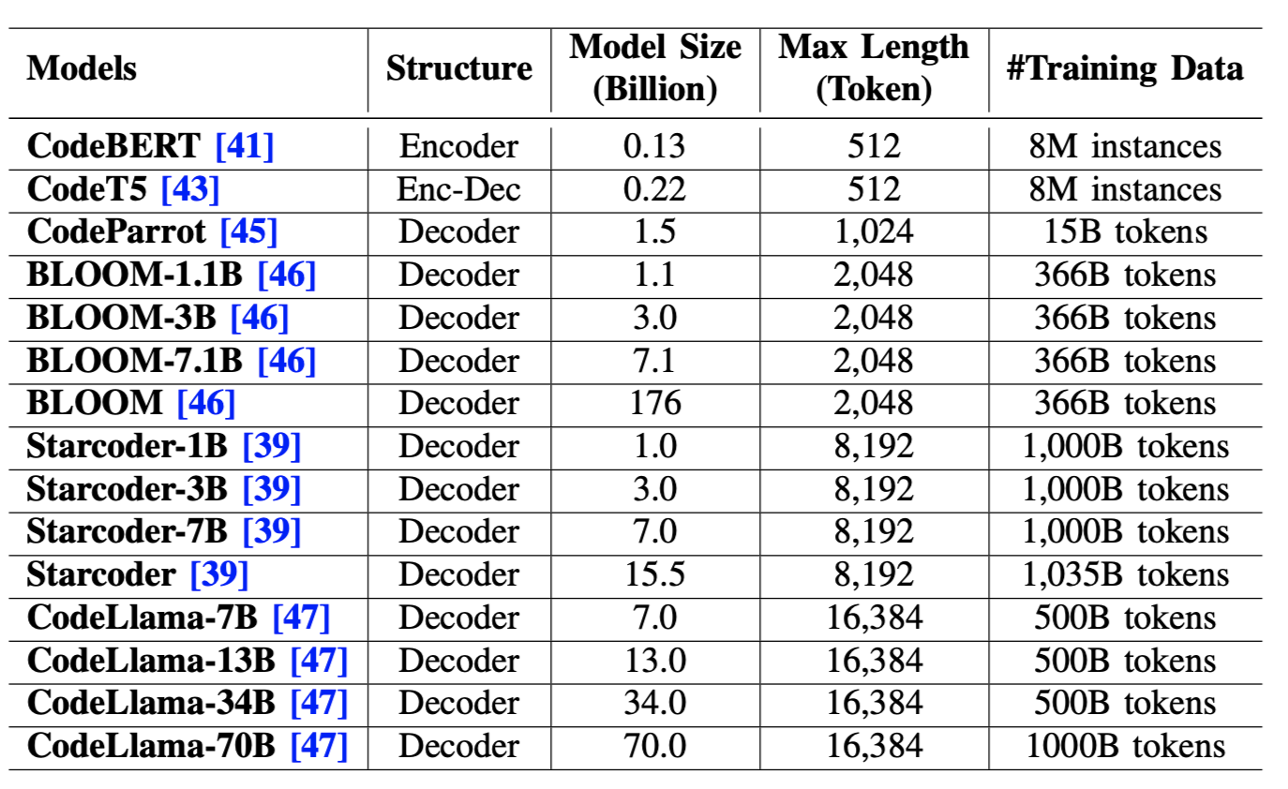
Related Work
CodeBERT – works best for us given our limited resources.
Notes:
Add slides that describe the patches and bugs.

Slide 8
Contribution
This work shows the value of LLMs for deriving insights from the code developmental cycle.
It also addresses data collection and processing using agentic AI, as discussed in recent studies, showcasing the reduced manual effort required.

Slide 9
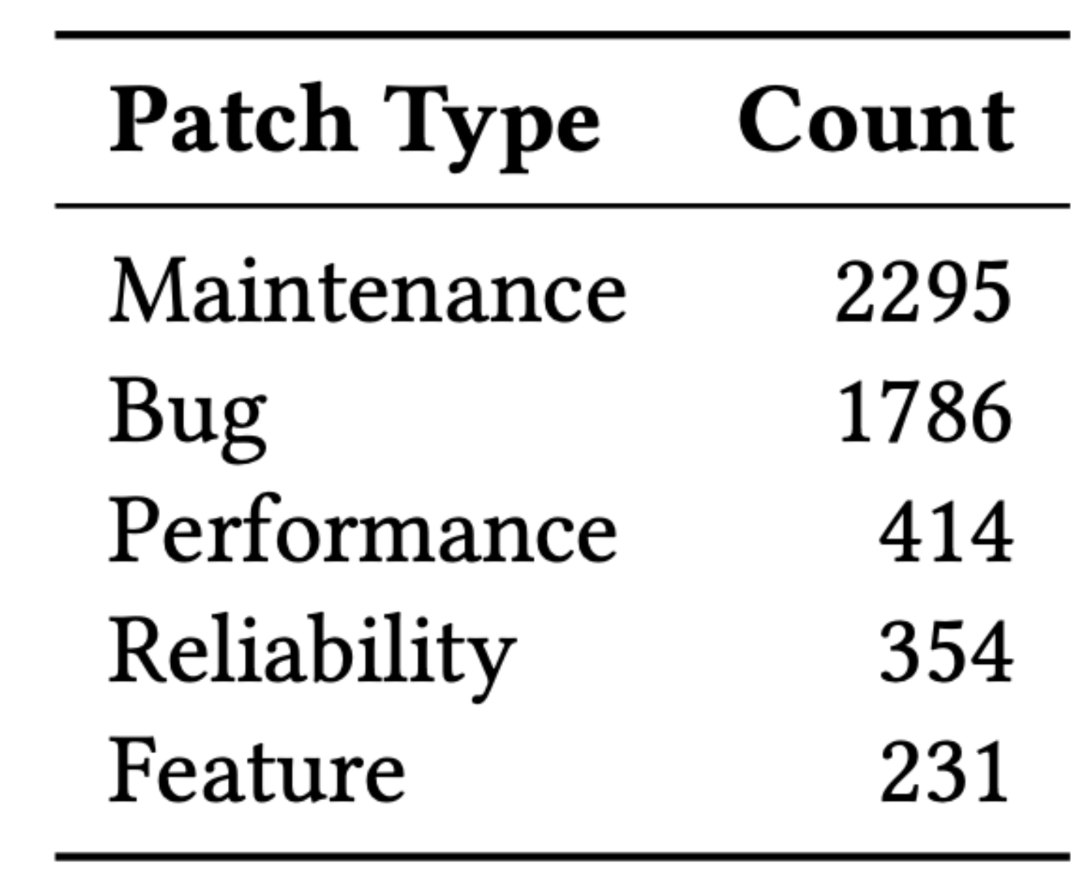
Materials and Methods
Dataset Overview
Utilizes the Linux PatchDB dataset from 'A Study of Linux File System Evolution', consisting of 5,079 patches from major Linux file systems.
Data Preprocessing
Involves encoding categorical variables and normalizing numerical features. Text-based features are processed using a pre-trained BERT model to generate 768-dimensional embeddings, converting textual metadata into dense vector representations for classification.
Methodology
The neural network model integrates multiple input features and utilizes cross-entropy loss for multi-class classification tasks. PyTorch and Hugging Face Transformers libraries are used for implementation, with training conducted over 30 epochs with an Adam optimizer.
Train-Test split = 80-20 %
Trained for 30 epochs
Accuracy Metric = F1-score

Slide 10
Dataset verification
Patches checked at https://www.kernel.org/pub/linux/kernel/v2.6/ChangeLog-2.6.x - ‘x’ range =[0-39]
Only limited changelogs were found.
XFS-patches found
Jfs-patches found
Ext3-patches found
Reiserfs-patches found
Ext4-patches not found
Btrfs-patches not found

Slide 11
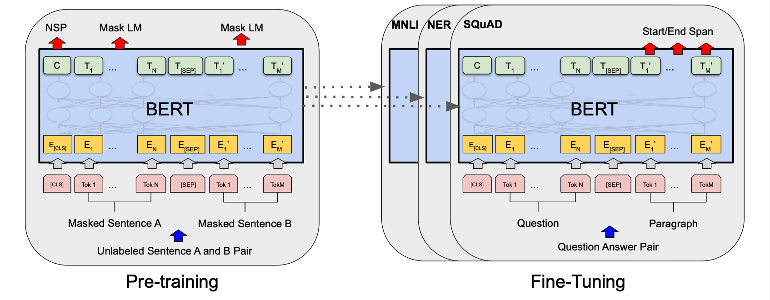
Materials and Methods

Slide 12
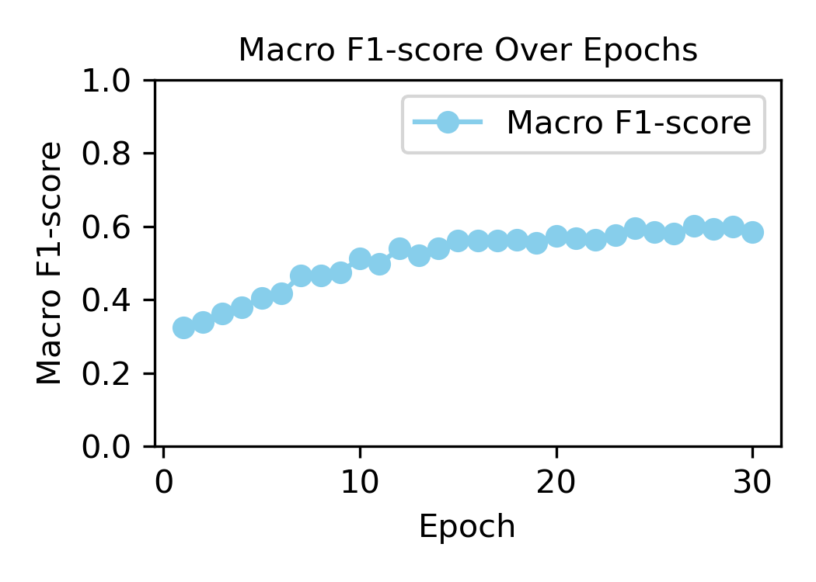
RESULTS

Slide 13
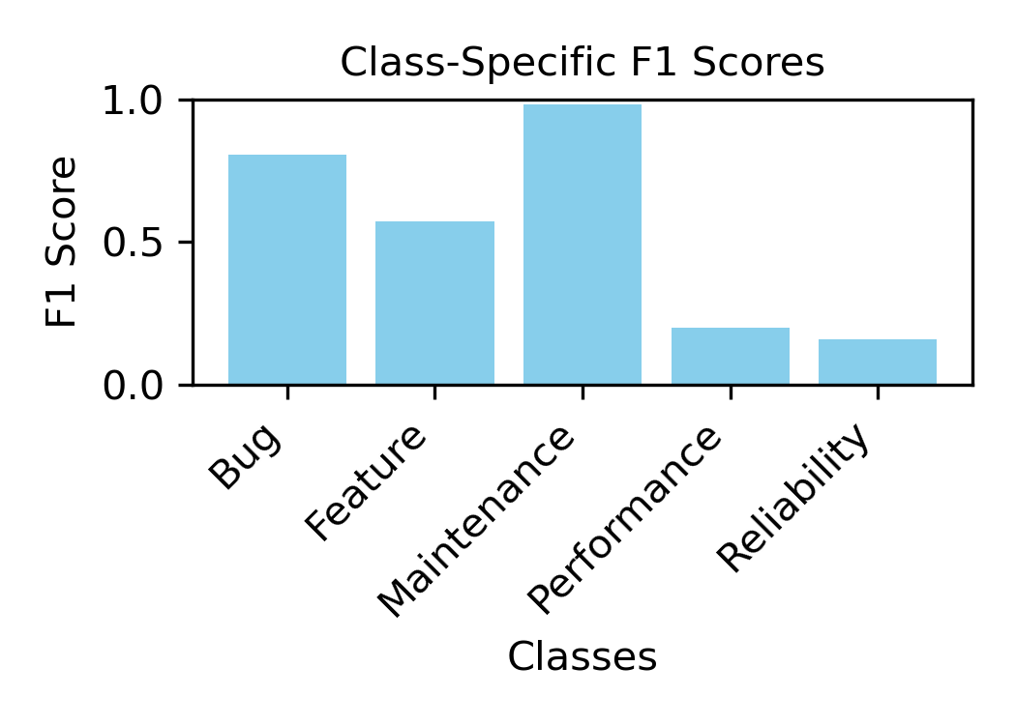
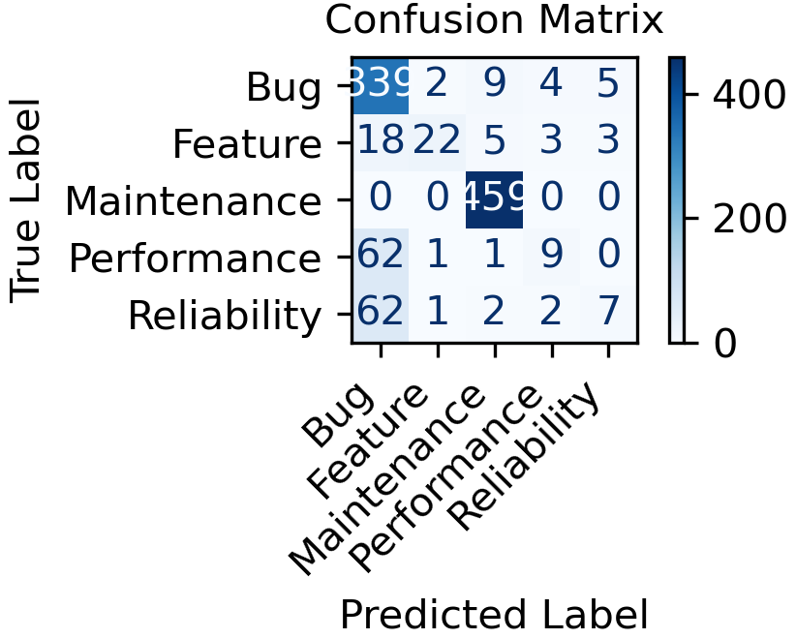
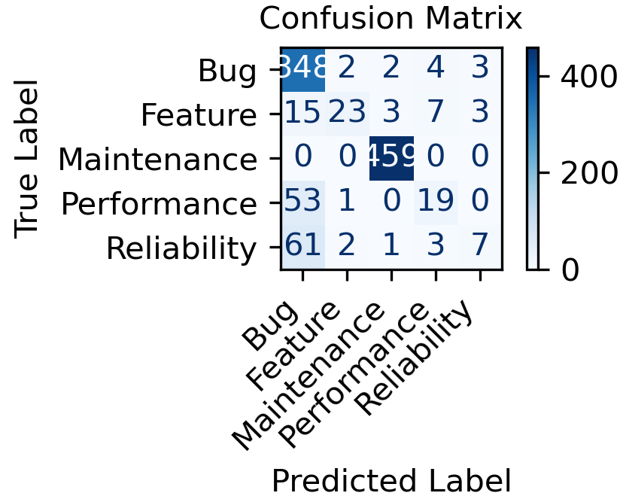
RESULTS
15 epochs
30 epochs

Slide 14
Next STEPs
Analysis and further training of the model.
Test the method on another dataset PatchDB (security vs non-security).
Document the requirements for creating an Agentic AI framework.
Can extract code corresponding to the patches to enhance patch classification

Slide 15
Security vs non-security dataset
Categories: Security, non-security
Features: 1. Patch description. 2. diff code.
Challenges: My MacBook system did not have enough memory to run the model for this data.

Slide 16
Agentic ai background
Agentic AI refers to autonomous systems capable of pursuing complex goals with minimal human intervention.
Unlike traditional AI, which relies on structured instructions, agentic AI exhibits adaptability, advanced decision-making, and self-sufficiency.
Core components include:
Reinforcement Learning (RL): Enables learning through trial and error.
Goal-Oriented Architectures: Manage multiple objectives.
Adaptive Control Mechanisms: Adjust to changing environments.

Slide 17
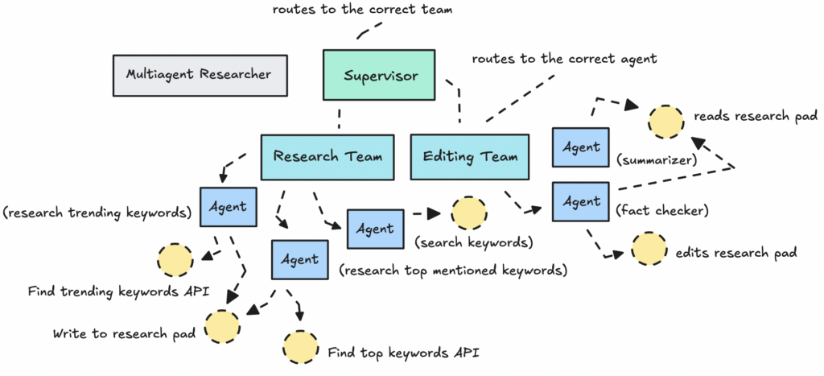
Agentic ai FRAMEWORK
CREDIT: TOWARDS DATASCIENCE

Slide 18
Langchain is preferred
Graph-based Workflows: enables complex, multi-agent coordination.
Extensive integrations: supports wide range of LLMs and tools, offering flexibility compared to other frameworks.
Community and Ecosystem: a large community provides extensive documentation and tutorials unlike newer frameworks like Open AI’s Swarm.
Advanced Features: Persistence, human-in-the-loop support, and streaming enhance reliability and user experience, surpassing minimalist frameworks like Swarm.

Slide 19
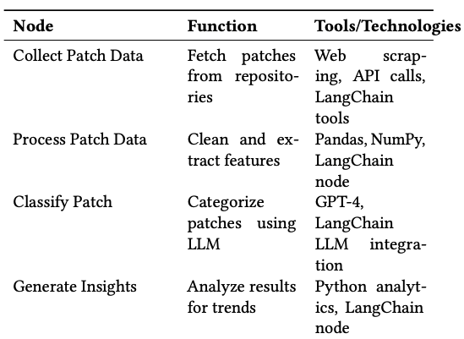
Proposed framework

