Slide 1

Server web - PHP
Steve
2022/11/11

Slide 2
Outline
IDE
VS Code
Server
XAMPP – Apache – PHP – MariaDB
PHP – Hello PHP
VCS
Git
PHP –PHP Samples
DB GUI Tools
phpMyAdmin
HeidiSQL
PHP – DB CRUD

Slide 3
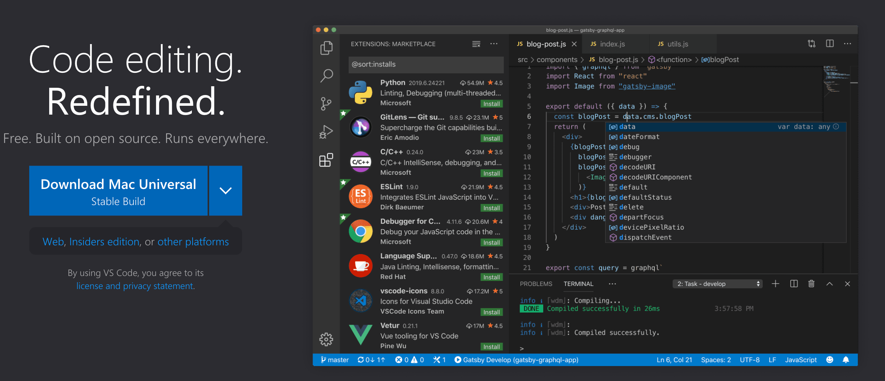
IDE – VS Code
https://code.visualstudio.com/

Slide 4
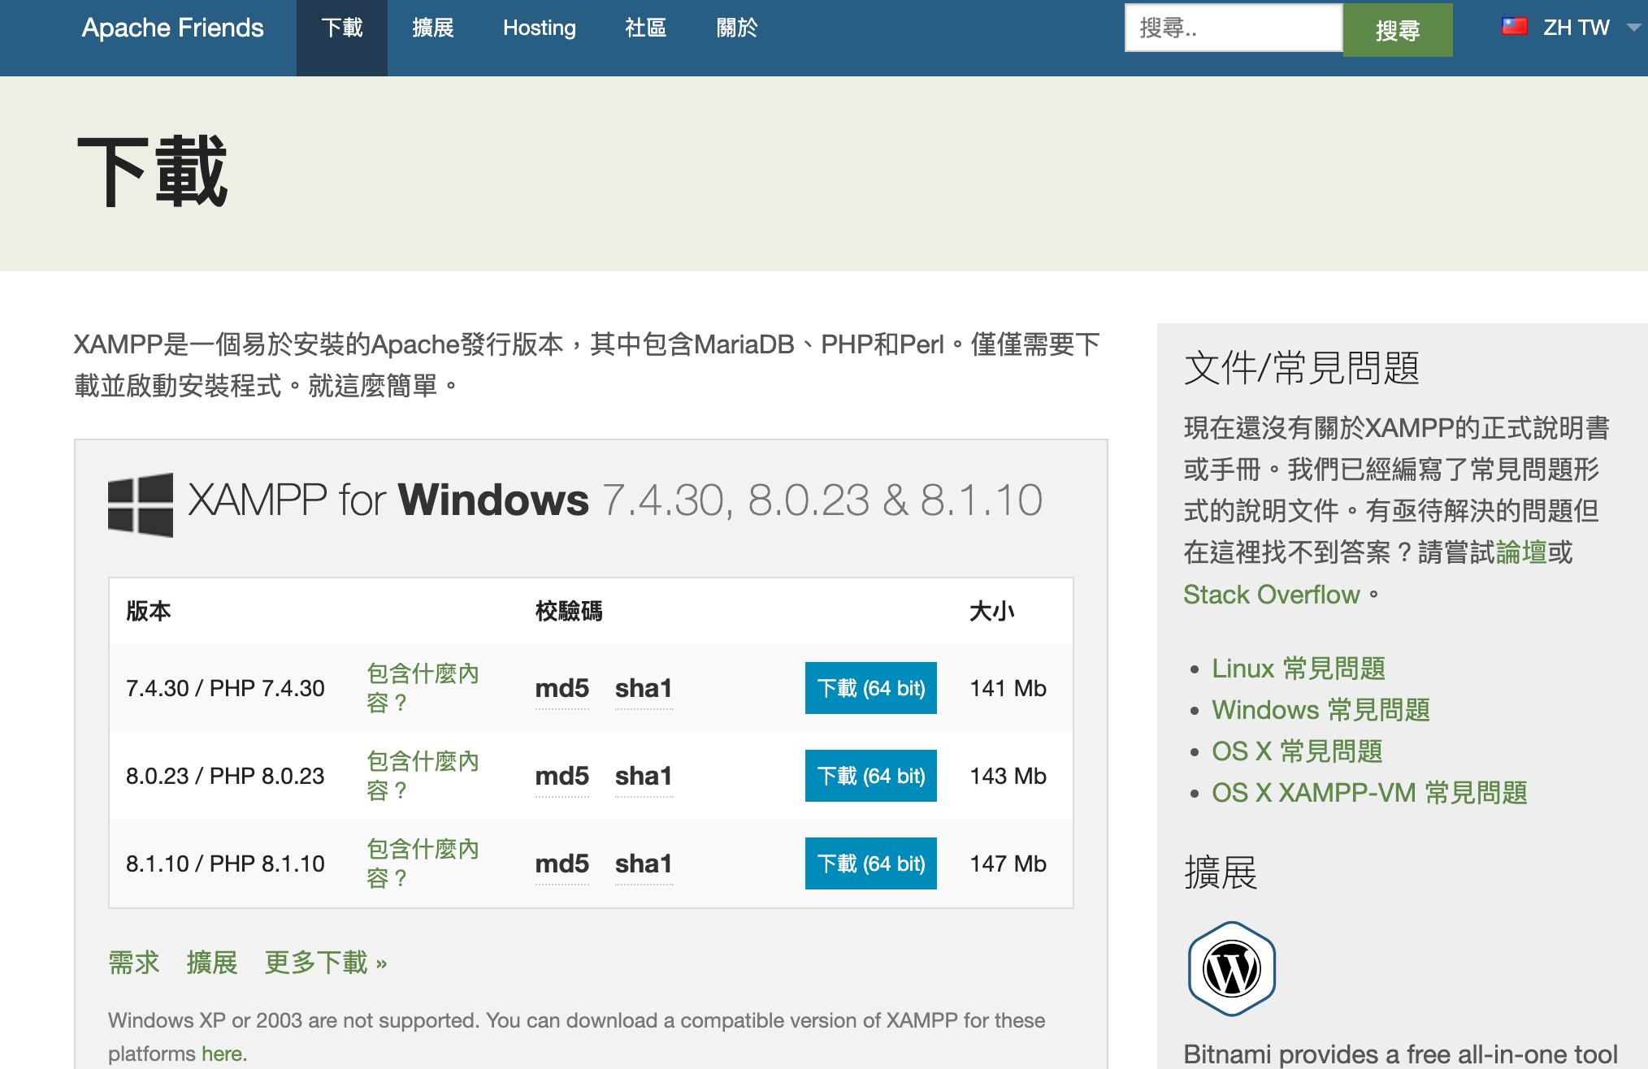
XAMPP
https://www.apachefriends.org/zh_tw/download.html

Slide 5
PHP
<?php
$hello = ‘Hello PHP’;
echo $hello;

Slide 6
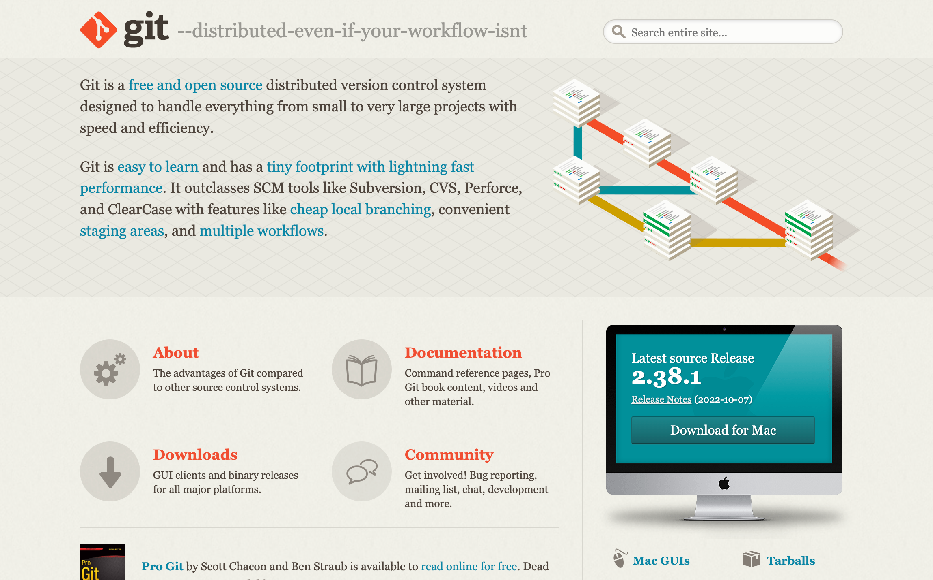
VCS – Git & Git hub
https://git-scm.com/

Slide 7
PHP SAMPLES
https://github.com/aapplle123/php_course.git

Slide 8
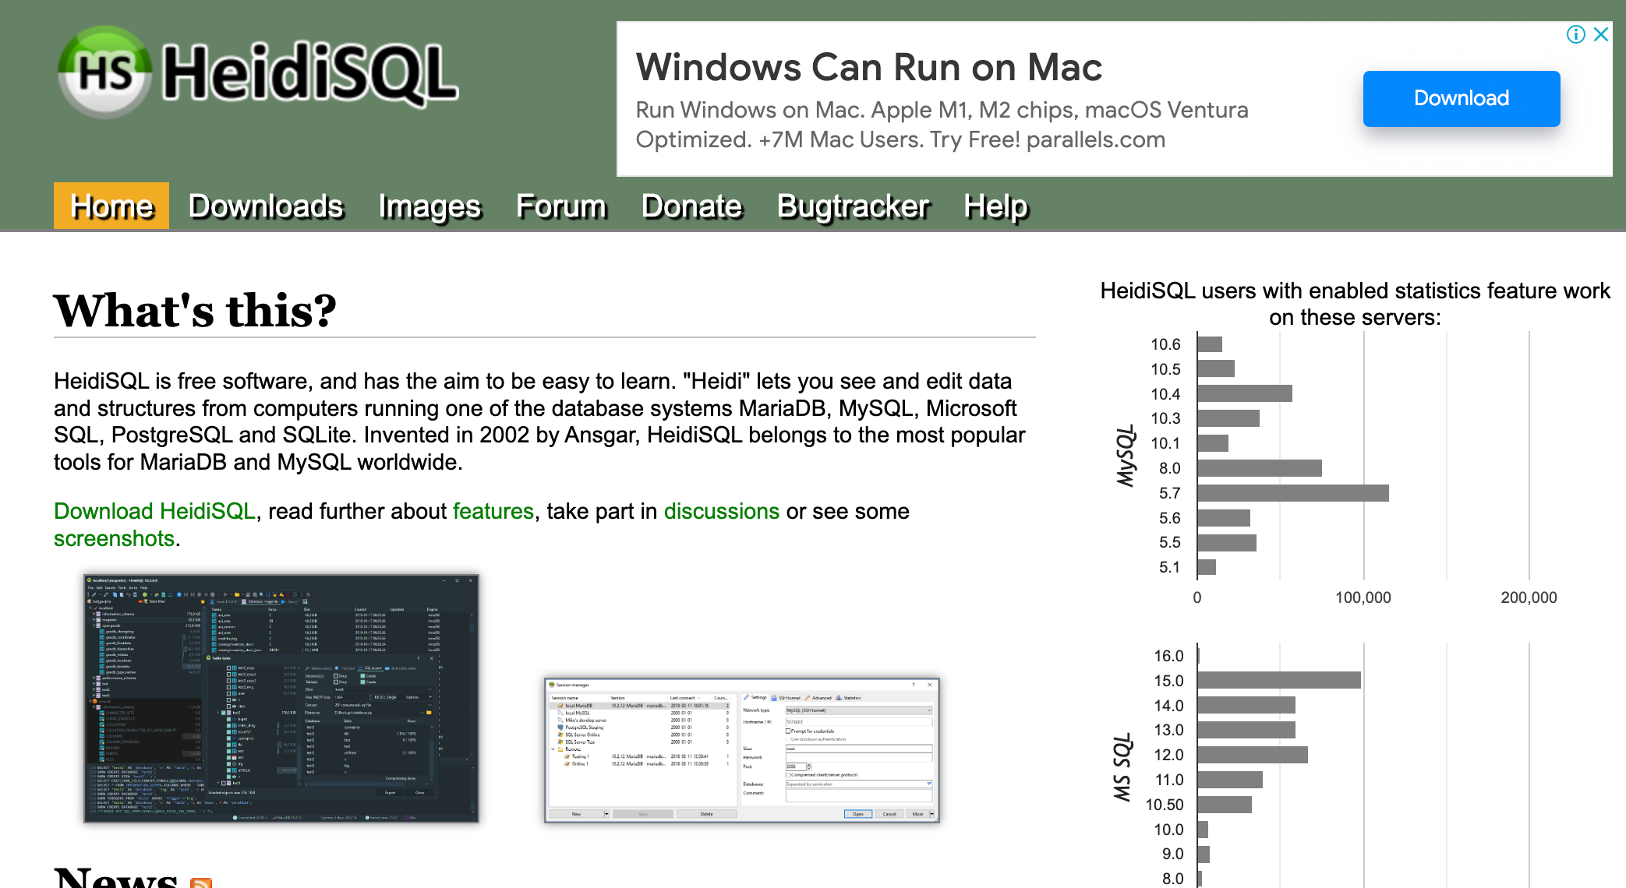
DB GUI Tools
phpMyAdmin
HeidiSQL

Slide 9
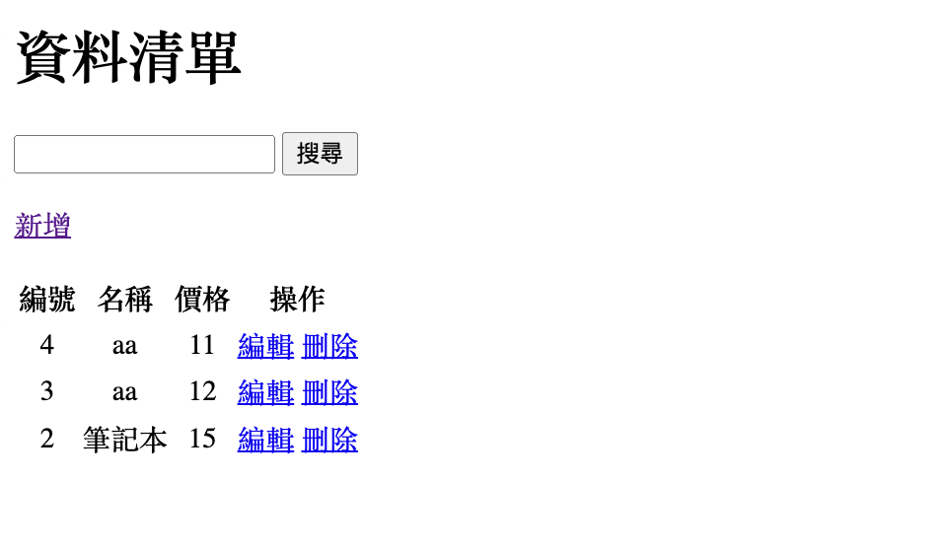
PHP – DB CRUD
http://localhost/php_course/crud/index.php
http://localhost/php_course/my_crud/index.php

Slide 10
Other Topics
API
RESTFul API
Postman

Slide 11


