Slide 1
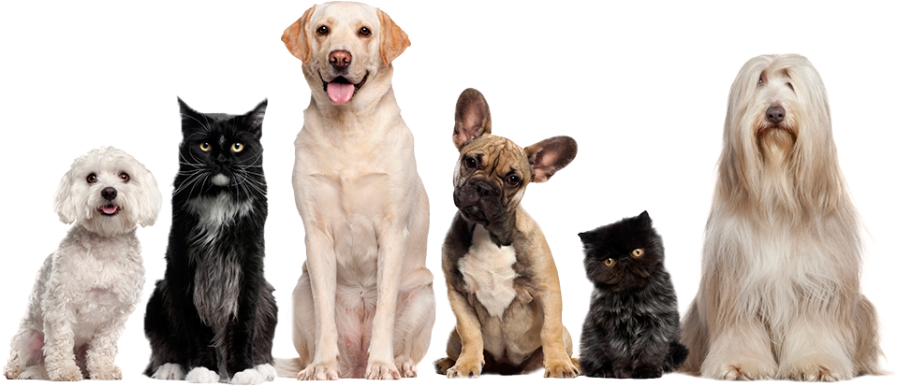
Prototyping a Privacy-Conscious Pet Monitoring System
Exploring the Adaptive Optimization of Deep Learning-Driven Semantic Segmentation Techniques
Allison Aprile

Slide 2
Background

Slide 3
Project Description
Pet monitoring systems, such as Furbo and Companion are becoming a necessity for pet owners. Some can even provide owners with real-time updates about their pets, or even allows owners to interact with them. However, these can be quite invasive of privacy!
Taking inspiration from Zoom’s ‘Blurred Background’ feature, I am aiming to build a prototype of a Privacy-Conscious Pet Monitoring System. In this iteration of the project, I focused on better optimizing the Deep Learning model back-ending the blur effect.
Using the Oxford III-T Pet dataset, I trained two variations of the U-Net Convolutional Neural Network architecture for the task of Semantic Segmentation: one with Attention Mechanisms and one without. Given an image, the networks output a pixel-wise classification (i.e. a mask) into the categories of pet, boundary, and not pet.
This project focuses on understanding and evaluating the performance of three popular optimizers for Deep Learning: RMSProp, Adam, and Adagrad.

Slide 4
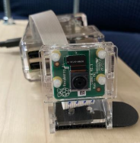
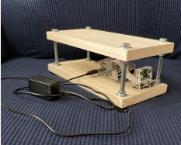
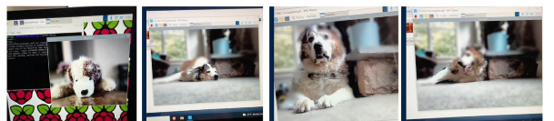
Previous Work
I completed the first iteration of this project in August 2021. I focused on hardware setup (using a Raspberry Pi 4 Model B and Arducam Raspberry Pi Official Camera Module V2), creating a rig out of wood, and exploring unsupervised techniques for Semantic Segmentation. Those methods (including edge detection and clustering) failed, so I quickly trained a U-Net CNN, which had mediocre results. I also reduced the dataset to the dogs.
I am revisiting the project given the recent popularity of Attention Mechanisms and Vision Transformers, and moreso to understand and explore the different optimization techniques. The data is now inclusive of both dogs and cats, increasing the generalizability of the model.
Camera Rig
Real-Time Results

Slide 5
Modeling

Slide 6
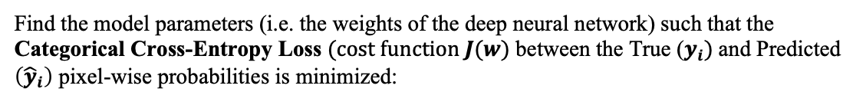
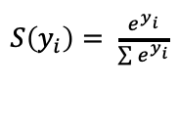
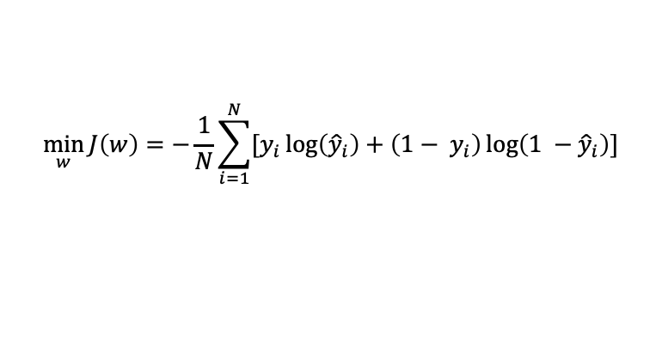
Optimization Model
Find the model parameters (i.e. the weights of the deep neural network) such that the Categorical Cross-Entropy Loss $(cost function J(w)$ between the True ($y_{i})$and Predicted $\left({\hat{y}}_{i}\right)$ pixel-wise probabilities is minimized:
$$\min_{w}{J\left(w\right)=−\frac{1}{N}\sum_{i=1}^{N}{[y_{i}\log\left({\hat{y}}_{i}\right)+\left(1− y_{i}\right)\log\left(1 −{\hat{y}}_{i}\right)]}}$$
$S\left(y_{i}\right)= \frac{e^{y_{i}}}{\sum{e^{y_{i}}}}$
where probabilities are configured with the Softmax Activation Function:
N is the number of categories.
Softmax converts scores to a normalized probability distribution, which is differentiable and well-behaved; it is used to ‘activate’ nodes.
In the models, this is specified as Sparse Categorical Cross-Entropy Loss due to the discretized format of the labels, i.e. [0], [1], or [2] instead of probability distributions – but the optimization processes itself considers it as probability distributions.
The network weights are optimized by backpropagating the gradient of the loss.
Unconstrained problem; many local minima and parameter configurations!

Slide 7
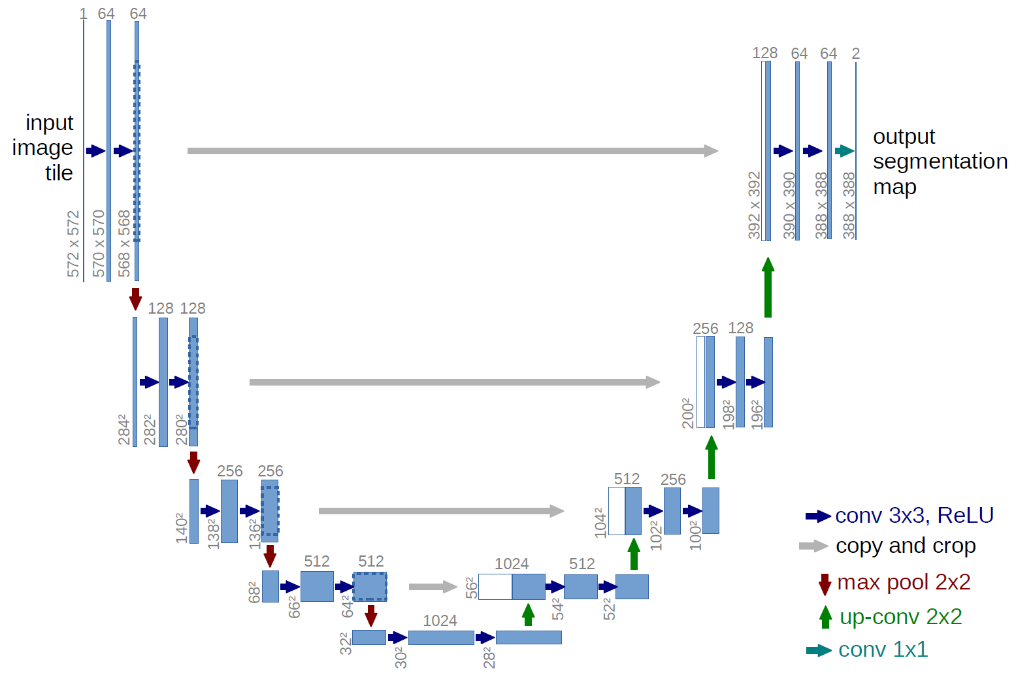
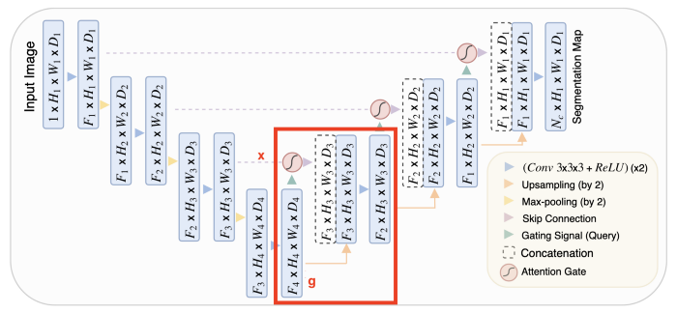
Proposed Solution (I)
Based on its success in biomedical Semantic Segmentation tasks, I implemented the standard U-Net Convolutional Neural Network and a simplified Attention U-Net Convolutional Neural Network.
U-NET CNN
https://lmb.informatik.uni-freiburg.de/people/ronneber/u-net/
Builds on standard CNN architecture
Contracting (downsampling) path to capture context
Expanding (upsampling) path to localize precisely
Propagates context of feature channels to higher-resolution layers (creates the U-shaped architecture)
No fully-connected layers
Effectively trained on smaller datasets
ATTENTION U-NET CNN
https://arxiv.org/pdf/1804.03999.pdf
Uses U-Net CNN as backbone
Contracting path maintained
Attention mechanisms are added into the skip connections in Expanding path to put more weight on relevant features
Attention highlights relevant activations during training
Here, Soft Attention is used because it is differentiable and thus can be trained with backpropagation

Slide 8
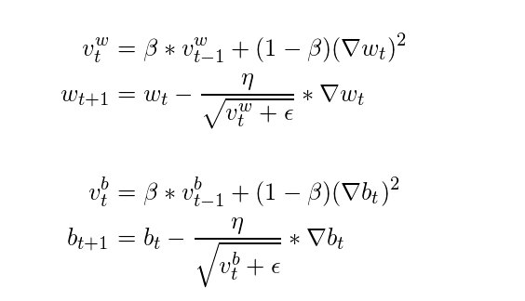
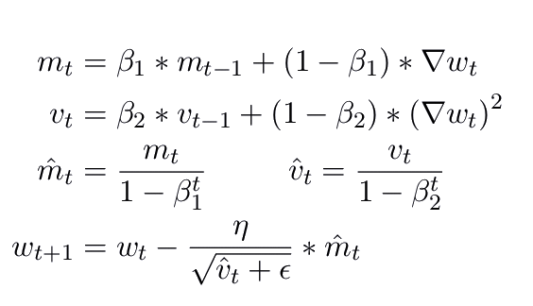
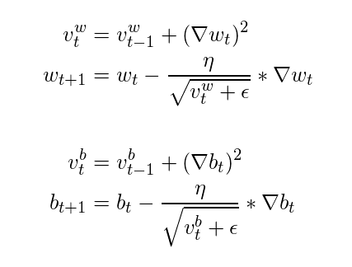
Proposed Solution (II)
Optimizers are used to tune the parameters w of the networks to minimize the cost J(w). Algorithms such as Gradient Descent are standard but require manually tuning the learning rate, which can be tedious for training deep networks. Adaptive Optimizers build on Stochastic Gradient Descent to alleviate this burden. These help to get a stable numerical solution and are conveniently provided in the machine learning frameworks.
This problem is hypothetically non-convex given the weights, but could be convex.
I trained both architectures, compiling using three different Adaptive Optimizers:
RMSPROP
‘Root Mean Square Propagation’
Decays the denominator in addition to the numerator the learning rate coefficient to avoid learning rate decay issue
ADAM
‘Adaptive Moment Estimation’
Combines RMSProp and Adagrad intuition
Uses a cumulative history of gradients
ADAGRAD
‘Adaptive Gradient Algorithm’
Decays learning rate for parameters proportionally to their update frequency
Converges fast with sparse features

Slide 9
Results

Slide 10
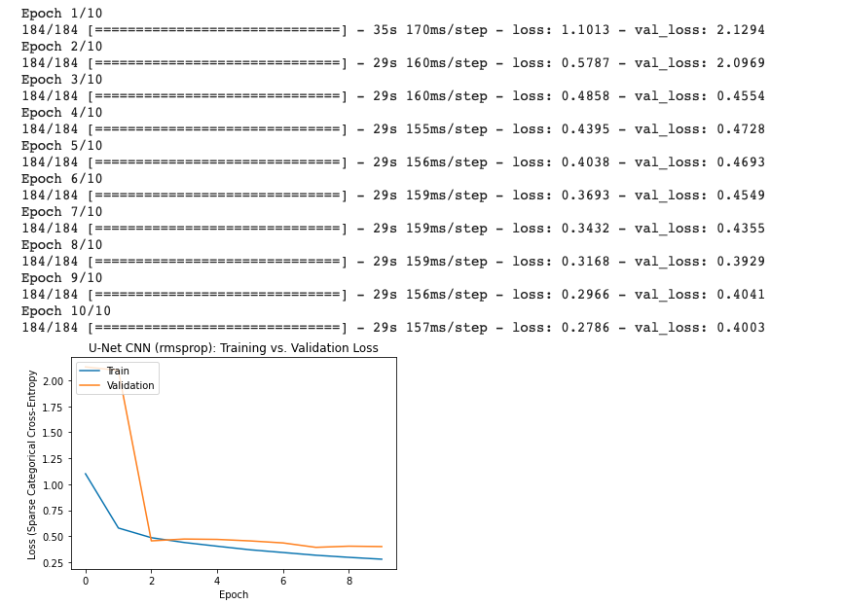
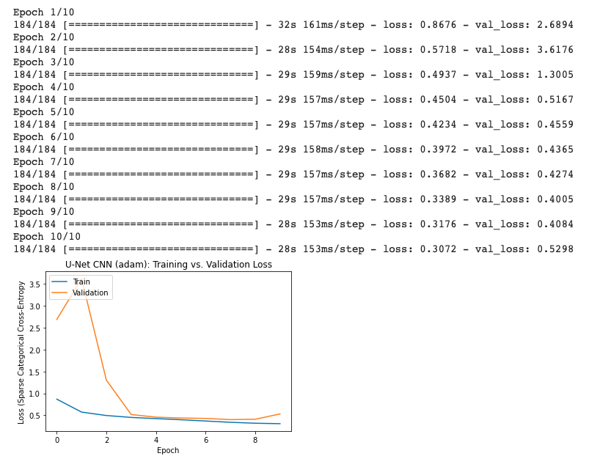
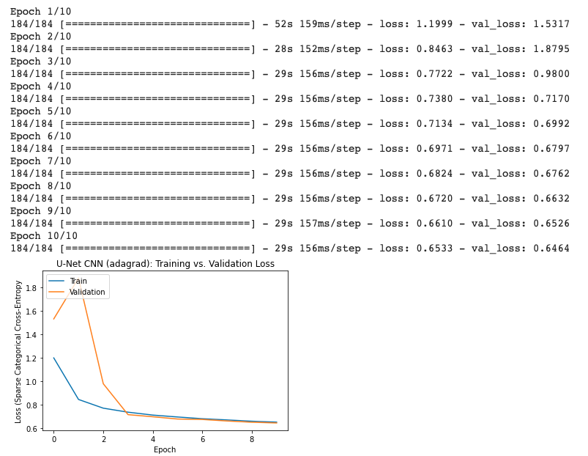
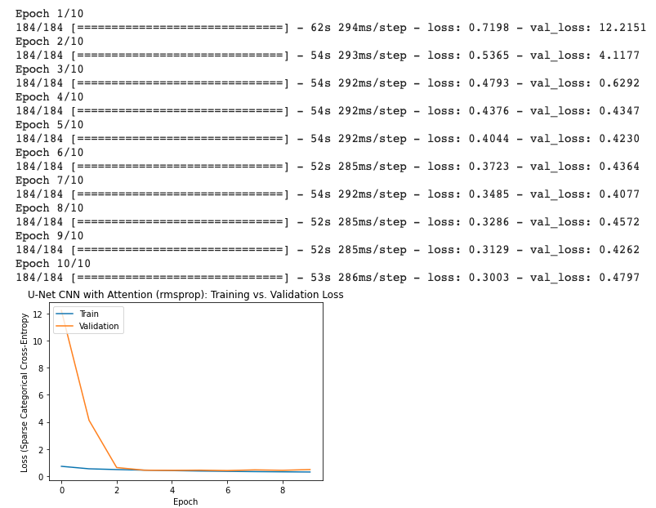
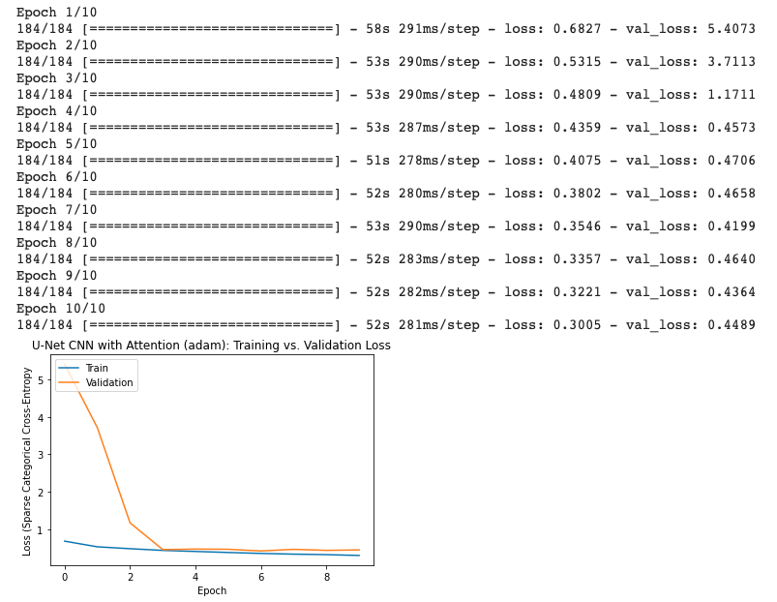
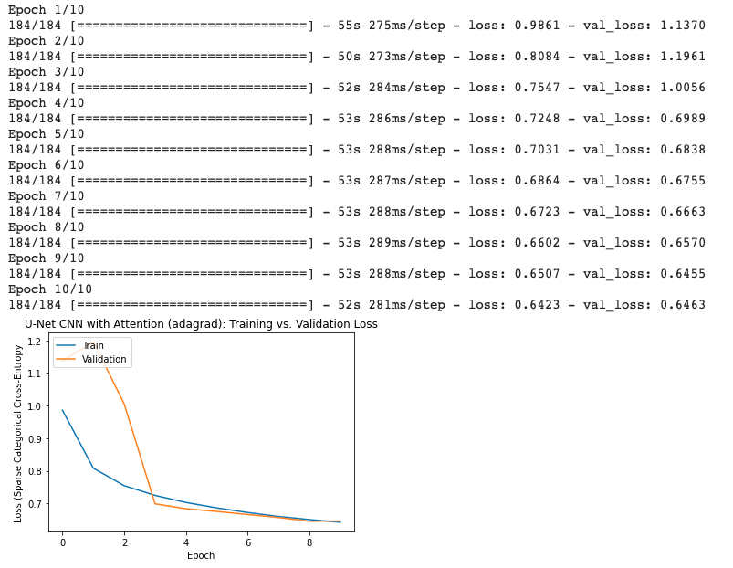
Optimization Behavior
RMSProp Adam Adagrad
U-Net CNN
RMSProp Adam Adagrad
Attention U-Net CNN

Slide 11
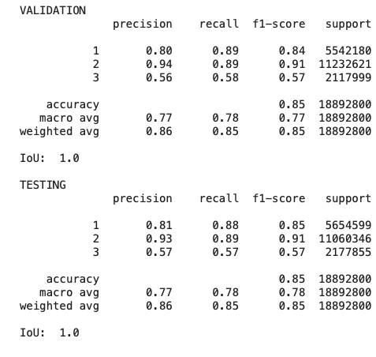
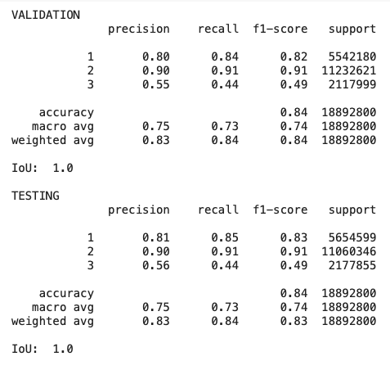
Validation (I)
I evaluated each optimizer’s loss trajectory over the course of the epochs, both for training and validation data. Based on final loss and stability, I selected the RMSProp-optimized model for the U-Net CNN and the Adam-optimized model for the Attention U-Net CNN.
For each model, I computed the class-wise Precision, Recall, and F1-Scores, as well as Intersection over Union (which was not very informative). These metrics are standard for classification tasks, and the latter especially for evaluating segmentation. I focused on F1-Score, as it is case-dependent whether to prioritize Precision or Recall.
U-Net CNN
Attention U-Net CNN

Slide 12
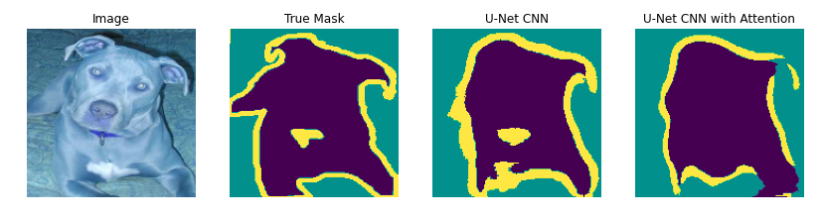
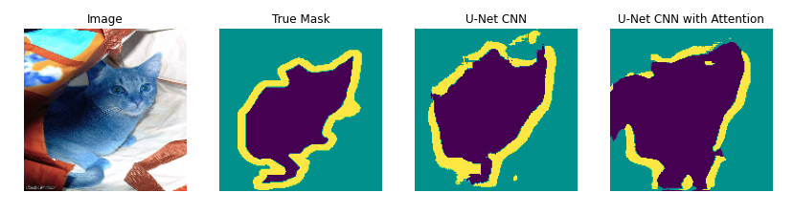
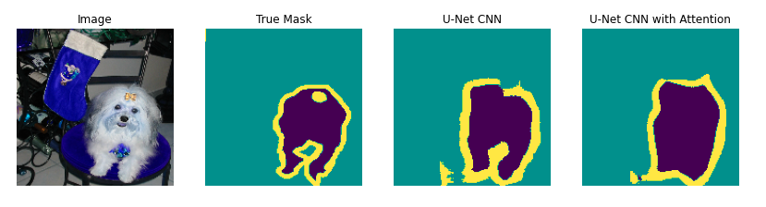
Validation (II)
Because this project is a prototype for a product, perhaps the most important test is human-evaluation. In this step, I selected a few images from the training and validation sets and compared their predicted masks to the ground truth.
Here, I prefer the output of the Attention U-Net CNN. Because the pet (purple) and boundary (yellow) pixels are combined in the post-processing steps, I especially feel that the Attention U-Net has a cleaner mask.

Slide 13
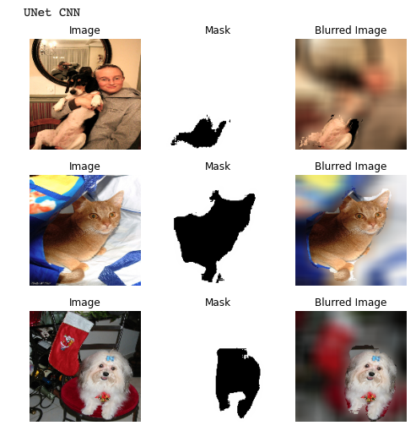
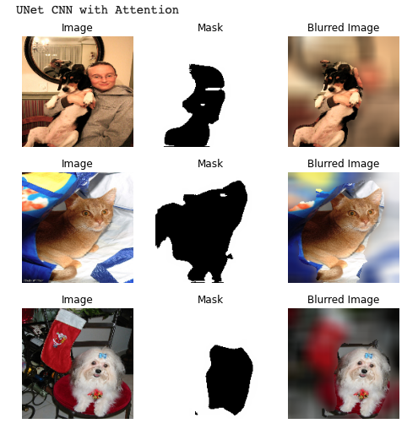
Simulation (I)
In order to evaluate the blurring effect, I incorporated the mask prediction step into a quick image-processing pipeline. The blurring is done using a large-Sigma Gaussian Filter convolved over a copy of the image, and the corresponding pixels classified as not-pet (white) from the blurred copy replace those in the original image. I first applied the pipeline to the previous dataset images:
U-Net CNN
Attention U-Net CNN

Slide 14
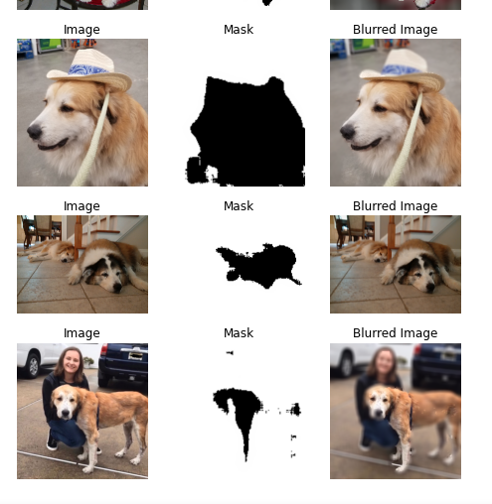
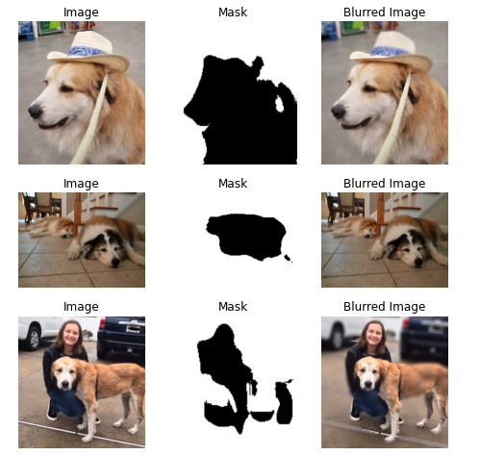
Simulation (II)
Then, I applied the pipeline to images of my own dogs. Here, it appears that the U-Net CNN performs better in the context of privatizing the images, although the Attention U-Net CNN has a much smoother result, which I feel is important for output aesthetic.
U-Net CNN
Attention U-Net CNN

Slide 15
Conclusions

Slide 16
Key Insights
When comparing results to the previous iteration of this project, focusing on the backend optimizer and network architecture was beneficial.
Adam appears to be the ‘go-to’ optimizer for deep neural networks, as supported in many papers.
Attention Mechanisms, although complicated to incorporate, are very informative to the network. In this case, they seemed to improve the smoothness of the results, although did cause some accuracy concerns in terms of detecting humans if near the pet. This is expected behavior based on the nature of Attention Mechanisms.

Slide 17
Major Conclusions
My approach was viable, mostly due to the capabilities of the Keras machine learning framework. However, because this is very black-boxed, later adaptions of the network may require TensorFlow.
Because I was training deep networks, I was forced to use a GPU, but even still I faced RAM issues with the Attention U-Net. This causes me some concern if I were to deploy this to the Raspberry Pi; I may require a better GPU.
I expected most of the results, and was especially satisfied with the Attention U-Net. The previous iteration of this project had issues with not completely capturing the pet, so I can see how incorporating Attention has helped to at least smooth the target region.

Slide 18
Improvements
Once I can alleviate the runtime issues, I plan to deploy the Attention U-Net CNN to Raspberry Pi and do real-time tests. That will allow me to evaluate the prediction latency and other behavior of the model.
A lot of the issues with the output may be resolved with more image-processing. For instance, I feel that applying some morphological closing may help to get rid of the sharp regions of the masks.
I have been researching a lot about the optimization of Vision Transformers. Although they are currently better-suited for Instance-Based Segmentation, I hope to find a way to incorporate them, at least for research purposes.

Slide 19
References
https://neptune.ai/blog/cross-entropy-loss-and-its-applications-in-deep-learning
https://towardsdatascience.com/learning-parameters-part-5-65a2f3583f7d
https://towardsdatascience.com/7-tips-to-choose-the-best-optimizer-47bb9c1219e
https://www.v7labs.com/blog/semantic-segmentation-guide
https://towardsdatascience.com/optimizers-for-training-neural-network-59450d71caf6
https://sh-tsang.medium.com/review-attention-u-net-learning-where-to-look-for-the-pancreas-biomedical-image-segmentation-e5f4699daf9f
https://towardsdatascience.com/using-attention-for-medical-image-segmentation-dd78825eaac6

