Slide 1
Bring Data Stories to Life
Alexander A. Pyles @aapyles
Director, Audience Engagement
Capital News Service

Slide 2
Social Listening

Slide 3
Social monitoring
If you’re a social user, you probably do this. It means keeping tabs on:
Mentions (of you, your news organization, a topic you care about)
Direct messages (from sources, from users, from colleagues)
Mentions (of competitors, i.e. other news organizations or journalists)

Slide 4
Social listening is more
Monitoring is passive and a bare-minimum social media use
Listening is active, intentional, with the goal of determining what’s being said, why and what it means
It’s long-term and ongoing
We seek out communities that make up our potential audience to hear them
We want to “lurk” online, and ultimately participate, to understand what communities care about

Slide 5
Social listening
Understand sentiment (positive, negative, neutral?)
Understand trends (for you, your profession, or your beat)
Understand questions the audience is asking

Slide 6

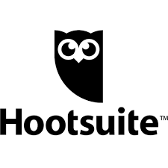


External tools can make this easier
Many are subscription based.
Notes:
I’m not saying these programs aren’t useful — they are.
But all they really do is automate commands that we can run ourselves.
If you’re a reporter trying to answer a few specific questions, running the search yourself is totally manageable on-platform and with free tools.

Slide 7
Verification

Slide 8
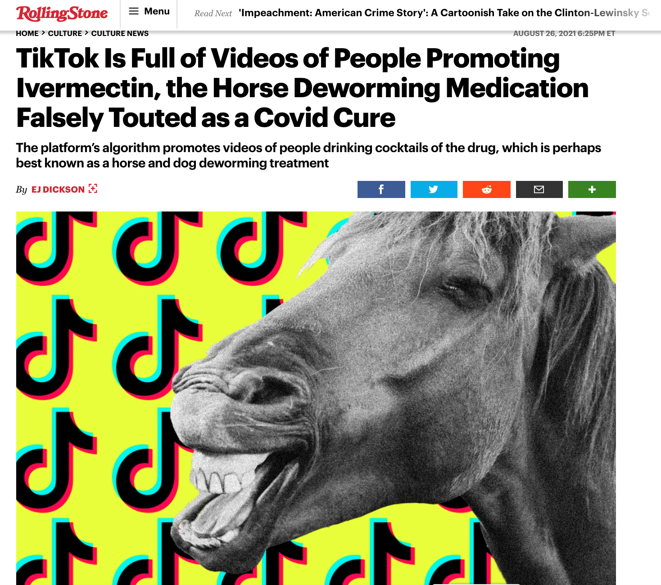

Slide 9
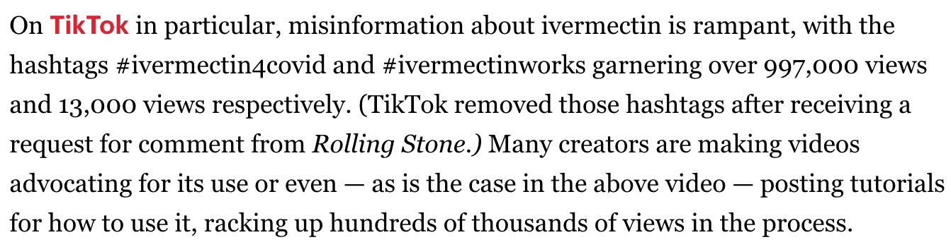

Slide 10
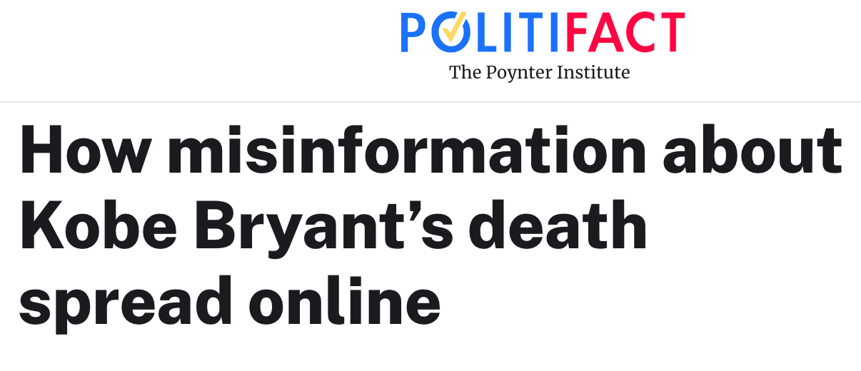
Notes:
Why is verification important?
Users should have verified this content.
They also could have verified the users spreading iti!

Slide 11
Key Takeaways
In the hours after Bryant’s death, social media users:
Posted video purportedly of the crash (it wasn’t)
These videos received millions of views on YouTube
Reported that Bryant’s death was planned (in one case, a ritual sacrifice)
Reported that Hillary Clinton murdered him
Those posts were shared thousands of times

Slide 12
Verify and fight disinformation.

Slide 13
Verification
The internet and social media are essential, powerful reporting tools
They’re also unreliable sources of information

Slide 14
Verification
Social media posts should never be the only source of information
Neither should most websites

Slide 15
How To Verify: Content
Trending topics are not necessarily news
Find additional sources (on social, not on social)
Double- and triple-check everything
Google Reverse Image Search

Slide 16
How To Verify: Users
Check follower counts
Very few? That may be a red flag
Check when the account was created
Just created today? Maybe a red flag
Who is following the account?
Seemingly fake accounts? Then this account is probably fake, too
Notes:
Follower counts can help, or can deceive. Very few may indicate a fake account. But fakers are aware of this problem, and follow each other. A fake may still have a big follower count.
A better way to verify might be looking at when the account launched. If it’s new and it’s making news, that’s a warning sign. Most platforms list on a user’s profile page how long an account has been active.

Slide 17
How To Verify: Users
Post history
What does this user usually post about?
Verify the identity separately from social media
Employer’s website? Or even a different social platform?

Slide 18
More Ways To Verify
Who
Individual? Organization? Leader in the field? How do we know? What else have they done?
What
Content? Structure, grammar, style? Complete and accurate info?
Where:
Where did the information being shared come from? Can you find it elsewhere?

Slide 19
More Ways To Verify
When
When was the information published? Is it still timely?
Why
Motivation. Why was this published?

Slide 20
Exercise:
Find The Fake (5 min)

Slide 21
Reach Your Target Audience

Slide 22
258.3 million
U.S. Adult Population Source: U.S. Census Bureau, 2021 Census
Notes:
~18% of U.S. households do not have broadband access. Keep this in mind.

Slide 23
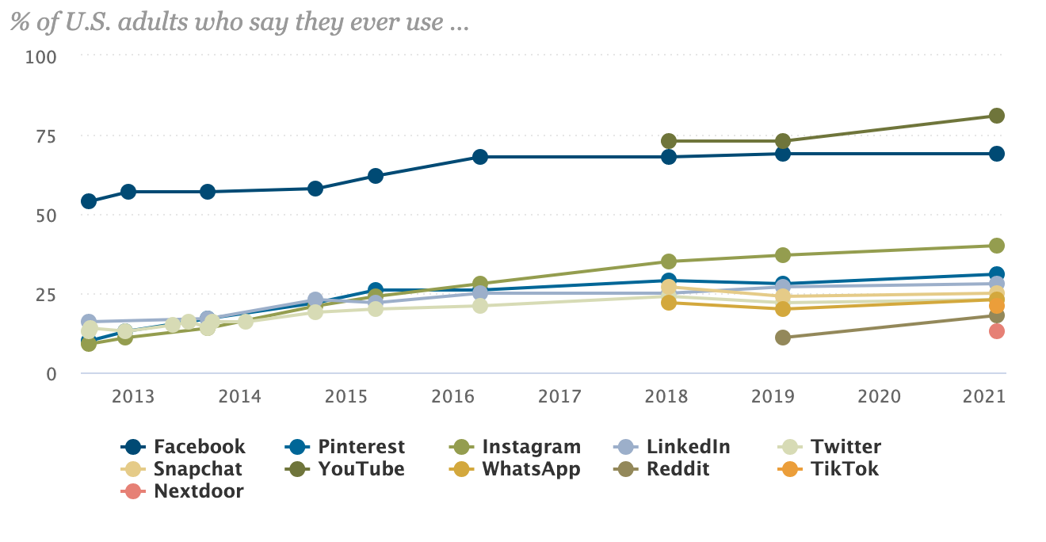
Where is the audience?
Graphic: Pew Research

Slide 24

Facebook Audience
69% of U.S. adults use
Age
70% of 18-29
77% of 30-49
73% of 50-64
50% of 65+
61% of men; 77% of women
67% of whites, 74% of Blacks, 72% of Hispanics
Source: Pew Research

Slide 25

Facebook Search
Notes:
Quick Activity: Find a Facebook Group to help you find sources for a story about COVID-19 in Maryland.

Slide 26

Instagram Audience
40% of U.S. adults use
Age
71% of 18-29
48% of 30-49
29% of 50-64
13% of 65+
44% of women; 36% of men
52% of Hispanics; 49% of Blacks; 35% of whites;
Source: Pew Research

Slide 27
Instagram Search

Slide 28

Twitter Audience
23% of U.S. adults use
Age
42% of 18-29
27% of 30-49
18% of 50-64
7% of 65+
25% of men; 22% of women
29% of Blacks; 23% of Hispanics; 22% of whites
Source: Pew Research

Slide 29
Twitter Search
Notes:
Search by Geocode! Go to Google Maps, right click on the place you want to search near and click “What’s here?” Use the geocode it spits out with this search instruction: geocode:lat,long,radius(mi/km)

Slide 30

Reddit Audience
18% of U.S. adults use
Age
36% of 18-29
22% of 30-49
10% of 50-64
3% of 65+
23% of men; 12% of women
17% of whites; 17% of Blacks; 14% of Hispanics;
Source: Pew Research

Slide 31
Reddit Search
Notes:
Quick Activity: Find a subreddit you may want to use in reporting on COVID-19 in Maryland.

Slide 32
Search Tips Across Platforms
Vary keywords
Car vs. Truck vs. Van vs. Automobile. Start with most likely candidate, then try the others.
Not getting what you want with “evict”? Try “eviction”
Think in terms of both topic and geography
Coronavirus, Maryland, Coronavirus Maryland, Coronavirus MD, etc.
Notes:
I think of trucks as pickups or semis. My sister calls anything bigger than a sedan a truck. Imagine the terms a user might be using. Google Trends can help you do this.

Slide 33
Get personal stories
Know your keywords, but also think about how users will relate their experiences. How will they tell their story?
Add “me,” “I” or “my” to your keyword searches

Slide 34
Exercise: Find storm stories

Slide 35
Sources & Additional Resources
Finding People and Sources Using Social Media
Find stories and sources on reddit, Instagram
ONA Audience Engagement Resources
Internet Troll and Disinformation Quiz
Ask me for more! aapyles@umd.edu / aapyles

