Slide 1
Data Bootcamp: Storytelling
Capital News Service, University of Maryland Philip Merrill College of Journalism

Slide 2
Social Listening & Verification

Slide 3
Social monitoring
You may have heard this term. It means keeping tabs on social for:
Mentions (of you, your news organization, a topic you care about)
Direct messages (from sources, from users, from colleagues)
Mentions (of competitors, i.e. other news organizations or journalists)

Slide 4
Social listening is more
Monitoring allows you to know what’s being said
Listening is the process of determining why and what it means

Slide 5
Social listening
Understand sentiment (positive, negative, neutral?)
Understand trends (for you, your profession, or your beat)
Understand questions the audience is asking

Slide 6




External tools can make this easier
Many are subscription based.
Notes:
I’m not saying these programs aren’t useful — they are.
But all they really do is automate commands that we can run ourselves.
If you’re a reporter trying to answer a few specific questions, running the search yourself is totally manageable on-platform and with free tools.

Slide 7
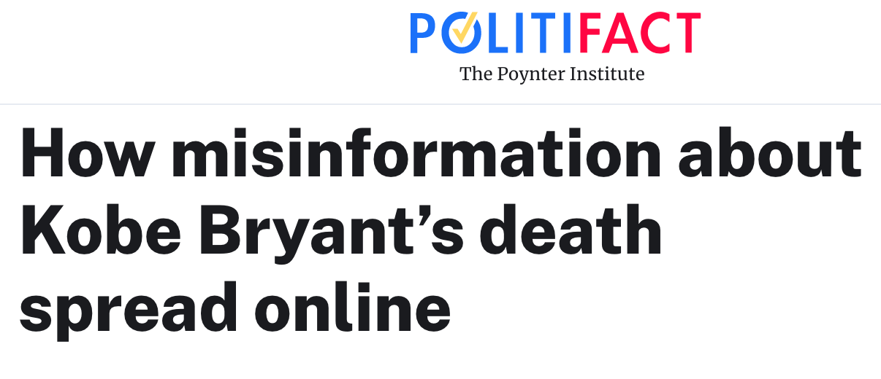
Notes:
Why is verification important?
Users should have verified this content.
They also could have verified the users spreading iti!

Slide 8
Key Takeaways
In the hours after Bryant’s death, social media users:
Posted video purportedly of the crash (it wasn’t)
These videos received millions of views on YouTube
Reported that Bryant’s death was planned (in one case, a ritual sacrifice)
Reported that Hillary Clinton murdered him
Those posts were shared thousands of times

Slide 9
Verify, verify verify.

Slide 10
Verification
The internet and social media are essential, powerful reporting tools
They’re also unreliable sources of information

Slide 11
Verification
Social media posts should never be the only source of information
Neither should most websites

Slide 12
How To Verify: Content
Trending news is not necessarily real news
Find additional sources (on social, not on social)
Double- and triple-check everything
Google Reverse Image Search

Slide 13
How To Verify: Users
Check follower counts
Very few? That may be a red flag
Check when the account was created
Just created today? Maybe a red flag
Who is following the account?
Seemingly fake accounts? Then this account is probably fake, too
Notes:
Follower counts can help, or can deceive. Very few may indicate a fake account. But fakers are aware of this problem, and follow each other. A fake may still have a big follower count.
A better way to verify might be looking at when the account launched. If it’s new and it’s making news, that’s a warning sign. Most platforms list on a user’s profile page how long an account has been active.

Slide 14
How To Verify: Users
Post history
What does this user usually post about?
Verify the identity separately from social media
Employer’s website? Or even a different social platform?

Slide 15
Exercise 1:
Find The Fake (5-10 min)

Slide 16
More Ways To Verify
Who
Individual? Organization? Leader in the field? How do we know? What else have they done?
What
Content? Structure, grammar, style? Complete and accurate info?
Where:
Where did the information being shared come from? Can you find it elsewhere?

Slide 17
More Ways To Verify
When
When was the information published? Is it still timely?
Why
Motivation. Why was this published?

Slide 18
Search On Social

Slide 19
SEO
Search Engine Optimization
Anyone who knows what they’re doing on the internet knows to write using keywords
A basic understanding of SEO will help in your search for sources

Slide 20
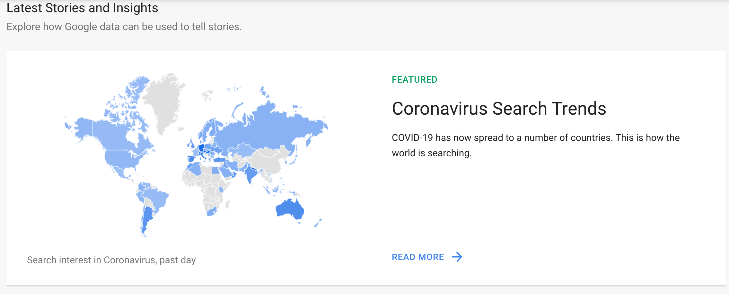
Google Trends
Google Trends will help you understand how users search
Notes:
Search Coronavirus.
Filter by U.S.
Filter by state.
Compare COVID, COVID-19, COVID19

Slide 21
Exercise 2: Identify a trend

Slide 22
Identify a trend (5-10 minutes)
Use Google Trends to determine what users are searching for right now in relation to your topic
Assume you plan to create content and publish it this week

Slide 23
If we know what users are curious about, we can create content that answers their questions.
Notes:
We as journalists can write stories or start initiatives to answer the audience’s questions. We’re helping them and us at the same time. When we create content, we should remember to include the keywords we found that were trending.

Slide 24
Free search tools
Social Searcher
Google Custom Searches
Notes:
Social Searcher will conduct a filtered search of all social media. It will even provide a sentiment ratio for your search phrase.
Did you know you can use Google Custom Search to only search a particular site, or to only search social media?

Slide 25
15-minute break

Slide 26
Who is your target audience?
Understand the demographics of social media users to better target the audience you want to reach
Don’t ignore other platforms, but focus attention where your audience is

Slide 27
255,200,373
U.S. Adult Population Estimate, July 2019 Source: U.S. Census Bureau

Slide 28
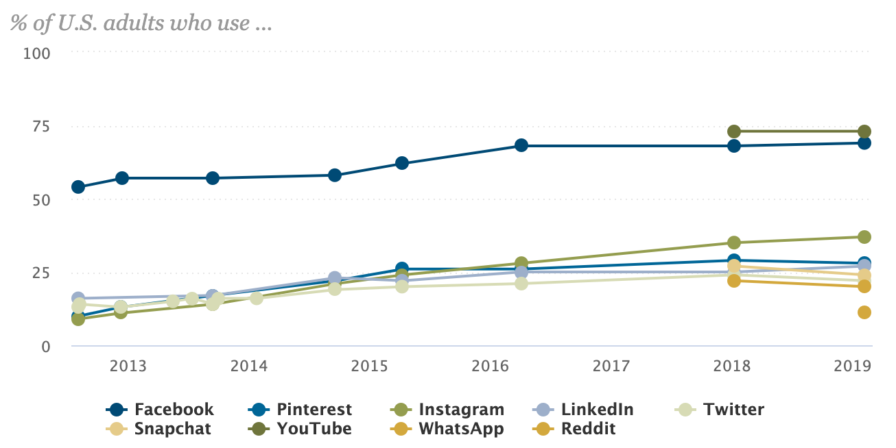
Where is the audience?
Graphic: Pew Research

Slide 29

Facebook Audience
69% of U.S. adults use
Age
79% of 18-29
79% of 30-49
68% of 50-64
46% of 65+
63% of men; 75% of women
70% of Whites/Blacks/Hispanics
Source: Pew Research

Slide 30

Facebook Search
Notes:
Quick Activity: Find a Facebook Group to help you find sources for a story about COVID-19 in Maryland.

Slide 31

Instagram Audience
37% of U.S. adults use
Age
67% of 18-29
47% of 30-49
23% of 50-64
8% of 65+
43% of women; 31% of men
51% of Hispanics; 40% of Blacks; 33% of whites;
Source: Pew Research

Slide 32
Instagram Search

Slide 33

Twitter Audience
22% of U.S. adults use
Age
38% of 18-29
26% of 30-49
17% of 50-64
7% of 65+
24% of men; 21% of women
25% of Hispanics; 24% of Blacks; 21% of whites
Source: Pew Research

Slide 34
Twitter Search
Notes:
Search by Geocode! Go to Google Maps, right click on the place you want to search near and click “What’s here?” Use the geocode it spits out with this search instruction: geocode:lat,long,radius(mi/km)

Slide 35

Reddit Audience
11% of U.S. adults use
Age
22% of 18-29
14% of 30-49
6% of 50-64
1% of 65+
15% of men; 8% of women
14% of Hispanics; 12% of whites; 4% of Blacks
Source: Pew Research

Slide 36
Reddit Search
Notes:
Quick Activity: Find a subreddit you may want to use in reporting on COVID-19 in Maryland.

Slide 37
Search Tips Across Platforms
Vary keywords
Car vs. Truck vs. Van vs. Automobile. Start with most likely candidate, then try the others.
Not getting what you want with “evict”? Try “eviction”
Think in terms of both topic and geography
Coronavirus, Maryland, Coronavirus Maryland, Coronavirus MD, etc.
Notes:
I think of trucks as pickups or semis. My sister calls anything bigger than a sedan a truck. Imagine the terms a user might be using. Google Trends can help you do this.

Slide 38
Get personal stories
Know your keywords, but also think about how users will relate their experiences. How will they tell their story?
Add “me,” “I” or “my” to your keyword searches

Slide 39
Exercise 3:
Find Sources

Slide 40
Find Sources
Find An Expert (15-20 min)
Find a local(ish) expert on public healthy, immunology, coronavirus, etc., to use in your story about the virus
Use native search on Facebook, Instagram, Twitter or Reddit or another tool
Take at least two steps to verify the account and person is real.
Save all of this in a Google Doc and be ready to share
Find A Personal Story (15-20 min)
Find a local person you may want to interview about the impact of coronavirus in the area you previously identified.
This person should have a story to share and likely needs to live or work in the locality your data sent you toward (Worcester & Somerset counties?)
Use native search on Facebook, Instagram, Twitter or Reddit or another tool
Save all of this in the same Google Doc and be prepared to share.

Slide 41
Find or build an audience
Notes:
Cut for time, if needed.

Slide 42
Audience Engagement
Creating value
Having a conversation
Giving/taking content

Slide 43
Audience Engagement
Building communities
Acquiring audiences
Adding community voices to stories

Slide 44
Why audience engagement matters
It builds trust between the audience and the journalist or news organization
It prevents us from being faceless disseminators of information
More transparency
Can show how we get stories
NYT’s “The Daily” podcast is an exercise in engagement!

Slide 45
Why audience engagement matters
Allows many voices to contribute to stories
Drives traffic/readership/viewership

Slide 46
Ways to engage

Slide 47
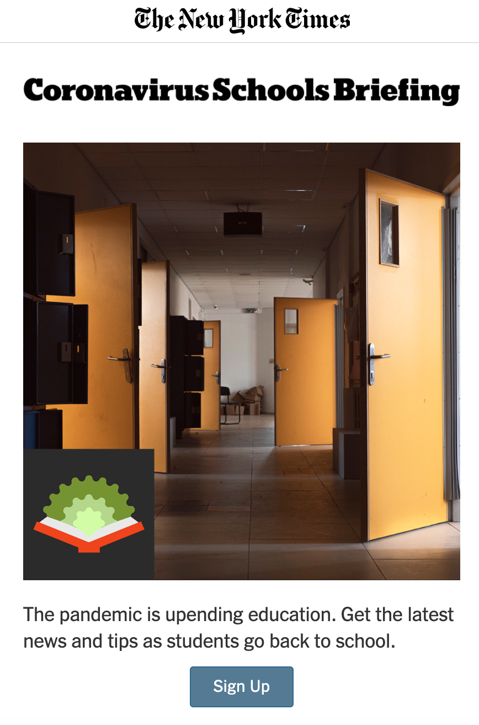
Newsletters
These can be regular (NYT’s Evening Briefing, Baltimore Sun’s Maryland Policy & Politics, etc.)
Or they can be special, built around a project or news topic
Ex: NYT’s Coronavirus Schools Briefing was launched as a result of social listening

Slide 48
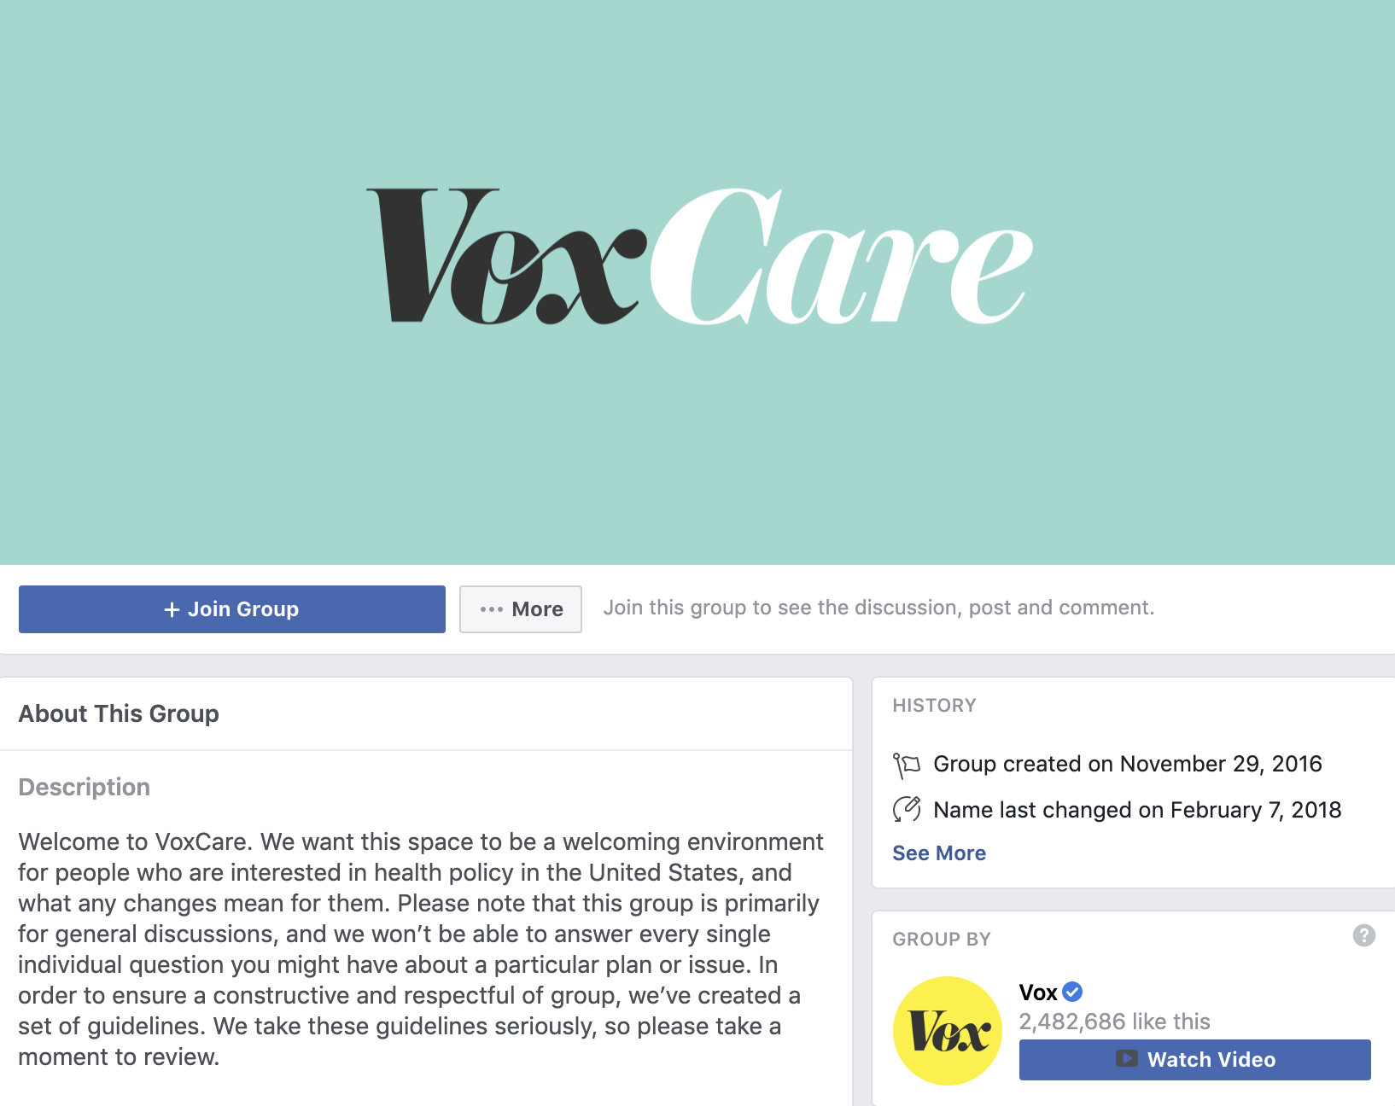
Facebook Groups
Create these to foster community
Get the audience talking about things they care about
These should be the things news organizations care about, too!
Get story ideas or find sources

Slide 49
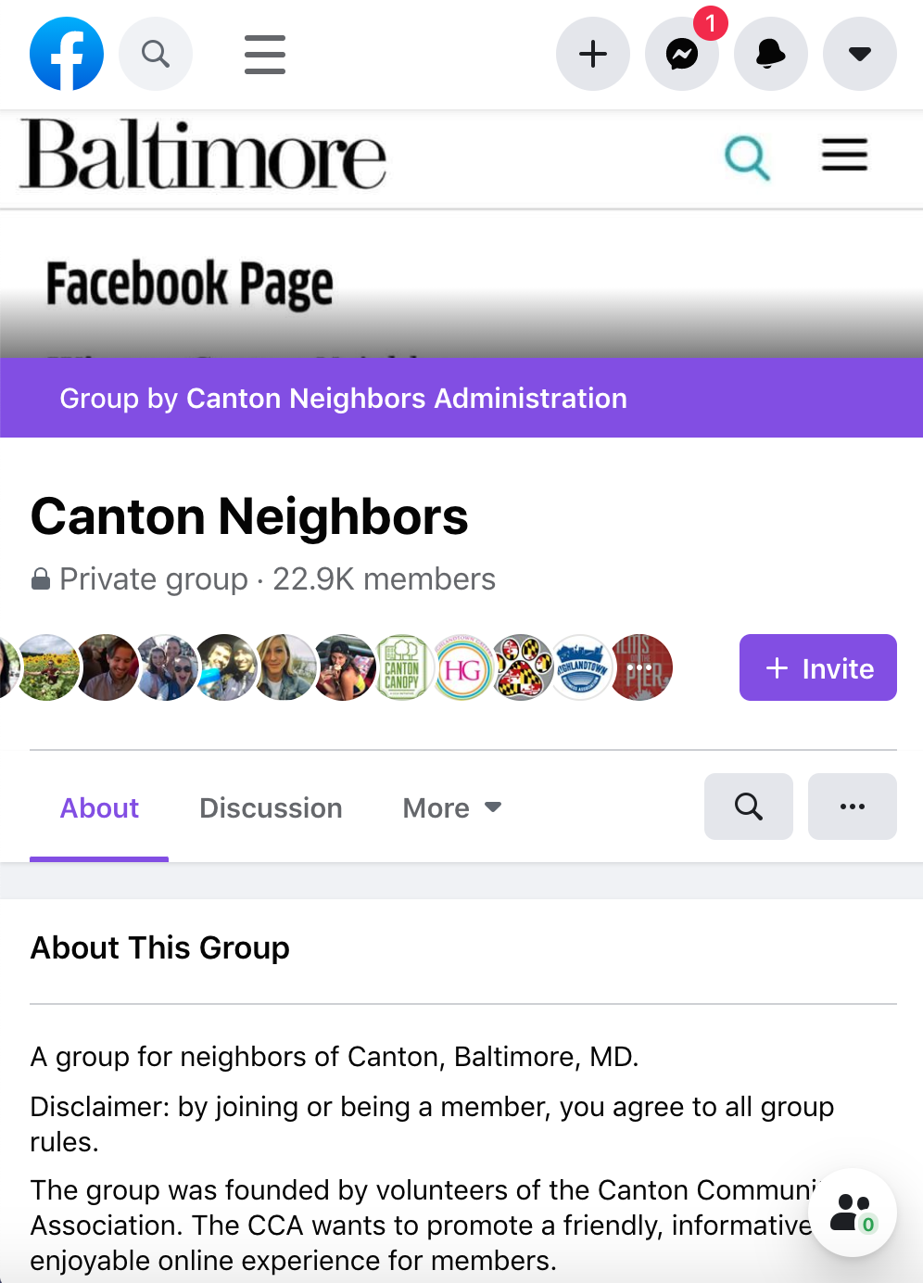
Facebook Groups
Join these to build trust
Get stories ideas or sources
Show that you, as a journalist, are invested in a topic that your audience cares about

Slide 50
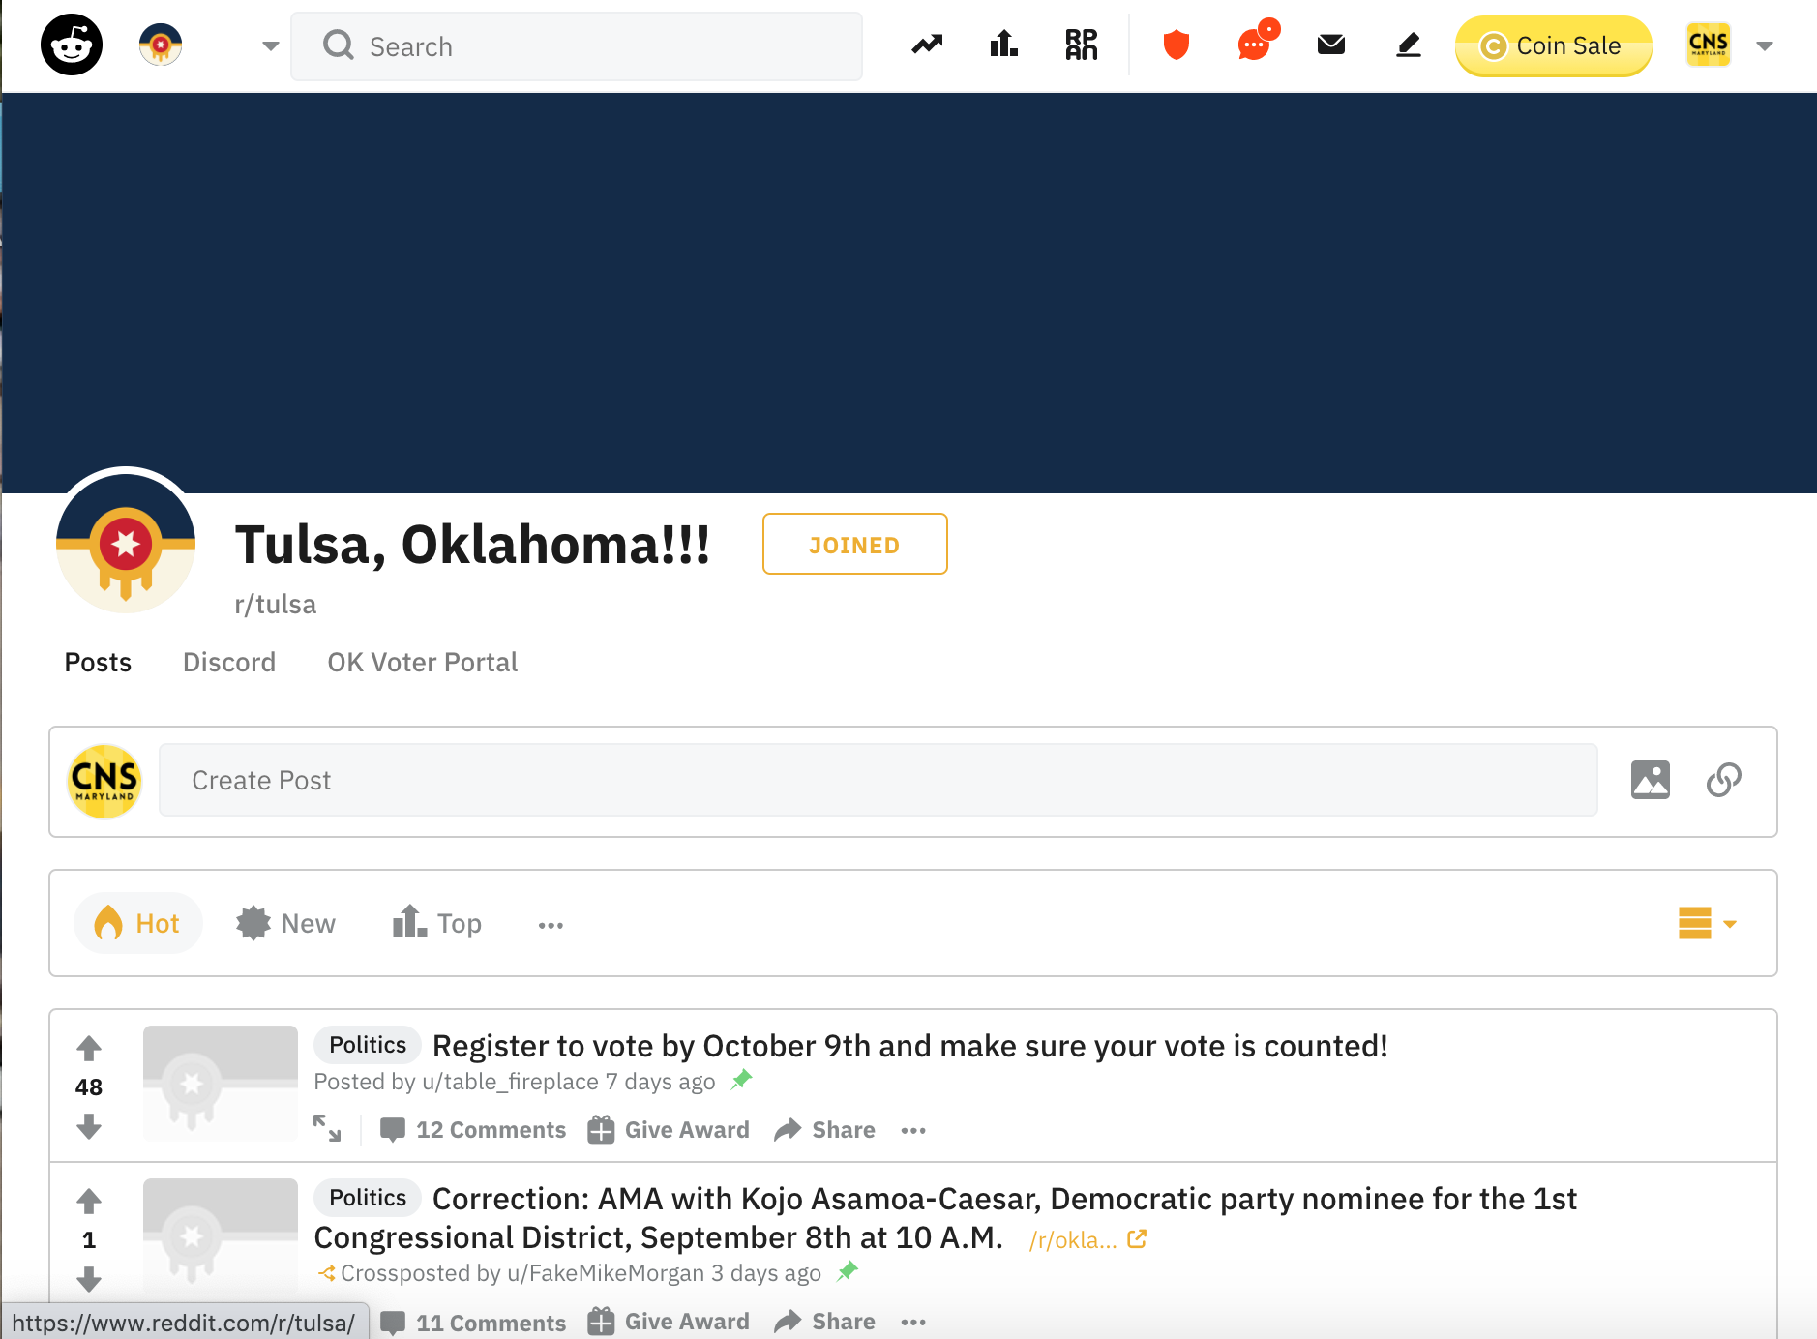
Subreddits
Lurk & post in communities you’re interested in
Sharing will work better if you’ve done some groundwork in that community
Don’t “parachute in” with a story related to the community’s interest and then disappear

Slide 51
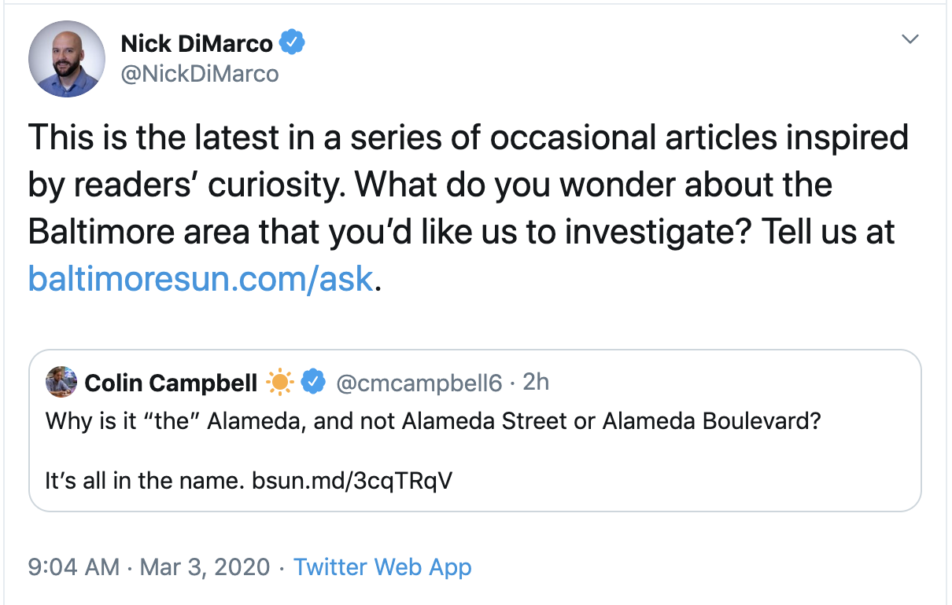
Ask/Call To Action
Use social accounts to encourage users to send ideas
The Baltimore Sun has been running an occasional series of stories generated by user questions
These are often stories newsrooms would ignore
It’s worth knowing what your audience is curious about!

Slide 52
Exercise 4:
Make A Plan

Slide 53
Make A Plan
In the time we have remaining:
Choose at least one engagement strategy to pursue (Create/join FB group, stalk a Subreddit, etc.)
Consider what you’ve learned from your expert and personal story sources
Consider who your target audience is
Consider what questions internet users are asking

Slide 54
Slides: aapyles.github.io/CNS/bootcamp

