Slide 1
Better Donation and Disease Forecasting with Feature Engineering
Team Flash

Slide 2
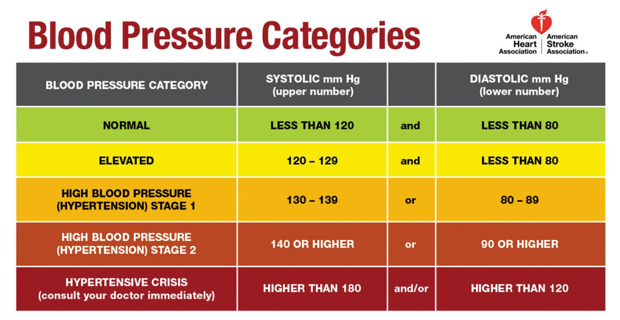
Blood Pressure Feature Engineering
Given the Donor’s Blood Pressure we have a made new columns to classify their blood pressure category and have seperated their systolic(upper) and diastolic(lower) numbers.

Slide 3
Example of Blood Pressure Feature Engineering
DonorBP | Systolic | Diastolic | Normal | Elevated | High Stage 1 | High Stage 2 | High Stage 3
120/80 | 120 | 80 | 1 | 0 | 0 | 0 | 0
130/91 | 120 | 91 | 0 | 1 | 0 | 0 | 0

Slide 4
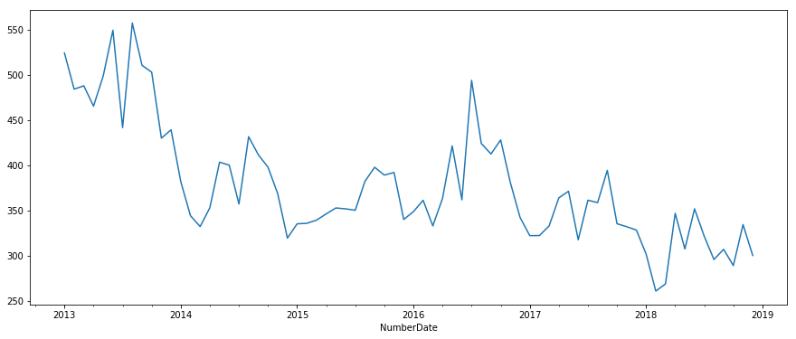
The Effect of Seasonal and Cultural Change over Time
As we can see, over time there are certain peaks and troughs that look cyclical

Slide 5
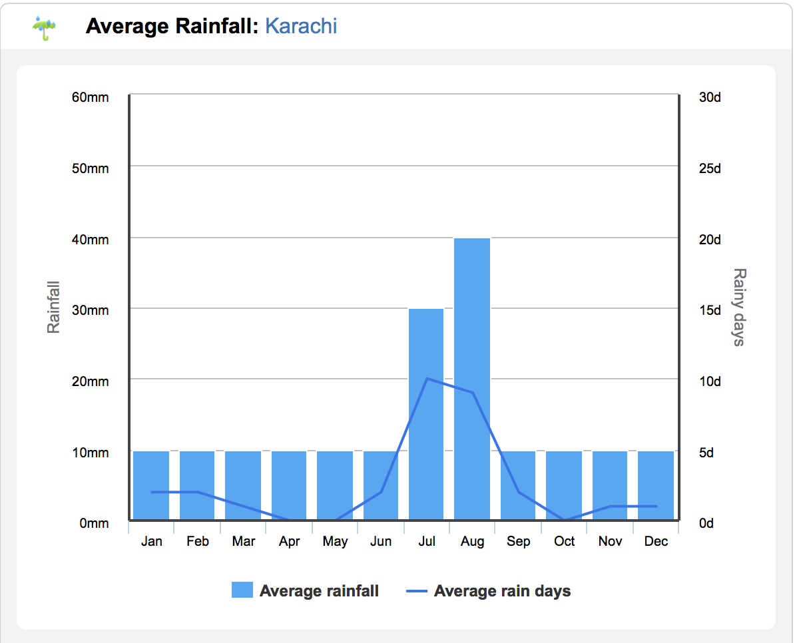
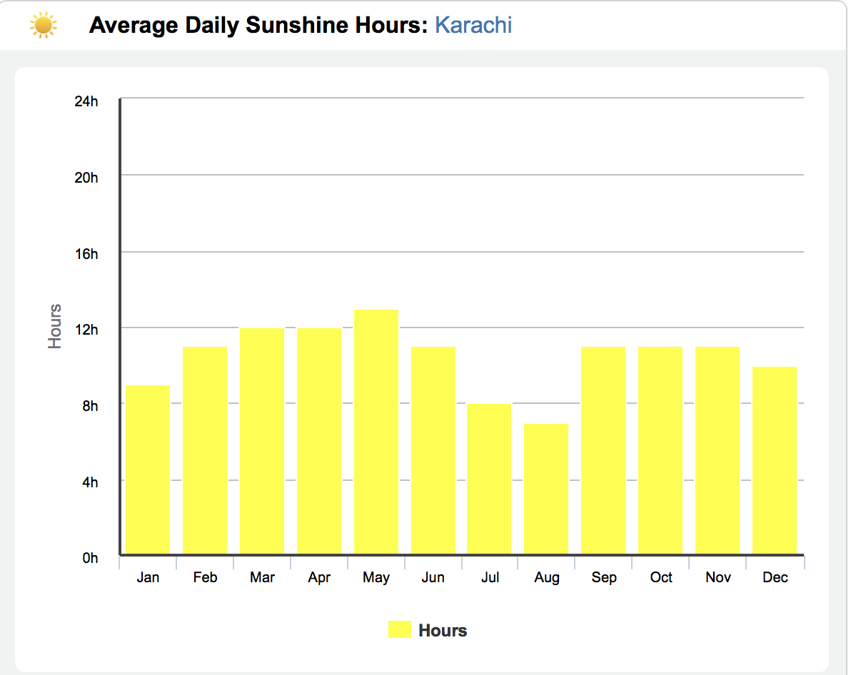
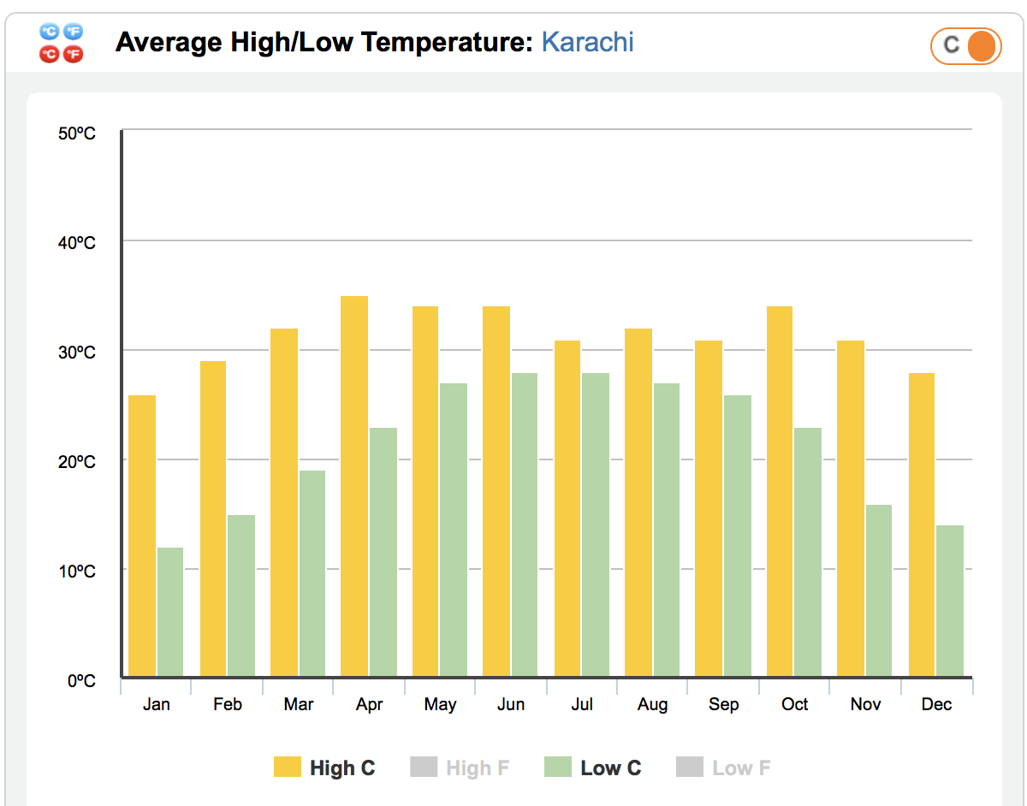
Example of Seasonal

Slide 6
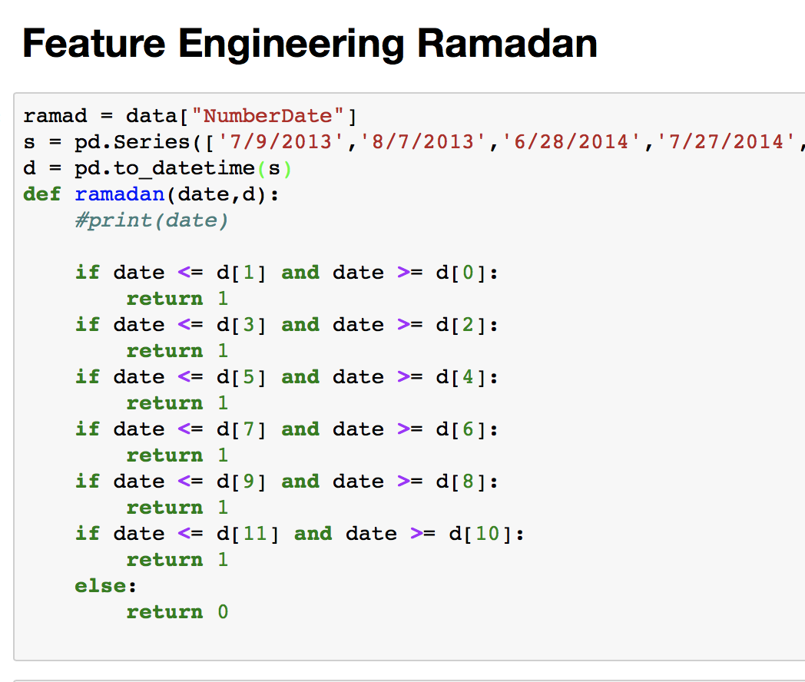
Cultural Holidays (Ramadan/Ramzan)
Because of the harsh weather conditions and the importance of Ramadan in Pakistan we can assume people will be donating less during the holy month to maintain their own health first. We calculate this using recorded dates of Ramadan and we can calculate future ones.

Slide 7
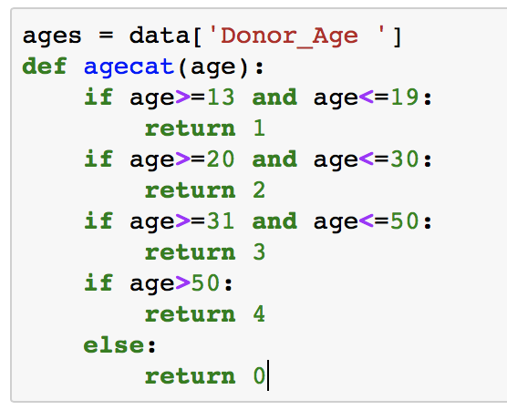
Feature Engineering Age
Age can be used as a reliable feature as probabilistic tool for predicting blood diseases. This comes with the assumption that people of different age group participate in different activities, live different lifestyles, take different medications which can lead to blood diseases.

Slide 8
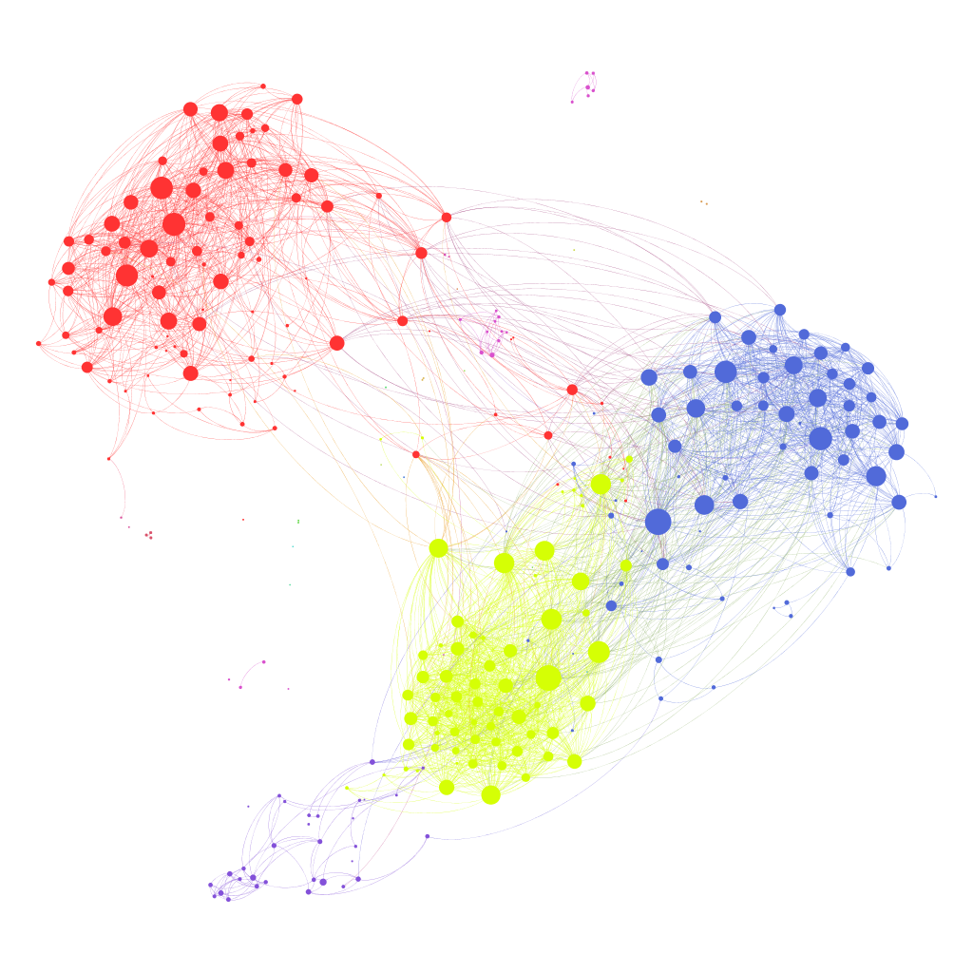
Feature Analysis Based off Location
Location is a great tools for disease prediction because it gives insight of the social groups of transmittable diseases.

Slide 9

Feature Analysis Based off Gender
Different Genders are subject to different diseases as some diseases show gender bias(Ex. Lupus for women, diabetes for men). Men and Women might also be taking different medication based on gender. Most importantly women are capable of becoming pregnant which completely stops them from donating blood.

