Slide 1

Grid Capture Ultimate Edition
Professor: Vahid Behzadan
Team Members: Alima Aqsai, Bilva Akshitha Kandoori

Slide 2
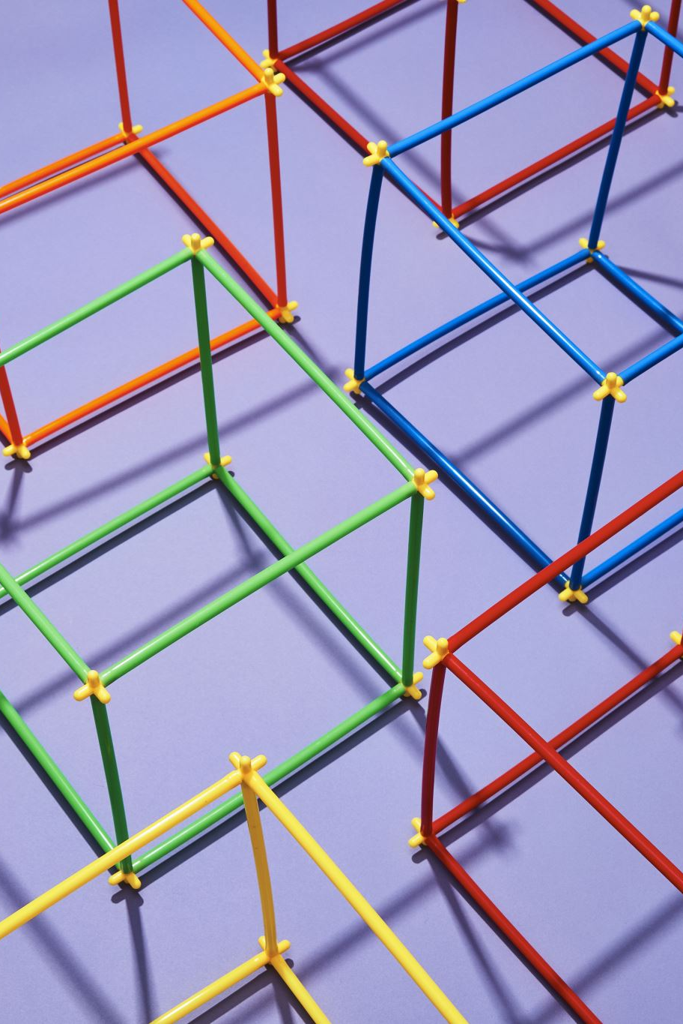
Project Description
5x5 grid-based strategy game
Two players take turns placing pieces on empty cells
Capturing occurs when a newly placed piece is adjacent to opponent pieces (they convert to the player’s color)
The game ends when all cells are filled
The winner is the player controlling the most pieces at the end
Player 1 uses blue pieces; player 2 uses red pieces

Slide 3

PROJECT OBJECTIVES
Build a fully functional strategy game with correct capture mechanics
Implement AI with multiple play styles and difficulty options
Enable quick evaluation of board state and possible moves
Create a clean, intuitive, and user-friendly interface

Slide 4

Approach (Tools & Techniques)
FastAPI for backend development
HTML, CSS, and JavaScript for the frontend interface
Minimax algorithm with heuristic-based decision making
AI strategies with a distinct playstyle “personalities”
A GameState system to manage rules, captures, and scoring
REST API endpoints for seamless gameplay communication

Slide 5
Deliverables
In-depth description of Grid Capture Ultimate game implementation
The game utilizes Python for AI algorithms and backend logic, while the frontend interface is built using HTML, CSS, and JavaScript.
A final written report and project presentation
Access the Python code and associated files via the GitHub repository ink.
YouTube video demonstrating the project’s implementation and detailed information slides

Slide 6
Evaluation Methodology
Evaluate AI performance across all difficulty levels
Conduct multiple test games to ensure balanced and fair outcomes.
Verify that capture mechanics and scoring rules are applied consistently.
Validate the accuracy of board state updates and system responses
Assess the overall user experience and level of player engagement

Slide 7

THANK YOU!

