Slide 1


Capstone Project - 1
Journal AI
Dr. Jenny Kasudiya
Chronicles – Write Your Journey
Under Guidance of

Slide 2
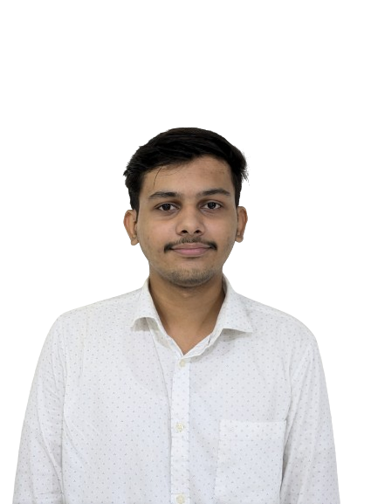
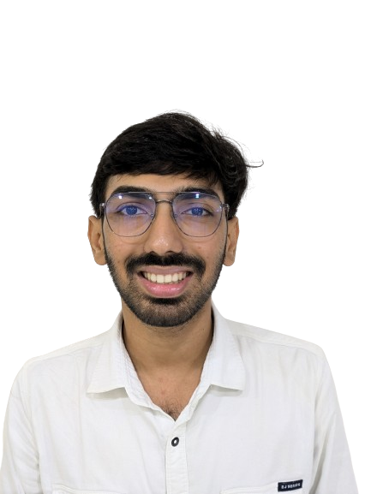


Team
Qureshi Aaquif Shafikahmed
Shah Mrunal Nirajkumar
Datari Asgar Kalbehusen
Shah Malav Ajay
202202626010033
202202626010043
202202626010009
202202626010041
aaquifsqureshi@gmail.com
mrunalnshah2883@gmail.com
datariasgar15@gmail.com
malavshah3112@gmail.com

Slide 3
Outline
Bigger Problem?
Problem Statement.
Study of Similar Applications.
Requirement Gathering.
Execution Plan!
Graphical Design & User Interface!
Technology Stack: Tools & Frameworks
Project Timeline.
Conclusion

Slide 4
Bigger Problem ?

Slide 5



1 in 4 People Feel Lonely

Slide 6
20 % – 40 % People are Introverts.

Slide 7
Fewer People can express themselves
and
Less people have clarity of thoughts.

Slide 8
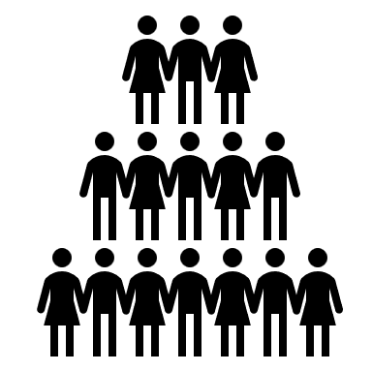





It impacts all of us.

Slide 9
Problem Statement
The number of people are suffering due to not being able to express their thought, diving deeper into their loneliness and eventually yielding to mental illnesses.
Less people introspect themselves
The need to make things digital in this world which revolves around modernity, privacy, availability, ease, convenience, and free usage.

Slide 10
no one solution!

Slide 11
Our proposed solution!
Chronicles – Write Your Journey
A cross-platform app which lets an individual write their daily dairy digitally

Slide 12


Maintaining a physical diary
Challenge to maintain the diary
Privacy is not guaranteed
Big generation change happening.

Slide 13
Aim
Involve more individual into writing daily dairies.
Helping individual become more happy, thoughtful and stress-free.
Helping more and more individual introspect themselves.
Helping individual get clarity of thoughts
Solving the bigger problem.

Slide 14
Features
Easy to write diaries
Todo list
Speech to Text, Text to Speech
Timely Reminders
Text Summarization
Conversion of digital diaries to pdf and/or epub
Progress Tracker ( Streak )
Open Diaries

Slide 15
Objectives
User friendly
Free to use
Cross Platform ( Android, IOS)
Secure

Slide 16
study of similar applications

Slide 17




Journey
Evernotes
Chronicles
Notion
One Day

Slide 18
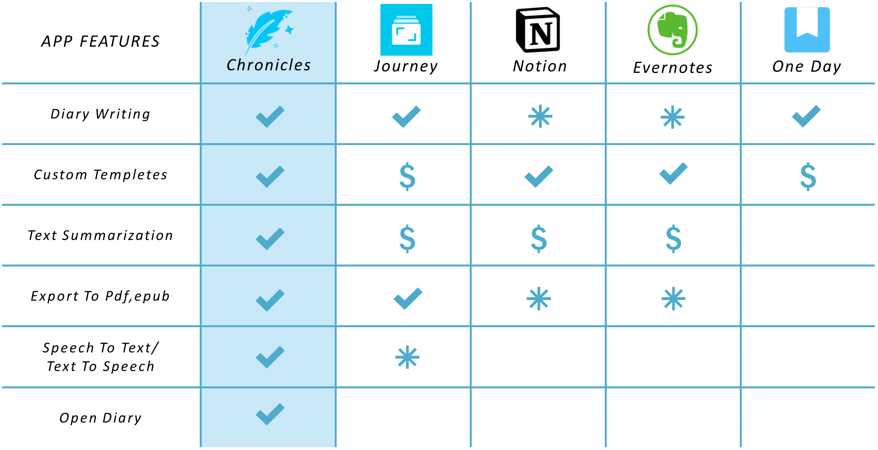
Comparing similar application

Slide 19





Requirement Gathering
Requirement Gathering
Text Editor
Text Summarization
Markdown Editors
Quill
[ Flutter Package ]
Appflowy
[ Flutter Package ]
Gemini API
OpenAI API
Grammarly API
Our Customized Text Editor
Our Customized Text Summarizer

Slide 20
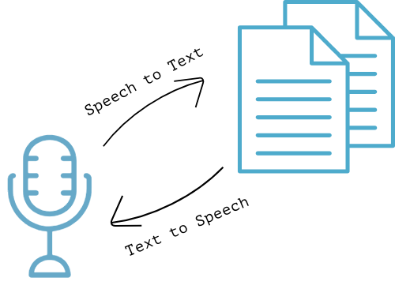
speech_to_text 6.6.2
flutter_tts 4.0.2
A flutter library that exposes device specific speech recognition capability.
A flutter text to speech plugin (Swift,Kotlin)

Slide 21
Execution Plan

Slide 22
Class Diagram

Slide 23
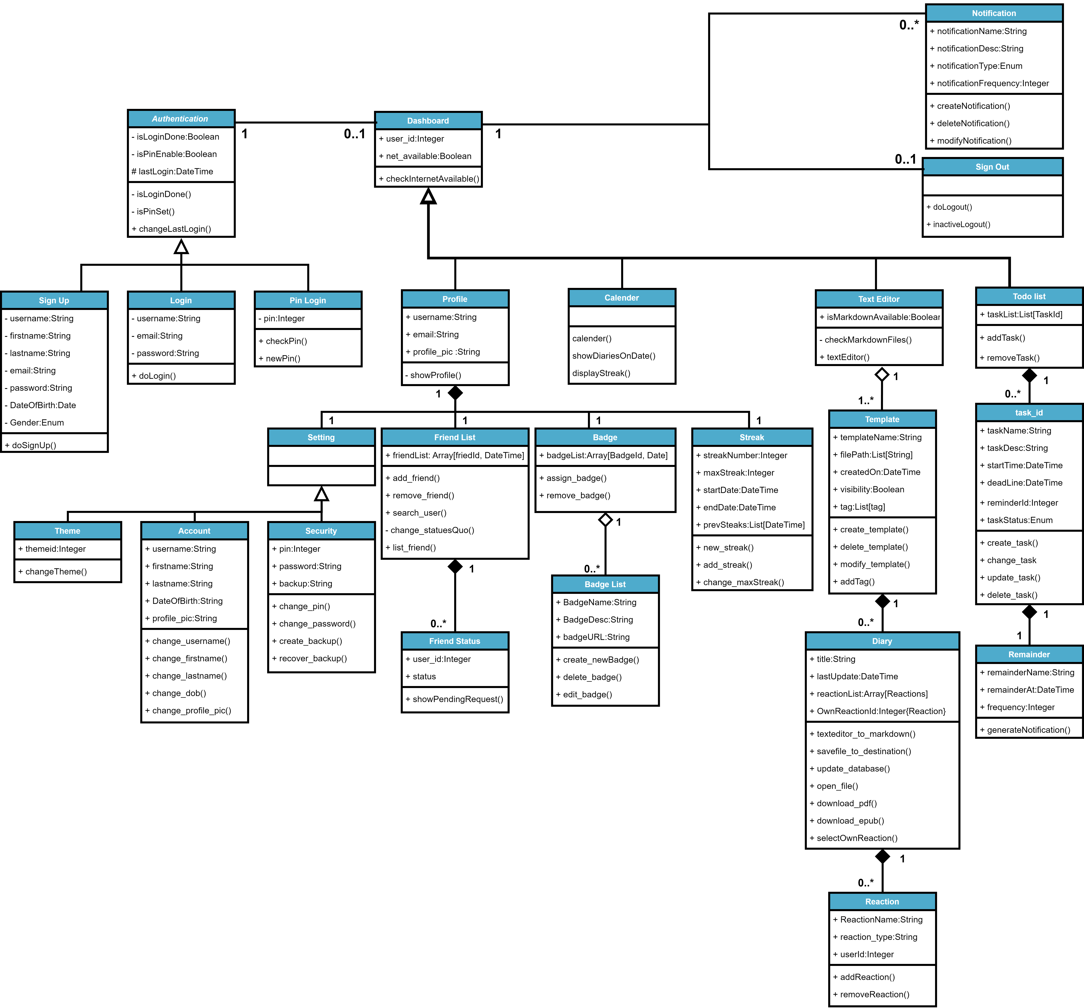

Slide 24
State Diagram

Slide 25
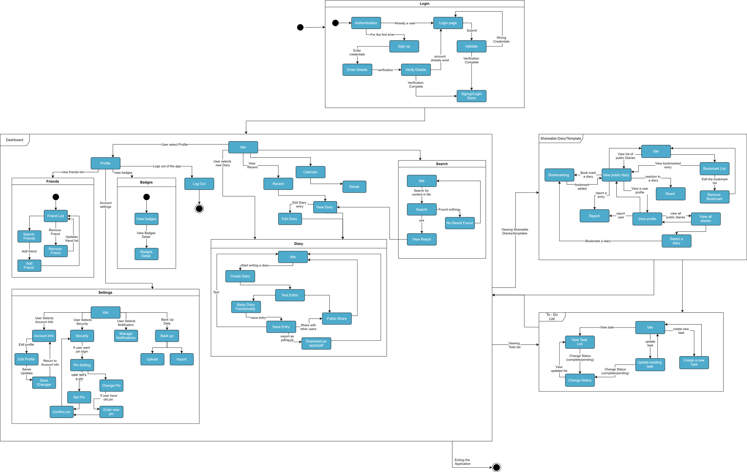

Slide 26
Activity Diagram

Slide 27
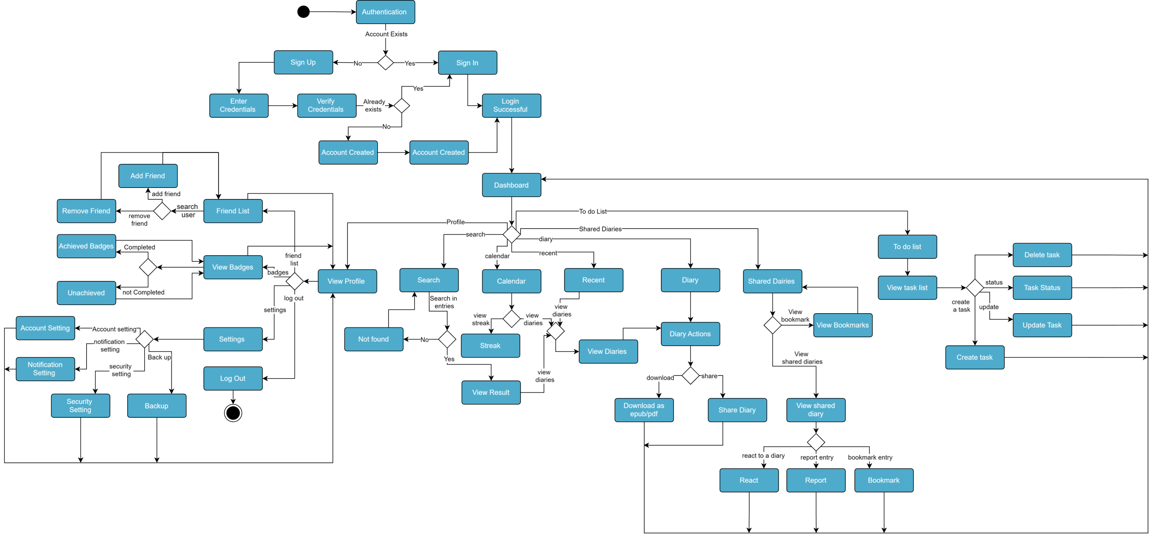

Slide 28
Sequence Diagram

Slide 29
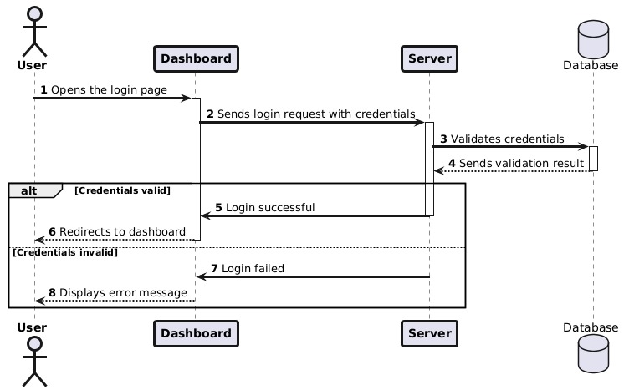

Slide 30
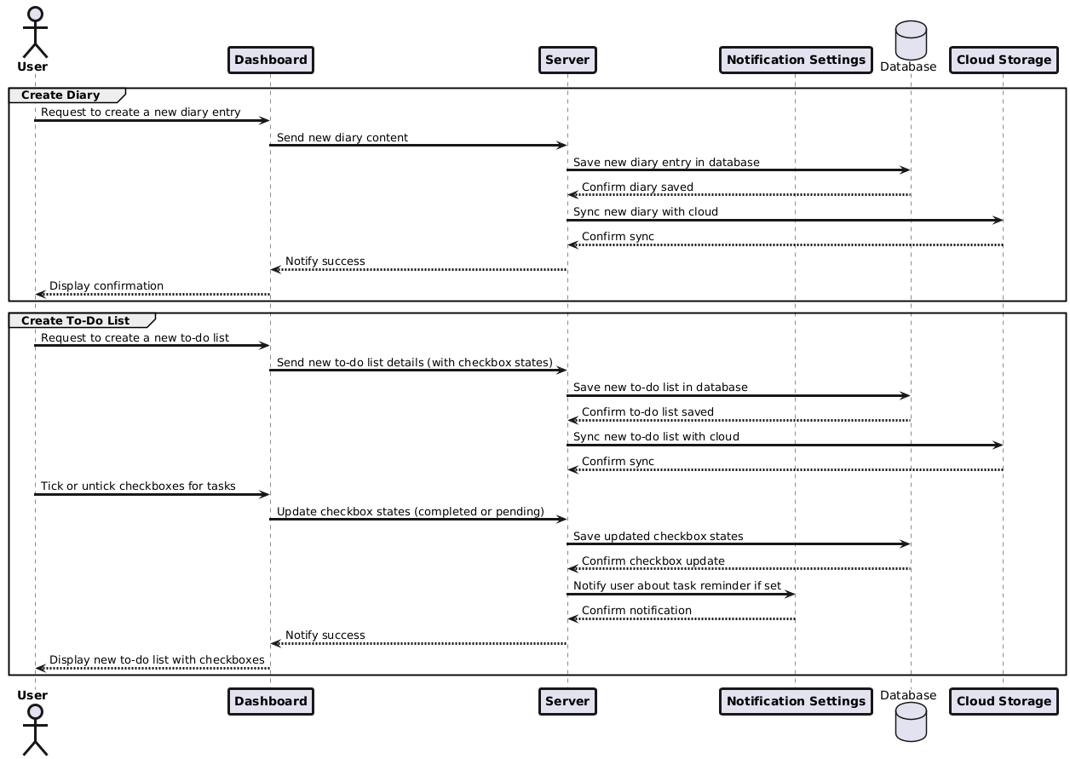

Slide 31
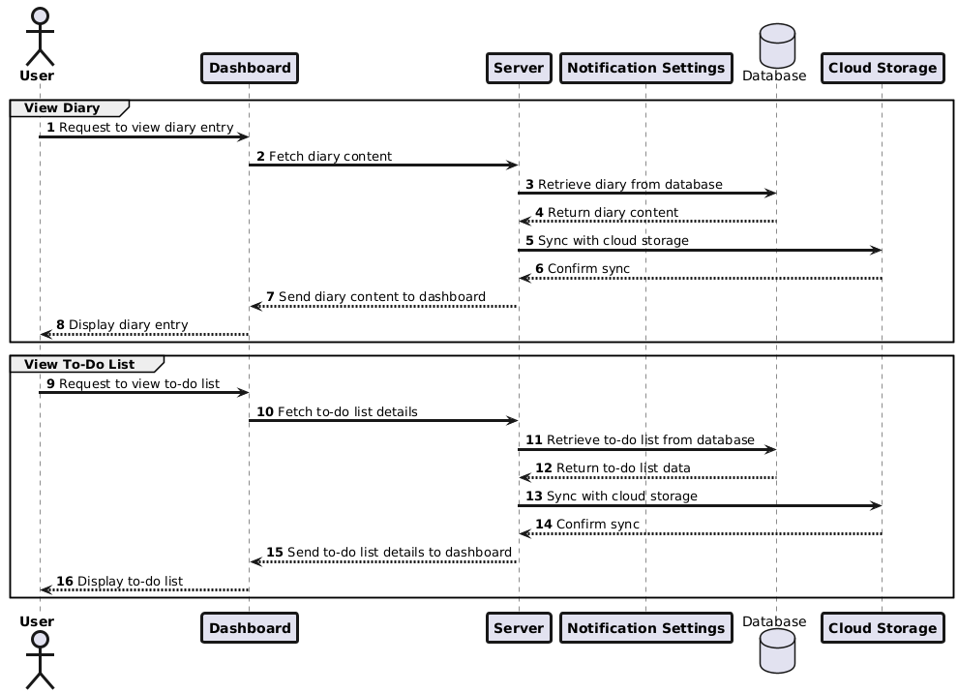

Slide 32
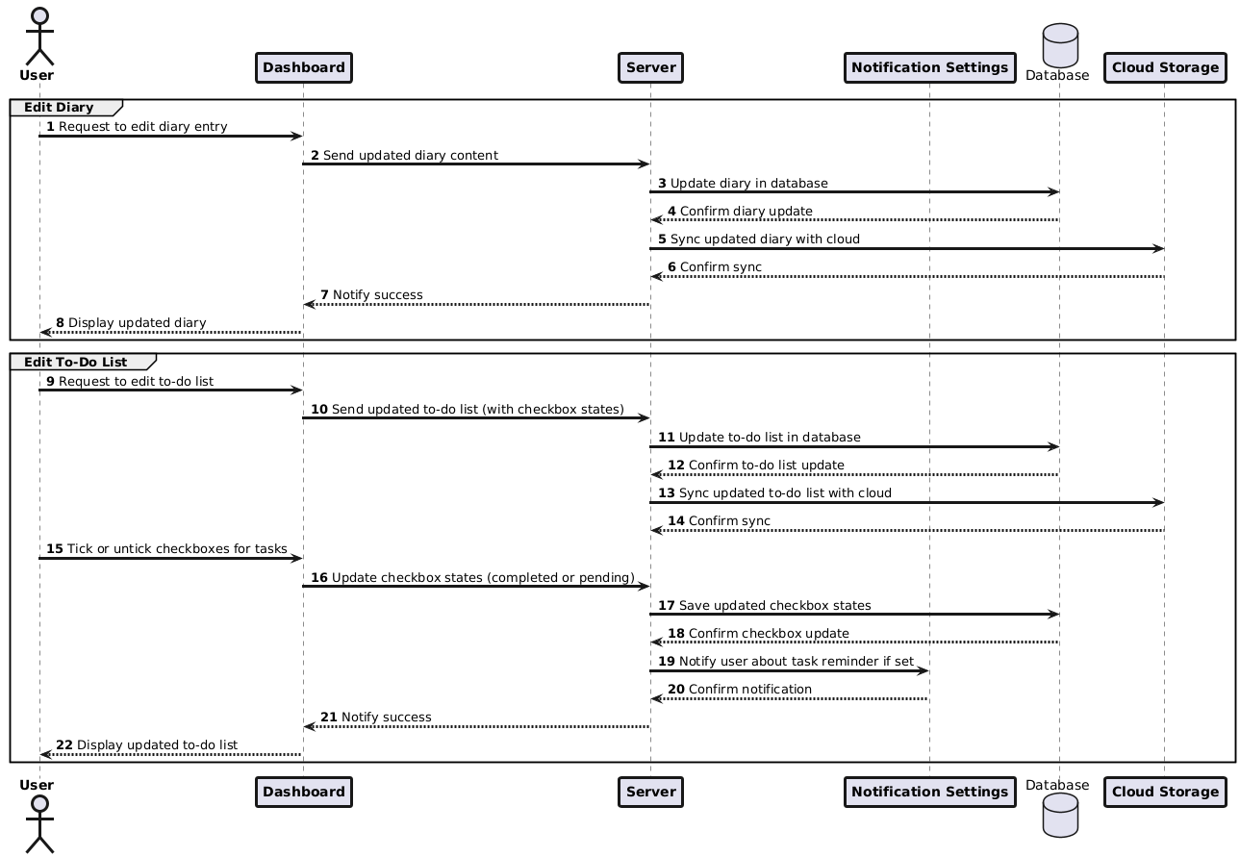

Slide 33
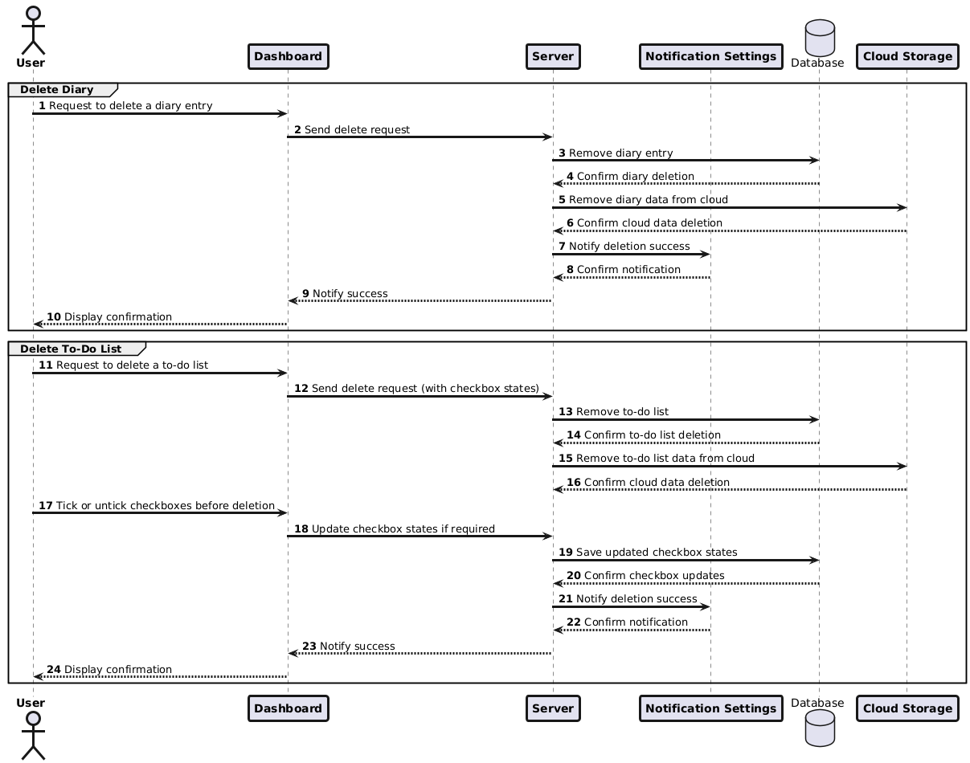

Slide 34
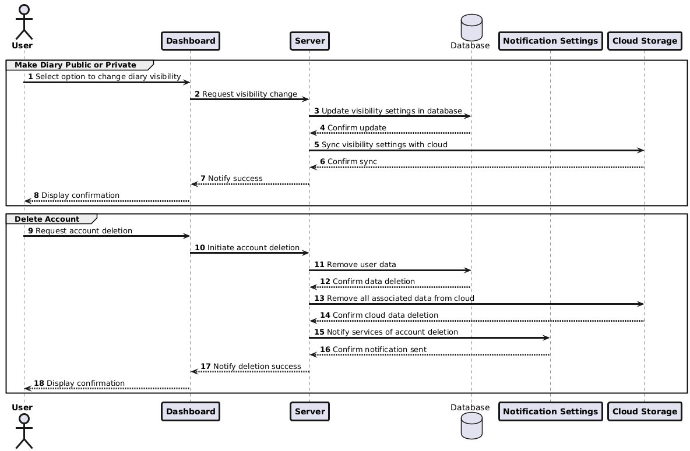

Slide 35
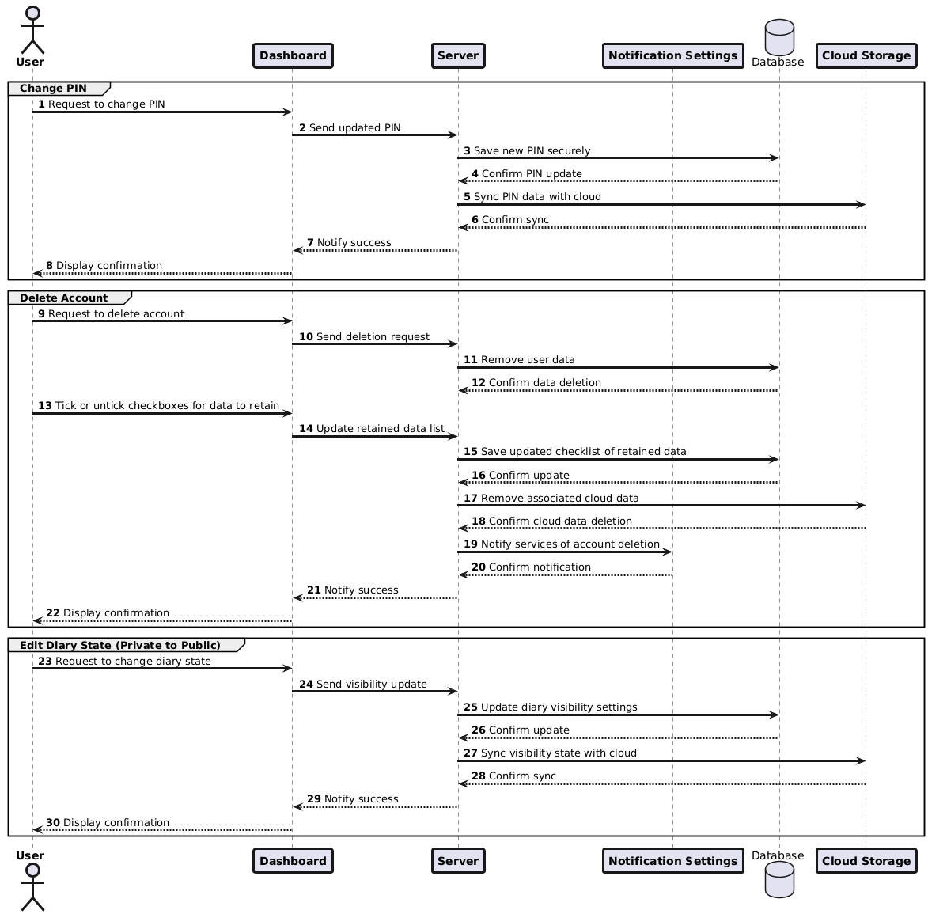

Slide 37
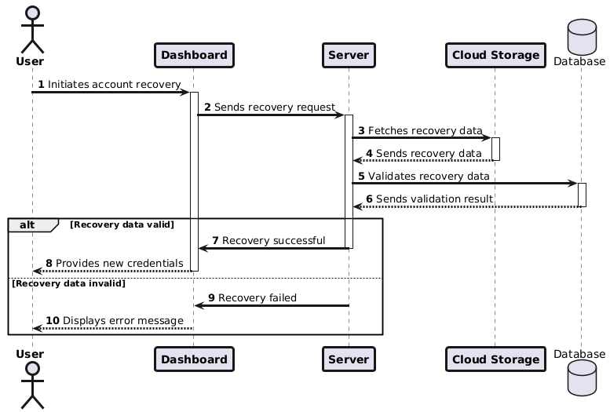

Slide 38
Data Dictionary

Slide 39
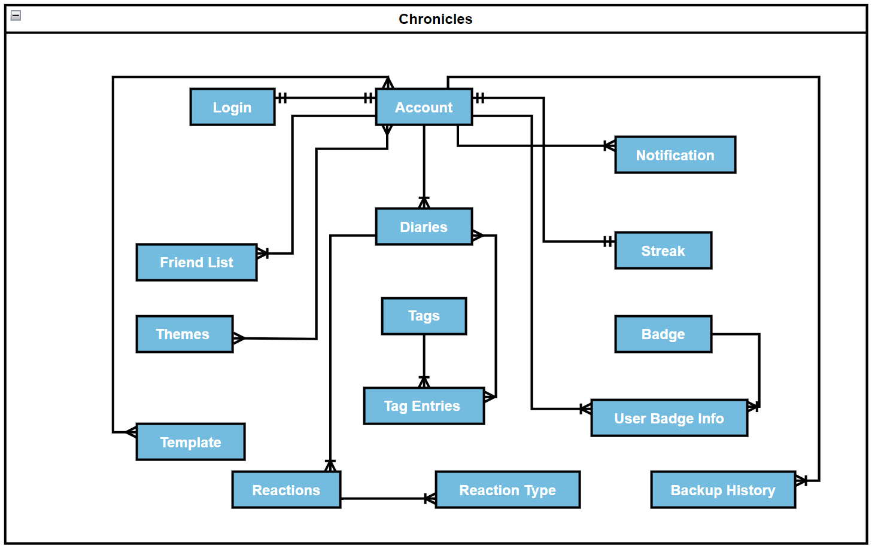

Slide 40
Data Flow Diagram

Slide 41
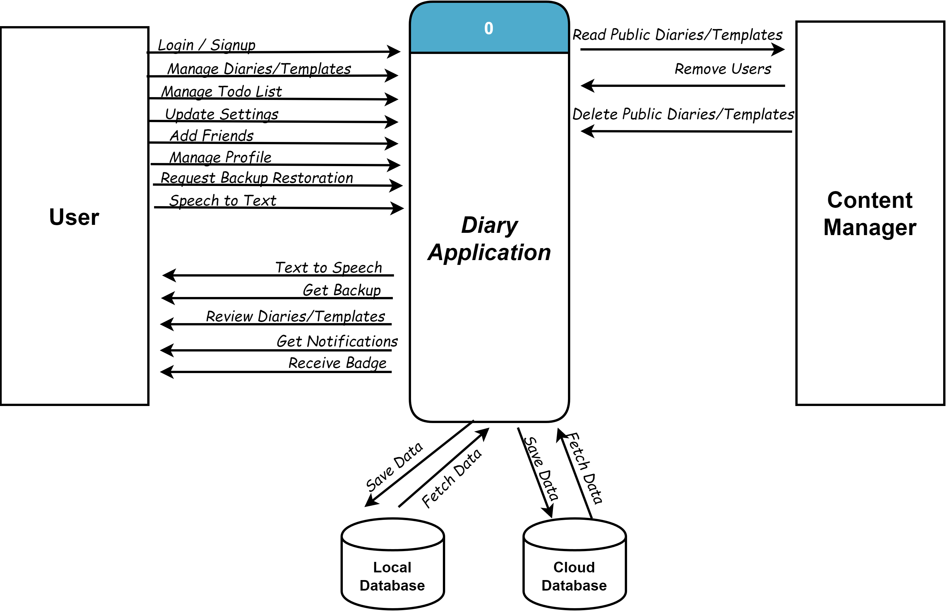
Using Gane and Sarson Notation

Slide 42
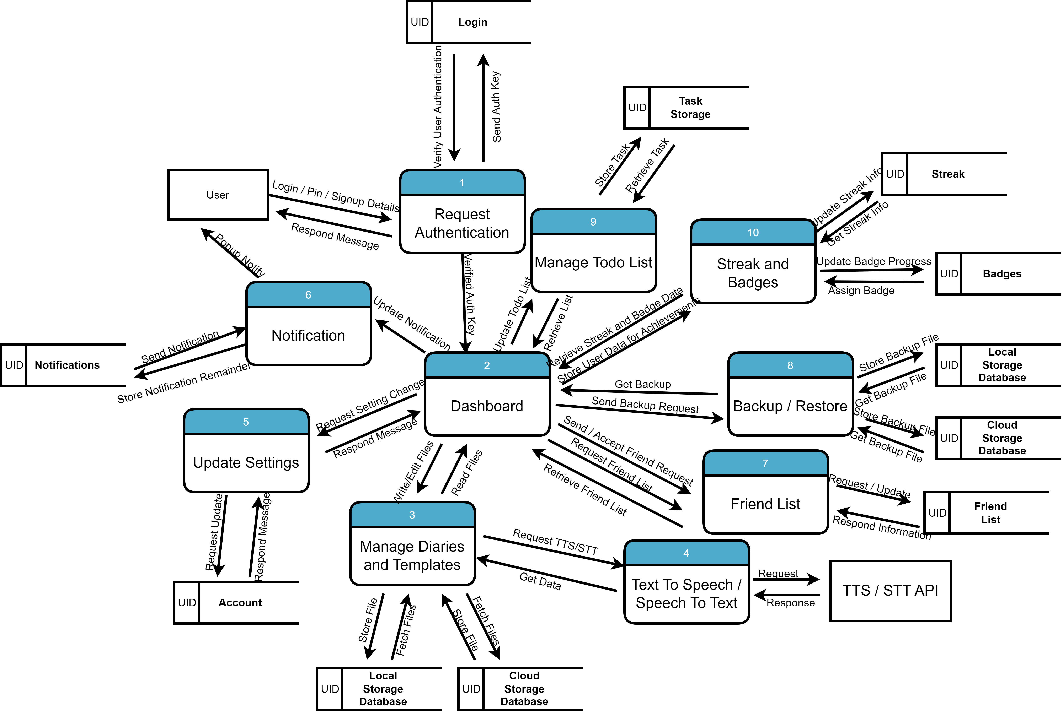
Using Gane and Sarson Notation

Slide 43
Use Case Diagram

Slide 44
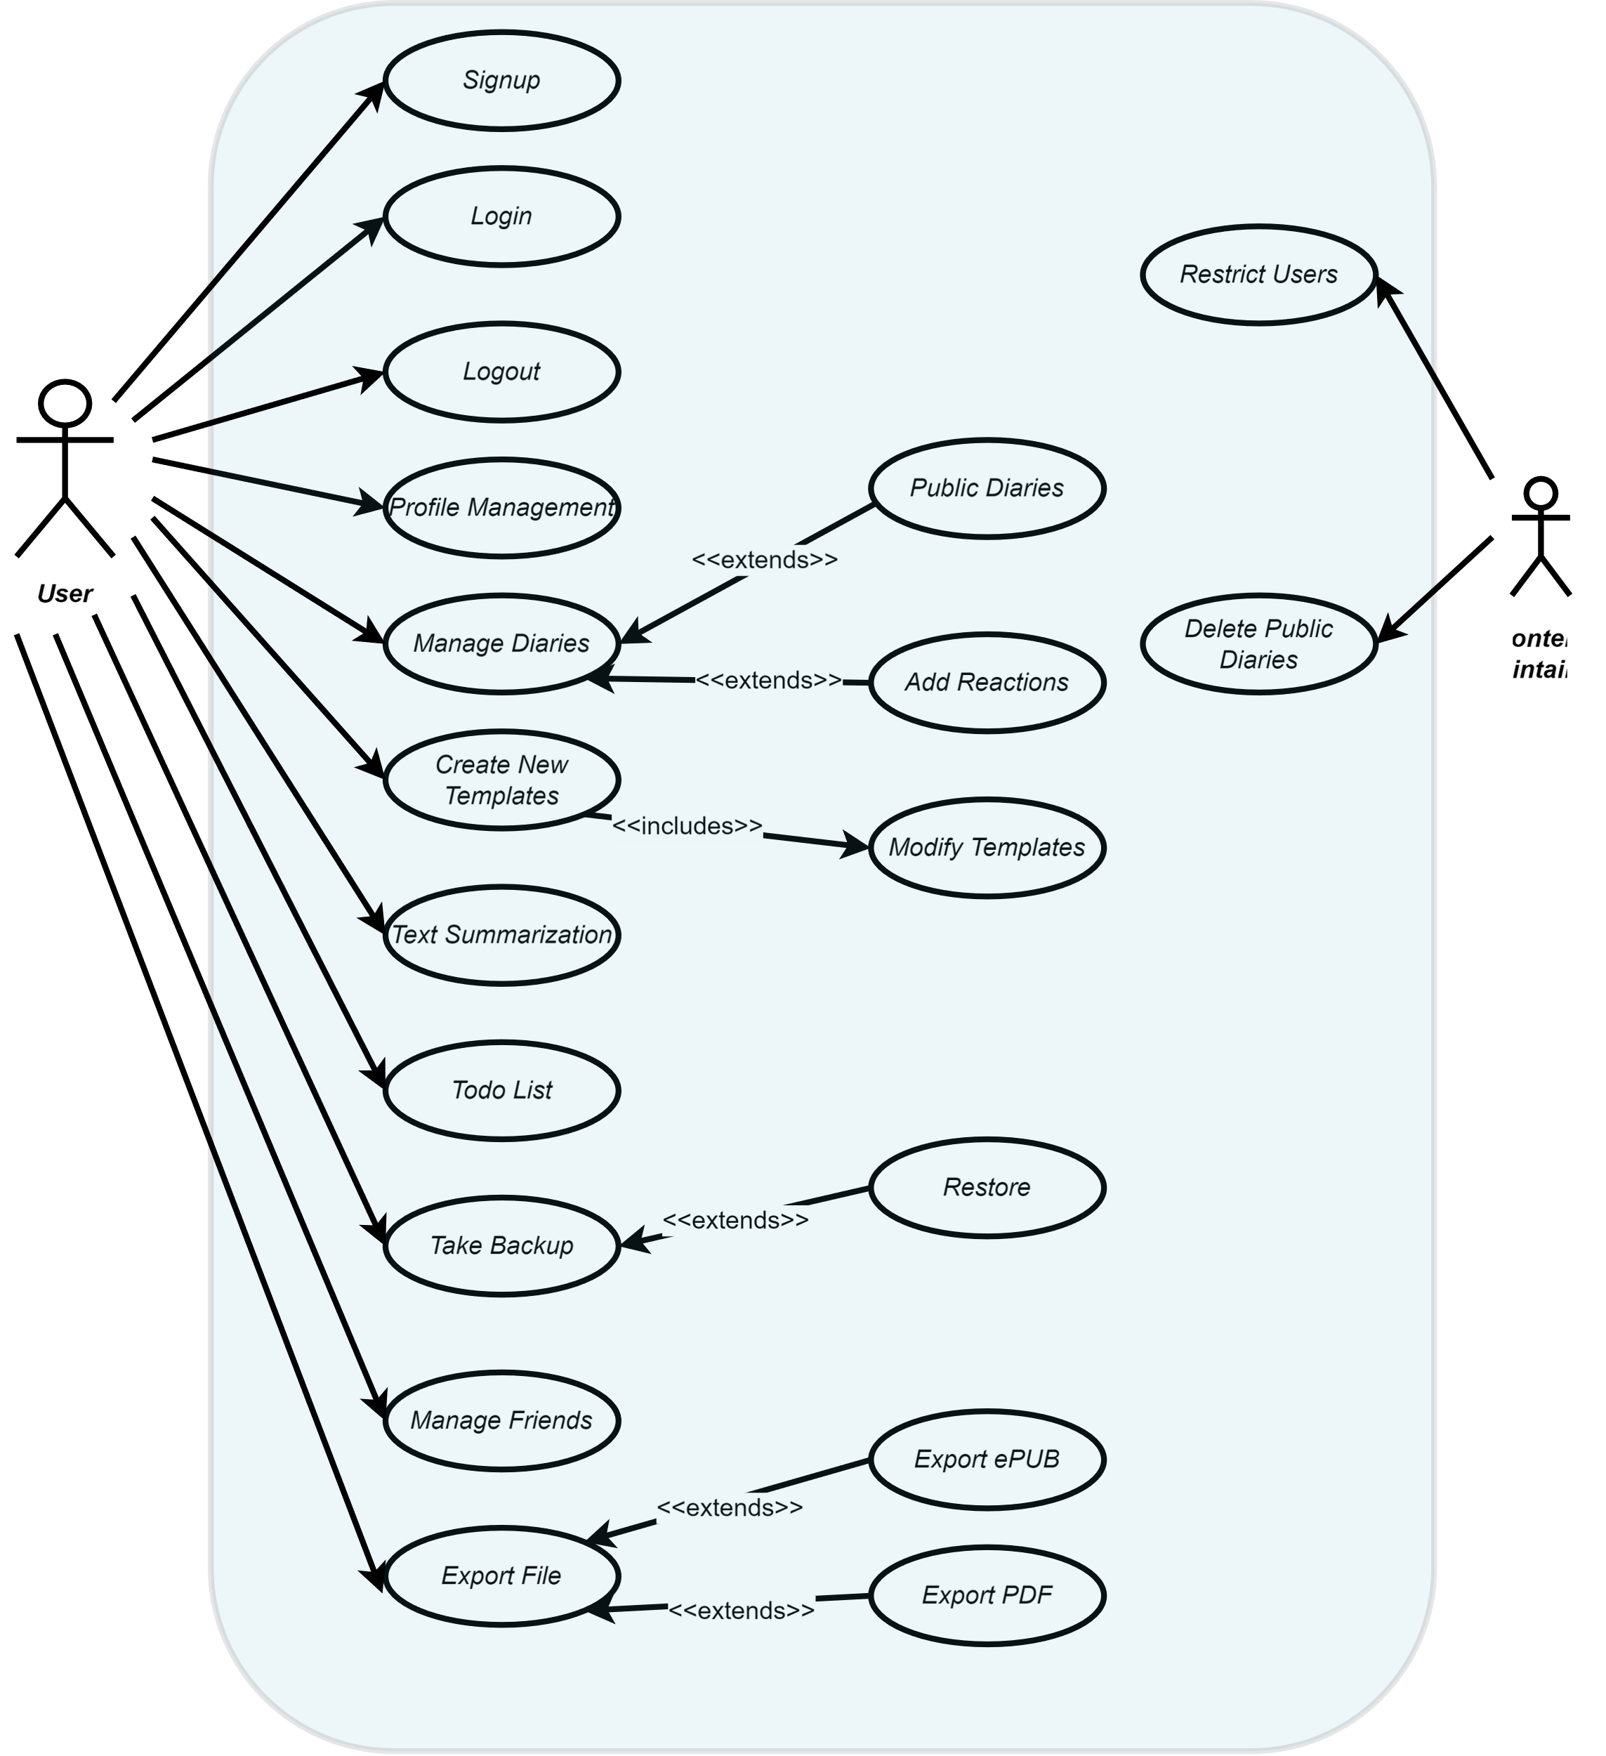

Slide 45
Graphical Design & User Interface

Slide 46
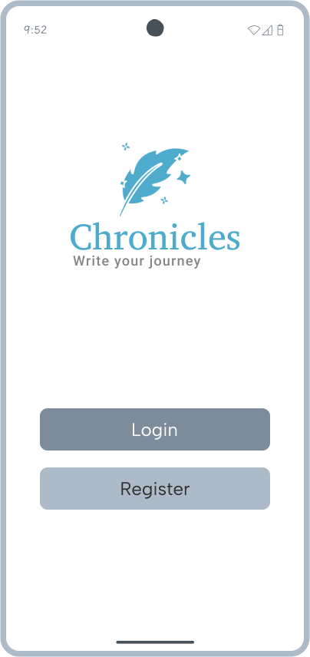
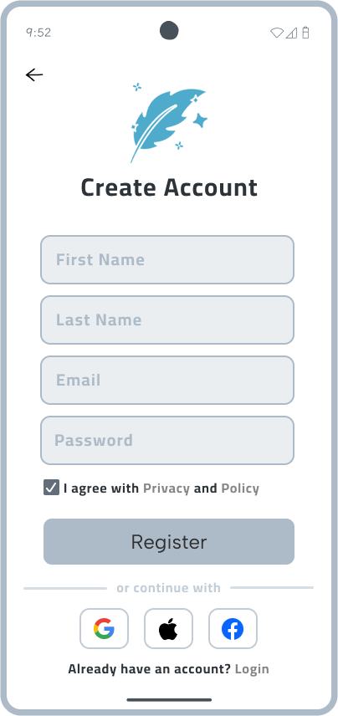
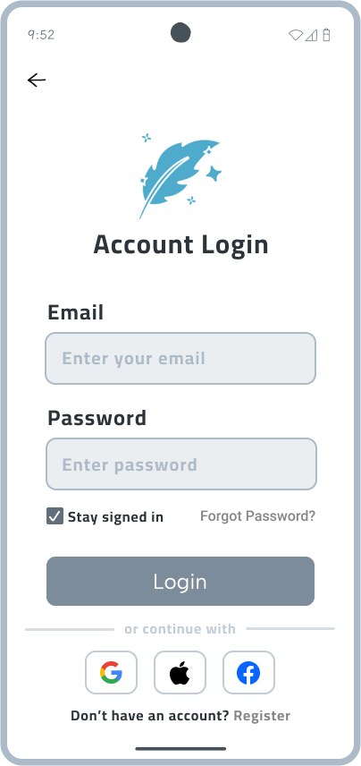

Slide 47
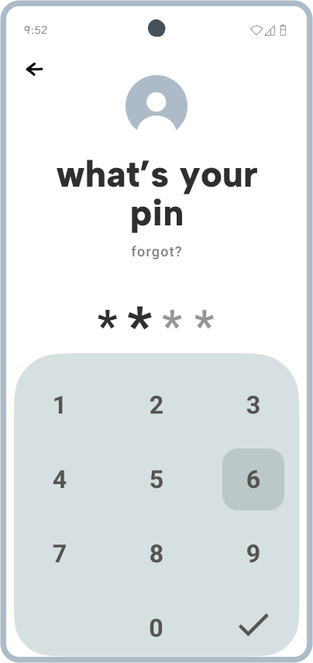
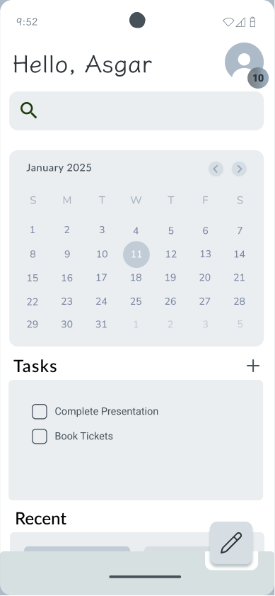
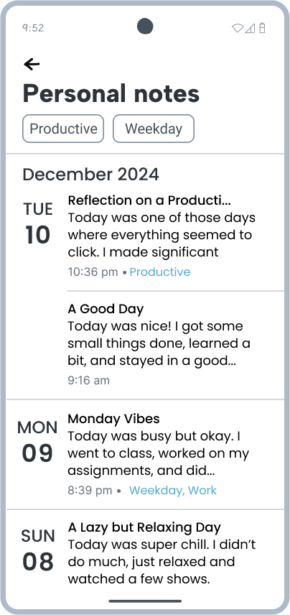

Slide 48

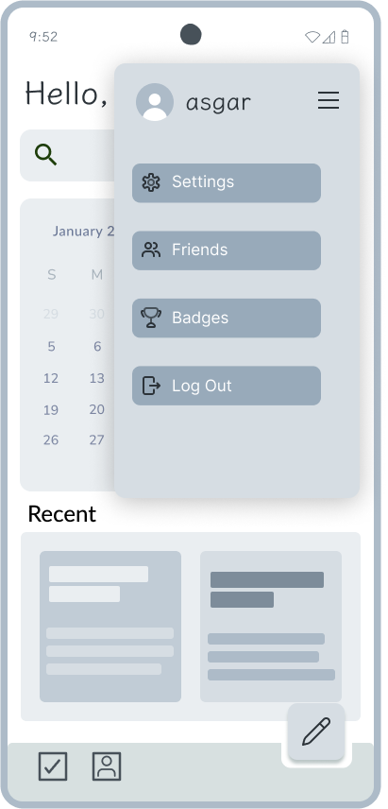
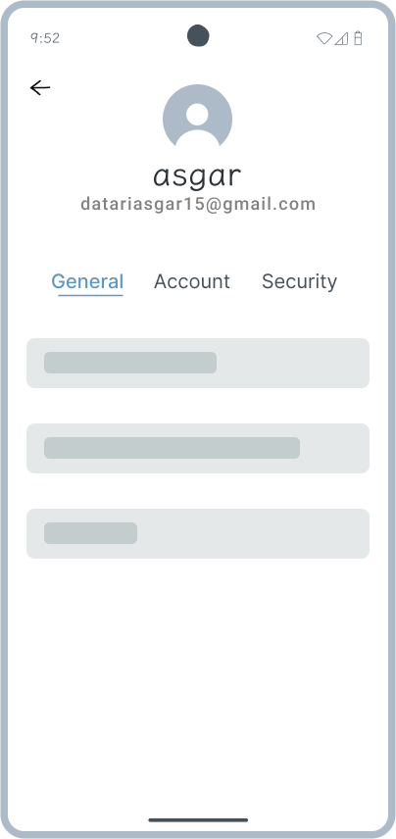

Slide 49
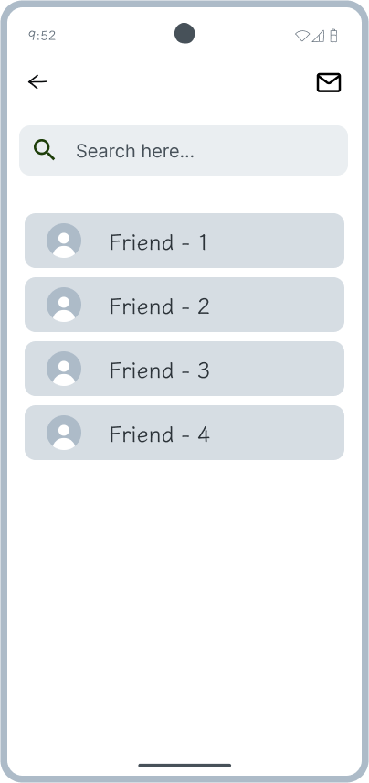
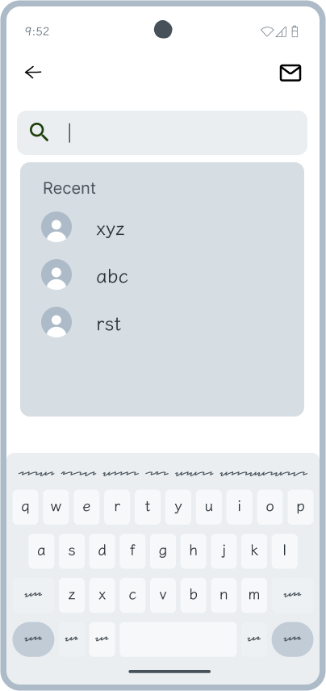
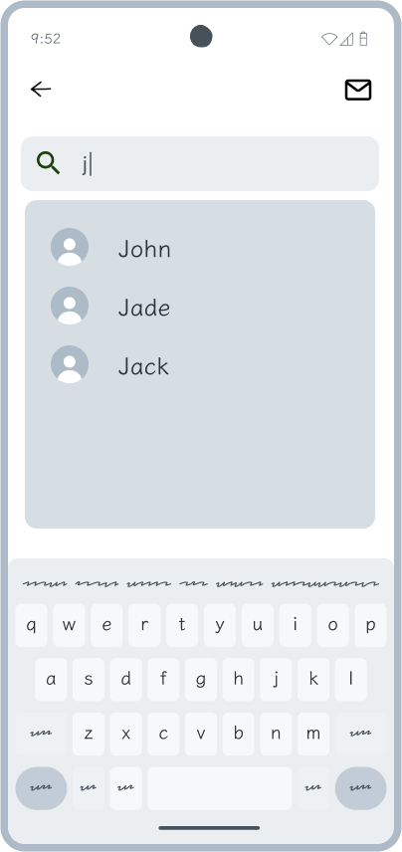
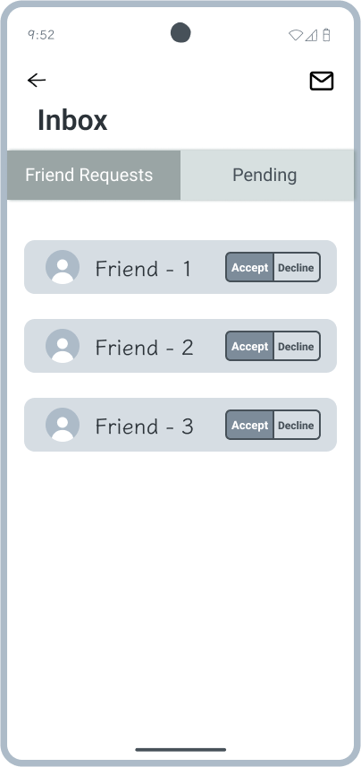

Slide 50
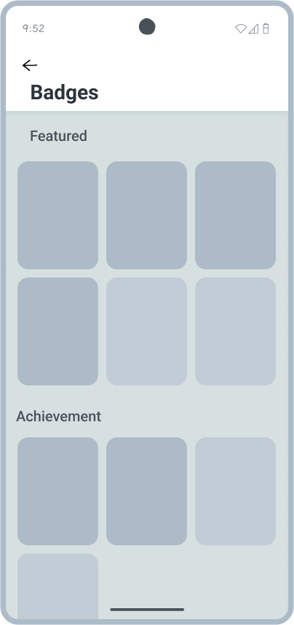
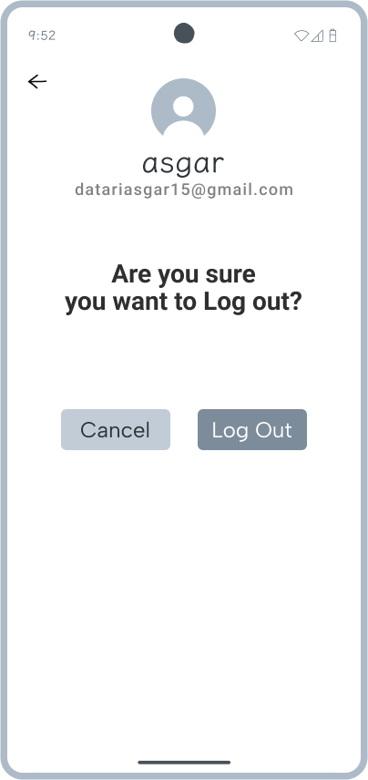

Slide 51
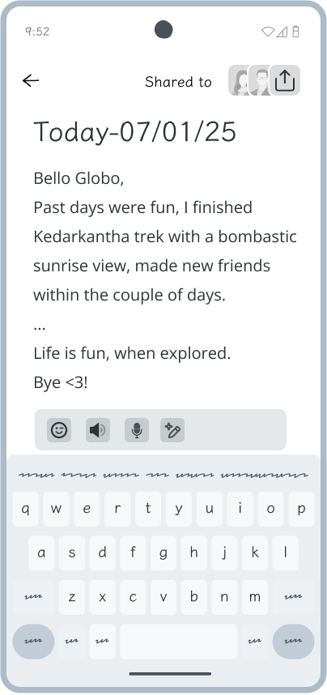
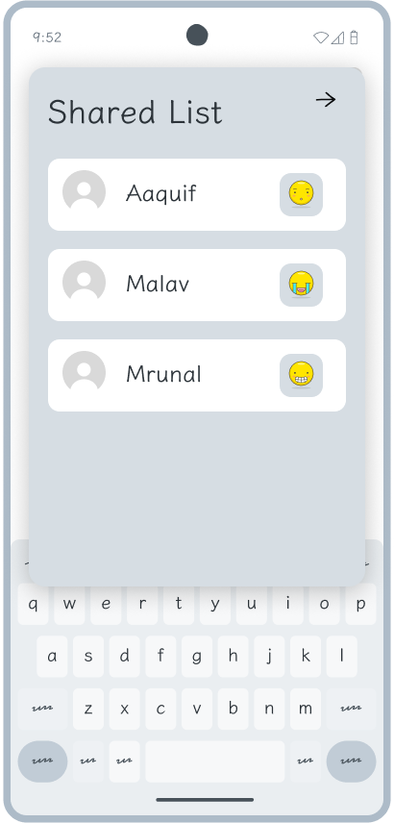
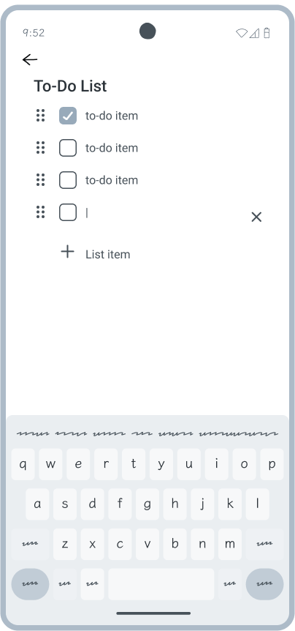

Slide 52
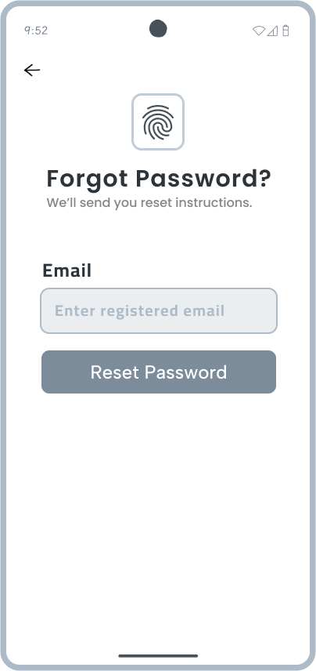
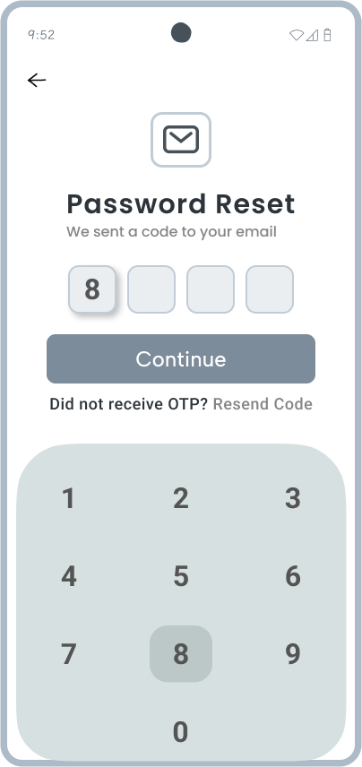
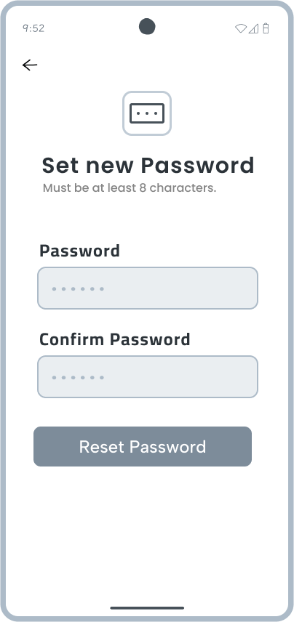

Slide 53
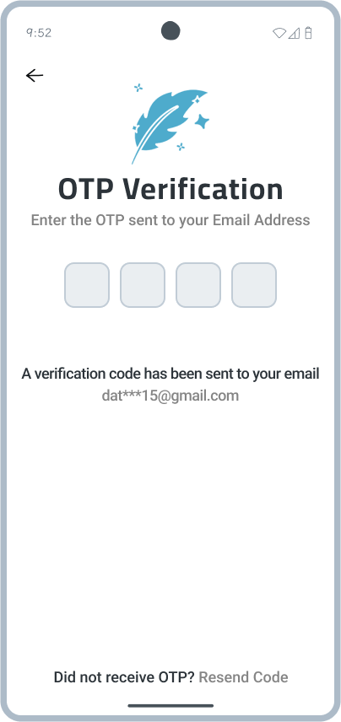
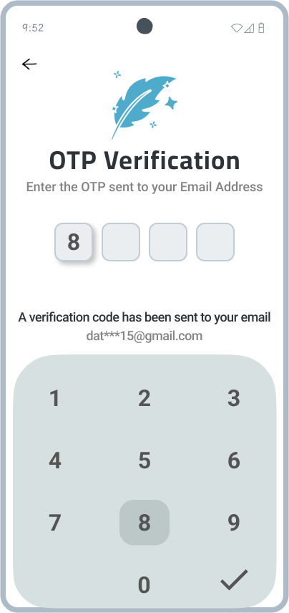
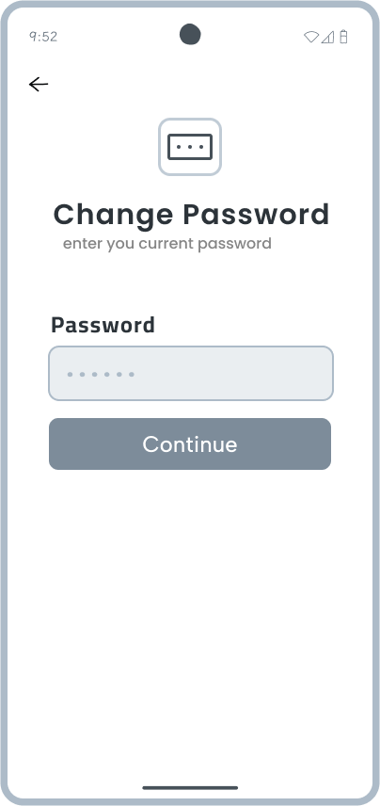

Slide 54
Technology Stack: Tools & Frameworks

Slide 55







Technology Stack
Front end development
Back end development
Database management
AI development
Designing and UML Development
Flutter
Flutter, Dart
SQLite, Firebase
Python
draw.io, Figma
Datari Asgar
Qureshi Aaquif
Shah Mrunal
Shah Malav
Qureshi Aaquif
Shah Mrunal
Shah Mrunal
Datari Asgar
Shah Mrunal
Datari Asgar
Qureshi Aaquif
Shah Malav

Slide 56
projected Timeline!

Slide 57
Timeline/Gantt Chart

Slide 58
Conclusion
free, easy to use diary writing app
Cross-platform app supporting Android, and iOS ( for time being )
Enabled with Artificial Intelligence.
Open Diaries where user can publicly share their view of world from their eyes.

Slide 59
Thank You

Slide 60
Reference
[ Flutter TTS ]
{https://pub.dev/packages/flutter_tts}
[ Flutter STT ]
{https://pub.dev/packages/speech_to_text}
[ Editors ]
{https://www.markdownguide.org/basic-syntax/}
{https://pub.dev/packages/flutter_markdown}
{https://pub.dev/packages/flutter_quill}
{https://pub.dev/packages/appflowy_editor}
[ Text Summarizer ]
{https://pub.dev/packages/flutter_gemini}
{https://pub.dev/packages/dart_openai}
[ Other ]
https://timesofindia.indiatimes.com/readersblog/be-best/the-psychology-behind-keeping-a-diary-how-can-writing-help-you-with-stress-and-anxiety-44669/
https://www.scientificamerican.com/article/extrovert-or-introvert-most-people-are-actually-ambiverts/
https://github.com/nuttyartist/plume-public?tab=readme-ov-file
https://medium.com/spidernitt/how-to-build-a-text-summarizer-from-scratch-1a68e39558c4

Slide 61
Login
Element | Data Type | Key | Auto Increment
userID | Integer(8) | Primary Key, Foreign key
username | varchar(32) | Foreign key
Password | varchar(64)
Pin | varchar(4)
Pin login Enabled | Boolean
Account login available | Boolean
Login attempt count | Integer(1)
Last login attempt | Timestamp

Slide 62
Account
Element | Data Type | Key | Auto Increment
User ID | Integer(8) | Primary Key | Yes
username | varchar(32)
Email | varchar(64)
First Name | varchar(32)
Last Name | varchar(32)
Gender | enum
DOB | datetime
PFP URL | varchar(255)
Date Joined | Timestamp
Theme ID | varchar(4)

Slide 63
Diaries
Element | Data Type | Key | Auto Increment
Diary ID | Integer(8) | Primary Key | Yes
User ID | Integer(8) | Foreign key
Public/Private Status | Boolean
Last Modified | Timestamp
First Created | Timestamp
Content Link | Varchar(255)

Slide 64
Themes
Element | Data Type | Key | Auto Increment
Theme ID | Integer(8) | Primary Key | Yes
Theme Name | varchar(24)
Theme Description | Varchar(64)
Format Link | Varchar(255)

Slide 65
Friend List
Element | Data Type | Key | Auto Increment
Friend Numbers | Integer(4) | Primary Key | Yes
User ID | Integer(8) | Foreign key
Friend User ID | Enum(ids)
Status | Boolean

Slide 66
Notification
Element | Data Type | Key | Auto Increment
Notification ID | Integer(8) | Primary Key | Yes
Notification Type | varchar(24)
Notification Desc | Varchar(255)
Notification Time | Datetime
Notification Date | Datetime
Reminder Frequency | Integer(2)

Slide 67
Streak
Element | Data Type | Key | Auto Increment
Streak ID | Integer(8) | Primary Key | Yes
User ID | Integer(8)
Date Started | Datetime

Slide 68
User Badge Info
Element | Data Type | Key | Auto Increment
Badge ID | Integer(8) | Primary Key | Yes
Badge Number | Integer(8) | Foreign key
User ID | Integer(8) | Foreign key
Date Given | Datetime

Slide 69
Badge
Element | Data Type | Key | Auto Increment
Badge Number | Integer(8) | Primary Key | Yes
Badge Name | Varchar(24)
Badge Type | Varchar(24)
Badge Link | Varchar(255)

Slide 70
Template
Element | Data Type | Key | Auto Increment
Template ID | Integer(8) | Primary Key | Yes
Template Name | Varchar(24)
Template Link | Varchar(255)
User ID | Integer(8) | Foreign key

Slide 71
Backup History
Element | Data Type | Key | Auto Increment
Backup ID | Integer(8) | Primary Key | Yes
User ID | Integer(8) | Foreign key
Backup Date | Timestamp
Backup Location | Varchar(255)
Status | Boolean

Slide 72
Reaction Type
Element | Data Type | Key | Auto Increment
Reaction ID | Integer(8) | Primary Key | Yes
Reaction Name | Varchar(24)
Reaction Description | Varchar(64)

Slide 73
Reactions
Element | Data Type | Key | Auto Increment
Reaction Number | Integer(4) | Primary Key | Yes
Diary ID | Integer(8) | Foreign key
User ID | Integer(8) | Foreign key
Reaction ID | Integer(8) | Foreign key

Slide 74
Tags
Element | Data Type | Key | Auto Increment
Tag ID | Integer(8) | Primary Key | Yes
Tag Name | Varchar(24)
Description | Varchar(64)

Slide 75
Tag Entries
Element | Data Type | Key | Auto Increment
Diary ID | Integer(8) | Foreign key
Tag ID | Integer(8) | Foreign key

