Slide 1
BOOTSTRAP
BOOTSTRAP =
(GRID SYSTEM + CLASSES+ COMPONENTS)
Grid system- gives responsiveness
Classes (img-fluid)
Components – buttons, form, alert, pagination

Slide 2


Create web application responsive
Bootstrap is the most popular HTML, CSS, and JavaScript framework for developing responsive, mobile-first web sites.
Bootstrap is completely free to download and use!

Slide 3
Bootstrap
Bootstrap is a free front-end framework for faster and easier web development.
Bootstrap includes HTML and CSS based design templates for typography, forms, buttons, tables, navigation, modals, image carousels and many other, as well as optional JavaScript plug-in
Bootstrap also gives you the ability to easily create responsive designs.
Responsive web design is about creating web sites which automatically adjust themselves to look good on all devices, from small phones to large desktops.

Slide 4
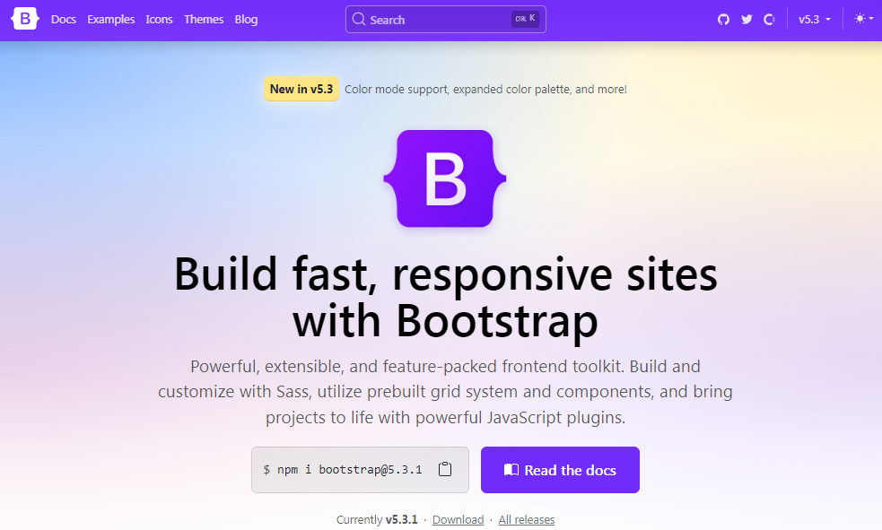
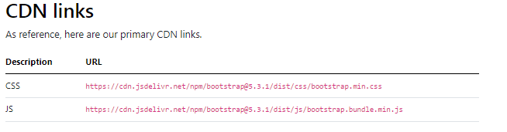
Bootstrap
A basic understanding of HTML is required to start learning Bootstrap. Some familiarity with how CSS works (CSS Selectors and Visual Rules) would be helpful,
Download Bootstrap from getbootstrap.com
There are 2 ways to attach and use bootstrap
Include Bootstrap from a CDN(fast)
Download & attach(slow)

Slide 5
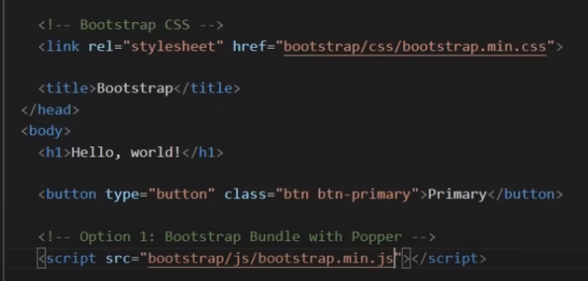
Exercise :
Create simple index page with links to bootstrap library.
use CDN Add button and check the code
downloaded bootstrap code (Use vs code editor) Add button and check the code
Download and Using direct file names js & css

Slide 6
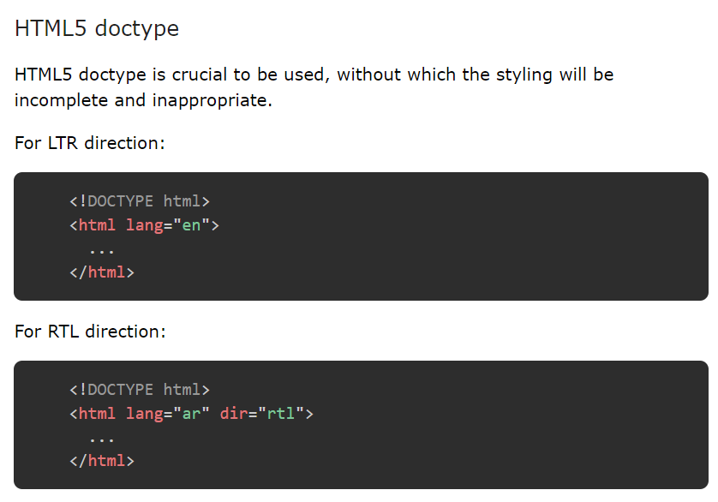
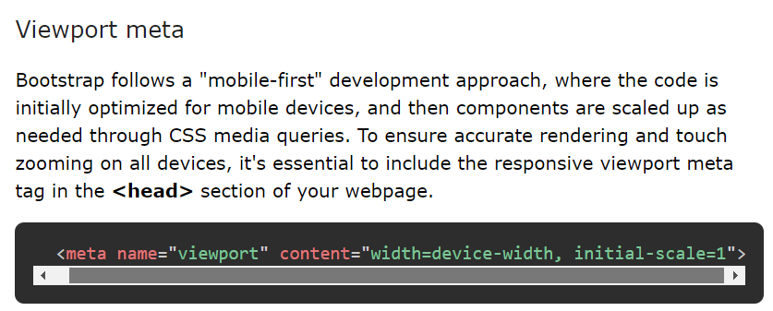

Slide 7
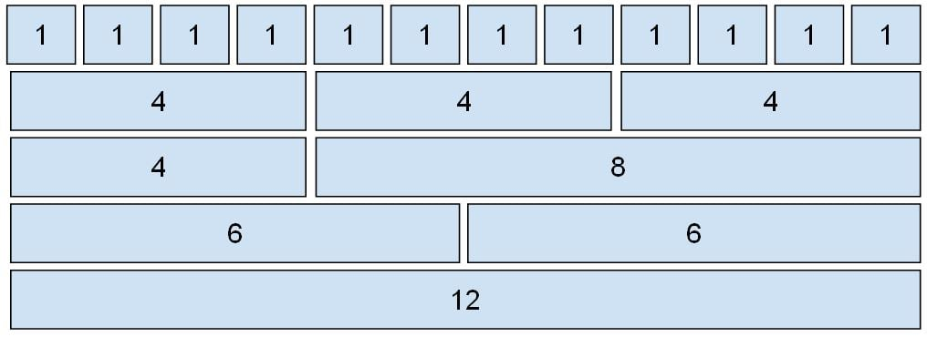
GRID SYSTEM
Grid System allows up to 12 columns across the page. You can use each of them individually or merge them together for wider columns. All combinations of values summing up to 12 can be used.

Slide 8
Grid Classes: Bootstrap grid system contains six classes (break points):
.col- It is used for extra small screen devices (screen width less than 576px).
.col-sm- It is used for small screen devices (screen width greater than or equal to 576px).
.col-md- It is used for medium screen size devices (screen width greater than or equal to 768px).
.col-lg- It is used for large screen size devices (screen width greater than or equal to 992px).
.col-xl- It is used for xlarge screen size devices (screen width equal to or greater than 1200px).
.col-xxl- It is used for xxlarge screen size devices (screen width equal to or greater than 1400px).

Slide 9
Components of Grid System:
Containers: Bootstrap requires a containing element to wrap site contents in a grid system. The word container is used to contain the row elements and row elements containing the column elements.
Rows: Rows must be placed within the container or container-fluid for proper alignment and padding. Rows are used to create horizontal groups of columns.
Columns: Grid columns are created by specifying the number of twelve available columns you wish to span. For example, three equal columns would use three col-lg-4.

Slide 10
Basic Grid Example
We define a .container to wrap our grid.
Inside the container, we create a .row that holds three columns.
Each .col represents a single column. By default, they will each take up 1/3 of the width because the grid is divided into 12 parts.
<div class="container">
<div class="row">
<div class="col">Column 1</div>
<div class="col">Column 2</div>
<div class="col">Column 3</div>
</div>
</div>

Slide 11
Example 1: This example uses bootstrap to create an equal width column grid on all devices and screen widths.

Slide 12
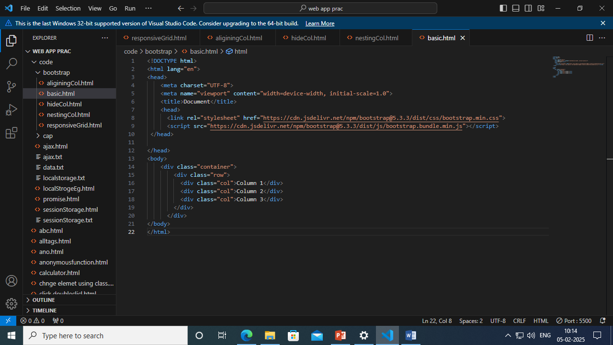

Slide 13
Column Sizing
You can specify the number of columns an element should span. For example, if you want a column to take up half of the width, you use .col-6 (since 6 out of 12 columns is half).
Column Width Example:
<div class="container">
<div class="row">
<div class="col-6">50% width</div>
<div class="col-6">50% width</div>
</div>
</div>
This will create two columns, each taking up 50% of the container width.

Slide 14
Responsive Columns (Breakpoints)
Bootstrap is mobile-first, meaning it designs for small screens first and works its way up. The grid system allows you to define different column sizes at various breakpoints.
You can create responsive layouts by specifying column widths for each breakpoint. For example, you can make columns stack on small screens but align side-by-side on larger screens.

Slide 15
Responsive Column Example:
<div class="container">
<div class="row">
<div class="col-12 col-md-6 col-lg-4">Column 1</div>
<div class="col-12 col-md-6 col-lg-4">Column 2</div>
<div class="col-12 col-md-6 col-lg-4">Column 3</div>
</div>
</div>
On small screens (less than 576px), each column takes up the full width (col-12).
On medium screens (≥768px), each column takes up 50% of the width (col-md-6).
On large screens (≥992px), each column takes up 33.33% of the width (col-lg-4).

Slide 16
Example 2: You can create responsive layouts by specifying column widths for each breakpoint. For example, you can make columns stack on small screens but align side-by-side on larger screens.

Slide 17
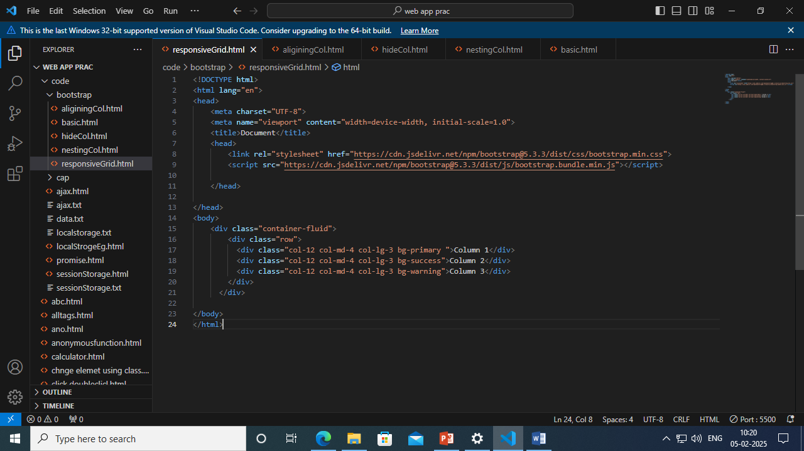

Slide 18
Nesting Columns -You use .row and .col-* classes inside another .row.
<div class="container">
<div class="row">
<div class="col-md-8">
<div class="row">
<div class="col-6">Nested Column 1</div>
<div class="col-6">Nested Column 2</div>
</div>
</div>
<div class="col-md-4">Main Column 2</div>
</div>
</div>
In this example, we have a main layout with two columns (col-md-8 and col-md-4). Inside the first column, we nest another row with two columns.

Slide 19
Hiding Columns
Bootstrap also allows you to hide columns on specific screen sizes using the .d-none, .d-sm-block, .d-md-none, etc., classes.
Hide Column on Small Screens Example:
<div class="container">
<div class="row">
<div class="col-12 col-sm-6 d-none d-sm-block">
This column is hidden on smallest screens</div>
<div class="col-12 col-sm-6">
This column is visible on all screens
</div>
</div>
</div>
.d-none: Hides the element on all screen sizes.
.d-sm-none: Hides the element on small screens (≥576px) and larger.
.d-md-none: Hides the element on medium screens (≥768px) and larger.
.d-lg-none: Hides the element on large screens (≥992px) and larger.
.d-xl-none: Hides the element on extra-large screens (≥1200px) and larger.

Slide 20
Example :create a responsive page to hide columns on different size of screen :
col 1- This column is hidden on extra small and small screens, visible on medium and larger screens.
col 2- This column is hidden on extra small, small, and medium screens, visible on large and extra-large screens.
col 3- This column is visible on all screen sizes.

Slide 21
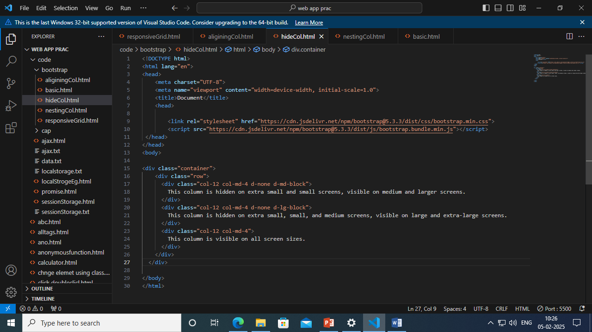

Slide 22
Grid system Summary
.row creates a row that holds columns.
.col-* defines column widths.
Breakpoints help you adjust the layout based on screen size.
Nesting columns creates more complex structures.
Column alignment allows you to center and align content easily.

Slide 23
Containers in Bootstrap with examples
In bootstrap, the container is used to set the content’s margin. It contains row elements and the row elements are containers of columns. This is known as the grid system. There are two container classes in bootstrap:
container – A fixed-width container with responsive padding.
container-fluid – A full-width container that spans the entire width of the viewport.

Slide 24
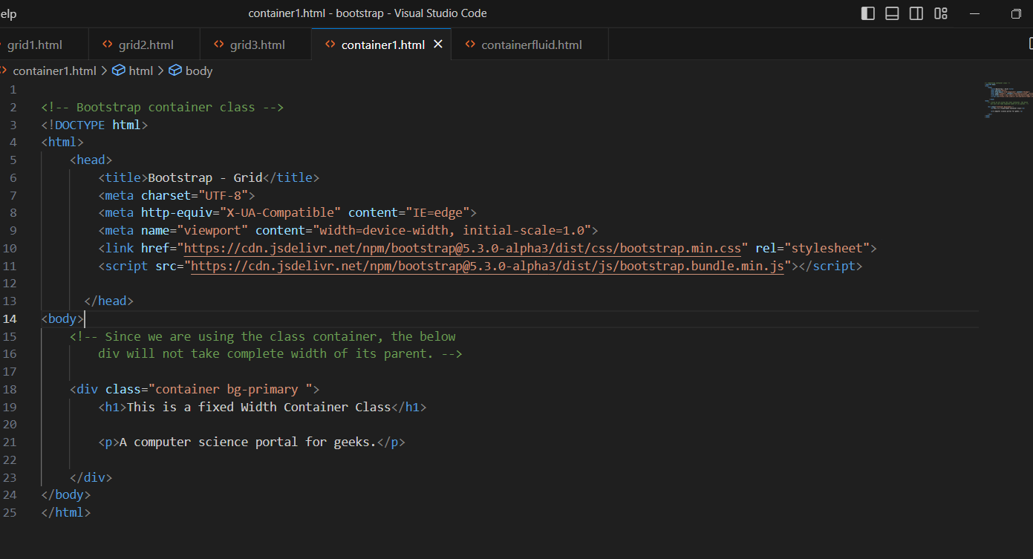
Example of a container div

Slide 25
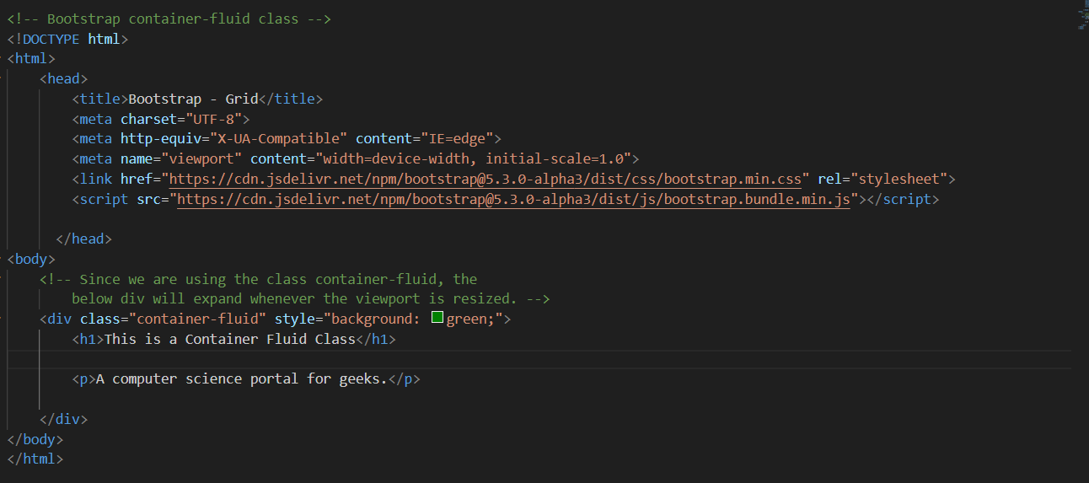
Example of a Container-fluid div

Slide 26
Navigation Bar
A navigation bar is used in every website to make it more user-friendly so that the navigation through the website becomes easy and the user can directly search for the topic of their interest. The navigation bar is placed at the top of the page.
Include popper.min.js for :
Dropdowns (the menu that opens on clicking a button or link)
Tooltips (small informational popups that appear when you hover over elements)
Popovers (similar to tooltips but more customizable)
Modals (for positioning content on the screen)
<script src="https://cdn.jsdelivr.net/npm/@popperjs/core@2.11.6/dist/umd/popper.min.js"></script>

Slide 27
Basic Navigation Bar
navbar navbar-expand-lg navbar-light bg-light: This creates a light-colored navigation bar.
The navbar-expand-lg class makes it responsive, so it will collapse into a hamburger menu on smaller screens.
navbar-brand: This is your brand/logo link.
navbar-toggler: This button will appear on smaller screens to toggle the collapsible menu (the hamburger icon).
navbar-collapse: This is the collapsible part of the navbar that includes the navigation links.
nav-item: This class is applied to each list item inside the navigation bar.
nav-link: This is applied to each anchor tag (<a>) to style the links.

Slide 28
Design a Example to show a simple Navbar
Design a Example to show a vertical navbar
Design a Example to show a dropdown navbar

Slide 29
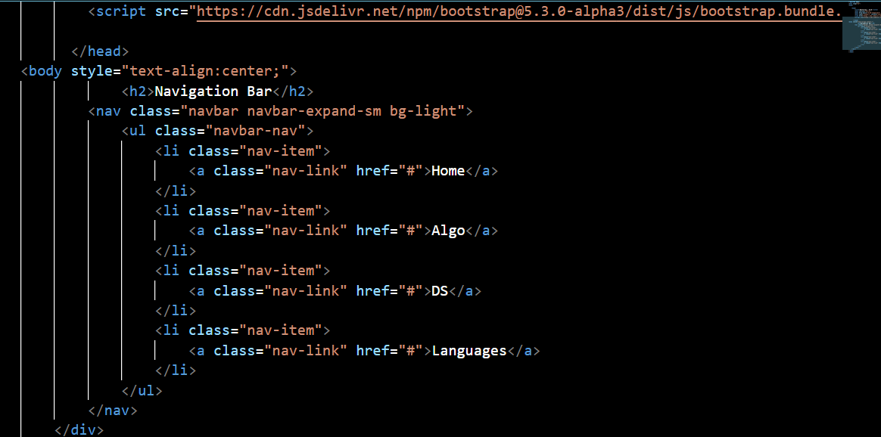

Slide 30
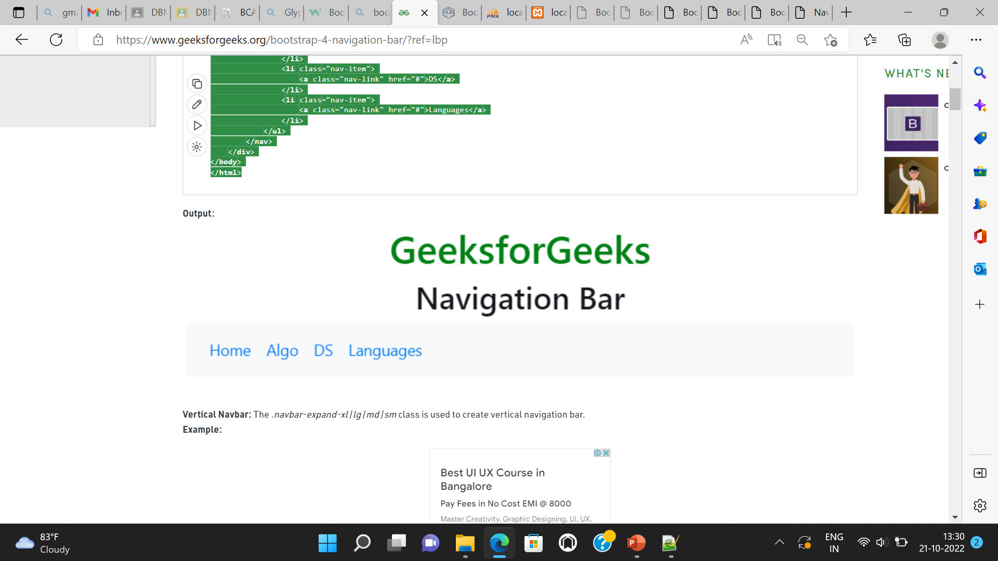

Slide 31
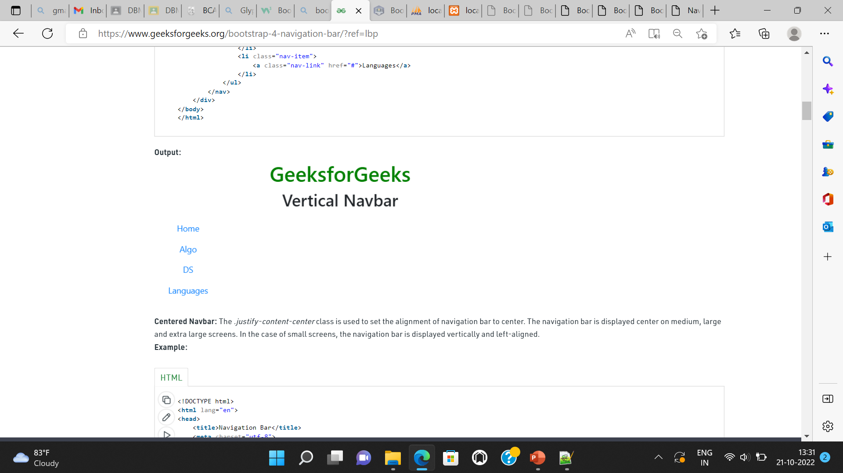
Vertical Navbar

Slide 32
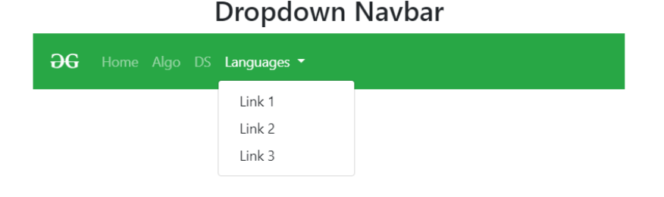
Dropdown Navbar: The navbar can be created by using dropdown menu.

Slide 33
Carousel
The Bootstrap Carousel is used to create an image slide show for the webpage to make it look more attractive. It can be included in the webpage using bootstrap.js or bootstrap.min.js. Carousels are not supported properly in Internet Explorer, this is because they use CSS3 transitions and animations to achieve the slide effect.

Slide 34
Basics of Carousel
carousel container: A wrapper for the carousel.
carousel slide: The class carousel slide is used to indicate this is a carousel component. The data-bs-ride="carousel" attribute automatically starts the carousel on page load.
carousel-inner: This is the container that holds all carousel items.
carousel-item: These are the individual slides. The first slide has the class active, which makes it visible by default.
carousel-control-prev and carousel-control-next: These buttons allow users to navigate to the previous and next items in the carousel.
Images in the carousel: You can add any image URL to the <img> tag inside each .carousel-item. I've used placeholder images in this example.

Slide 35
Example :
Design a page to Show a carousel example with auto play option and image 2 as default view and with caption

Slide 36
Glyphicons (in older version)
Bootstrap provides set of graphic icons, symbols and fonts called Glyphicons. Some Glyphicons like Home icon, User icon, Lock icon, etc. Generally, Glyphicons are icon fonts which you can use in your web projects. Bootstrap includes 260 glyphicons. Glyphicons Halflings are not available for free of cost, but their creator has made them available for Bootstrap free of cost.

Slide 37
Tables
Bootstrap provides a series of classes that can be used to apply various styling to the tables such as changing the heading appearance, making the rows stripped, adding or removing borders, making rows hoverable, etc. Bootstrap also provides classes for making tables responsive.
Simple Table: The .table class is used to create a simple Bootstrap table. This class name is used with the <table> tag to create a table.
table class="table"> Table Contents... <table>

Slide 38
Basics of table
table: This class is used to create a basic styled table.
thead: Defines the header section of the table.
tbody: Defines the body section of the table, where the actual data goes.
th: Defines header cells, which are usually bold by default.
scope="col": Defines the scope for a column header. Helps screen readers interpret the table structure.
table-sm: This class makes the table more compact, reducing padding and making the table cells smaller.

Slide 39
Table in bootstrap
Striped Rows
Adding the table-striped class will alternate the background color of rows to make the table more visually readable.
Bordered Table
You can add borders to the table using the table-bordered class.
Hoverable Rows :
To make rows highlight when you hover over them, use the table-hover class
Coloured table :
Bootstrap provides a number of contextual classes that can be used to color the entire row or a single cell of a table.

Slide 40
Create a web page to show stripped, hover able, colored and bordered table

Slide 41
Images
Bootstrap offers different classes for images to make their appearance better and also to make them responsive. Making an image responsive means it should scale according to its parent element. That is, the size of the image should not overflow its parent element and will grow and shrink according to the change in the size of its parent without losing its aspect ratio.

Slide 42
The different classes available in Bootstrap for images are as explained below:
1. Responsive Images: The .img-fluid class is used within the <img> tag to create the responsive image. The responsive image is used to adjust the image automatically to the specified box.
<img src="image_source" class="img-fluid" ...>
2. Rounded Corners Image: The .rounded class is used to create a rounded corner image. This class is used with <img> tag.
img src="image_source" class="rounded“
3. Circle Image: The .rounded-circle class is used to create the circle shape image
img src="image_source" class="rounded-circle“
4. Thumbnail Image: The .img-thumbnail class is used to create a thumbnail (bordered) image.
<img src="image_source" class="img-thumbnail" ...>

Slide 43
Forms
Creating forms in Bootstrap is straightforward and can be customized with various components for a clean and responsive design. Bootstrap offers form controls, layouts, validation, and custom styling to make forms both functional and visually appealing.

Slide 44
Basics of Form
container: The container class is used to center the form and add margins.
form-control: This class is applied to form inputs (text, email, password) to give them a consistent style with padding and borders.
mb-3: This is a margin class (mb-3 adds margin to the bottom of the form groups) that creates spacing between form elements.
form-label: A class for labels, making them consistent with Bootstrap's styling.
btn: This is the class for buttons in Bootstrap. It is used with the btn-primary class to apply Bootstrap's default button style.

Slide 45
Design a form with name, email, password, and a submit button.

Slide 46
Typography in Bootstrap
Font Size :
Use text size classes like fs-1, fs-2, etc., to adjust the font size.
<h1 class="fs-1">Heading 1 (Largest)</h1>
<h2 class="fs-2">Heading 2</h2>
<h3 class="fs-3">Heading 3</h3>
<h4 class="fs-4">Heading 4</h4>
<h5 class="fs-5">Heading 5</h5>
<h6 class="fs-6">Heading 6 (Smallest)</h6>

Slide 47
Typography in Bootstrap
Text Alignment
<p class="text-start">This text is left-aligned.</p>
<p class="text-center">This text is centered.</p>
<p class="text-end">This text is right-aligned.</p>
Font Weight
<p class="fw-bold">This text is bold.</p>
<p class="fw-light">This text is light weight.</p>
<p class="fw-normal">This text is normal weight.</p>

Slide 48
Typography in Bootstrap
Text Transform
<p class="text-uppercase">This text is uppercase.</p>
<p class="text-lowercase">This text is lowercase.</p>
<p class="text-capitalize">This text has capitalized first letters.</p>
Line Height
<p class="lh-1">This paragraph has a small line height.</p>
<p class="lh-sm">This paragraph has a small line height (small). </p>
<p class="lh-lg">This paragraph has a larger line height.</p>

Slide 49
Typography in Bootstrap
Line Height
<p class="lh-1">This paragraph has a small line height.</p>
<p class="lh-sm">This paragraph has a small line height (small). </p>
<p class="lh-lg">This paragraph has a larger line height.</p>
lh-1: Reduces the line height.
lh-sm: Sets the line height to a smaller value.
lh-lg: Sets the line height to a larger value.

Slide 50
Bootstrap text colors
<p class="text-primary">This text is blue (primary color).</p>
<p class="text-secondary">This text is gray (secondary color).</p>
<p class="text-success">This text is green (success color).</p>
<p class="text-danger">This text is red (danger color).</p>
<p class="text-warning">This text is yellow (warning color).</p>
<p class="text-info">This text is light blue (info color).</p>
<p class="text-light bg-dark">This text is light, with dark background.</p>
<p class="text-dark">This text is dark (default color).</p>
<p class="text-muted">This text is muted (lighter color).</p>
<p class="text-white bg-dark">This text is white on a dark background.</p>

Slide 51
Background Colors – Background
Available Classes for Background Colors:
bg-primary: Applies the primary background color.
bg-secondary: Applies the secondary background color.
bg-success: Applies the success background color.
bg-danger: Applies the danger background color.
bg-warning: Applies the warning background color.
bg-info: Applies the info background color.
bg-light: Applies the light background color (usually white or light gray).
bg-dark: Applies the dark background color (usually black or dark gray).
bg-white: Applies a white background.
bg-transparent: Makes the background transparent.

Slide 52
Border Colors
border-primary: Adds a blue (primary) border.
border-secondary: Adds a gray (secondary) border.
border-success: Adds a green (success) border.
border-danger: Adds a red (danger) border.
border-warning: Adds a yellow (warning) border.
border-info: Adds a light blue (info) border.
border-light: Adds a light gray border.
border-dark: Adds a dark border.
border-white: Adds a white border.
border-transparent: Adds a transparent border.

Slide 53
text-opacity
To change that opacity, override --bs-text-opacity via custom styles or inline styles.
<div class="text-primary">This is default primary text</div>
<div class="text-primary text-opacity-75">This is 75% opacity primary text</div>
<div class="text-primary text-opacity-50">This is 50% opacity primary text</div>
<div class="text-primary text-opacity-25">This is 25% opacity primary text</div>

Slide 54
create a page to show font size , text transform, font weight ,text align, line height, colors, text opacity

