Slide 1
Front End Engineering-I Project
Team Details:
Aaradhya Srivastava (Leader)
Vinay Prakash Singh
Faculty Coordinator:
Ratan Lal Gupta
Chitkara University Institute of Engineering and Technology,
Chitkara University, Punjab

Slide 2
Table of Contents
Introduction
Problem Statement
Technical Details
Key Features
Project Highlights
Bonus Feature
Conclusion
References/Links used

Slide 3
Introduction
Expense Tracker: Simplifying Personal Finance
Team members:
Aaradhya Srivastava (2410993246)
Vinay Prakash Singh (2410993326)
Overview:
This project is a web-based application designed to help users track their income and expenses. By inputting financial data and categorizing it as income or expenses, users can easily monitor their personal budget

Slide 4
Problem Statement
Many people struggle to keep track of their daily expenses, leading to overspending and poor financial planning. Our expense tracker aims to solve this by providing a simple, user-friendly interface that categorizes and sums up expenses and income, giving users clear visibility over their finances.
With the increasing importance of financial literacy, a personal expense tracker can be an essential tool for budgeting and avoiding financial pitfalls.

Slide 5
Technical Details
Technologies used:
HTML for structuring the webpage.
CSS for styling and making the interface visually appealing.
JavaScript for functionality, sign-in and sign-up, and for user input handling, income/expense categorization, and total calculations.
Methods: Basic DOM manipulation, event handling, and conditional logic were implemented to differentiate between income and expenses based on the symbols "+" and "-".
We have also integrated Bootstrap and animations from animate.css in our project.

Slide 6
Technical Details
We have added JavaScript in our Sign-In and Sign-Up pages as well.
Now, a user can register themselves, one per email.
If they try to register again with the same email, we can inform them about it.
We have used local storage to store the users’ information, and it will confirm the credentials when they try to sign in as well.

Slide 7
Key Features
Simple Input Mechanism: Users can input amounts with a "+" sign for income and a "-" sign for expenses.
Dynamic Total Calculation: The app instantly updates the total balance as users add new income or expenses.
Clear Categorization: Separate display of total income and expenses for better visibility.
User-Friendly Design: The interface is designed for ease of use, even for people with minimal technical skills.
Sign-In and Sign-Up: We have created optional sign-in and sign-up pages to provide extra security to the users’ data.

Slide 8
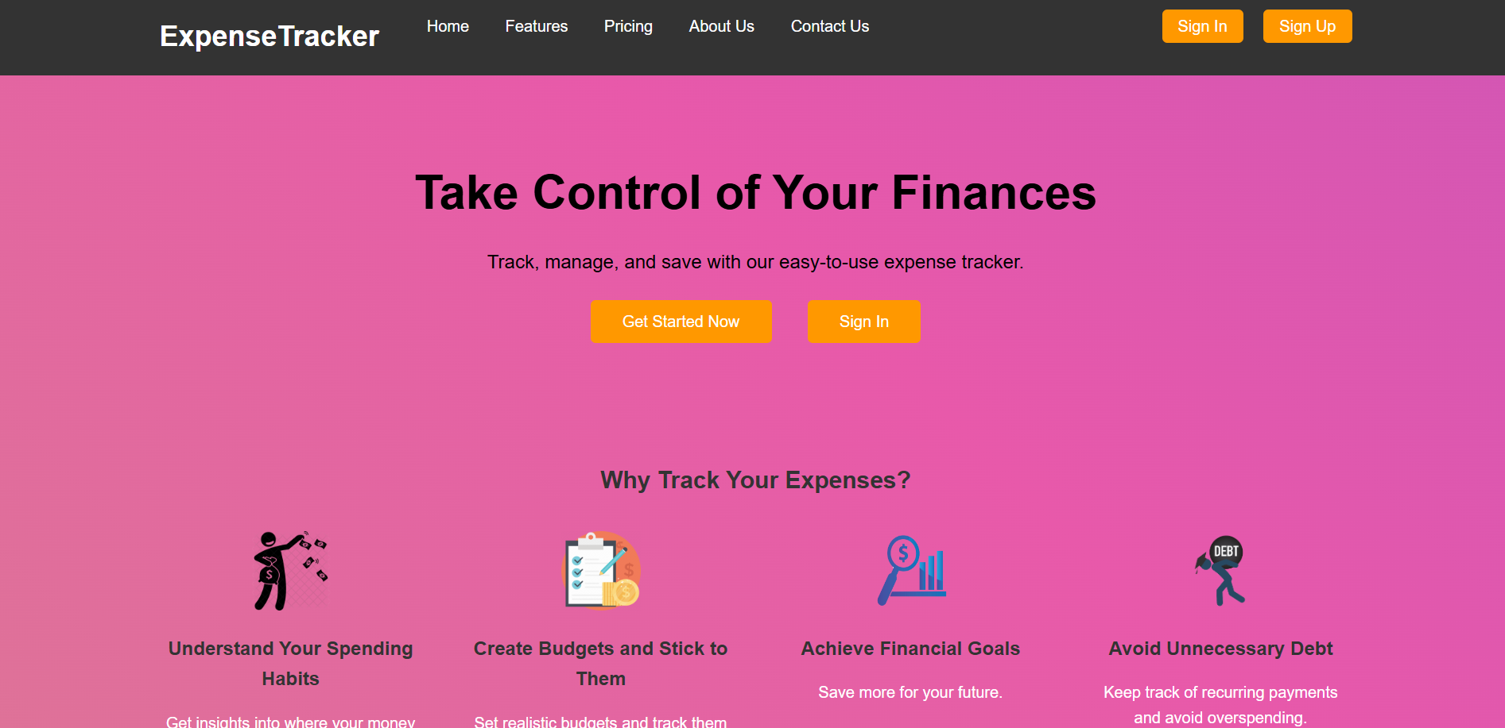
Project Highlights
This is our landing page.

Slide 9
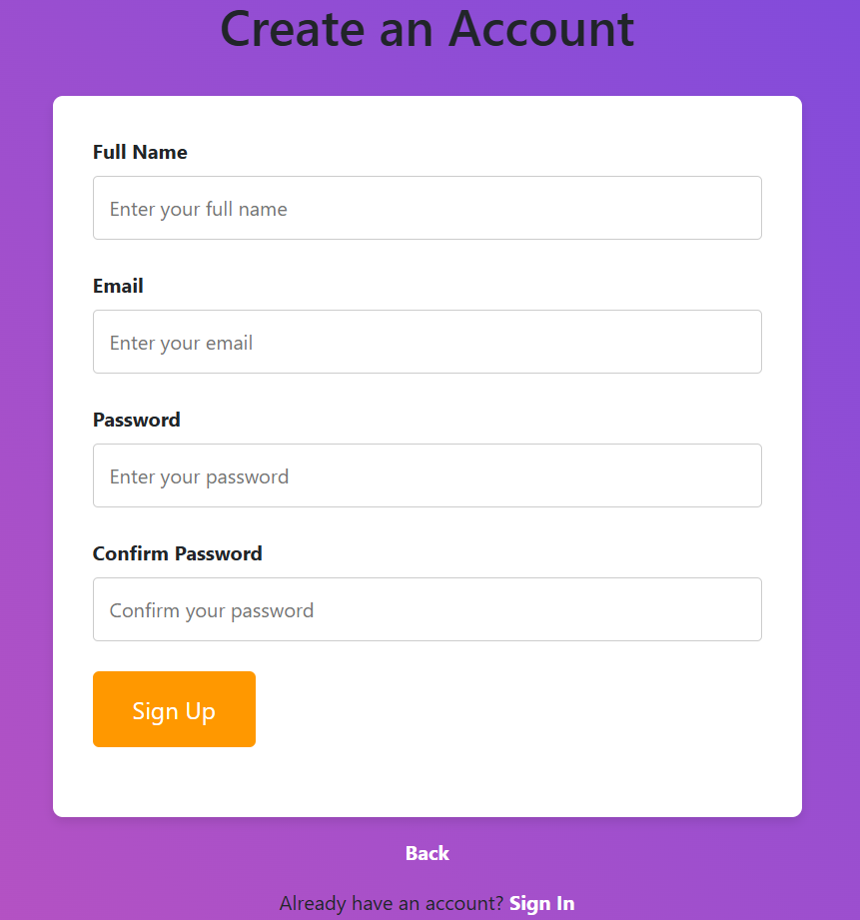
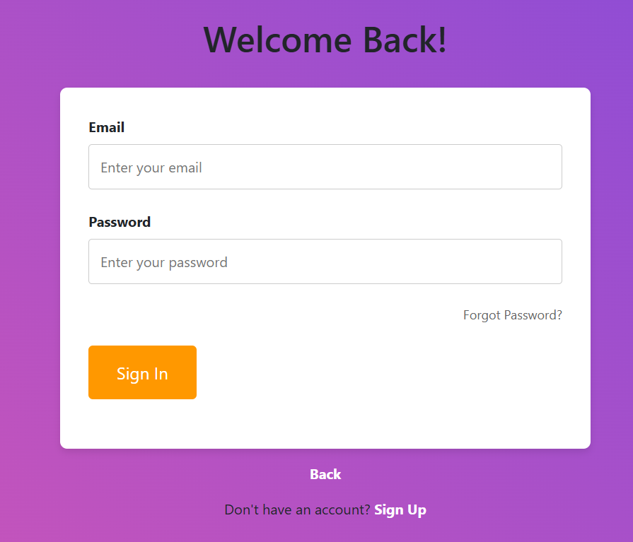
Project Highlights
We have made the site free to use, with optional sign-in or sign-up process.

Slide 10
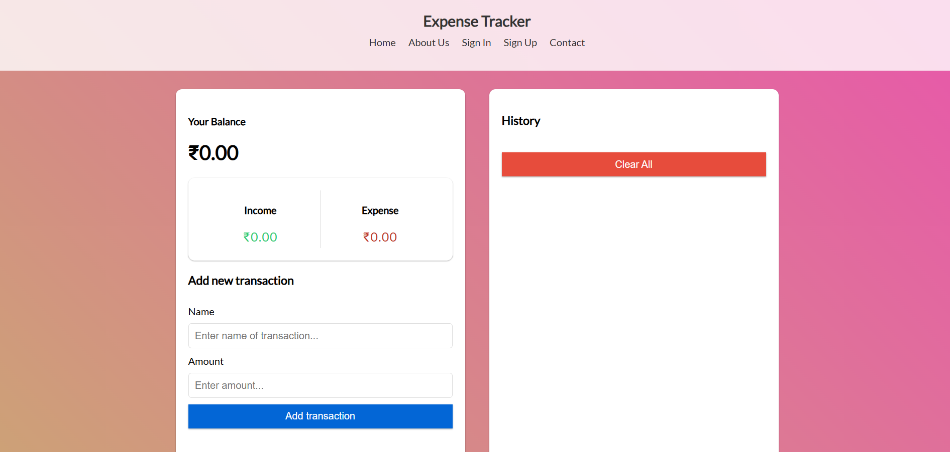
Project Highlights
This is how our main site looks.

Slide 11
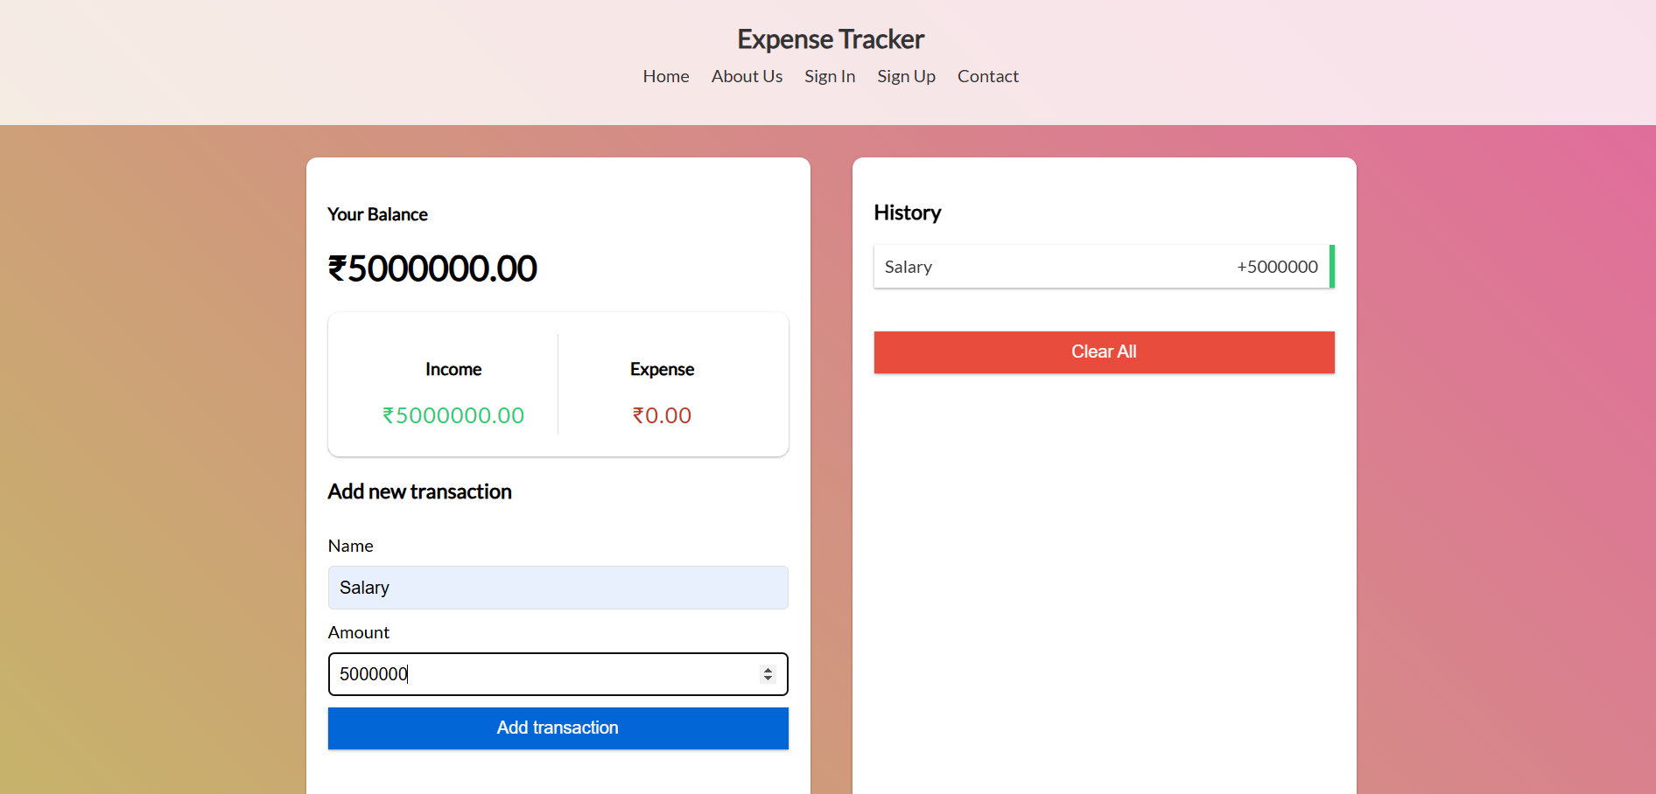
Project Highlights
This is how we can add income.

Slide 12
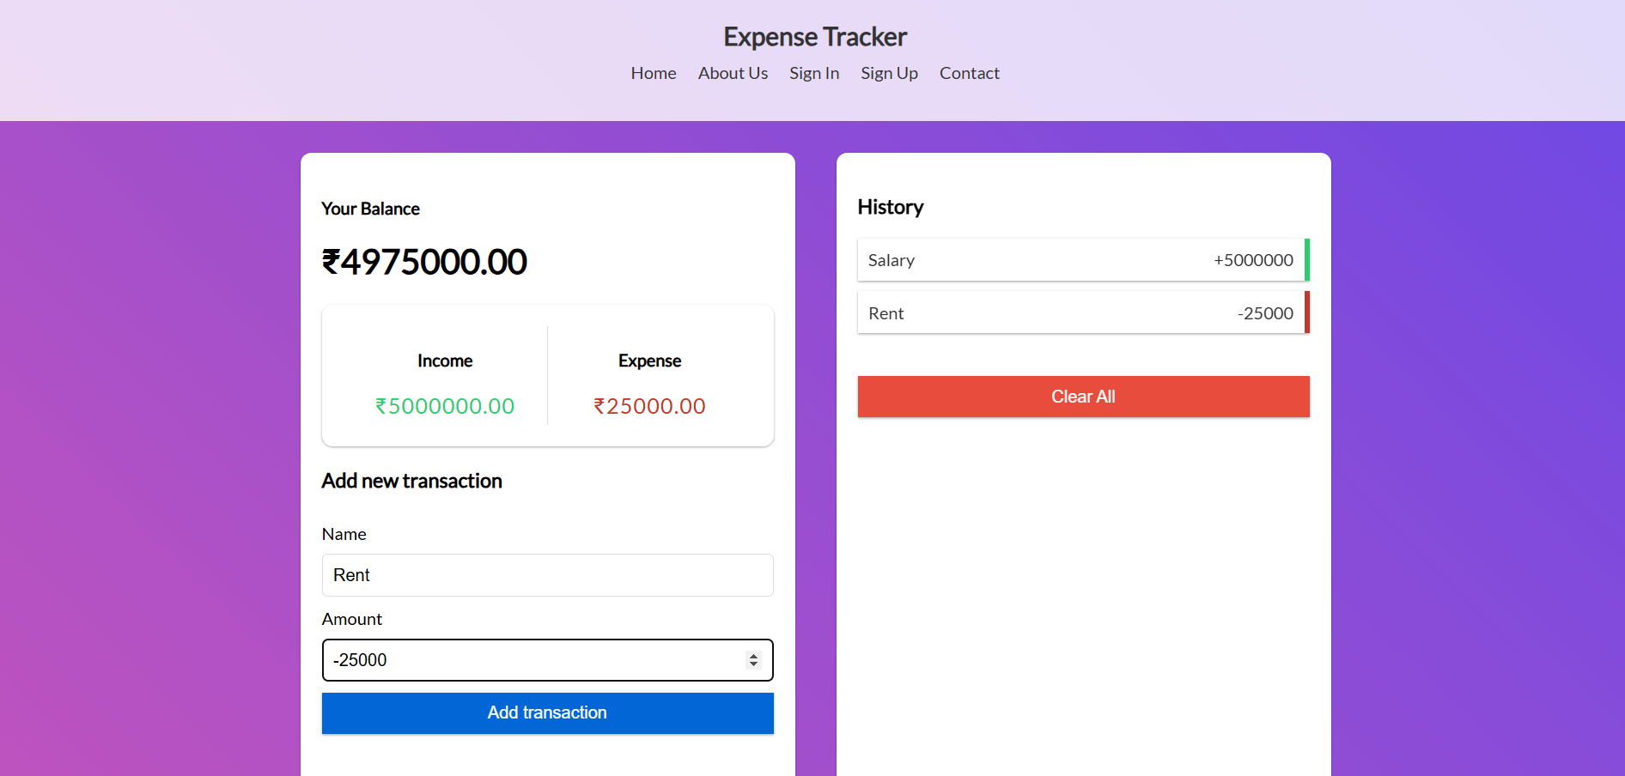
Project Highlights
By using a ‘-’ minus sign before the amount, we can add the figure to the expense category.

Slide 13
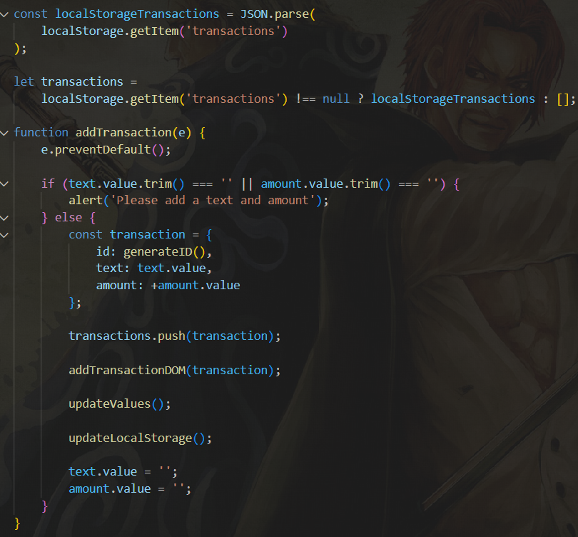
Bonus Feature(optional)
Data Persistence: We used ‘local storage’ to save the user’s expense history.

Slide 14
Conclusion
The Expense Tracker project was a practical learning experience in building a functional web application using HTML, CSS, and JavaScript. It helped us understand the importance of structuring user input, handling real-time data processing, and ensuring a seamless user experience. We gained valuable experience in front-end engineering and how small web applications can have significant real-world use cases.

Slide 15
References/Links used
We used ChatGPT for our main reference. The styling and the site building was done by us, and the backend technicalities were referenced by ChatGPT.
We used MDN Web Docs, CSS-Tricks, JavaScript event handling resources, and some online forums like W3Schools and GeeksforGeeks to take an idea for our project.

Slide 16


